Slide 1
Self Driving Cars
Greg Fousas, h2o.ai

Slide 2
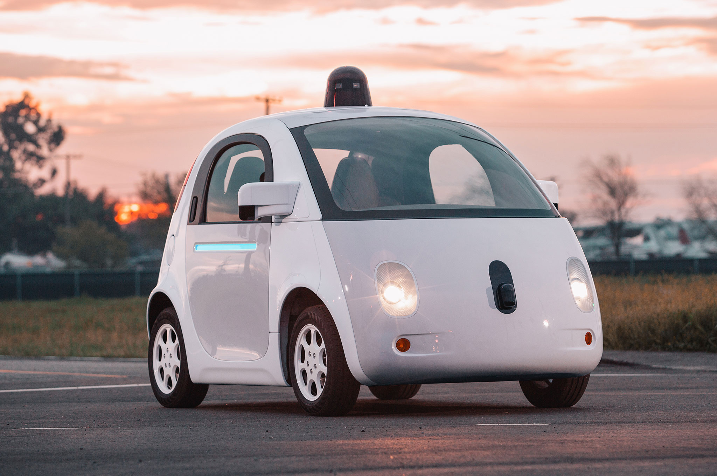
Self-driving car = Robot
camera
Collect data
radar
lidar
Analyse
Make decisions

Slide 3
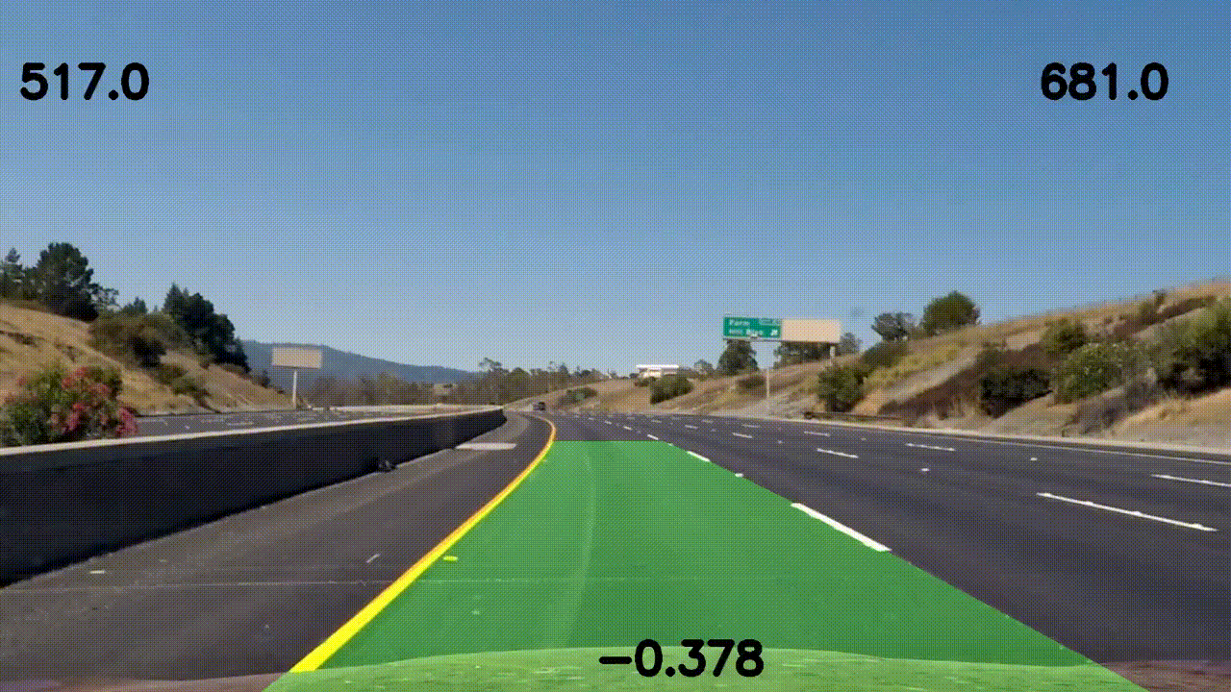
Computer Vision - Lane finding

Slide 4




Neural Networks – Signs classifier

Slide 5
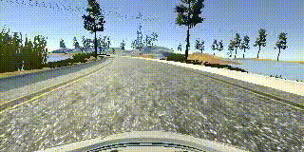
Neural Networks - Behavioural cloning

Slide 6
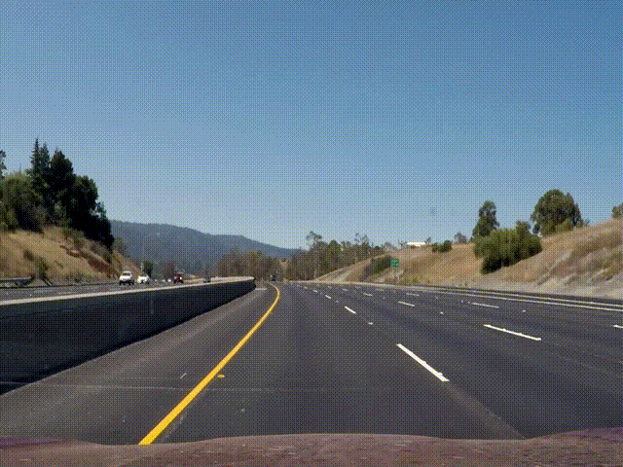
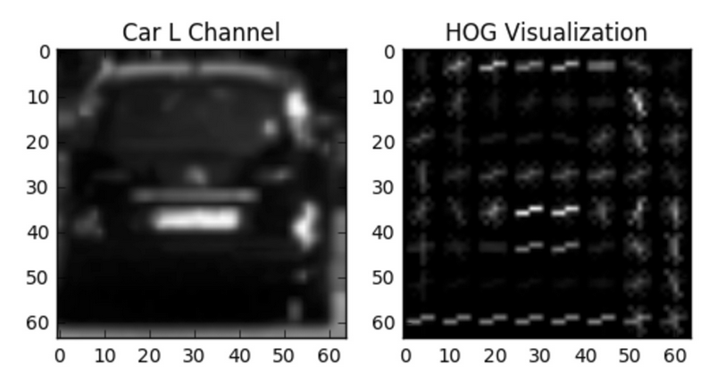
Machine Learning using HOG features – Vehicle Detection

Slide 7
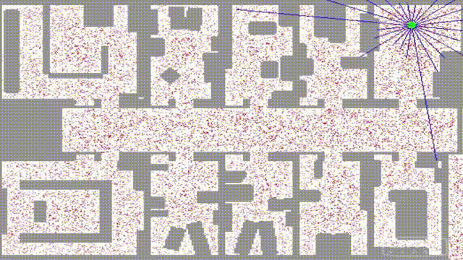
Sensor Fusion & Localization
Taken from Udacity Self-Driving cars program, Term 2, lesson 13

Slide 8
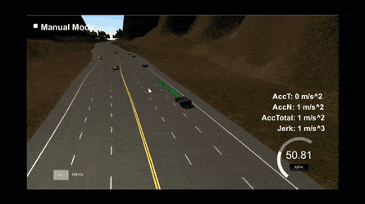
Path planning
Taken from Udacity Self-Driving cars program, Term 3, Path planning project

