Slide 1



Super-fast Custom NumPy Data Loaders for Binary Data
Also for more general data
( irregularly structured data, large text files, etc…)
Use when existing data loaders are:
A) Too slow
B) Too inconvenient
C) Don’t exist at all

Slide 2
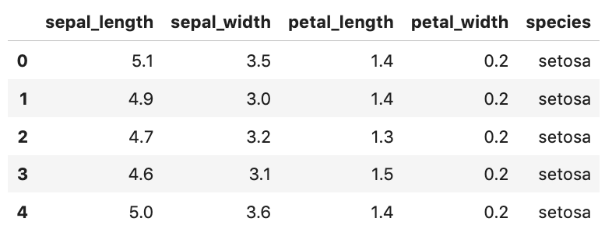
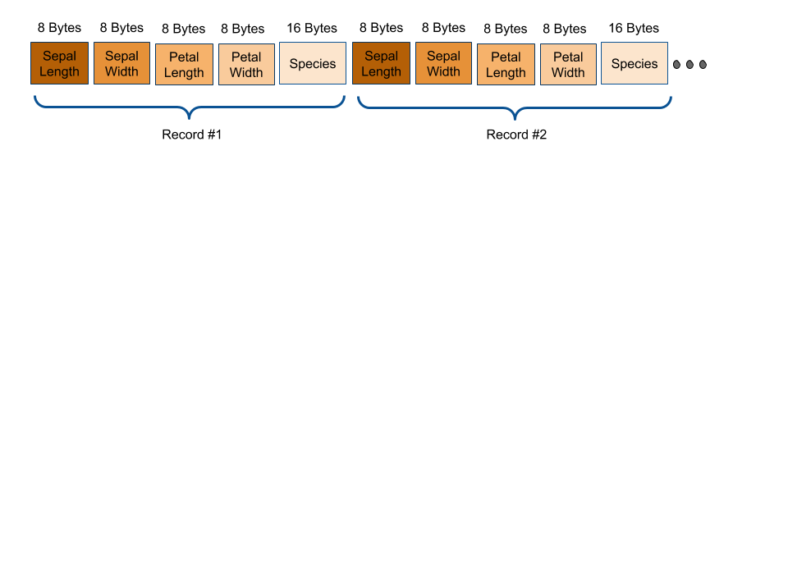
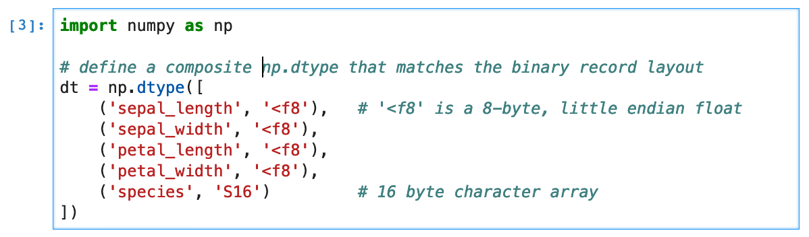
Simplest Case: ‘Square Data’
NumPy directly supports loading
Square data format:
Single record type in binary data
Can define matching NumPy dtype

Slide 3
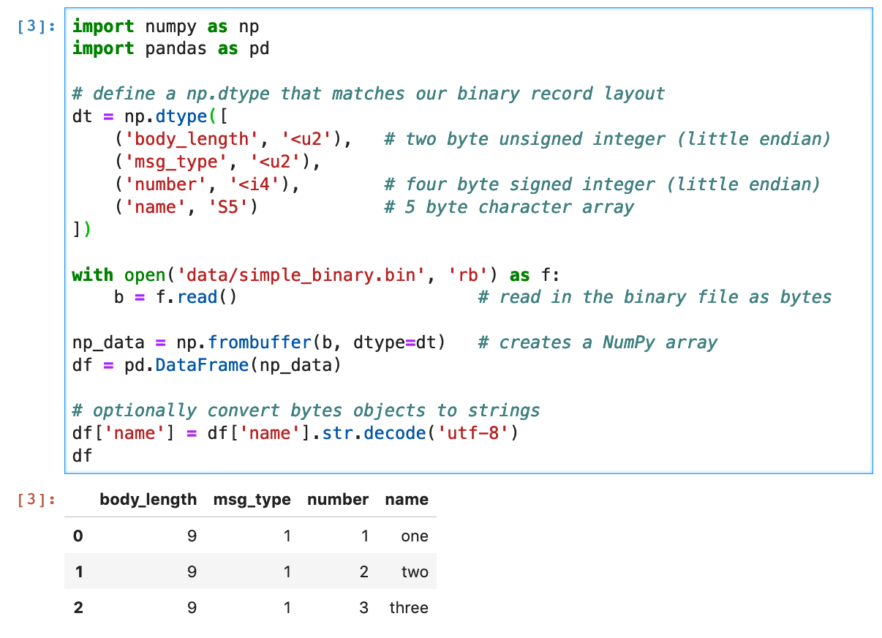
Square Data: Sample Code
Define a NumPy dtype
Read in file ( optionally read only part of file )
Create NumPy array and Pandas DataFrame

Slide 4
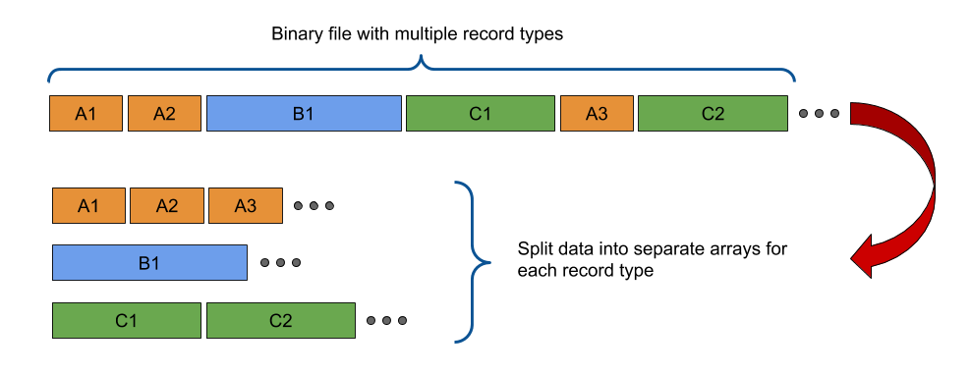
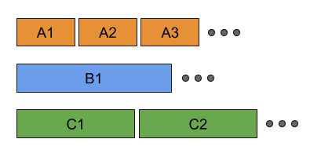
General Case: Multiple Record Types
General Method
1) Fan the data out to a ‘square’ data format. This code is specialized to YOUR data
2) Store the square data in objects that implement the Python Buffer Protocol.
3) Create NumPy / Pandas data using numpy.frombuffer

Slide 5
Python Buffer Protocol
Lets objects share and access memory ☺ Great! Performance gains ahead!
Is available only at the C-API* level ☹ No native Python access
Can be easily implemented in Cython ☺ Great! We need Cython anyway
numpy.frombuffer
( requests access to memory)
( calls getbuffer )
Buffer Object
( has data to share )
( implements getbuffer )
Implemented at C-API level. Not accessible from Python
getbuffer(PyBuffer *view, int flags)
PyBuffer is a simple C struct. The buffer object needs to fill in details about its memory ( ie, pointer to data, data format )
flags is passed by the Requestor. It tells what format the data is expected to be in. ( e.g. dimensions, strides, etc… )
* The C-API is a doorway into the internals of Python but it’s not easy to use

Slide 6
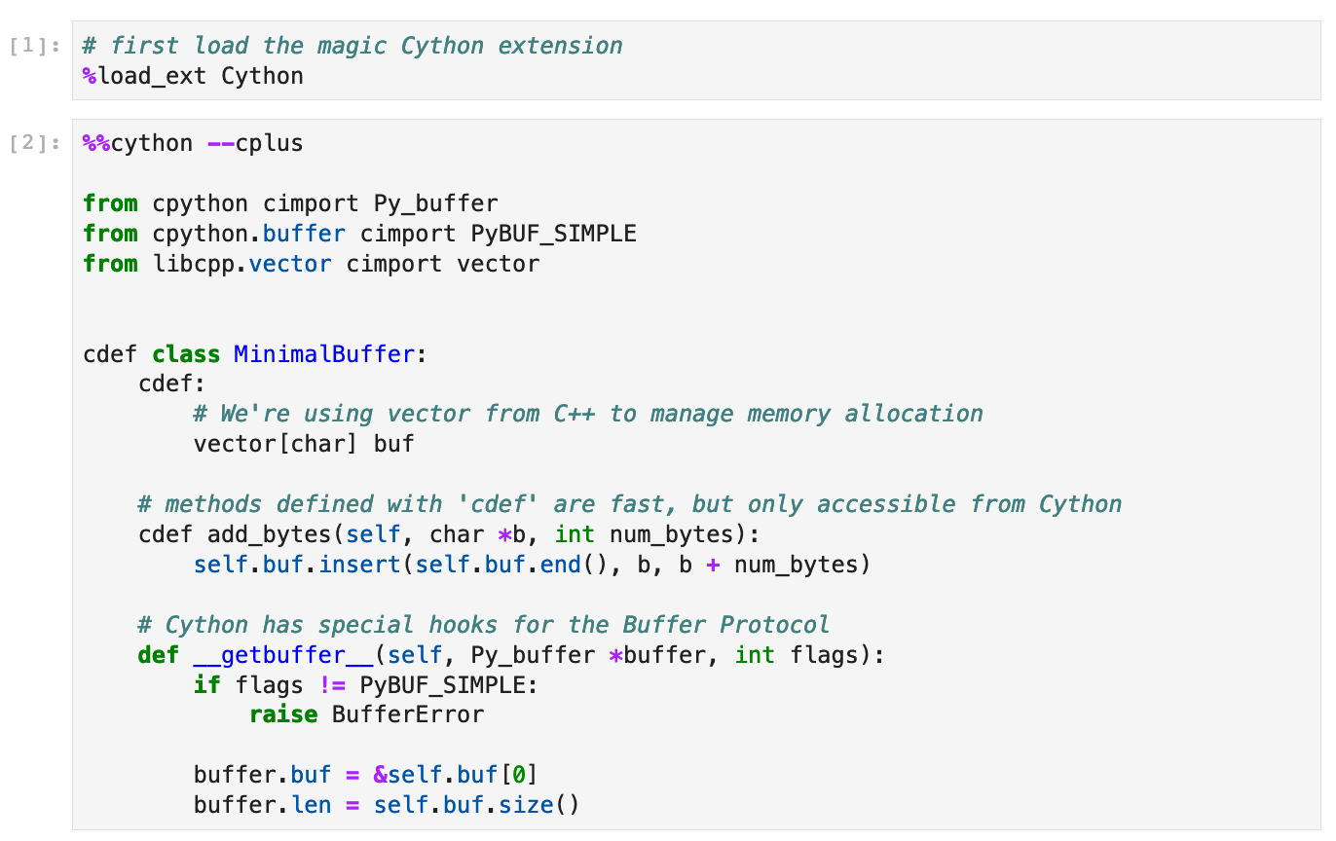
DIY Cython Buffer: Minimal Sample Code

Slide 7
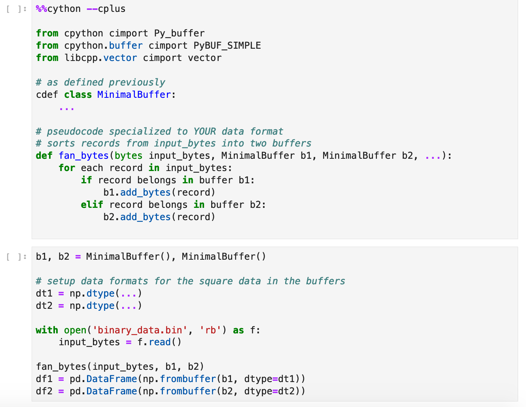
Put it all together!! ( pseudocode )
Same as previously defined. This is generic
Pseudo-Code. Specialized to YOUR data
Create the buffers
Define dtypes for the square data
Load the datafile
Create the DataFrames!!

Slide 8
Final Remarks
Need more details? See the article ‘Loading Binary Data to NumPy/Pandas’ on Towards Data Science.
Sample code / notebooks? See the github repo linked in the TDS article.
The buffer we made is not memory safe. See the github notebooks and the Towards Data Science article for a better version.
What about irregular non-binary data? Use the same methods.
Feel free to reach out with any questions if you’d like help.

