Slide 1

Note: The data and information in this document is reflective of a hypothetical situation and client. This document is to be used for KPMG Virtual Internship purposes only.
Sprocket Central Pty Ltd
Data analytics approach
Dauda Sani Abdullahi
[[Junior Consultant]

Slide 2
Note: The data and information in this document is reflective of a hypothetical situation and client. This document is to be used for KPMG Virtual Internship purposes only.
Agenda
Introduction
Data Exploration
Model Development
Interpretation

Slide 3
Note: The data and information in this document is reflective of a hypothetical situation and client. This document is to be used for KPMG Virtual Internship purposes only.
Introduction
EDA on Sprocket Central Customer Data
Distributions
Correlations
Relationships
segmentation

Slide 4
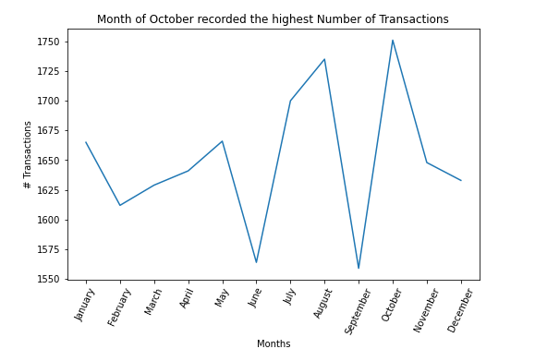
Note: The data and information in this document is reflective of a hypothetical situation and client. This document is to be used for KPMG Virtual Internship purposes only.
Data Exploration
Trends in Transactions

Slide 5
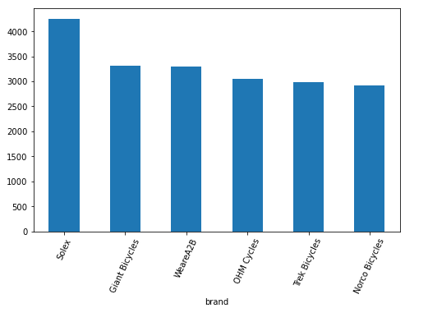
Note: The data and information in this document is reflective of a hypothetical situation and client. This document is to be used for KPMG Virtual Internship purposes only.
Data Exploration
Distributions of Product Brands

Slide 6
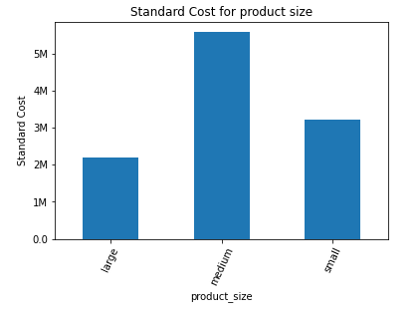
Note: The data and information in this document is reflective of a hypothetical situation and client. This document is to be used for KPMG Virtual Internship purposes only.
Data Exploration

Slide 7
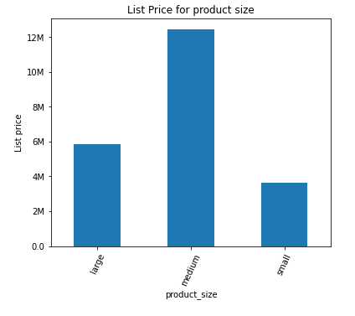
Note: The data and information in this document is reflective of a hypothetical situation and client. This document is to be used for KPMG Virtual Internship purposes only.
Data Exploration

Slide 8
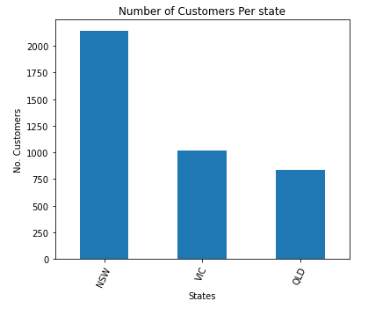
Note: The data and information in this document is reflective of a hypothetical situation and client. This document is to be used for KPMG Virtual Internship purposes only.
Data Exploration

Slide 9
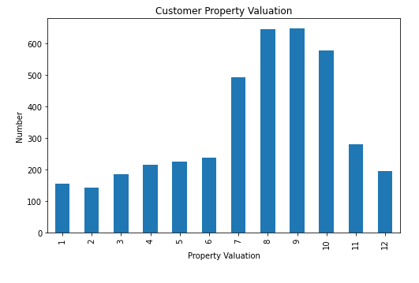
Note: The data and information in this document is reflective of a hypothetical situation and client. This document is to be used for KPMG Virtual Internship purposes only.
Data Exploration

Slide 10
Note: The data and information in this document is reflective of a hypothetical situation and client. This document is to be used for KPMG Virtual Internship purposes only.
Model Development
Unsupervised Learning will be used for customer segmentation
Customer demographic data like zip code, state and address
Types of product bought by the customer
Types of order

Slide 11
Note: The data and information in this document is reflective of a hypothetical situation and client. This document is to be used for KPMG Virtual Internship purposes only.
Thank You

