Slide 1

Practice #1: Perceptron Learning Gradient-Descent Methods (Batch, Stochastic, Mini-batch)
[SKT AI Course: Deep Learning Basics]
TA: Jun-Sik Choi & Jee-Seok Yoon
Instructor: Heung-Il Suk
hisuk@korea.ac.kr
http://www.ku-milab.org
Department of Brain and Cognitive Engineering,
Korea University
September 23, 2017

Slide 2
Contents
Rosenblatt’s Perceptron with Vanilla Gradient Descent
Widrow-Hoff’s Perceptron with Vanilla Gradient Descent
Widrow-Hoff’s Perceptron with Stochastic Gradient Descent

Slide 3
Rosenblatt’s Perceptron with Vanilla Gradient Descent

Slide 4
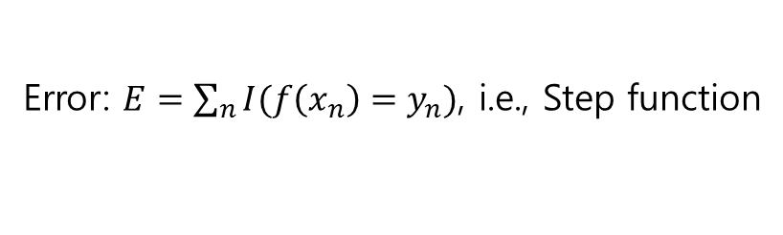
Rosenblatt’s Perceptron Conceptual Diagram
Error: $E=\sum_{n}{I(f\left(x_{n}\right)=y_{n})}$, i.e., Step function
Notes:
Perceptron: Linear model 의 입력을 벡터형식으로 바꿈으로서 신경망 구조를 가짐.
Error function: # of misclassification, $E=\sum_{n}{I(f\left(x_{n}\right)=y_{n})}$, i.e. Step Function

Slide 5
Class Perceptron
Class Variables
eta : Learning rate
epochs : # of epochs to train
weights : Connection weight variables
errors : # of wrong prediction

Slide 6
Class Perceptron
Class Methods
__init__(self, eta=0.01, epochs=10)
Initialize model with learning rate and training epochs
fit(self, X, y)
Trains model with input data X and its corresponding label y
net_input(self, X)
Provides input to the perceptron and returns perceptron's output
predict(self, X)
Returns model's prediction

Slide 7
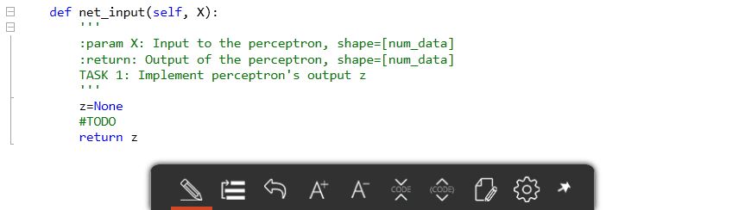

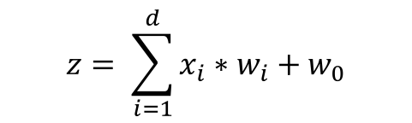
Implement major methods of Class Perceptron (1)
Task 1: Implement Perceptron's output z in net_input(self, X)
$$z= \sum_{i=1}^{d}{x_{i}∗w_{i}}+w_{0}$$

Slide 8
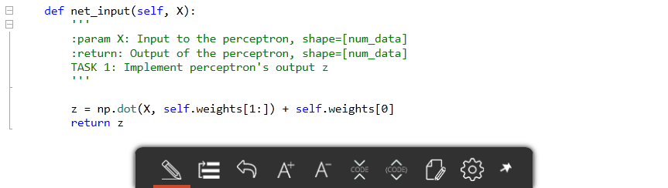
Answer
Task 1: Implement Perceptron's output z in net_input(self, X)
$$z= \sum_{i=1}^{d}{x_{i}∗w_{i}}+w_{0}$$

Slide 9
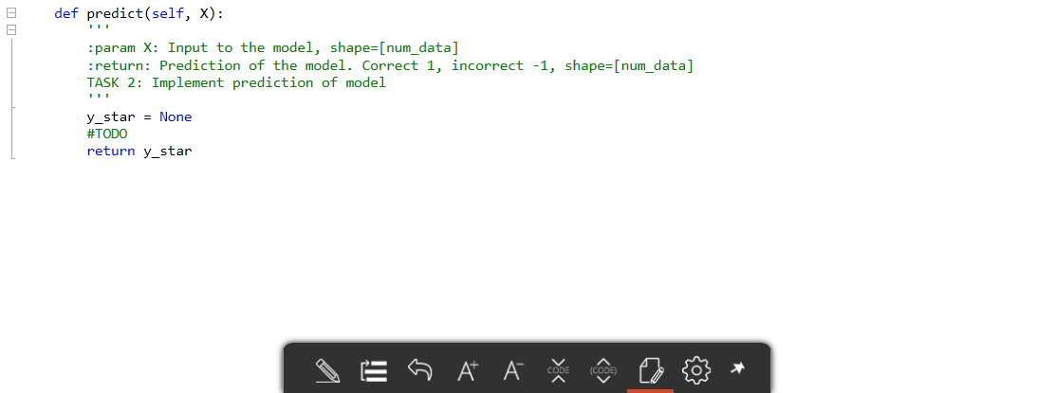
Implement major methods of Class Perceptron (2)
Task 2: Implement prediction of model with method predict(self, X)

Slide 10
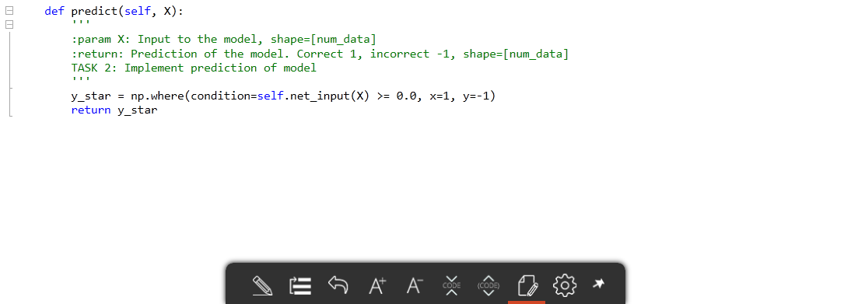
Answer
Task 2: Implement prediction of model with method predict(self, X)

Slide 11
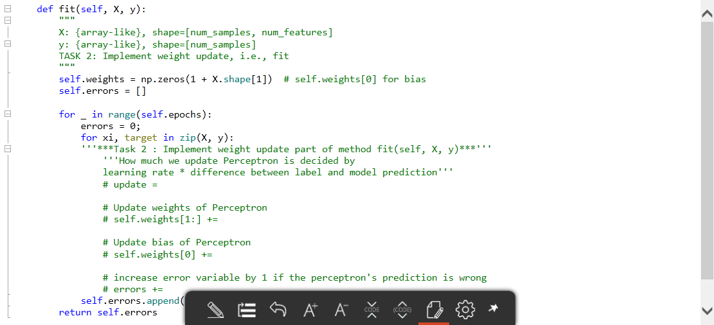
Implement major methods of Class Perceptron (3)
Task 3: Implement weight update part of method fit(self, X, y)

Slide 12
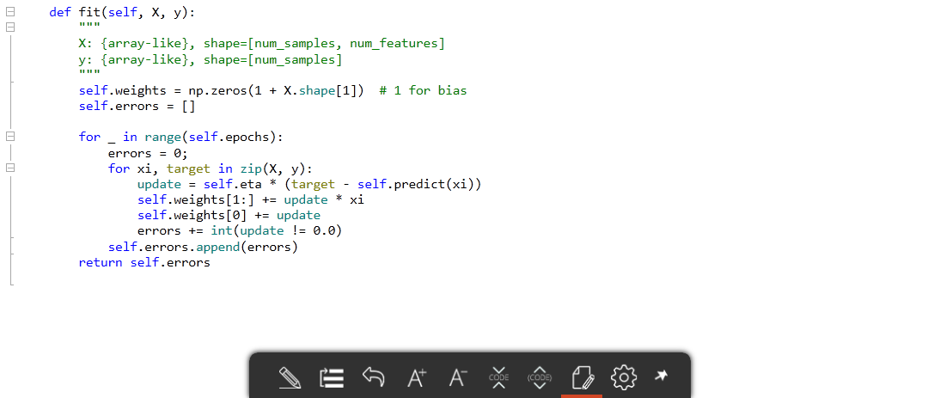
Answer
Task 3: Implement weight update part of method fit(self, X, y)

Slide 13
Widrow-Hoff’s Perceptron with Vanilla Gradient Descent

Slide 14
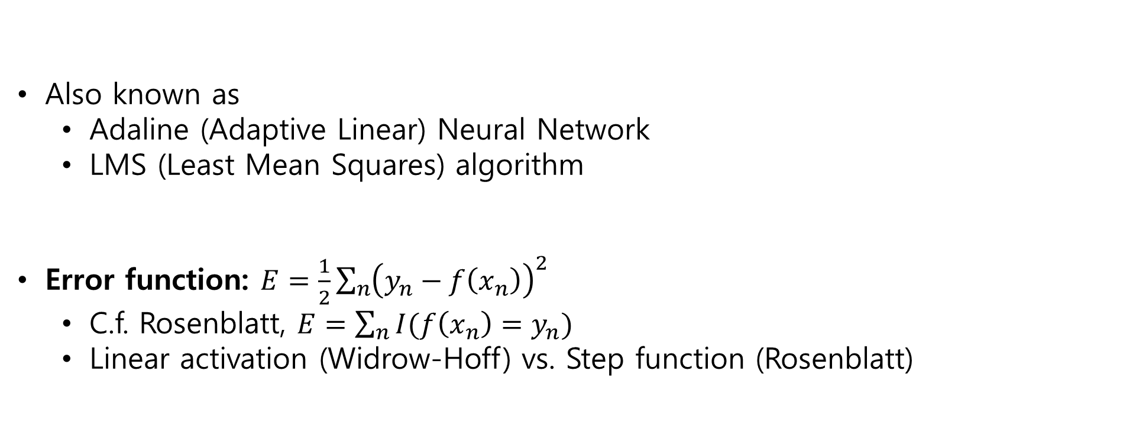
Widrow-Hoff’s Perceptron Conceptual Diagram
Also known as
Adaline (Adaptive Linear) Neural Network
LMS (Least Mean Squares) algorithm
Error function: $E=\frac{1}{2}\sum_{n}{{\left(y_{n}−f\left(x_{n}\right)\right)}^{2}}$
C.f. Rosenblatt, $E=\sum_{n}{I(f\left(x_{n}\right)=y_{n})}$
Linear activation (Widrow-Hoff) vs. Step function (Rosenblatt)
Notes:
AKA. Adaline (Adaptive Linear) Neural Network, LMS (Least Mean Squares) algorithm

Slide 15
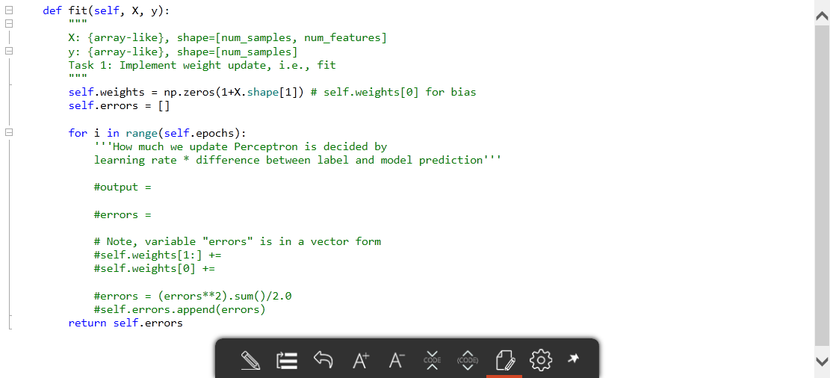
Implement major methods of Class AdalineGD (1)
Task 1: Implement prediction of model with method predict(self, X)

Slide 16
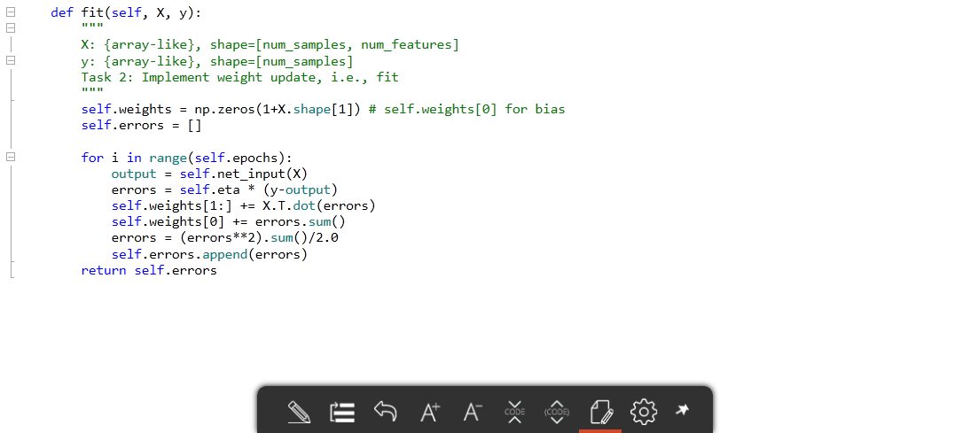
Answer
Task 1: Implement prediction of model with method predict(self, X)

Slide 17
Widrow-Hoff’s Perceptron with Stochastic Gradient Descent

Slide 18
Stochastic Gradient Descent Conceptual Diagram
Vanilla Gradient Descent
1 Epoch = 1 Step = All dataset as input
Stochastic Gradient Descent
1 Epoch = N step
1 Step = N^{th} batch from dataset as input
Notes:
모든 데이터를 한번에 보기 힘듬 → 크기, 시간,

Slide 19
Class AdalineSGD
New Class Variables
bShuffle : Whether to shuffle the data or not
random_state : Random seed for the shuffle
minibatch_size : Size of each batch

Slide 20
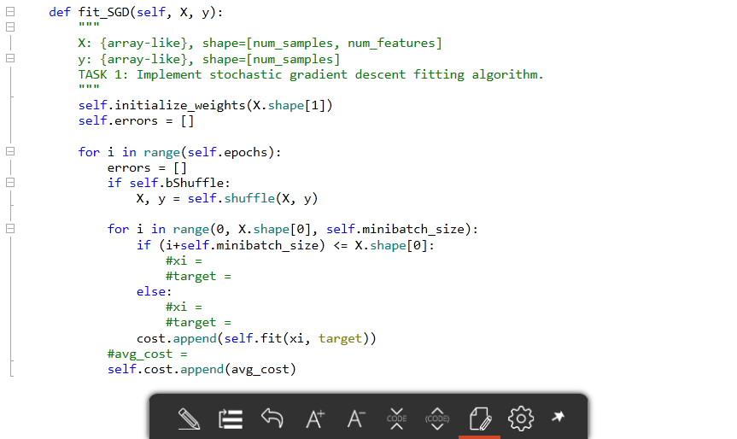
Implement major methods of Class AdalineSGD (1)
Task 1: Implement fit_SGD(self, X, y)

Slide 21
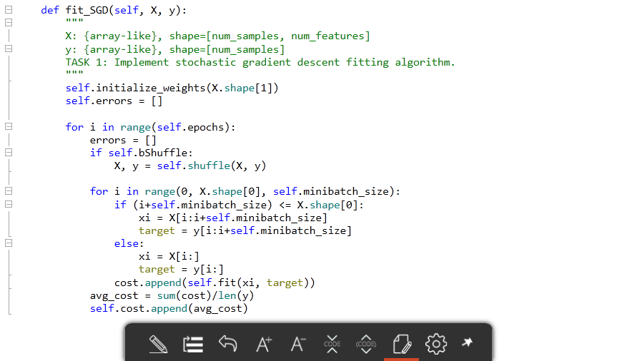
Answer
Task 1: Implement fit_SGD(self, X, y)

Slide 22
Thank you
for your attention!!!
(Q & A)
hisuk (AT) korea.ac.kr
http://www.ku-milab.org

