Slide 1

Practice #2: Feed Forward Neural Network Simple Multi-layer Perceptron
[SKT AI Course: Deep Learning Basics]
TA: Jun-Sik Choi & Jee-Seok Yoon
Instructor: Heung-Il Suk
hisuk@korea.ac.kr
http://www.ku-milab.org
Department of Brain and Cognitive Engineering,
Korea University
September 23, 2017

Slide 2
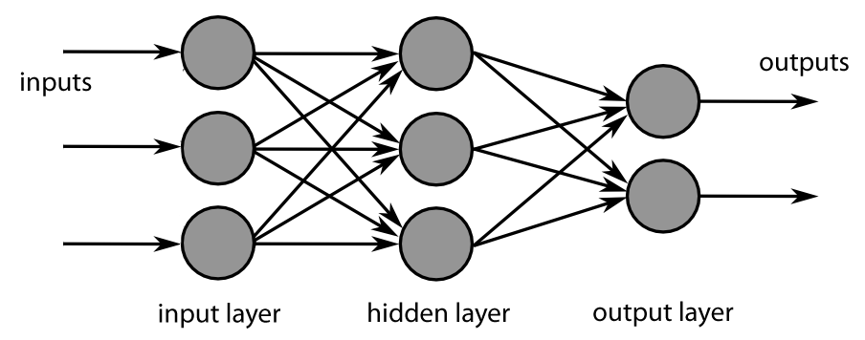
Feed Forward Neural Network
Neural Network → Multi-layer Perceptrons!
Vector calculation to matrix calculation
Notes:
Vector → Matrix! That’s it!

Slide 3
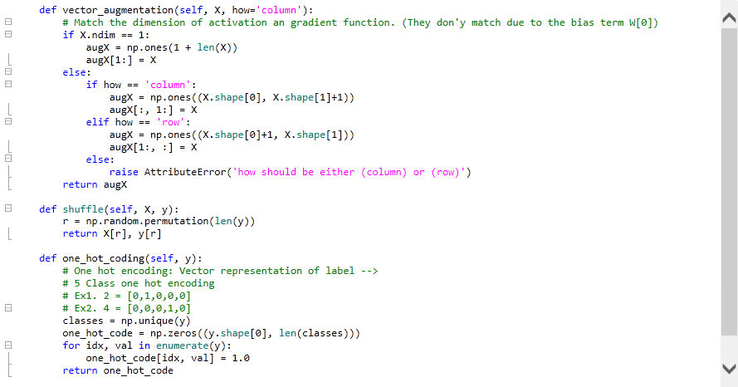
Detailed Implementation Overview
Notes:
Vector → Matrix! That’s it!

Slide 4
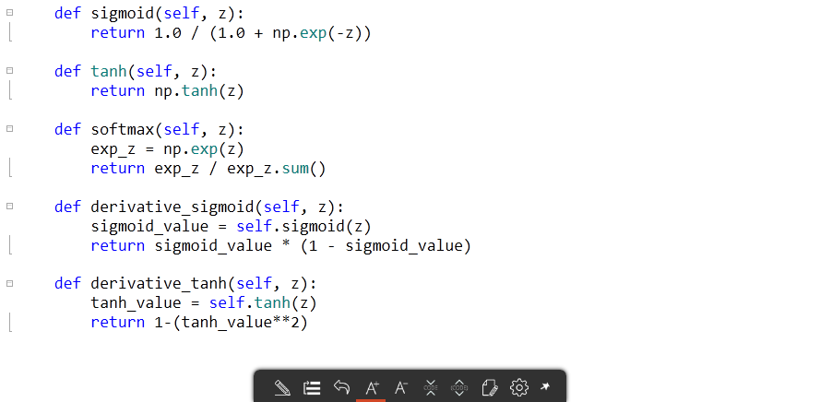
Detailed Implementation Overview
Notes:
Vector → Matrix! That’s it!

Slide 5
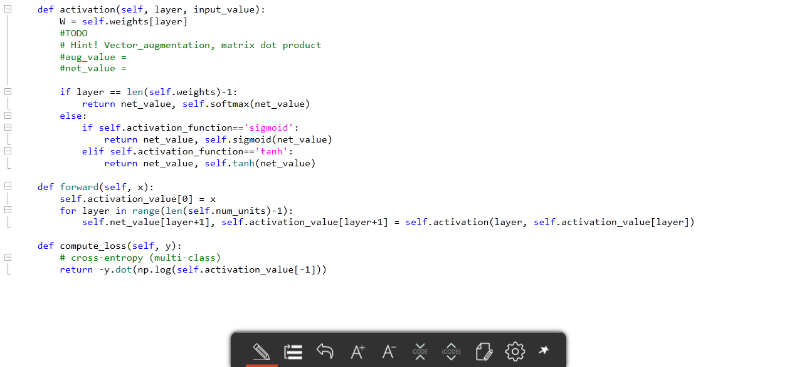
Detailed Implementation Overview
Notes:
25쪽!

Slide 6
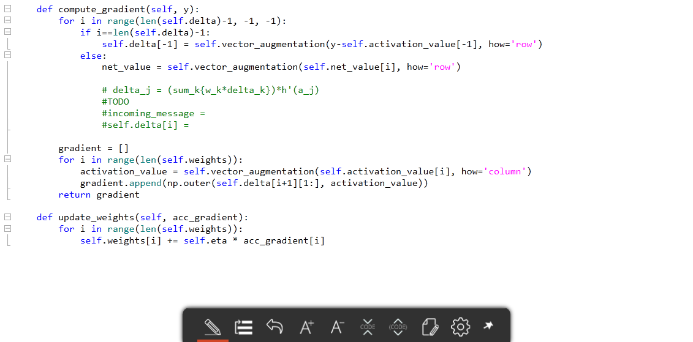
Detailed Implementation Overview
Notes:
38장 참고

Slide 7
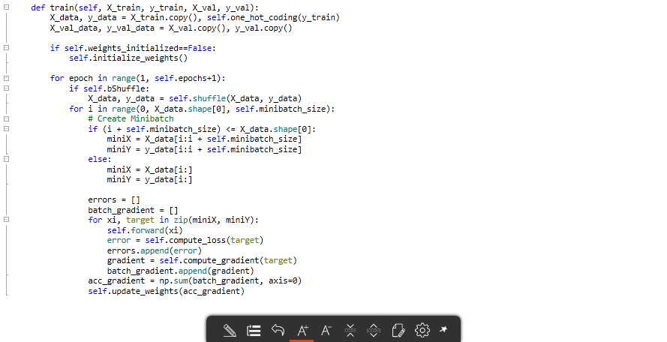
Detailed Implementation Overview
Notes:
Vector → Matrix! That’s it!

Slide 8
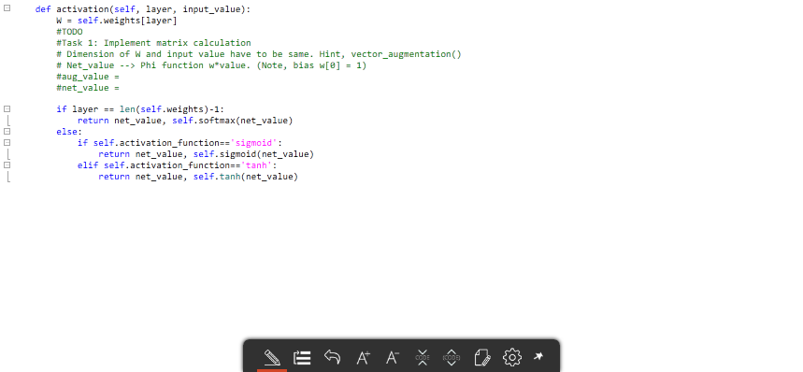

Implement major methods of Class FF (1)
Task 1: Implement matrix calculation in method activation(layer, input_value)

Slide 9
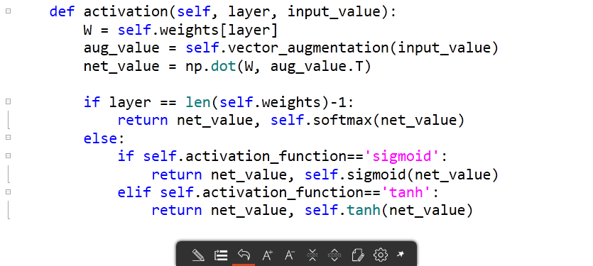
Answer
Task 1: Implement matrix calculation in method activation(layer, input_value)

Slide 10
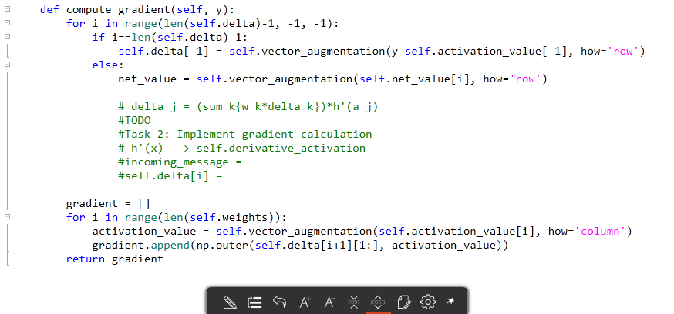
Implement major methods of Class FF (2)
Task 2: Implement gradient calculation in method compute_gradient(y)

Slide 11
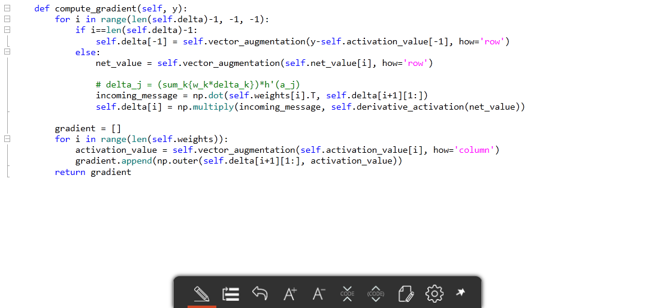
Answer
Task 2: Implement gradient calculation in method compute_gradient(y)

Slide 12
Thank you
for your attention!!!
(Q & A)
hisuk (AT) korea.ac.kr
http://www.ku-milab.org

