Slide 1

Practice: Applications of Deep Learning Models
[SKT AI Course: Deep Learning Basics]
TA: Min-je Choi
Instructor: Jaegul Choo
devnote5676@naver.com
http://davian.korea.ac.kr
Department of Computer Science and Engineering,
Korea University
October 27, 2017

Slide 2
Contents
LSTM-based Language Model
Neural Style Transfer
Neural Machine Translation
RNN for Stock Prediction

Slide 3
LSTM-based Language Model

Slide 4
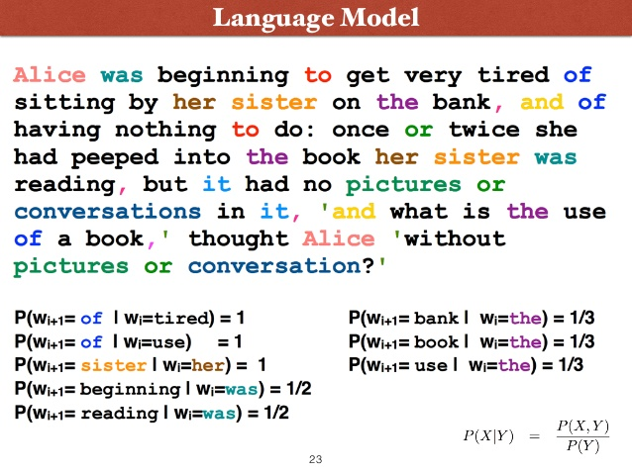
Language model이란
Task: 어떤 주어진 단어(들) 가지고 이어서 단어의 연속 및 문장 생성

Slide 5
Language model
Dataset: Penn Tree Bank (PTB) dataset
the u.s. is one of the few industrialized nations that does n't have a higher standard of regulation for the smooth <unk> fibers such as <unk> that are classified as <unk> according to <unk> t. <unk> a professor of <unk> at the university of vermont college of medicine
more common <unk> fibers are <unk> and are more easily rejected by the body dr. <unk> explained
in july the environmental protection agency imposed a gradual ban on virtually all uses of asbestos
by N almost all remaining uses of <unk> asbestos will be outlawed
about N workers at a factory that made paper for the kent filters were exposed to asbestos in the 1950s
areas of the factory were particularly dusty where the <unk> was used
workers dumped large <unk> <unk> of the imported material into a huge <unk> poured in cotton and <unk> fibers and <unk> mixed the dry fibers in a process used to make filters
workers described clouds of blue dust that hung over parts of the factory even though <unk> fans <unk> the area
there 's no question that some of those workers and managers contracted <unk> diseases said <unk> phillips vice president of human resources for <unk> & <unk>
but you have to recognize that these events took place N years ago

Slide 6
Language model
main.py : 모델 training; data load;
data.py: 텍스트 전처리 시 필요한 dictionary와 corpus 라는 클래스 생성
lang_model.py: RNN 기반의 language model

Slide 7
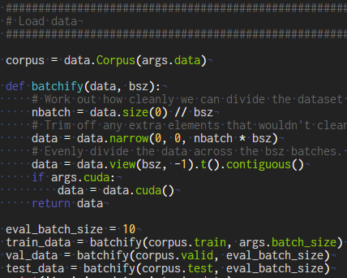
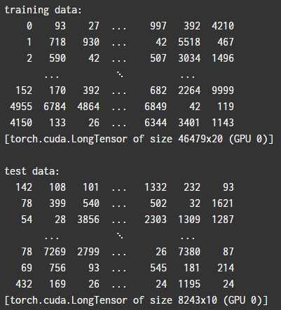
Language model
main.py
line 49: 텍스트 데이터 전처리

Slide 8
Language model
main.py
line 49: 텍스트 데이터 전처리

Slide 9
Neural Style Transfer

Slide 10
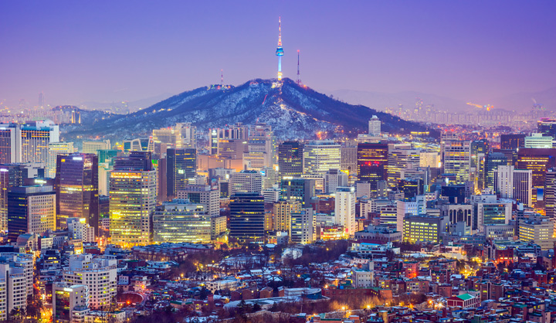
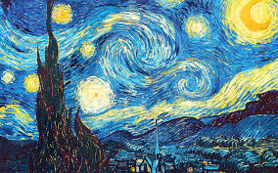
Neural Style Transfer
한 이미지를 다른 이미지의 스타일로 바꿔주는 작업
+
= ???

Slide 11
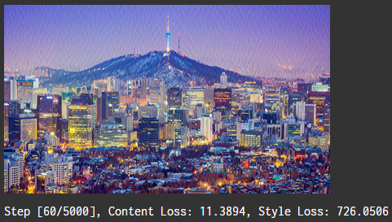
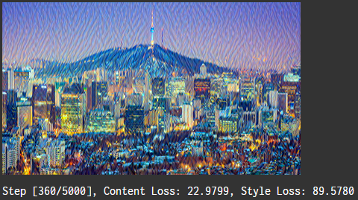
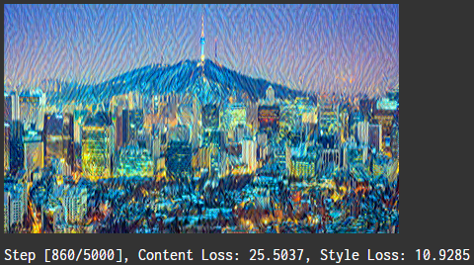

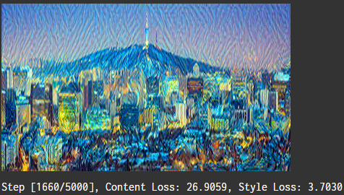
Neural Style Transfer
한 이미지를 다른 이미지의 스타일로 바꿔주는 작업

Slide 12
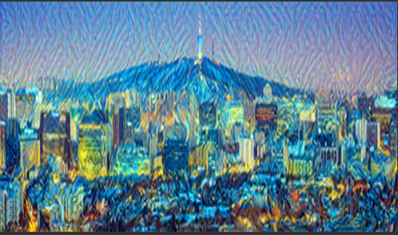

Slide 13
Neural Machine Translation

Slide 14
NMT
Dataset
Europar En-Fr dataset
EN
FR
Resumption of the session
I declare resumed the session of the European Parliament adjourned on Friday 17 December 1999, and I would like once again to wish you a happy new year in the hope that you enjoyed a pleasant festive period.
Although, as you will have seen, the dreaded 'millennium bug' failed to materialise, still the people in a number of countries suffered a series of natural disasters that truly were dreadful.
Reprise de la session
Je déclare reprise la session du Parlement européen qui avait été interrompue le vendredi 17 décembre dernier et je vous renouvelle tous mes vux en espérant que vous avez passé de bonnes vacances.
Comme vous avez pu le constater, le grand "bogue de l'an 2000" ne s'est pas produit. En revanche, les citoyens d'un certain nombre de nos pays ont été victimes de catastrophes naturelles qui ont vraiment été terribles.

Slide 15
Thank you
For your attention!!!
(Q & A)
devnote5676@naver.com

