Slide 1
11.Demonstrate Basic variables, Anchored Declarations and Usage of Assignment Operation Using PL/SQL block

Slide 2
PL/SQL
PL/SQL stands for Procedural Language extension to the Structured Query Language (SQL).
PL/SQL is a combination of SQL along with the procedural features of programming languages.
Oracle uses a PL/SQL engine to processes the PL/SQL statements.
PL/SQL includes procedural language elements like conditions and loops.
It allows declaration of constants and variables, procedures and functions, triggers,cursors .

Slide 3
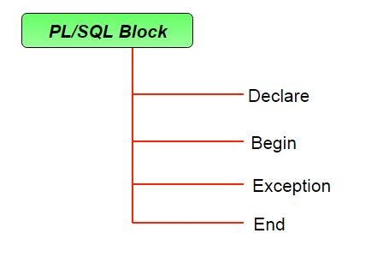
Structure of PL/SQL Block
The basic unit in PL/SQL program is a block.

Slide 4
Structure of PL/SQL Block
DECLARE --- Optional
variables ,functions, constants, cursors, ….
BEGIN --- Mandatory
SQL statements(DML,TCL)
Procedural statements(conditional ,loops etc)
EXCEPTIONS --- optional
exception handling statements ;
END; ----Mandatory

Slide 5
Variables in PL/SQL
• A variable is a meaningful name that provides facility for programmer to store data temporary during execution of code. It helps to manipulate data in PL/SQL.
• syntax: variable_name datatype [ (size) ];
variable_name := value ;

Slide 6
Find addition of two numbers using PL/SQL block
DECLARE
a integer := 10;
b integer := 20;
c integer;
BEGIN
c := a + b;
dbms_output.put_line(‘sum is ' || c);
END;
output :
Sum is 30

Slide 7
Find employee details using PL/SQL block
DECLARE
v_ename varchar2(20);
v_salary Number;
BEGIN
SELECT ename , sal
INTO v_ename, v_salary
FROM emp WHERE eno = 101;
DBMS_OUTPUT.PUT_LINE (‘Emp name is’ || v_ename || ‘ And salary is’ || v_salary);
END;

Slide 8
Anchored Declarations
When you declare a PL/SQL variable to hold the value of a table column, it must be declared as of column data type and precision, otherwise error will occur on execution.
PL/SQL provides the facility to declare a variable without having to specify a particular data type using %TYPE attributes.

Slide 9
Anchored Declarations
The %TYPE is used to declare variables according to the already declared PL/SQL variable or database column.
The data type and precision of the variable declared using %TYPE attribute is the same as that of the column that is referred from a given table.
This is particularly useful when declaring variables that will hold database values.

Slide 10
Anchored Declarations
syntax for declaring a variable with %TYPE
var_name <tab_name>.<column_name> %TYPE;
Example: SALARY EMP.SAL % TYPE;
This declaration will declare a variable SALARY that has the same data type as column SAL of the EMP table.

Slide 11
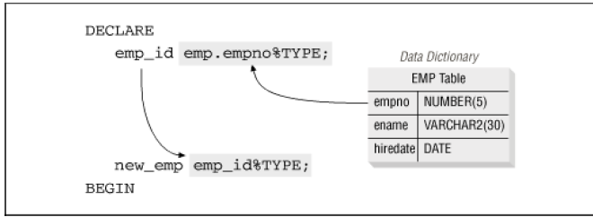
Anchored Declarations

Slide 12
Find employee salary using PL/SQL BLOCK
DECLARE
SALARY EMP.SAL % TYPE;
ECODE EMP.empno % TYPE;
BEGIN
Ecode := &Ecode;
SELECT SAL INTO SALARY FROM EMP WHERE EMPNO = Ecode;
DBMS_OUTPUT.PUT_LINE('Salary of ' || ECODE || ‘is ’ || salary);
END;

Slide 13
Find employee salary using PL/SQL BLOCK
OUTPUT:
Enter value for ecode: 7499
Salary of 7499 is = 1600
PL/SQL procedure successfully completed.

