Slide 1
12 Demonstrate Bind and Substitution Variables using PL SQL block

Slide 2
Bind Variables
Oracle provides the bind variable functionality to the user, where we can create the variable in a host environment and use that variable in different PL/SQL blocks as per our requirement.
We can create bind variables with different data types.

Slide 3
Bind Variables
Declaration of bind variable:
Syntax:
VARIABLE variable_name DATA TYPE;
Example: VARIABLE marks NUMBER;

Slide 4
Bind Variables
Referencing in a PL/SQL block
Bind variables declared in the host environment can be used in a PL/SQL block prefixed with colon symbol (:)
For example: Initializing variable marks
BEGIN
:marks := 67;
END;

Slide 5
Bind Variables
Displaying the value in a bind variable:
1. To show the value of your bind variable, just give the name of your bind variable as a parameter to the DBMS_OUTPUT package’s PUT LINE function.
Example: DBMS_OUTPUT.PUT LINE(:marks);
2. Using PRINT command,
Syntax print variable_name;
Example: Print marks;

Slide 6
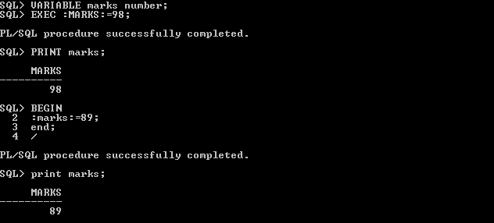
Bind Variables

Slide 7
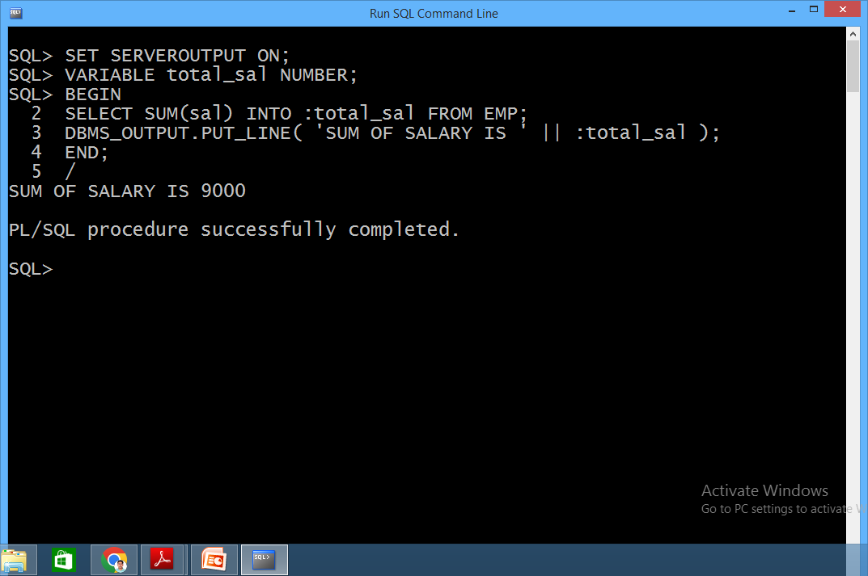
Bind Variables
Find total salary of all employees in PL/SQL

Slide 8
Substitution Variables
PL/SQL blocks can accept user input while execution.
Whenever PL/SQL processor encounters a substitution variable in a block, it waits for user input.
All the substitution variables in the block are replaced by the inputted values before sending it to the database.
Substitution variables are used by prefixing a variable name with the ampersand(&) or double ampersand (&&).

Slide 9
Substitution Variables
Ampersand(&) is used when you want to give a new value each time a substitution variable is encountered in the code.
The user has to input value even if the same substitution variable is used at multiple places in a PL/SQL program.

Slide 10
Substitution Variables
Double ampersand (&&) is used when you want the same value to be used for all occurrences of a substitution variable in PL/SQL program.
With &&, PL/SQL processor asks only once for each substitution variable. Wherever the substitution variable is encountered in the code it is replaced with previously assigned value.

Slide 11
BEGIN
DBMS_OUTPUT.PUT_LINE(‘I am going to town on ‘||’&vday’);
DBMS_OUTPUT.PUT_LINE(‘I am coming back on ‘||‘&vday’);
END;

Slide 12
BEGIN DBMS_OUTPUT.PUT_LINE(‘I am going to town on ‘||’&&vday’); DBMS_OUTPUT.PUT_LINE(‘I am coming back on ‘||‘&vday’); END;

