Slide 1
Queries to facilitate acquaintance of Built-In Functions String Functions, Number Functions, Date Functions Conversion Functions.

Slide 2
Functions
Functions are objects in SQL which take one or more input parameter(s) and return a value.

Slide 3
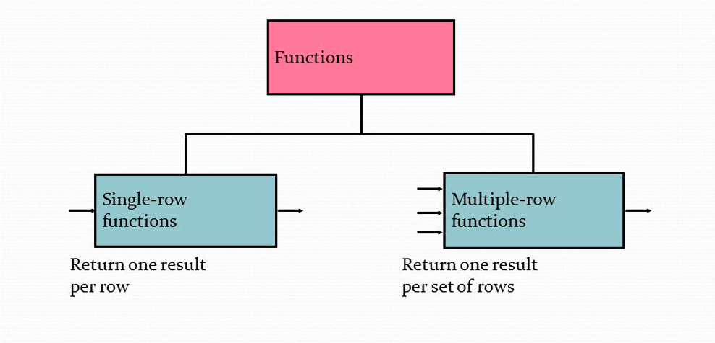
Functions

Slide 4
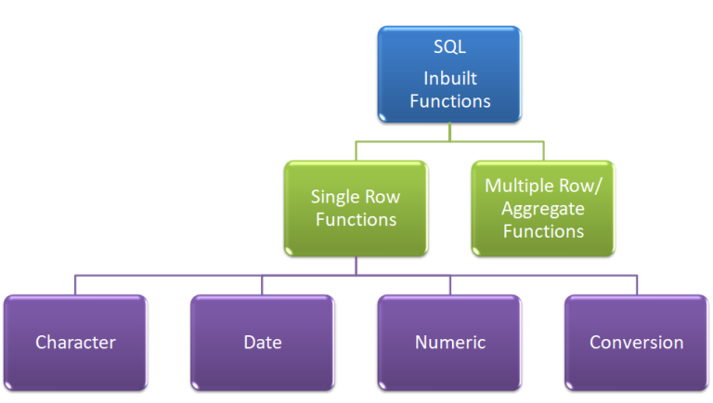
Functions

Slide 5
Character Functions(string Functions)
Character functions accept character input values and can return either characters or number values as output.

Slide 6
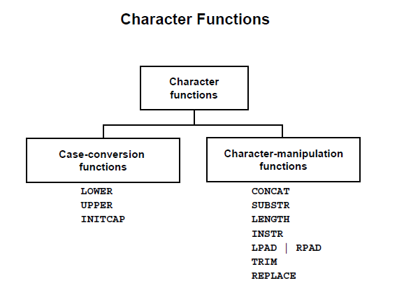

Slide 7
Character Functions
Case-Conversion Functions
LOWER
Returns a given string in lower case.
SYNTAX: LOWER(COLNAME | STRING)
Example: select LOWER(‘ORACLE’)
AS LOWER_OUTPUT from dual; LOWER-OUTPUT ------------- oracle

Slide 8
Character Functions
Case-Conversion Functions
UPPER
Returns a given string in UPPER case.
SYNTAX: UPPER (COLNAME | STRING)
Example: select UPPER(‘oracle’) AS UPPER_OUTPUT from dual; UPPER_OUTPUT ------------- ORACLE

Slide 9
Character Functions
Case-Conversion Functions
3. INITCAP
Returns a given string with Initial letter in capital.
SYNTAX: INITCAP (COLNAME | STRING)
Example: select INITCAP(‘oracle’) from dual; INITCAP ------------------ Oracle

Slide 10
String manipulative Functions
CONCAT
SUBSTR
LENGTH
INSTR
LPAD
RPAD
REPLACE
TRIM | LTRIM | RTRIM

Slide 11
String manipulative Functions
CONCAT function joins two strings and returns a single string.
Syntax: CONCAT(column1|string1 , column2|String2)
This function always appends string2 to the end of string1.
Ex1: SELECT CONCAT(‘oracle', ’server ') FROM DUAL;
o/p: Concat ---------------- oracleserver

Slide 12
String manipulative Functions
Example2
Select concat(concat(ename,' is a '),job) from emp; output: Concat
---------------- Smith is a clerk John is a Manager Sunny is a GenManager

Slide 13
String manipulative Functions
Example3
Select concat(concat(‘oracle’, ‘server'),’2021’) from dual;
Output: oracleserver2021

Slide 14
String manipulative Functions
LENGTH
Returns the length of a given string.
Syntax: LENGTH(Column|String)
Example1: select length(‘oracle’) from dual; LENGTH ------------ 6
Example2: select length(ename) from emp;

Slide 15
String manipulative Functions
SUBSTR
Returns a substring from a given string starting from position ‘pos’ upto ‘n’ characters
Syntax: SUBSTR(Column|String, pos, [ N ] )
Ex1: select substr(‘ABCDEFGH', 3, 4) from dual;
Substr -------- CDEF

Slide 16
String manipulative Functions
SUBSTR
Ex2: select substr(‘ABCDEFGH', 2) from dual;
Substr -------- BCDEFGH
Ex3: select substr(‘ABCDEFGH', -3, 2) from dual;
Substr -------- FG

Slide 17
String manipulative Functions
INSTR
Checks whether a given character or pattern occurs in the given string or not.
If the pattern occurs in the string then returns the first position of its occurrence otherwise returns 0.
Syntax:
INSTR( Column|String, ‘pattern', [startposition-m] , [occurrence-n] )
Optionally, you can provide a position m to start searching, and the occurrence n of pattern.
Also, if the starting position is not given, then it starts search from index 1, by default.

Slide 18
String manipulative Functions
INSTR
Example 1:
SELECT INSTR(‘ABCDABCDABCD’, ‘AB’, 1 , 1)
FROM DUAL;
Output: 1
Example 2:
SELECT INSTR(‘ABCDABCDABCD’, ‘AB’, 1 , 3)
FROM DUAL;
Output: 9

Slide 19
String manipulative Functions
INSTR
Example 3:
SELECT INSTR(‘ABCDABCDABCD’, ‘EF’, 1 , 1)
FROM DUAL;
Output: 0
Example 4:
SELECT INSTR( ‘ABCDABCDABCD’, ‘AB’, 4 , 1)
FROM DUAL;
Output: 5

Slide 20
String manipulative Functions
REVERSE
Reverses the given string.
Syntax: REVERSE (Columnname | String)
Example: SELECT REVERSE(‘ABCD’) FROM DUAL;
Output: DCBA

Slide 21
String manipulative Functions
REPLACE
Replace a sequence of characters in a string with another set of characters.
The REPLACE function accepts three parameter
Syntax:
REPLACE(input_str, str_to_replace, replacement_str)

Slide 22
String manipulative Functions
REPLACE
Ex: SELECT REPLACE(‘oracle server’, ’oracle', ’sql') FROM DUAL; output: sql server

Slide 23
String manipulative Functions
LPAD
returns the string padded leftside with a specified pad string and to a specified length.
If the pad string is not specified, then the given string is padded on the left with spaces.
Syntax: LPAD( Column|String, n, ‘padstring')
n is specified length of string.
Padstring is a character or string.

Slide 24
String manipulative Functions
LPAD
Ex1: SELECT LPAD(‘oracle',10,‘#') FROM DUAL;
Output: ####oracle
Example2: SELECT LPAD(‘oracle',10) FROM DUAL;
Output: oracle

Slide 25
String manipulative Functions
RPAD
returns the string padded rightside with a specified pad string and to a specified length.
If the pad string is not specified, then the given string is padded on the right with spaces.
Syntax: RPAD( Column|String, n, ‘padstring')
n is specified length of string.
Padstring is a character or string.

Slide 26
String manipulative Functions
RPAD
Ex1: SELECT RPAD(‘oracle',10,‘#') FROM DUAL;
Output: oracle####
Example2: SELECT RPAD(‘oracle',10) FROM DUAL;
Output:
O | r | a | c | l | e

Slide 27
String manipulative Functions
Nesting LPAD and RPAD
Example: SELECT RPAD(LPAD(‘oracle',10,‘#') ,14, ‘#’) FROM DUAL;
Output: ####oracle####

Slide 28
String manipulative Functions
LTRIM
Trims(removes) unwanted character(s) from leftside of given string.
Syntax:
LTRIM(column|string, [ ‘trim_characters’ ] )
Ex1: SELECT LTRIM(‘oracle‘, ‘o’) from dual;
Output: racle

Slide 29
String manipulative Functions
SELECT LTRIM(‘oracle‘, ‘x’) from dual;
Output: oracle
SELECT LTRIM(‘oracle‘, ‘oa’) from dual;
Output: racle
SELECT LTRIM(‘oracle‘, ‘ora’) from dual;
Output: cle
SELECT LTRIM(‘oracle‘, ‘roa’) from dual;
Output: cle

Slide 30
String manipulative Functions
RTRIM
Trims(removes) unwanted character(s) from rightside of given string.
Syntax:
RTRIM(column|string, [ ‘trim_characters’ ] )
Ex1: SELECT RTRIM(‘oracle‘, ‘cle’) from dual;
Output: ora

Slide 31
String manipulative Functions
SELECT RTRIM(‘oracle‘, ‘o’) from dual;
Output: oracle
SELECT RTRIM(‘oracle‘, ‘@lce’) from dual;
Output: ora

Slide 32
String manipulative Functions
TRIM : This function trims the specified character(s) from the left or right or bothsides of the given string.
If no character is specified to be trimmed from the string and there exists some extra space at start or end of the string, then those extra spaces are trimmed off.
Syntax:
TRIM( [ LEADING|TRAILING|BOTH ]
[ ‘trim_character’ FROM ] ‘SOURCE’ )

Slide 33
String manipulative Functions
SELECT TRIM(‘o' FROM ‘ooracleoo') FROM DUAL;
output: racle
SELECT TRIM(LEADING ‘o' FROM ‘ooracleoo') FROM DUAL;
output: racleoo

Slide 34
String manipulative Functions
SELECT TRIM(TRAILING ‘o' FROM ‘ooracleoo') FROM DUAL;
output: ooracle
SELECT TRIM(BOTH ‘o' FROM ‘ooracleoo') FROM DUAL;
output: racle

Slide 35
NUMBER FUNCTIONS
Number functions accept numeric input and return numeric value.
ABS | MOD
CEIL | LOG
FLOOR | LN
POWER | ROUND
EXP | TRUNCATE
SQRT

Slide 36
NUMBER FUNCTIONS
ABS(N): It returns the absolute value of N.
EXAMPLES: SELECT ABS(-10) FROM DUAL;
OUTPUT: 10
SELECT ABS(1) , ABS(-2) FROM DUAL;
OUTPUT: 1 2

Slide 37
NUMBER FUNCTIONS
CEIL(N): It returns the smallest integer that is greater than or equal to N.
Example: SELECT CEIL(25.75) FROM DUAL;
Output: 26

Slide 38
NUMBER FUNCTIONS
FLOOR(N): It returns the largest integer value that is less than or equal to N.
Example: SELECT FLOOR(25.75) FROM DUAL;
Output: 25

Slide 39
NUMBER FUNCTIONS
POWER(m, n): It returns m raised to the nth power.
Example: SELECT POWER(4, 2) FROM DUAL;
Output: 16

Slide 40
NUMBER FUNCTIONS
EXP(N): It returns ‘e’ raised to the power of N where e = 2.718.
Example: SELECT EXP(1) FROM DUAL;
Output: 2.718281828459045

Slide 41
NUMBER FUNCTIONS
SQRT(N): It returns the square root of N.
Example: SELECT SQRT(25) FROM DUAL;
Output: 5

Slide 42
NUMBER FUNCTIONS
MOD(M,N): Returns the remainder after dividing M with N.
ExampleS: SELECT MOD(10,2) FROM DUAL;
Output: 0 SELECT MOD(18, 4) FROM DUAL;
Output: 2

Slide 43
NUMBER FUNCTIONS
LOG(M,N) Returns the logarithm of N with base M.
Example: SELECT LOG(10,100) FROM DUAL; output: 2
SELECT LOG(10,10), LOG(20,20) FROM DUAL;
output: 1 1

Slide 44
NUMBER FUNCTIONS
LN(N)- Returns natural logarithm of n (base ‘e’).
Example: SELECT LN(3) FROM DUAL;
output: 1.098

Slide 45
NUMBER FUNCTIONS
SIGN(N): SIGN function returns -1 if N < 0
0 if N = 0
1 if N > 0
Example: SELECT SIGN(-3), SIGN(0), SIGN(3) FROM DUAL;
output: -1 0 1

Slide 46
NUMBER FUNCTIONS
ROUND(N, M)
It returns a number N rounded off to M decimal places.
If you omit M(optional), then N is rounded to 0 places.
Example:
SELECT ROUND(3.4573,2) FROM DUAL; Round ------------ 3.46

Slide 47
NUMBER FUNCTIONS
ROUND(N, M)
Example: SELECT ROUND(3.45) FROM DUAL; output: 3
Example: SELECT ROUND(3.67) FROM DUAL; output: 4

Slide 48
NUMBER FUNCTIONS
TRUNC(N, M) : Returns a decimal number N
truncated to M decimal positions.
If M is ignored, then decimal part is trunacted.
Example1: SELECT TRUNC(3.457,2) FROM DUAL; output : 3.45
Example2: SELECT TRUNC(3.457) FROM DUAL; output : 3

Slide 49
DATE FUNCTIONS
SYSDATE
ADD_MONTHS()
LAST_DAY()
NEXT_DAY()
MONTHS_BETWEEN
NEW_TIME()
TRUNC()
ROUND()
EXTRACT()

Slide 50
DATE FUNCTIONS
SYSDATE
Function used to return the current date and time.
Examples:
1. SELECT SYSDATE AS CURRENTDATE FROM DUAL;
OUTPUT: 06-OCT-23
2. SELECT SYSDATE+1 FROM DUAL
OUTPUT: 07-OCT-23

Slide 51
DATE FUNCTIONS
ADD_MONTHS()
This function adds a number(n) of months to a given date and returns the same day of month n .
Syntax:
ADD_MONTHS(date, integer)

Slide 52
DATE FUNCTIONS
ADD_MONTHS()
1: SELECT ADD_MONTHS( ‘06-OCT-2023', 1 )
FROM dual;
OUTPUT: 06-NOV-2023
2: SELECT ADD_MONTHS( ‘06-OCT-2023', -1 ) FROM dual;
OUTPUT: 06-SEP-2023
3: SELECT ADD_MONTHS( ‘SYSDATE', 1 ) FROM dual;

Slide 53
DATE FUNCTIONS
LAST_DAY()
It takes a date argument and returns the last day of the month of that date.
Syntax: LAST_DAY(date)
Example:
SELECT LAST_DAY(‘06/OCT/2023’) AS LAST FROM DUAL;
OUTPUT: 31/0CT/2023

Slide 54
DATE FUNCTIONS
NEXT_DAY() function returns the date of the first weekday that is later than a date.
Weekday is the day of the week that you wish to return.
The weekday can be full name( eg: Tuesday) or abbreviation (e.g., Tue)
Syntax
NEXT_DAY(date, weekday)

Slide 55
DATE FUNCTIONS
NEXT_DAY()
SELECT NEXT_DAY('07-OCT-2023', ‘MONDAY' ) FROM dual;
OUTPUT: 09-OCT-23
SELECT NEXT_DAY('07-OCT-2023', ‘MON' ) FROM dual;
OUTPUT: 09-OCT-23

Slide 56
DATE FUNCTIONS
MONTHS_BETWEEN
This function returns the number of months between two dates.
Syntax: MONTHS_BETWEEN(date1, date2)
If date1 is later than date2, then the result is positive.
If date1 is earlier than date2, then the result is negative.
If date1 and date2 are either the same days of the month or both last days of months, then the result is always an integer.

Slide 57
DATE FUNCTIONS
MONTHS_BETWEEN
SELECT MONTHS_BETWEEN('06/oct/23', '06/sep/23' ) FROM DUAL;
Output: 1
SELECT MONTHS_BETWEEN('06/sep/23', '06/oct/23' ) FROM DUAL;
Output: -1
SELECT MONTHS_BETWEEN('06/oct/23', '06/oct/23' ) FROM DUAL;
Output: 0

Slide 58
DATE FUNCTIONS
NEW_TIME() function is used to convert a date from timezone1 to a date in timezone2.
Syntax:
NEW_TIME(date, timezone1, timezone2)
date : A date value
timezone1 : A time zone of the date
timezone2: A time zone to which the date should be converted

Slide 59
DATE FUNCTIONS
AST Atlantic Standard Time
BST Bering Standard Time
CST Central Standard Time
EST Eastern Standard Time
GMT Greenwich Mean Time
HST Alaska-Hawaii Standard Time
MST Mountain Standard Time
PST Pacific Standard Time

Slide 60
DATE FUNCTIONS
NEW_TIME()
SELECT NEW_TIME('07-oct-2023', 'AST', 'MST') from dual;
Output: 06-oct-2023

Slide 61
DATE FUNCTIONS
TRUNC() function returns a DATE value truncated to a specified unit of measure.
Syntax : TRUNC(date, [format])
format argument determines the unit to which the date will be truncated.

Slide 62
DATE FUNCTIONS
format values
YYYY, YEAR, YY, Y - Year
Q - Quarter
MONTH, MON, MM, - Month of the year
W - Day no of the week of month.
---- ww – week of the year
dd, ddd - begin of the day
day, dy ,d - start day of the week

Slide 63
DATE FUNCTIONS
TRUNC() Examples
SELECT TRUNC(TO_DATE('22-AUG-23'), 'YEAR') FROM DUAL;
OUTPUT: '01-JAN-23'
SELECT TRUNC(TO_DATE('22-AUG-23'), 'Q') FROM DUAL;
OUTPUT: '01-JUL-23‘ '

Slide 64
DATE FUNCTIONS
TRUNC() Examples
SELECT TRUNC(TO_DATE('22-AUG-23'), 'MONTH') FROM DUAL;
OUTPUT: '01-AUG-23'
SELECT TRUNC(TO_DATE('22-AUG-23'), 'DDD') FROM DUAL;
OUTPUT: '22-AUG-23'

Slide 65
DATE FUNCTIONS
TRUNC() Examples
SELECT TRUNC(TO_DATE('22-AUG-23'), 'DAY') FROM DUAL;
OUTPUT: 21-AUG-23
SELECT TRUNC(TO_DATE('28-SEP-23'), ‘W') FROM DUAL;
OUTPUT: 22-SEP-23

Slide 66
DATE FUNCTIONS
ROUND() function is used to get the date rounded to the unit specified by the format.
SYNTAX: ROUND(date [ ,format ] )
SELECT ROUND(TO_DATE ('16-SEP-2023'), ‘YEAR‘) FROM DUAL;
OUTPUT: 01-JAN-2024

Slide 67
DATE FUNCTIONS
EXTRACT() function extracts a specific component (year, month, day) from a date value.
Syntax : EXTRACT(field FROM date)
field argument for date allows YEAR, MONTH, DAY.
Example: SELECT SYSDATE, EXTRACT(YEAR FROM SYSDATE) AS YEAR from dual;
OUTPUT: 07-OCT-23 2023

Slide 68
Conversion Functions
TO_CHAR
TO_DATE
TO_NUMBER()

Slide 69
Conversion Functions
TO_CHAR() function converts a number or date to a string.
Syntax
TO_CHAR( value , [format_mask] )
Value - A number or date to be converted to a string.
format_mask(Optional). This determines the format of the result string.

Slide 70
Conversion Functions
TO_CHAR() with date values
1. SELECT TO_CHAR( sysdate, 'YYYY-MM-DD' ) FROM dual;
Output: 2023-10-07
2. SELECT TO_CHAR( sysdate) FROM dual;
Output: 07-OCT-23
3. SELECT ename, TO_CHAR( joindate, 'DD-MON -YYYY' ) as joineddate FROM emp;

Slide 71
Conversion Functions
TO_CHAR() with numbers
1. SELECT TO_CHAR(15000) AS RESULT FROM DUAL;
OUTPUT: 15000
2. SELECT TO_CHAR(15000, '$99,999') AS RESULT FROM DUAL;
OUTPUT: $15,000

Slide 72
Conversion Functions
TO_DATE function converts a string to a date.
Syntax:
TO_DATE ( string, [format_mask] )
String: It is used to specify the string to be converted.
Format_mask: It is an optional parameter which is used to specify the format to be used for conversion.

Slide 73
Conversion Functions
TO_DATE
SELECT TO_DATE ('07102023', 'DDMMYYYY') FROM DUAL;
OUTPUT: 07-OCT-23
SELECT TO_DATE('2023/OCT/07', ‘YYYY/MON/DD') FROM DUAL;
OUTPUT: 07-OCT-23

Slide 74
Conversion Functions
TO_NUMBER() function converts a string to a number.
Syntax
TO_NUMBER( string, [format_mask] )
Ex: SELECT TO_NUMBER('1234.56', '9999.99') AS RESULT FROM DUAL;
1234.56
Ex: SELECT TO_NUMBER('123') AS RESULT FROM DUAL;
123

Slide 75
Aggregate Functions
Aggregate functions calculate on a group of rows and return a single value for each group.
AVG() – returns the average of a set.
COUNT() – returns the number of items in a set.
MAX() – returns the maximum value in a set.
MIN() – returns the minimum value in a set
SUM() – returns the sum of all values in a set

Slide 76
Aggregate Functions
Select AVG (salary) FROM emp;
Select MAX(salary) FROM emp;
Select MIN(salary) FROM emp;
Select SUM(salary) FROM emp;

Slide 77
Aggregate Functions
Select COUNT(salary) FROM emp;
Select COUNT (DISTINCT salary) FROM emp;
Select COUNT (*) FROM emp;

