Slide 1
Reinforcement Learning
Slides from
R.S. Sutton and A.G. Barto
Reinforcement Learning: An Introduction
http://www.cs.ualberta.ca/~sutton/book/the-book.html
http://rlai.cs.ualberta.ca/RLAI/RLAIcourse/RLAIcourse.html

Slide 2
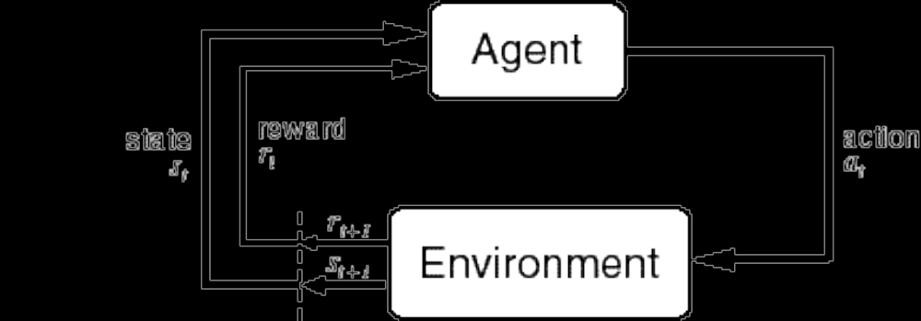
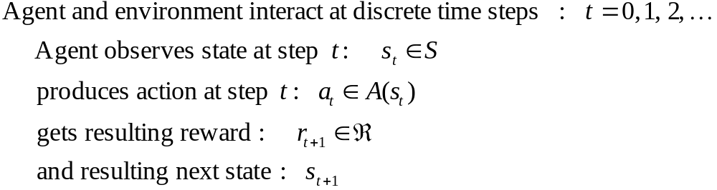
The Agent-Environment Interface
. . .
r
t +1
r
t +2
r
. . .
s
s
t +1
s
t +2
t +3
s
t +3
t
a
a
t +1
a
t +2
a
t
t +3

Slide 3
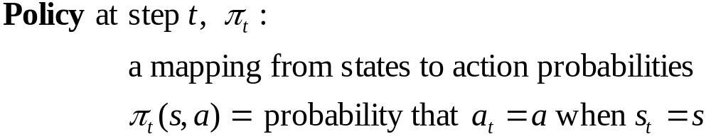
The Agent Learns a Policy
Reinforcement learning methods specify how the agent changes its policy as a result of experience.
Roughly, the agent’s goal is to get as much reward as it can over the long run.

Slide 4
Getting the Degree of Abstraction Right
Time steps need not refer to fixed intervals of real time.
Actions can be low level (e.g., voltages to motors), or high level (e.g., accept a job offer), “mental” (e.g., shift in focus of attention), etc.
States can be low-level “sensations”, or they can be abstract, symbolic, based on memory, or subjective (e.g., the state of being “surprised” or “lost”).
An RL agent is not like a whole animal or robot, which consist of many RL agents as well as other components.
The environment is not necessarily unknown to the agent, only incompletely controllable.
Reward computation is in the agent’s environment because the agent cannot change it arbitrarily.

Slide 5
Goals and Rewards
Is a scalar reward signal an adequate notion of a goal?—maybe not, but it is surprisingly flexible.
A goal should specify what we want to achieve, not how we want to achieve it.
A goal must be outside the agent’s direct control—thus outside the agent.
The agent must be able to measure success:
  explicitly;
  frequently during its lifespan.

Slide 6
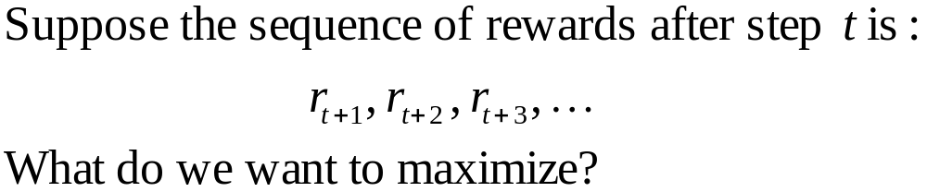
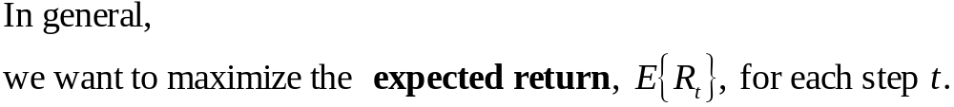

Returns
Episodic tasks: interaction breaks naturally into episodes, e.g., plays of a game, trips through a maze.
where T is a final time step at which a terminal state is reached, ending an episode.

Slide 7
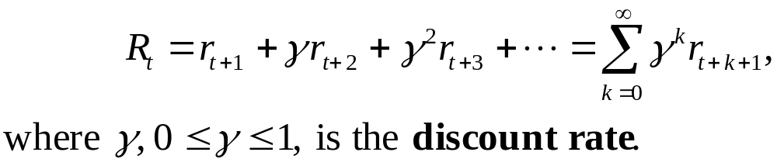
Returns for Continuing Tasks
Continuing tasks: interaction does not have natural episodes.
Discounted return:

Slide 8
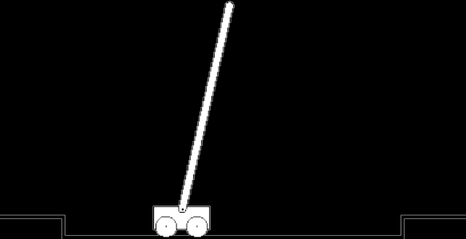
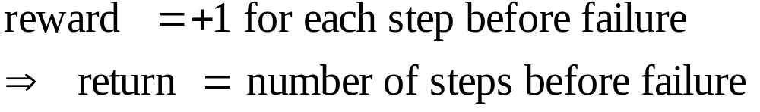
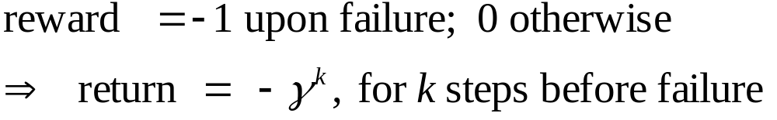
An Example
Avoid failure: the pole falling beyond
a critical angle or the cart hitting end of
track.
As an episodic task where episode ends upon failure:
As a continuing task with discounted return:
In either case, return is maximized by
avoiding failure for as long as possible.

Slide 9
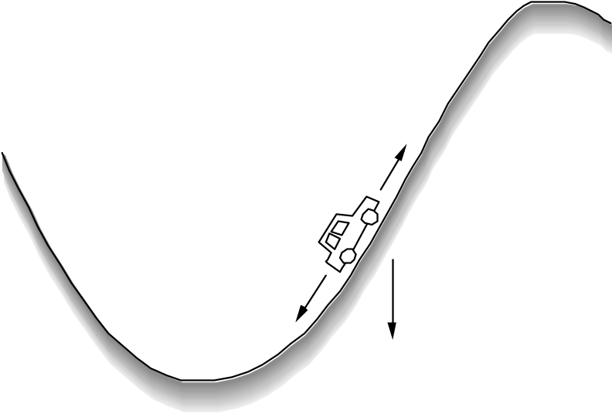
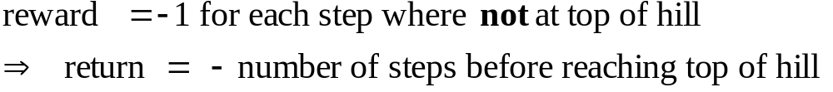
Another Example
Get to the top of the hill
as quickly as possible.
Return is maximized by minimizing
number of steps reach the top of the hill.

Slide 10


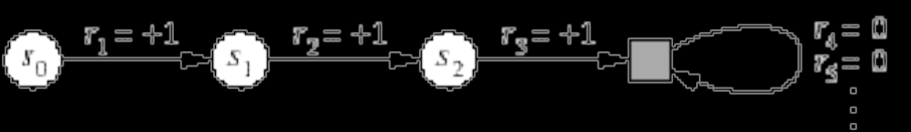
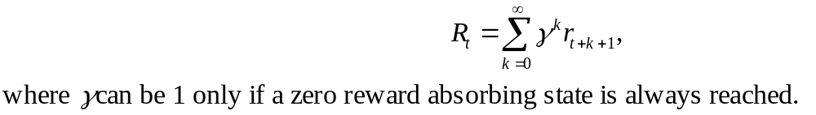
A Unified Notation
In episodic tasks, we number the time steps of each episode starting from zero.
We usually do not have distinguish between episodes, so we write instead of for the state at step t of episode j.
Think of each episode as ending in an absorbing state that always produces reward of zero:
We can cover all cases by writing

Slide 11
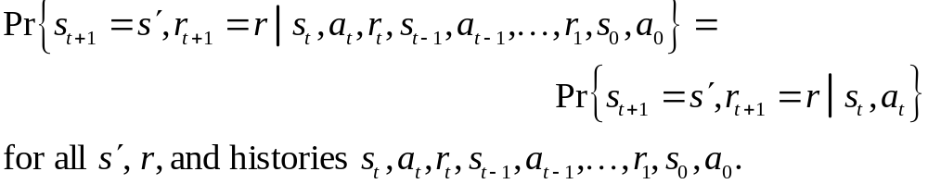
The Markov Property
By “the state” at step t, the book means whatever information is available to the agent at step t about its environment.
The state can include immediate “sensations,” highly processed sensations, and structures built up over time from sequences of sensations.
Ideally, a state should summarize past sensations so as to retain all “essential” information, i.e., it should have the Markov Property:

Slide 12
Markov Decision Processes
If a reinforcement learning task has the Markov Property, it is basically a Markov Decision Process (MDP).
If state and action sets are finite, it is a finite MDP.
To define a finite MDP, you need to give:
  state and action sets
  one-step “dynamics” defined by transition probabilities:
  reward probabilities:

Slide 13
An Example Finite MDP
Recycling Robot
At each step, robot has to decide whether it should (1) actively search for a can, (2) wait for someone to bring it a can, or (3) go to home base and recharge.
Searching is better but runs down the battery; if runs out of power while searching, has to be rescued (which is bad).
Decisions made on basis of current energy level: high, low.
Reward = number of cans collected

Slide 14
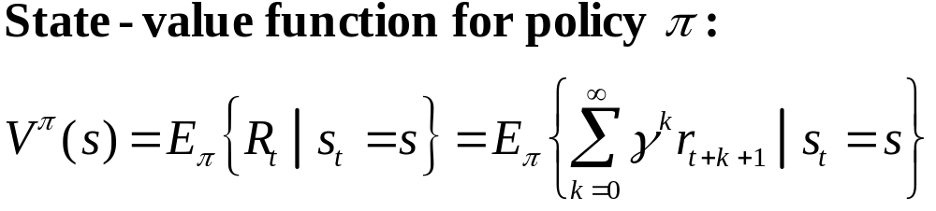
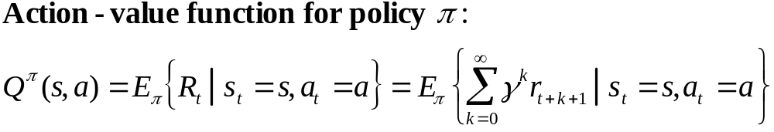
Value Functions
The value of a state is the expected return starting from that state; depends on the agent’s policy:
The value of taking an action in a state under policy π is the expected return starting from that state, taking that action, and thereafter following π :

Slide 15
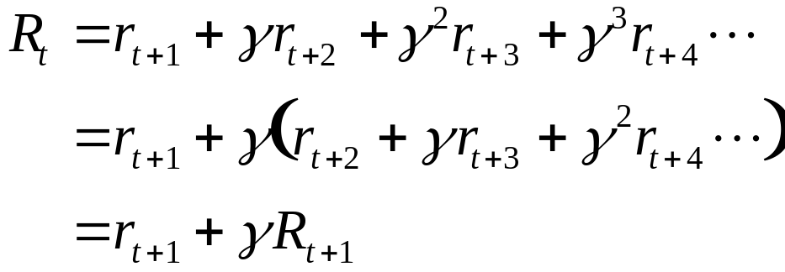
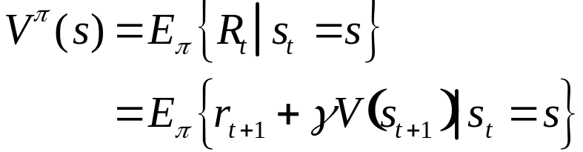
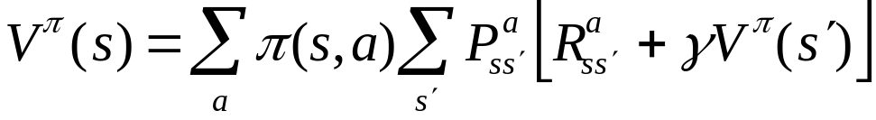
Bellman Equation for a Policy π
The basic idea:
So:
Or, without the expectation operator:

Slide 16
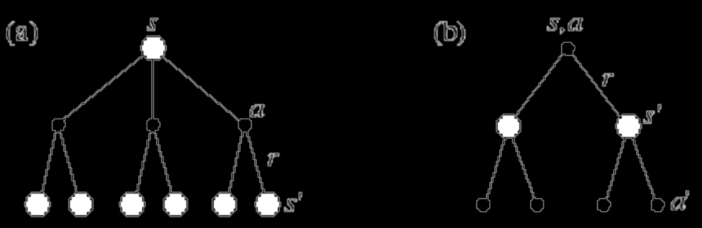


More on the Bellman Equation
This is a set of equations (in fact, linear), one for each state.
The value function for π is its unique solution.
Backup diagrams:

Slide 17
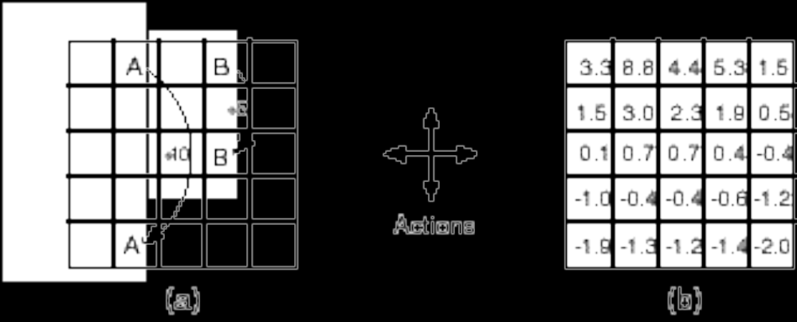
Gridworld
Actions: north, south, east, west; deterministic.
If would take agent off the grid: no move but reward = –1
Other actions produce reward = 0, except actions that move agent out of special states A and B as shown.
State-value function
for equiprobable
random policy;
γ = 0.9

Slide 18
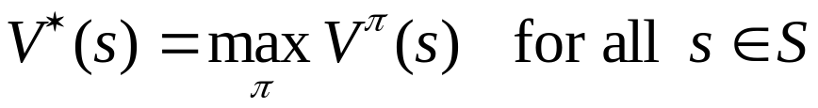
Optimal Value Functions
For finite MDPs, policies can be partially ordered:
There is always at least one (and possibly many) policies that is better than or equal to all the others. This is an optimal policy. We denote them all π *.
Optimal policies share the same optimal state-value function:
Optimal policies also share the same optimal action-value function:
This is the expected return for taking action a in state s and thereafter following an optimal policy.

Slide 19
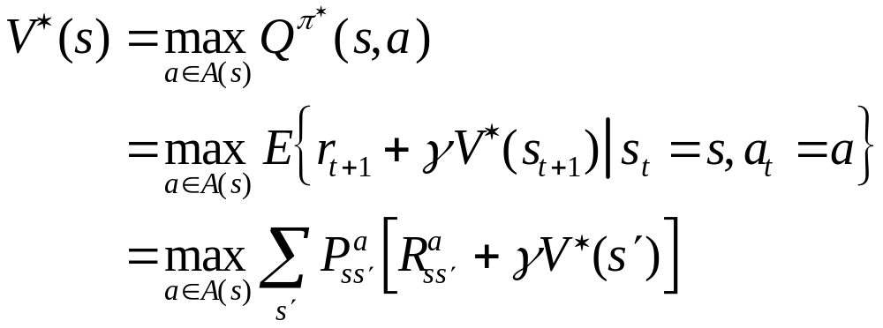
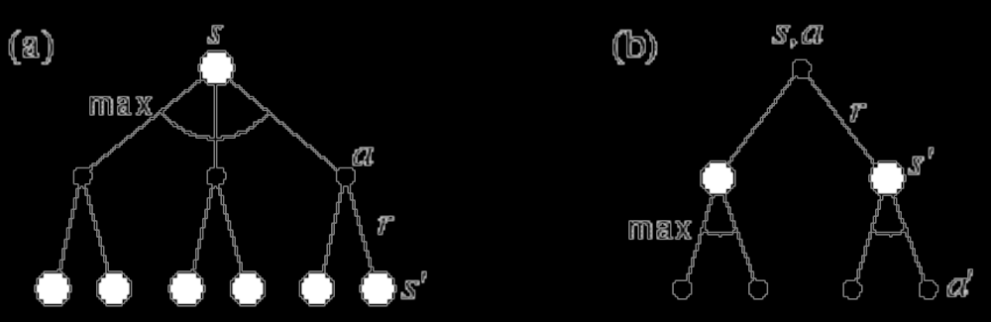

Bellman Optimality Equation for V*
The value of a state under an optimal policy must equal
the expected return for the best action from that state:
The relevant backup diagram:
is the unique solution of this system of nonlinear equations.

Slide 20
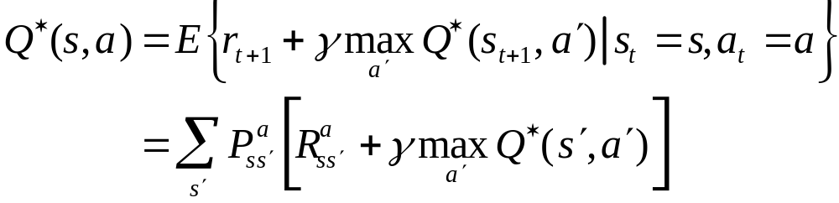

Bellman Optimality Equation for Q*
The relevant backup diagram:
is the unique solution of this system of nonlinear equations.

Slide 21
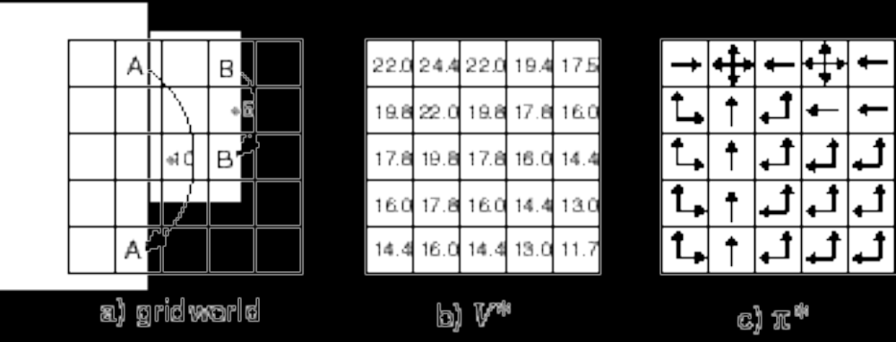
Why Optimal State-Value Functions are Useful
Any policy that is greedy with respect to is an optimal policy.
Therefore, given , one-step-ahead search produces the
long-term optimal actions.
E.g., back to the gridworld:

Slide 22
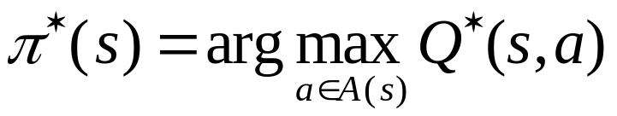
What About Optimal Action-Value Functions?
Given , the agent does not even
have to do a one-step-ahead search:

Slide 23
Solving the Bellman Optimality Equation
Finding an optimal policy by solving the Bellman Optimality Equation requires the following:
  accurate knowledge of environment dynamics;
  we have enough space an time to do the computation;
  the Markov Property.
How much space and time do we need?
  polynomial in number of states (via dynamic programming methods; Chapter 4),
  BUT, number of states is often huge (e.g., backgammon has about 10**20 states).
We usually have to settle for approximations.
Many RL methods can be understood as approximately solving the Bellman Optimality Equation.

Slide 24

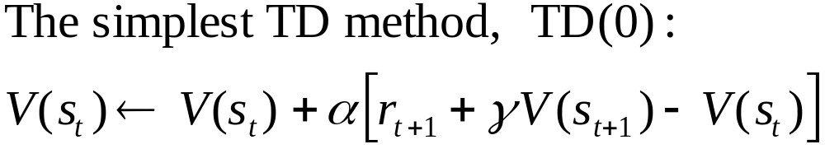
TD Prediction
Policy Evaluation (the prediction problem):
for a given policy π, compute the state-value function
target: an estimate of the return
R. S. Sutton and A. G. Barto: Reinforcement Learning: An Introduction

Slide 25

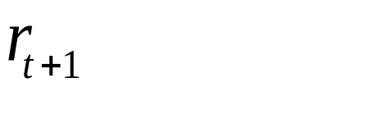
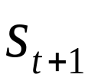
Simplest TD Method
T
T
T
T
T
T
T
T
T
T
T
T
T
T
T
T
T
T
T
T
R. S. Sutton and A. G. Barto: Reinforcement Learning: An Introduction

Slide 26
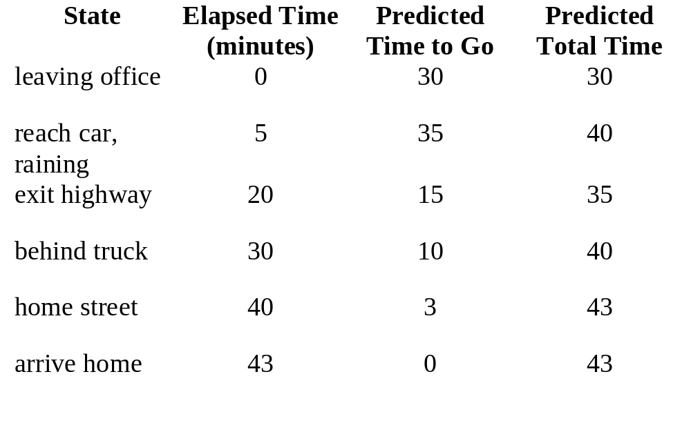
Example: Driving Home
R. S. Sutton and A. G. Barto: Reinforcement Learning: An Introduction

Slide 27
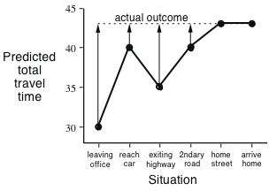
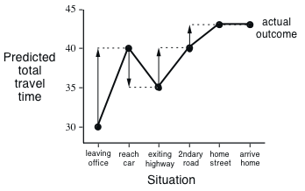
Driving Home
  Changes recommended by Monte Carlo methods (α=1)
  Changes recommended
  by TD methods (α=1)
R. S. Sutton and A. G. Barto: Reinforcement Learning: An Introduction

Slide 28
Advantages of TD Learning
TD methods do not require a model of the environment, only experience
TD methods can be fully incremental
  You can learn before knowing the final outcome
    Less memory
    Less peak computation
  You can learn without the final outcome
    From incomplete sequences
R. S. Sutton and A. G. Barto: Reinforcement Learning: An Introduction

Slide 29

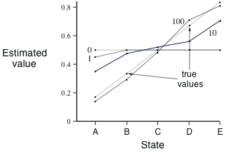
Random Walk Example
    Values learned by TD(0) after
    various numbers of episodes
R. S. Sutton and A. G. Barto: Reinforcement Learning: An Introduction

Slide 30
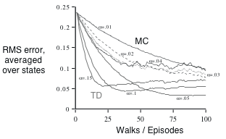
TD and MC on the Random Walk
    Data averaged over
    100 sequences of episodes
R. S. Sutton and A. G. Barto: Reinforcement Learning: An Introduction

Slide 31
Optimality of TD(0)
Batch Updating: train completely on a finite amount of data,
e.g., train repeatedly on 10 episodes until convergence.
Compute updates according to TD(0), but only update
estimates after each complete pass through the data.
For any finite Markov prediction task, under batch updating,
TD(0) converges for sufficiently small α.
Constant-α MC also converges under these conditions, but to
a difference answer!
R. S. Sutton and A. G. Barto: Reinforcement Learning: An Introduction

Slide 32
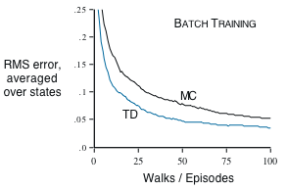
Random Walk under Batch Updating
    After each new episode, all previous episodes were treated as a batch, and algorithm was trained until convergence. All repeated 100 times.
R. S. Sutton and A. G. Barto: Reinforcement Learning: An Introduction

Slide 33

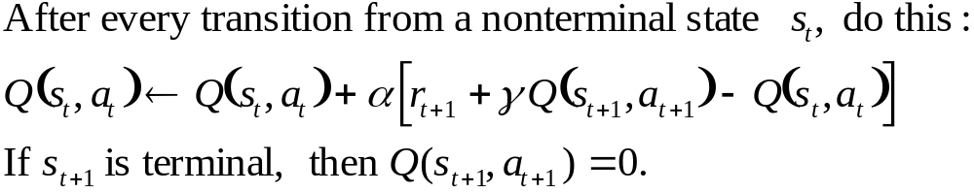
Learning An Action-Value Function
R. S. Sutton and A. G. Barto: Reinforcement Learning: An Introduction

Slide 34
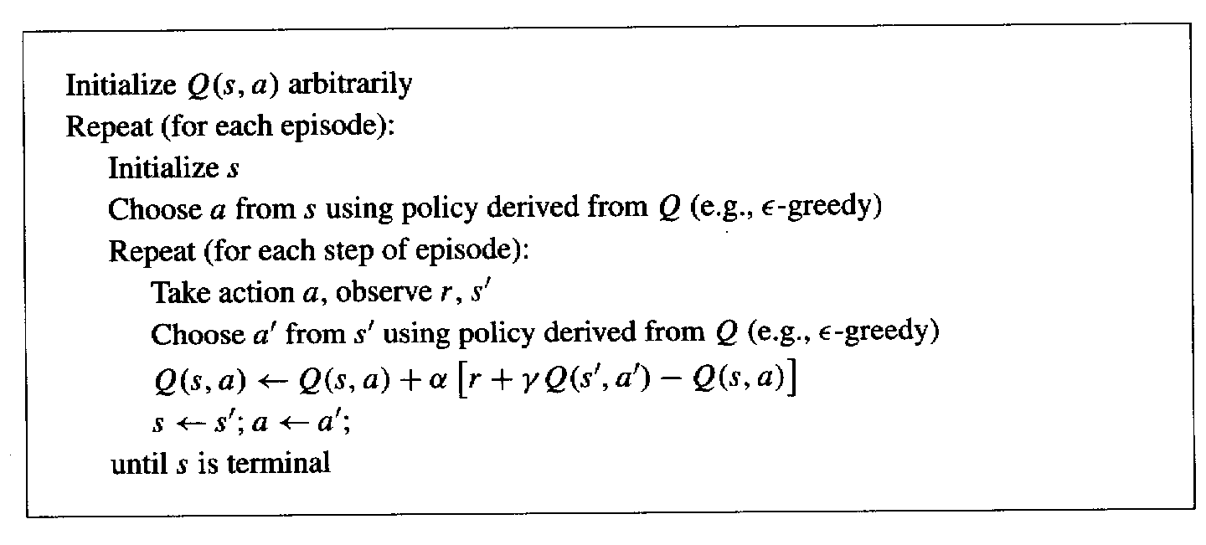
Sarsa: On-Policy TD Control
Turn this into a control method by always updating the
policy to be greedy with respect to the current estimate:
R. S. Sutton and A. G. Barto: Reinforcement Learning: An Introduction

Slide 35
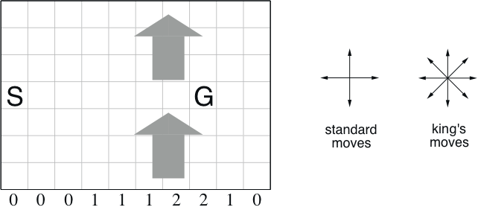
Windy Gridworld
undiscounted, episodic, reward = –1 until goal
R. S. Sutton and A. G. Barto: Reinforcement Learning: An Introduction

Slide 36
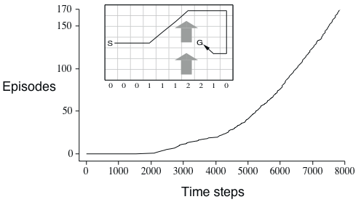
Results of Sarsa on the Windy Gridworld
R. S. Sutton and A. G. Barto: Reinforcement Learning: An Introduction

Slide 37
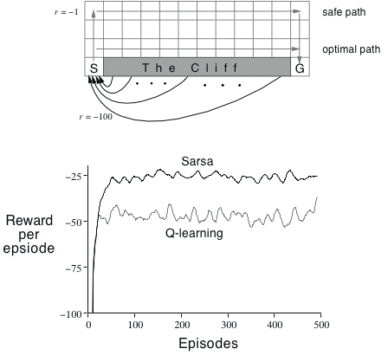
Cliffwalking
    ε−greedy, ε = 0.1
R. S. Sutton and A. G. Barto: Reinforcement Learning: An Introduction

