Slide 1
CMSC 471
Fall 2009
RL using Dynamic Programming
Prof. Marie desJardins
Class #23/24 – Tuesday, 11/17 and 11/24
Thanks to Rich Sutton and Andy Barto for the use of their slides!
R. S. Sutton and A. G. Barto: Reinforcement Learning: An Introduction

Slide 2
Chapter 4: Dynamic Programming
Objectives of this chapter:
Overview of a collection of classical solution methods for MDPs known as dynamic programming (DP)
Show how DP can be used to compute value functions, and hence, optimal policies
Discuss efficiency and utility of DP
R. S. Sutton and A. G. Barto: Reinforcement Learning: An Introduction

Slide 3
Policy Evaluation
Policy Evaluation: for a given policy π, compute the
state-value function
Recall:
R. S. Sutton and A. G. Barto: Reinforcement Learning: An Introduction

Slide 4
Iterative Methods
a “sweep”
A sweep consists of applying a backup operation to each state.
A full policy evaluation backup:
R. S. Sutton and A. G. Barto: Reinforcement Learning: An Introduction

Slide 5
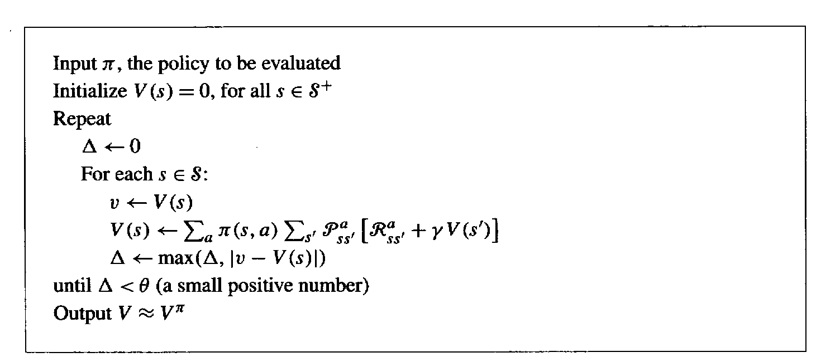
Iterative Policy Evaluation
R. S. Sutton and A. G. Barto: Reinforcement Learning: An Introduction

Slide 6
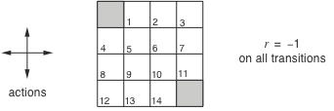
A Small Gridworld
An undiscounted episodic task
Nonterminal states: 1, 2, . . ., 14;
One terminal state (shown twice as shaded squares)
Actions that would take agent off the grid leave state unchanged
Reward is –1 until the terminal state is reached
R. S. Sutton and A. G. Barto: Reinforcement Learning: An Introduction

Slide 7
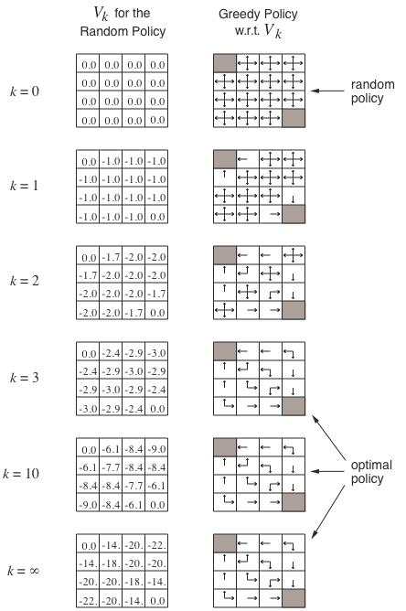
Iterative Policy Eval for the Small Gridworld
R. S. Sutton and A. G. Barto: Reinforcement Learning: An Introduction

Slide 8
Policy Improvement
Suppose we have computed for a deterministic policy π.
For a given state s,
would it be better to do an action ?
R. S. Sutton and A. G. Barto: Reinforcement Learning: An Introduction

Slide 9
Policy Improvement Cont.
R. S. Sutton and A. G. Barto: Reinforcement Learning: An Introduction

Slide 10
Policy Improvement Cont.
R. S. Sutton and A. G. Barto: Reinforcement Learning: An Introduction

Slide 11
Policy Iteration
policy evaluation
policy improvement
“greedification”
R. S. Sutton and A. G. Barto: Reinforcement Learning: An Introduction

Slide 12
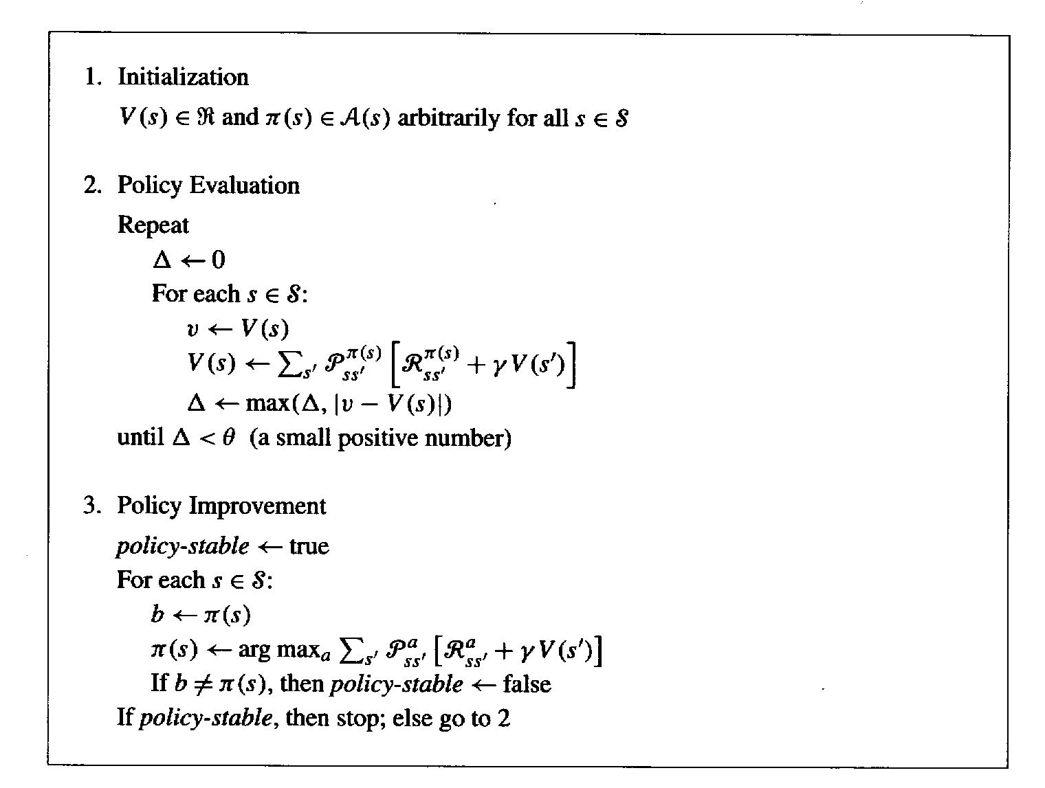
Policy Iteration
R. S. Sutton and A. G. Barto: Reinforcement Learning: An Introduction

Slide 13
Value Iteration
Recall the full policy evaluation backup:
Here is the full value iteration backup:
R. S. Sutton and A. G. Barto: Reinforcement Learning: An Introduction

Slide 14
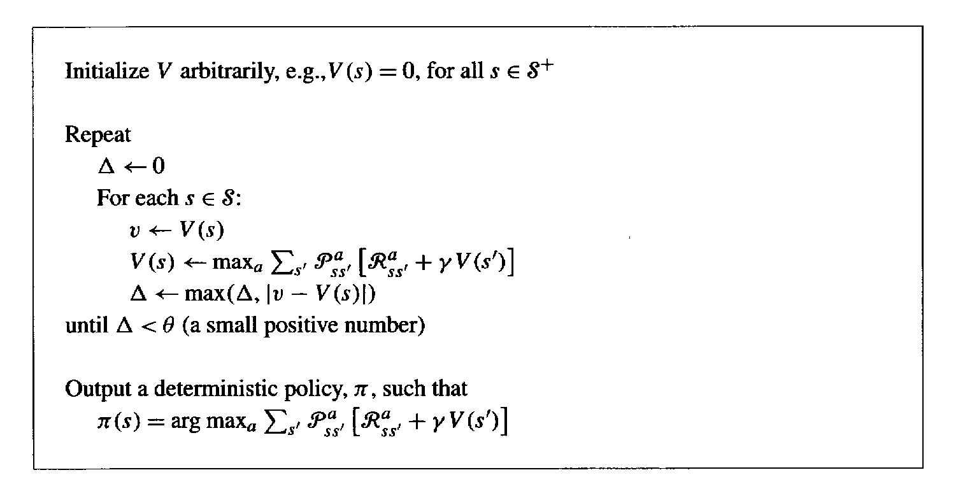
Value Iteration Cont.
R. S. Sutton and A. G. Barto: Reinforcement Learning: An Introduction

Slide 15
Asynchronous DP
All the DP methods described so far require exhaustive sweeps of the entire state set.
Asynchronous DP does not use sweeps. Instead it works like this:
  Repeat until convergence criterion is met:
    Pick a state at random and apply the appropriate backup
Still need lots of computation, but does not get locked into hopelessly long sweeps
Can you select states to backup intelligently? YES: an agent’s experience can act as a guide.
R. S. Sutton and A. G. Barto: Reinforcement Learning: An Introduction

Slide 16
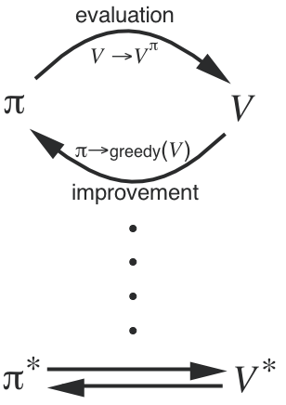
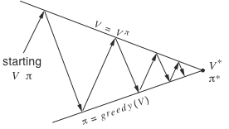
Generalized Policy Iteration
Generalized Policy Iteration (GPI):
any interaction of policy evaluation and policy improvement,
independent of their granularity.
A geometric metaphor for
convergence of GPI:
R. S. Sutton and A. G. Barto: Reinforcement Learning: An Introduction

Slide 17
Efficiency of DP
To find an optimal policy is polynomial in the number of states…
BUT, the number of states is often astronomical, e.g., often growing exponentially with the number of state variables (what Bellman called “the curse of dimensionality”).
In practice, classical DP can be applied to problems with a few millions of states.
Asynchronous DP can be applied to larger problems, and appropriate for parallel computation.
It is surprisingly easy to come up with MDPs for which DP methods are not practical.
R. S. Sutton and A. G. Barto: Reinforcement Learning: An Introduction

Slide 18
Summary
Policy evaluation: backups without a max
Policy improvement: form a greedy policy, if only locally
Policy iteration: alternate the above two processes
Value iteration: backups with a max
Full backups (to be contrasted later with sample backups)
Generalized Policy Iteration (GPI)
Asynchronous DP: a way to avoid exhaustive sweeps
Bootstrapping: updating estimates based on other estimates
R. S. Sutton and A. G. Barto: Reinforcement Learning: An Introduction

