Slide 1
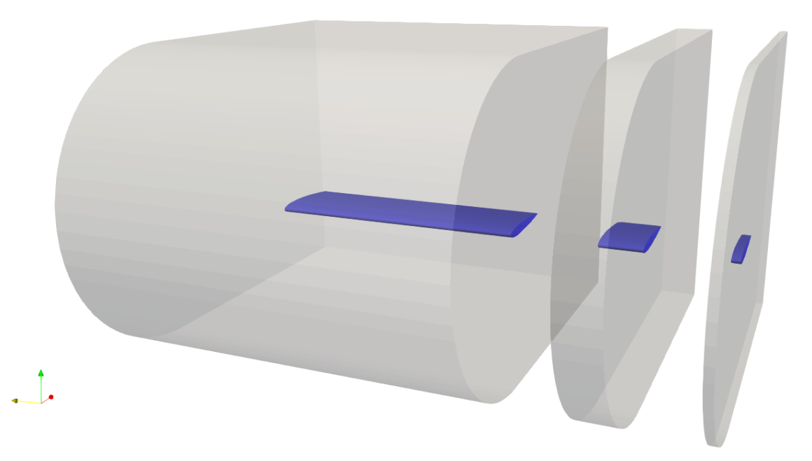
Mesh Generation with blockMesh Structured C-Mesh for airfoils and wings
v3 (23/08/2024)

Slide 2
Objectives
Generation of structured C-type grids for airfoils and wings
Mesh generation using blockMesh utility of OpenFOAM
Inputs: Airfoil coordinates file, wing shape file, and block structure
Outputs: blockMesh input files incl. vertices, blocks, edges, BCs…

Slide 3
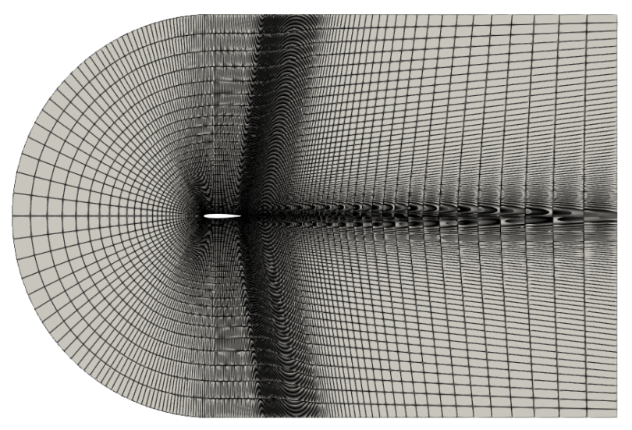
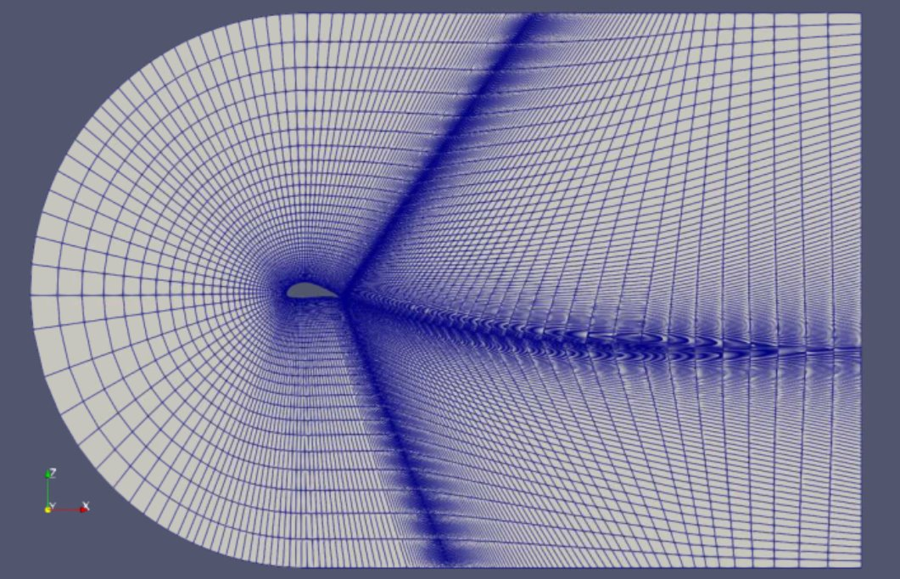
Examples
2D grid of NACA 0012 airfoil
2D grid of MegAWES Mrev-v2 airfoil

Slide 4
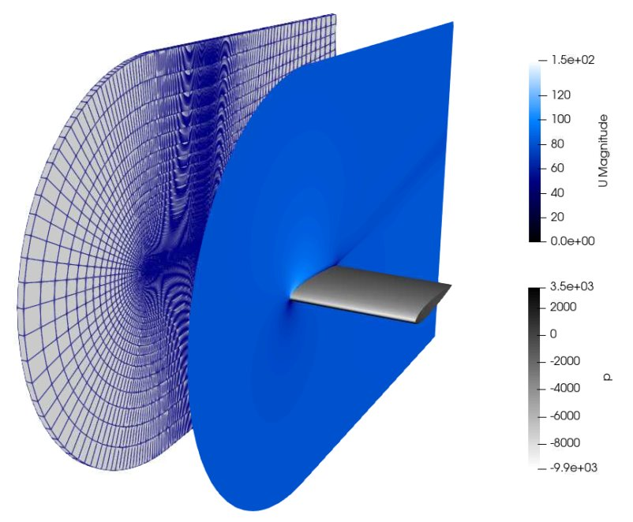
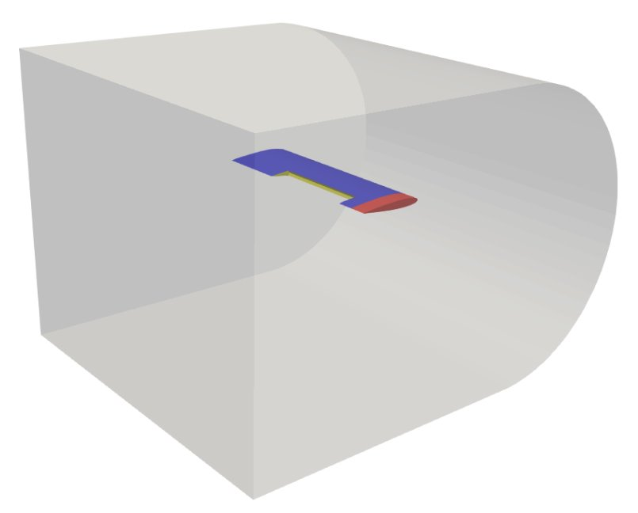
Examples
Half-wing with tip flow extension
Half-wing with aileron cut-off

Slide 5


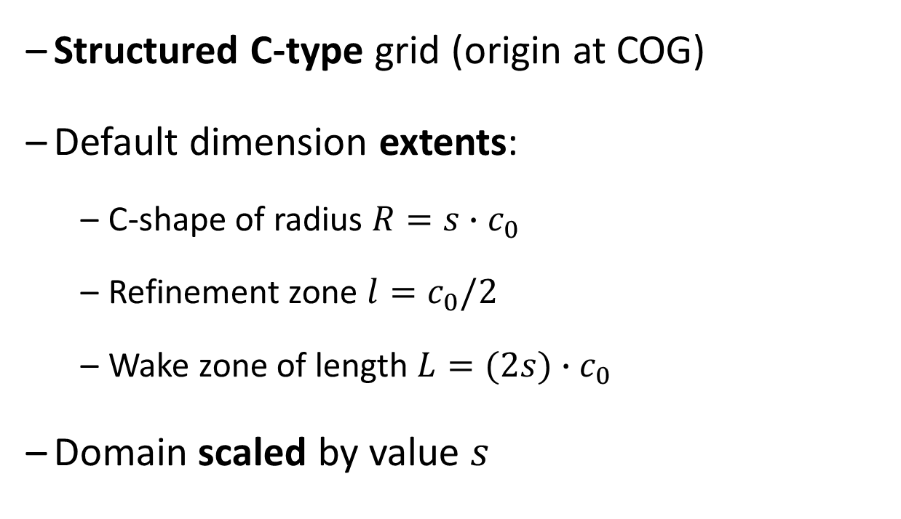



Mesh structure
Structured C-type grid (origin at COG)
Default dimension extents:
C-shape of radius $R={s∙c}_{0}$
Refinement zone $l=c_{0}/2$
Wake zone of length $L=(2{s)∙c}_{0}$
Domain scaled by value $s$
$$R=s∙c_{0}$$
$$L=(2s)∙c_{0}$$
×
$$c_{0}$$
$$l=c_{0}/2$$
Refinement zone is not scaled with $s$

Slide 6
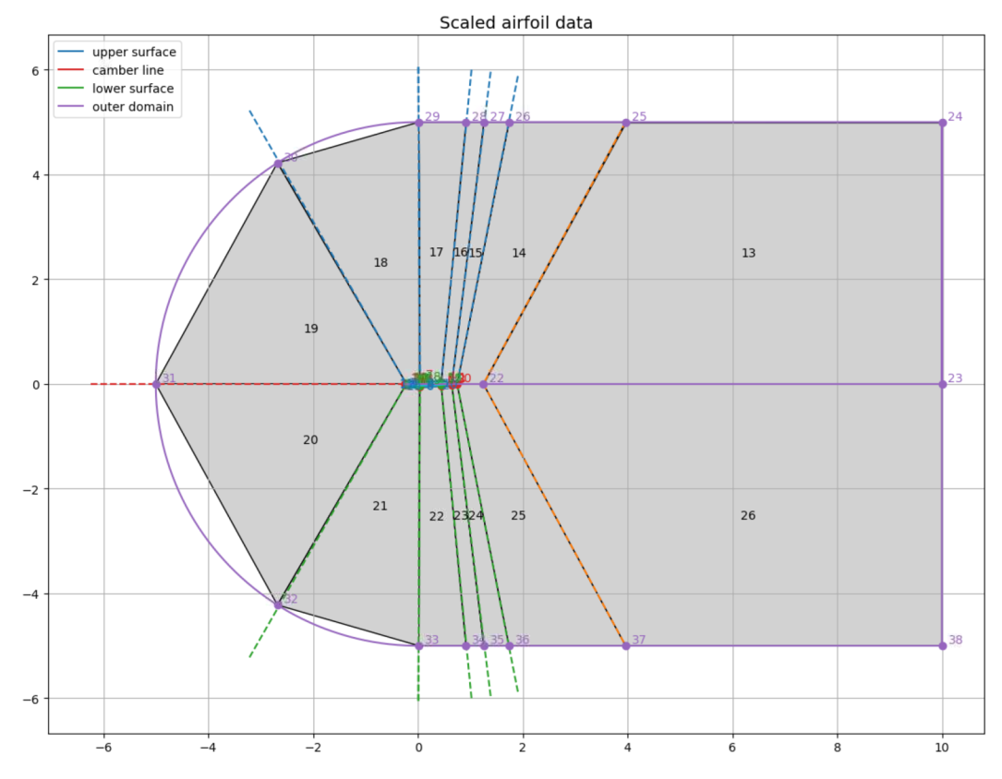
Mesh structure (2D layer structure)
Inside and outside of airfoil is meshed
Mesh structure controlled by
13 user-defined control points on airfoil
8 computed control points on airfoil
17 user-defined control points in domain
13 interior blocks and 14 exterior blocks

Slide 7
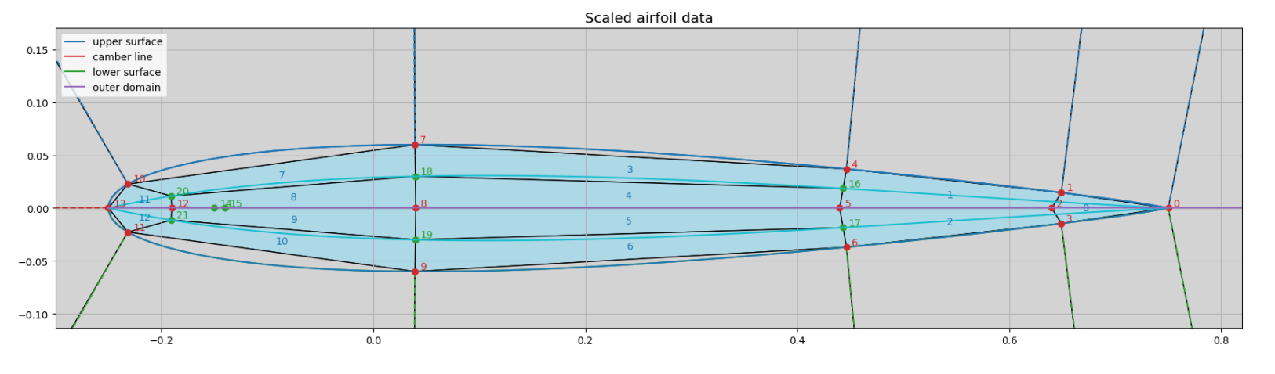
Structure control (airfoil inside)
14 user-defined control points (0-13) on airfoil
8 interpolated control points (14-21) on airfoil
13 interior blocks (0-12)
Blocks 0, 1, and 2 can be used for aileron cut-off

Slide 8
Structure control (airfoil outside)
17 user-defined control points (22-38) in domain
→ 14 exterior blocks (13-26)
Default values of control points 0-38 are provided for different C-mesh radii for both NACA0012 and Mrev-v2 airfoils

Slide 9
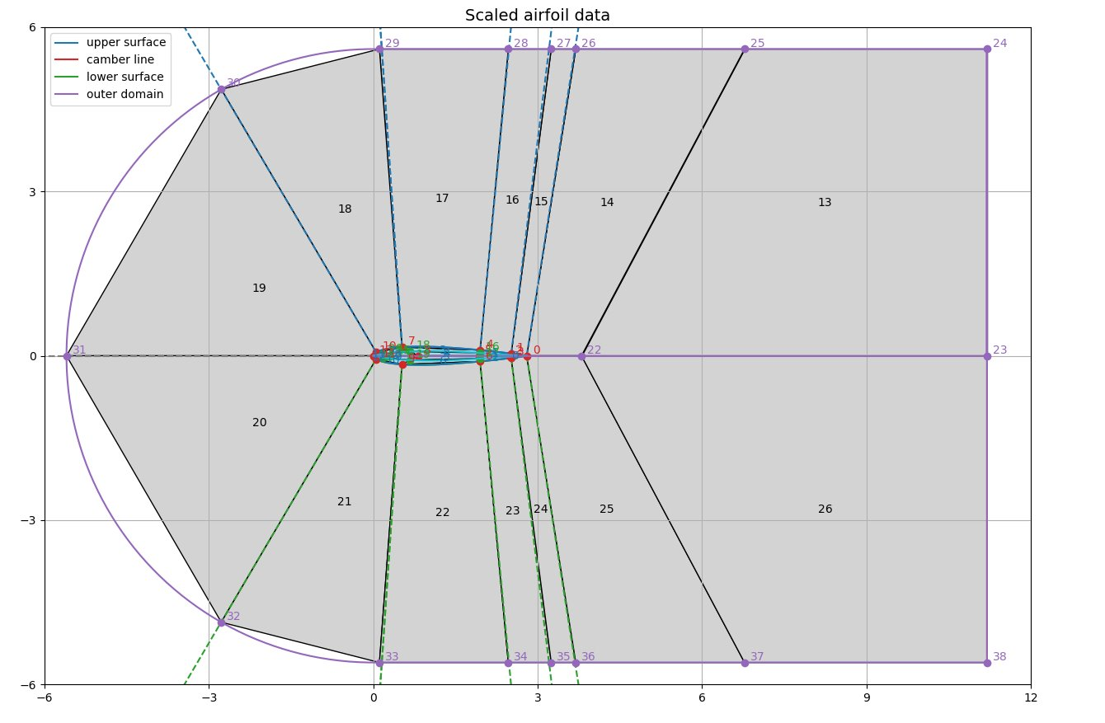










Grading
$$e0$$
$$e10$$
$$e9$$
$$e6$$
$$e5$$
$$e4$$
$$e7$$
$$e2$$
$$e1$$
Missing on Figure: e8
$$e3$$

Slide 10











Grading
$$e6$$
$$e5$$
$$e4$$
$$e3$$
$$e7$$
$$e7$$
$$e3$$
$$e4$$
$$e8$$
$$e6$$
$$e5$$
To ensure a smooth interface between blocks 1 and blocks 3 and 4, respectively 2 with 5 and 6, the resolution of edge e8 should be half of edge e3. Ideally, their gradings should also match.

Slide 11






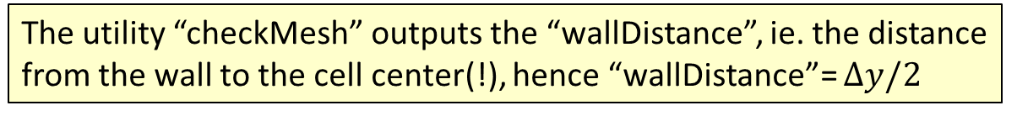


Default meshes
The utility “checkMesh” outputs the “wallDistance”, ie. the distance from the wall to the cell center(!), hence “wallDistance”= $∆y/2$
See file: /meshGeneration/default_files/default_cmesh_parameters.py
Meshes generated for ${Re}_{c}=6M$
Tuned for OpenFOAM requirements
Non-orthogonality, Aspect ratio…
Refinement for $y^{+}−AR$ combinations
FINE: $y^{+}≈1$, $∆y≈1∙{10}^{−5}$
MEDIUM: $y^{+}≈50$, $∆y≈5∙{10}^{−4}$
COARSE: $y^{+}≈500$, $∆y≈5∙{10}^{−3}$
$$NO<70°$$
$$γ$$
$$AR≈10−30$$
$$R$$
$$c/2$$
$$2R$$
$$AR≤100−250$$

Slide 12
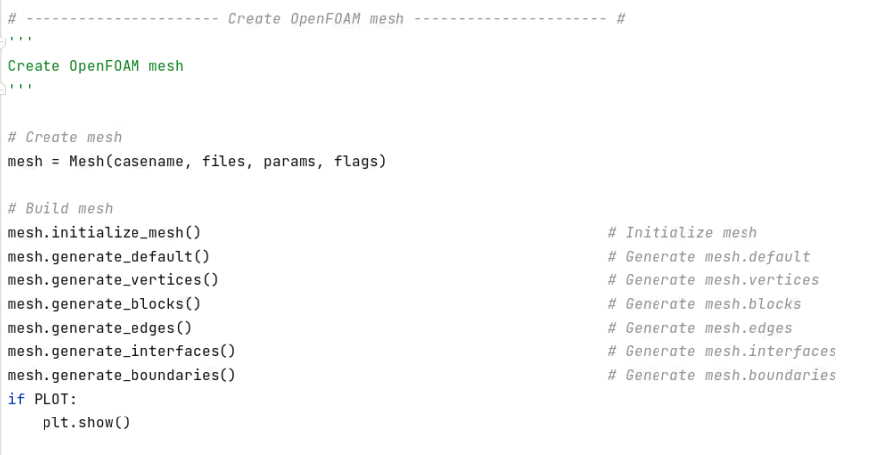
Mesh creation using the class “Mesh”
See files: /examples/generate_mesh.py and /meshGeneration/mesh_class.py
Step-by-step mesh creation
Easy for debugging

Slide 13
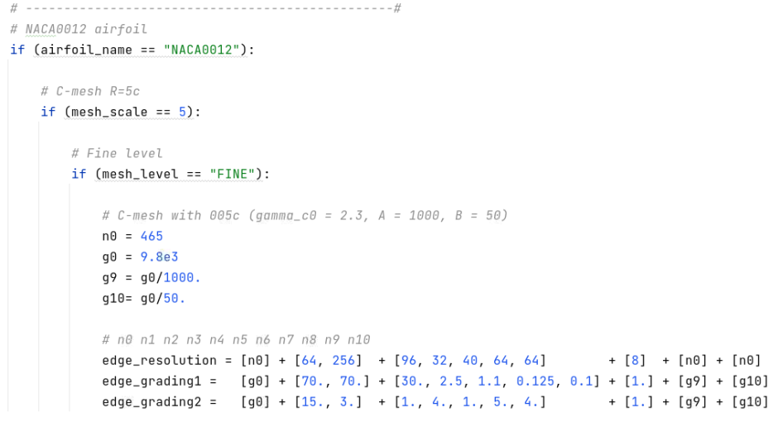

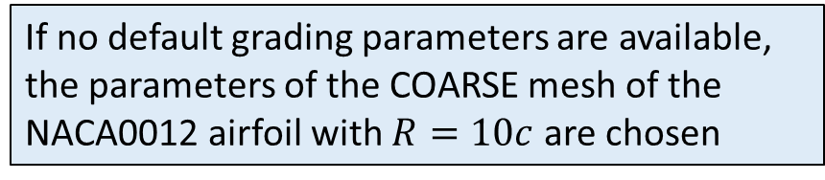
Default edge meshing
If no default grading parameters are available, the parameters of the COARSE mesh of the NACA0012 airfoil with $R=10c$ are chosen
See file: /meshGeneration/default_files/default_cmesh_parameters.py
Airfoil name from [“NACA0012”, “Mrev-v2”]
Mesh scale $R/c$ from [20,10, 5, 3, 1.5, 0.75]
Refinement level from [“FINE”, “MEDIUM”, “COARSE”]
Radial grading params
Wake grading params
Airfoil grading params

Slide 14
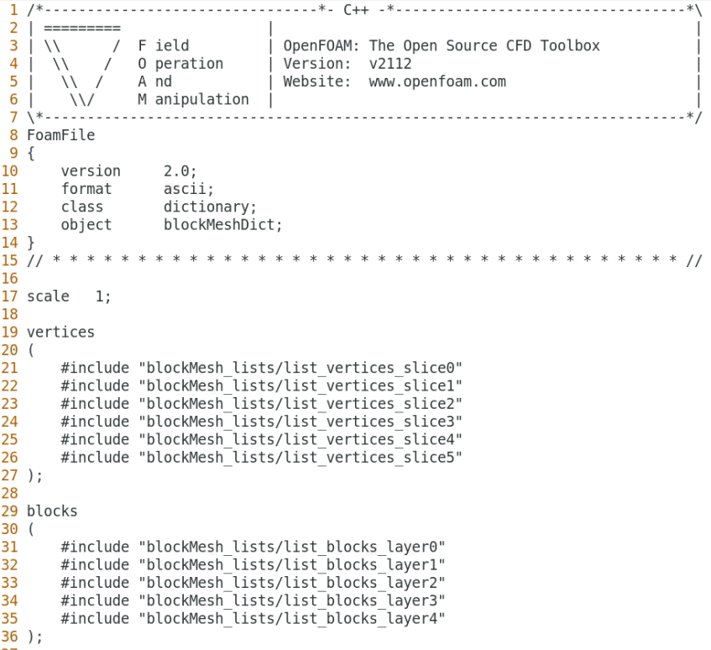
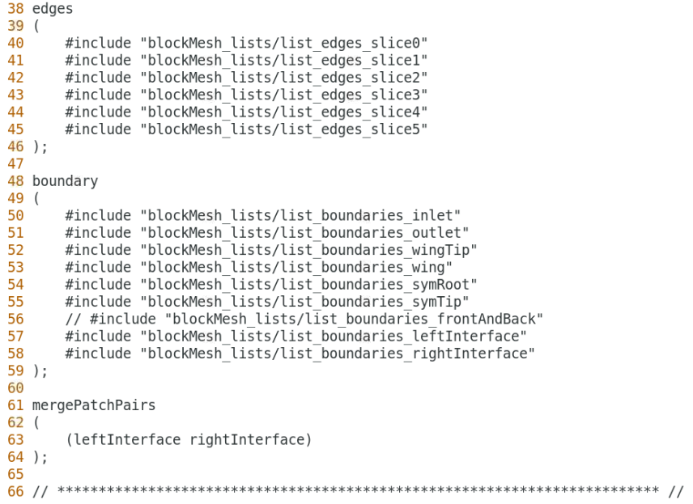
Mesh generation with blockMesh
See file: /openFoamMesh/system/blockMeshDict
Mesh with n slices and n-1 layers

Slide 15

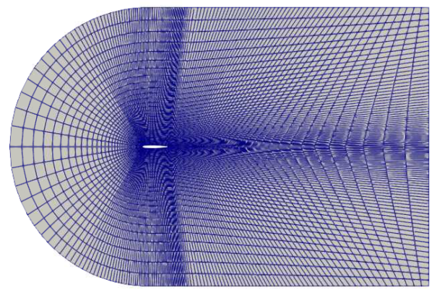
Complex block topologies: 2D airfoil

Slide 16
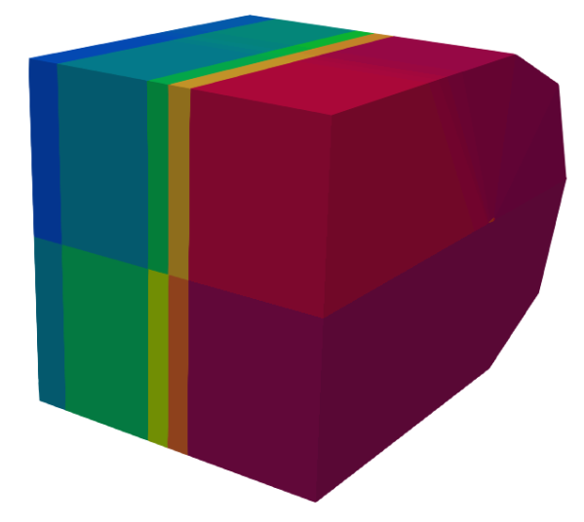
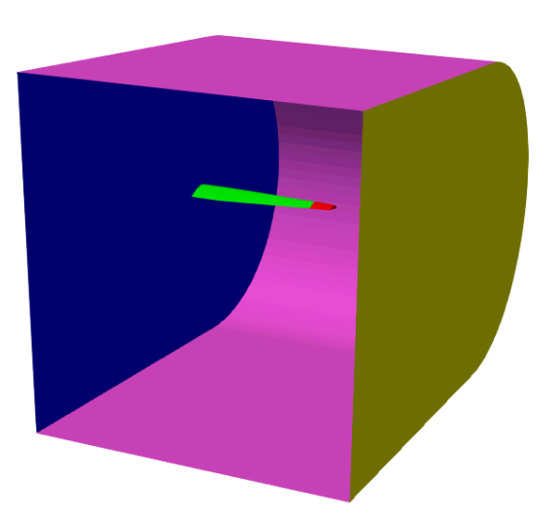
Complex block topologies: 3D wing
Block structure
Surface boundaries

Slide 17
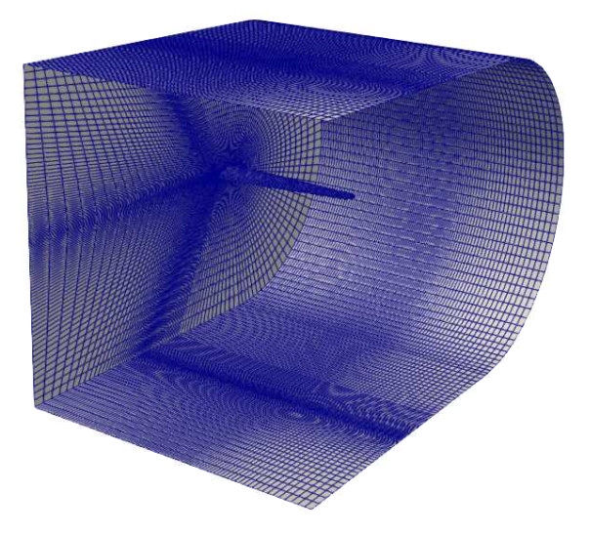
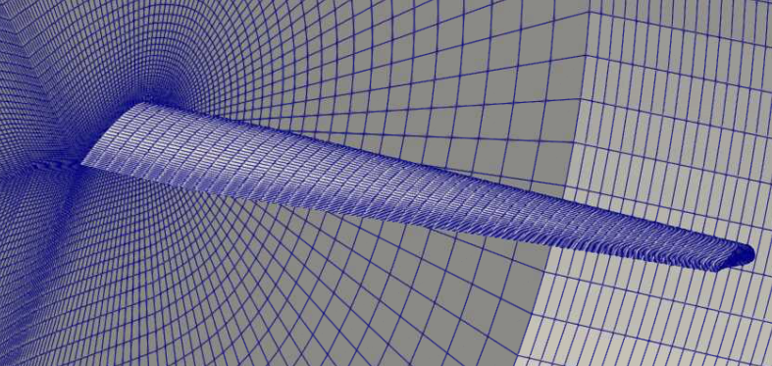
Complex block topologies: 3D wing

Slide 18
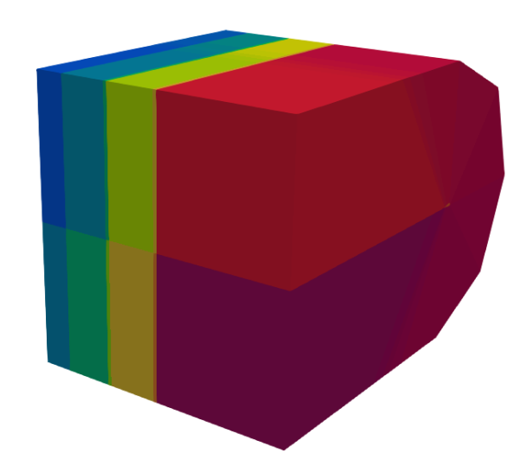
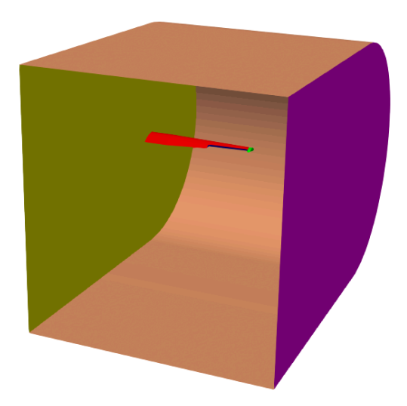
Complex block topologies: 3D wing + aileron
Block structure
Surface boundaries

Slide 19
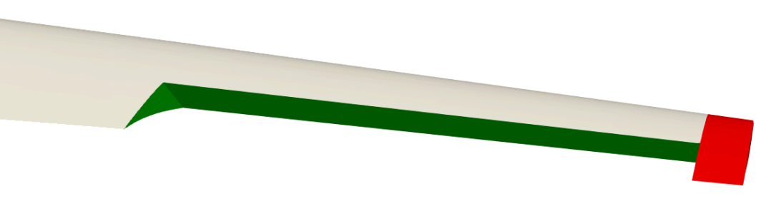
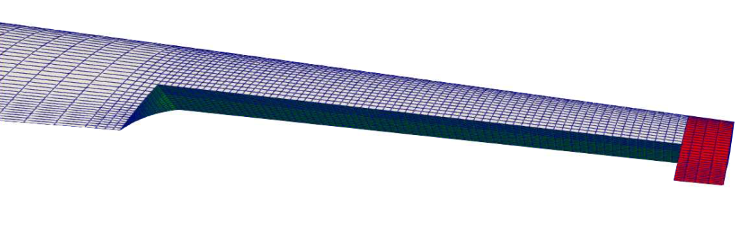
Complex block topologies: 3D wing + aileron

Slide 20
Workflow on the local cluster
Create mesh files with PyCharm (ml purge; ml PyCharm; pycharm.sh)
Set up the mesh parameters in Python in examples/mesh_generate*.py
Create mesh files with Python by running mesh_generate*.py
Generate mesh with OpenFOAM (ml purge; ml OpenFOAM/v2112-foss-2021b; source $FOAM_BASH)
Copy lists of vertices, blocks, edges to openFoamMesh/system/BMLists
Run blockMesh-procedure with scripts ./Allclean and ./Allrun.pre
You can run the commands in Allrun.pre manually if you prefer
Visualize the mesh in ParaView by loading file open.foam and blockFaces.vtp
Transform the OpenFOAM mesh to Fluent
Run command foamMeshToFluent within the folder openFoamMeshLoad Fluent (ml purge; ml ANSYS_CFD/2021R1)
Create new folder from fluentInterface and adapt the boundary conditions

