Slide 1
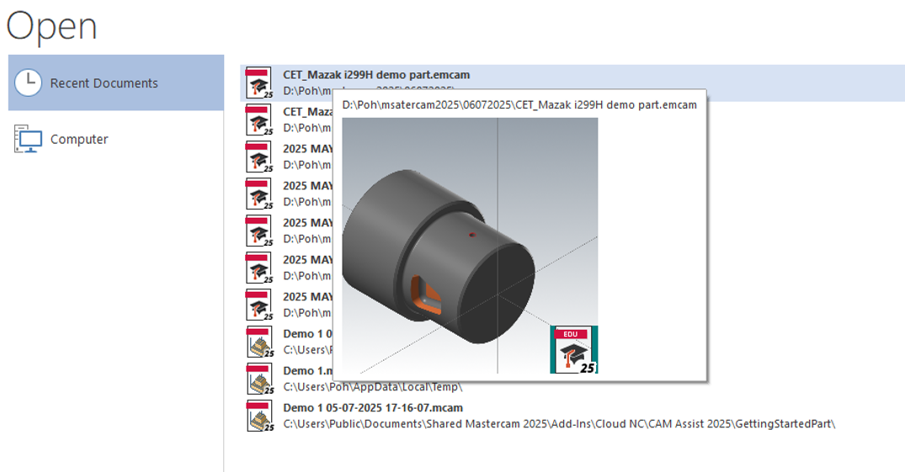
Open part file ready for machine set up

Slide 2
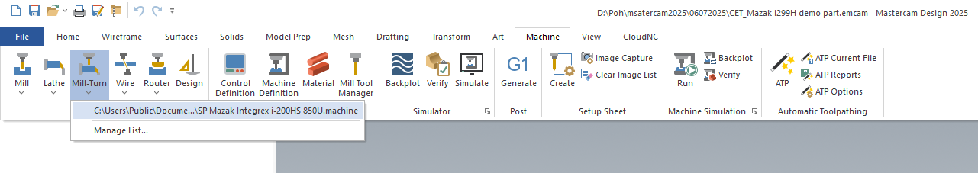
Select Machine Type

Slide 3
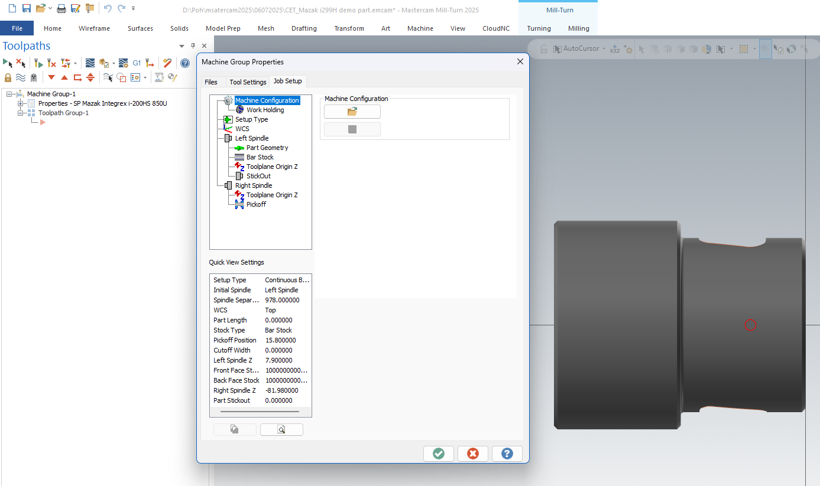
After selected machine Type the Machine Group Properties pop up
Now we need to setup all related items for Machine Group Properties before we can start to do the Toolpaths process

Slide 4
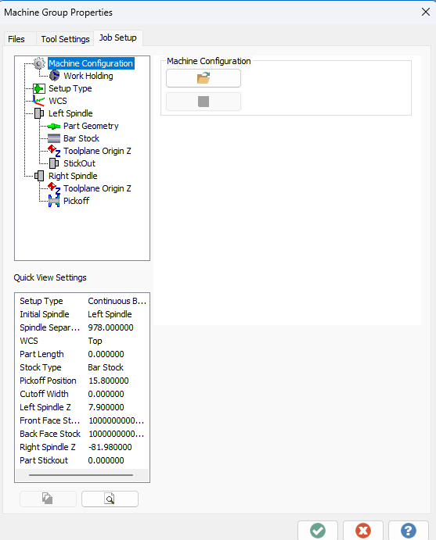
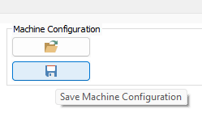

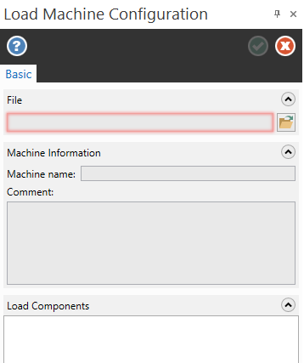

Just for information about Machine Configuration
If you have saved some existing machine configuration you can load it and use it and can save some setting time due less items need to modify.

Slide 5
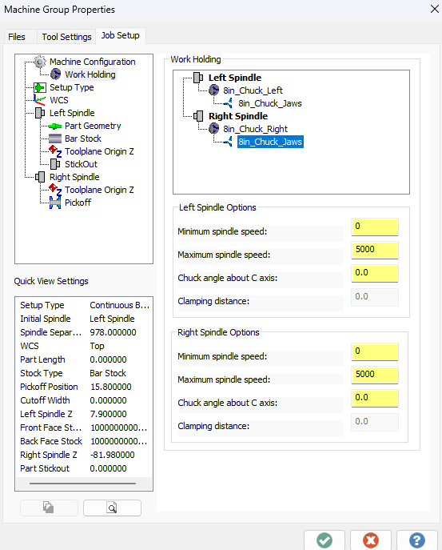
Select Work Holding to change the Left and right spindle chucks setting

Slide 6
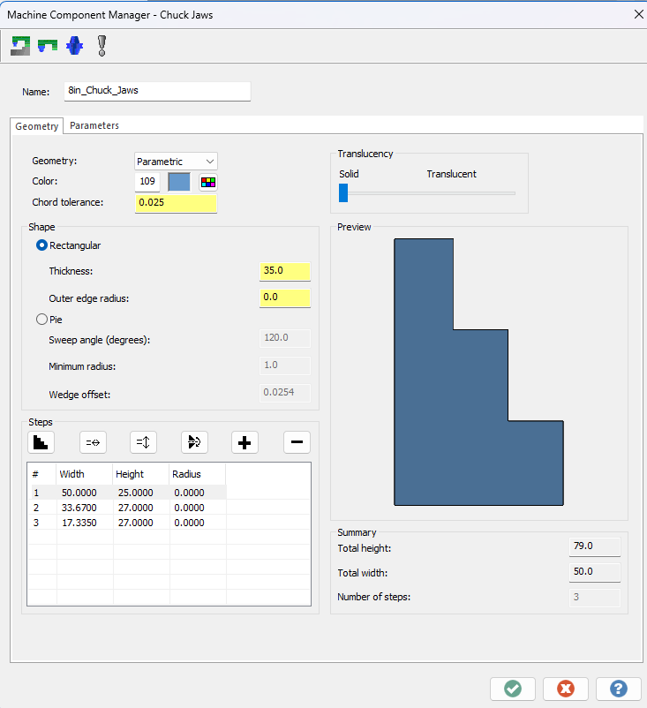
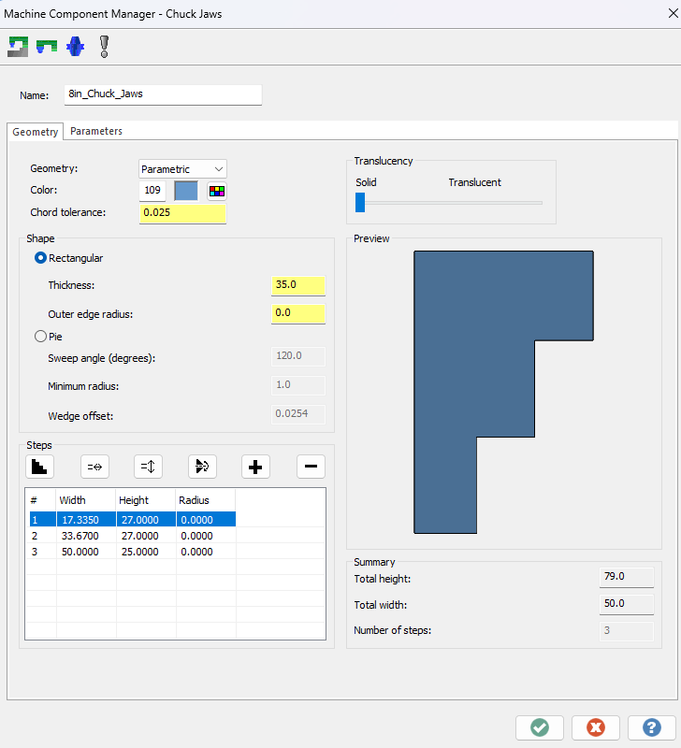
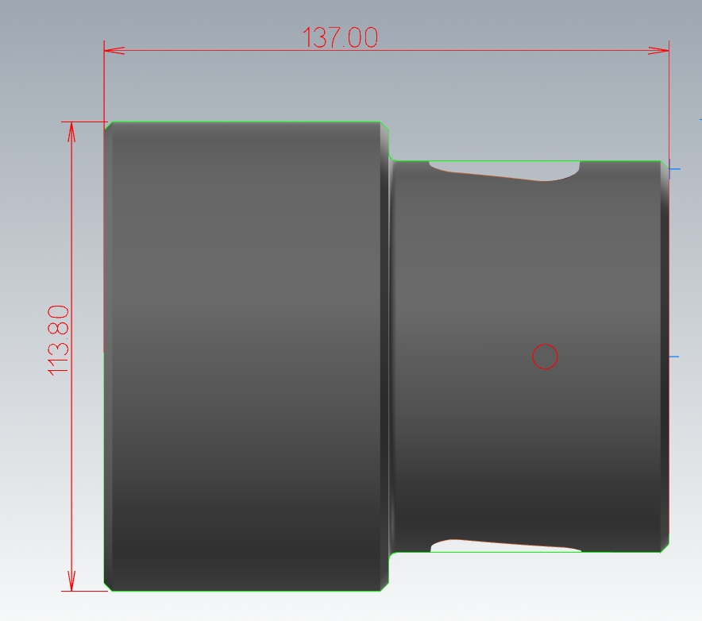
Set the Left Spindle Chuck as picture 2 parameters
Before
Picture 1
After
Picture 2

Slide 7
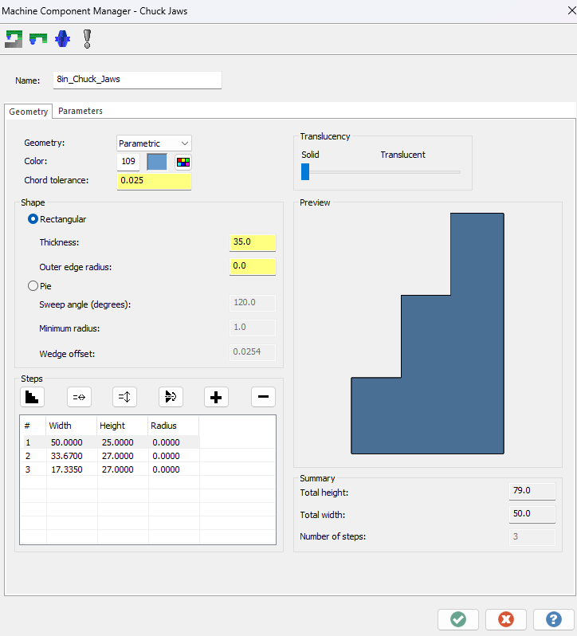
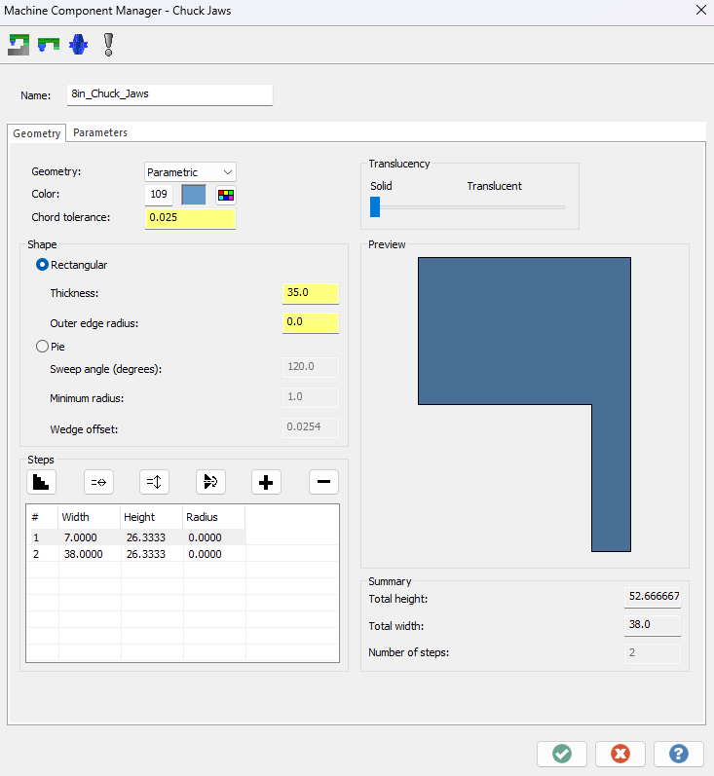
Set the Right Spindle Chuck as picture 2 parameters
Before
Picture 1
After
Picture 2

Slide 8

Change Max speed for Left and Right spindle to 2500

Slide 9
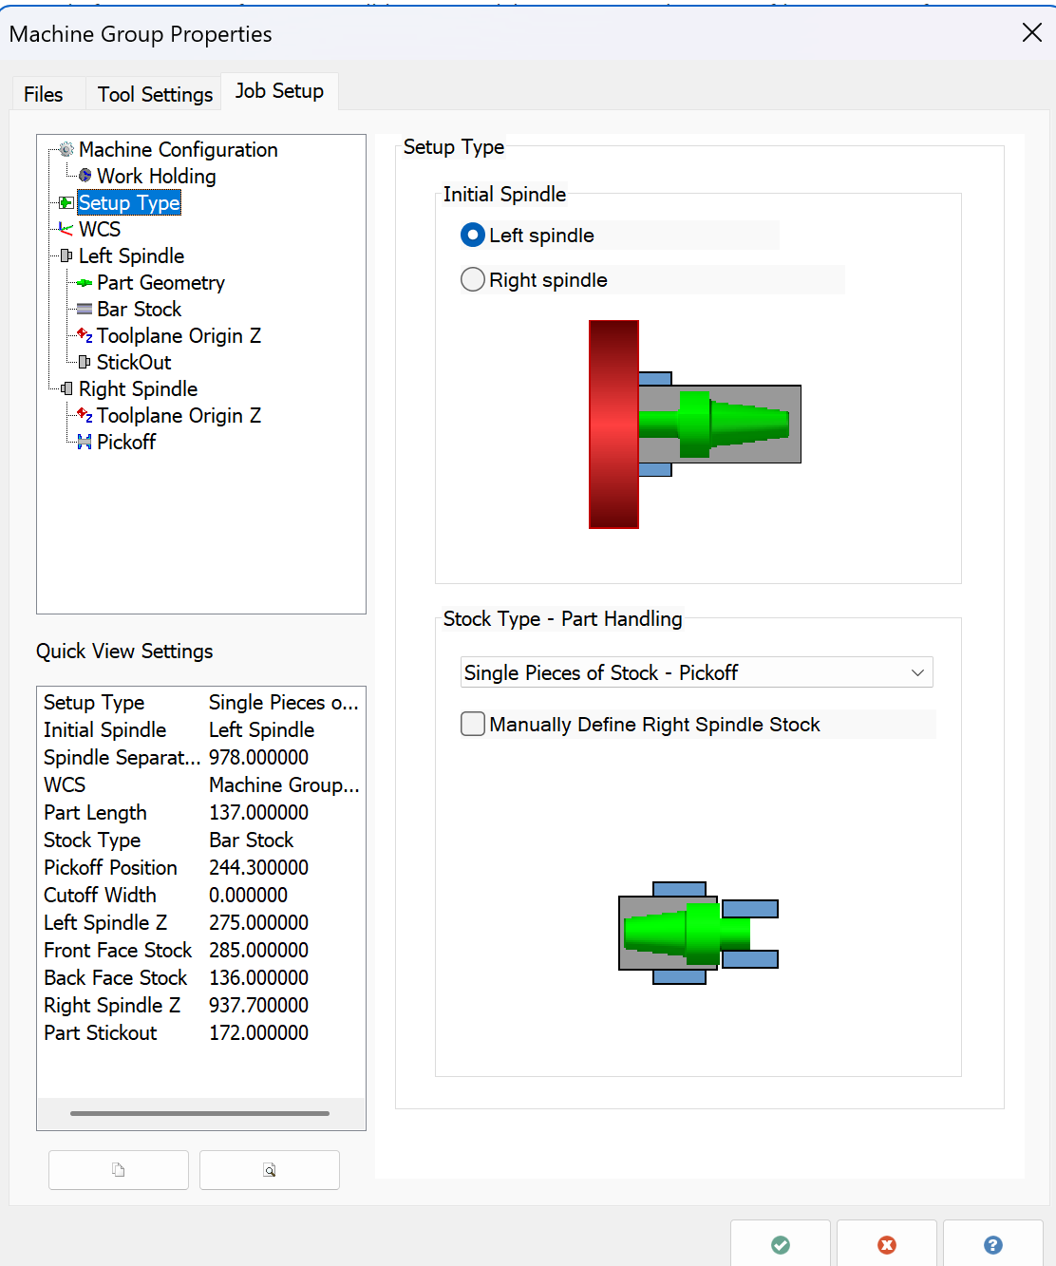



Set the Setup Type as show at below picture

Slide 10
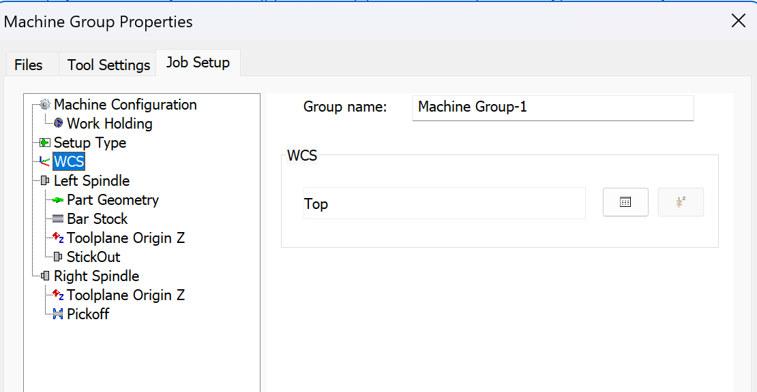
Set WCS to Top

Slide 11
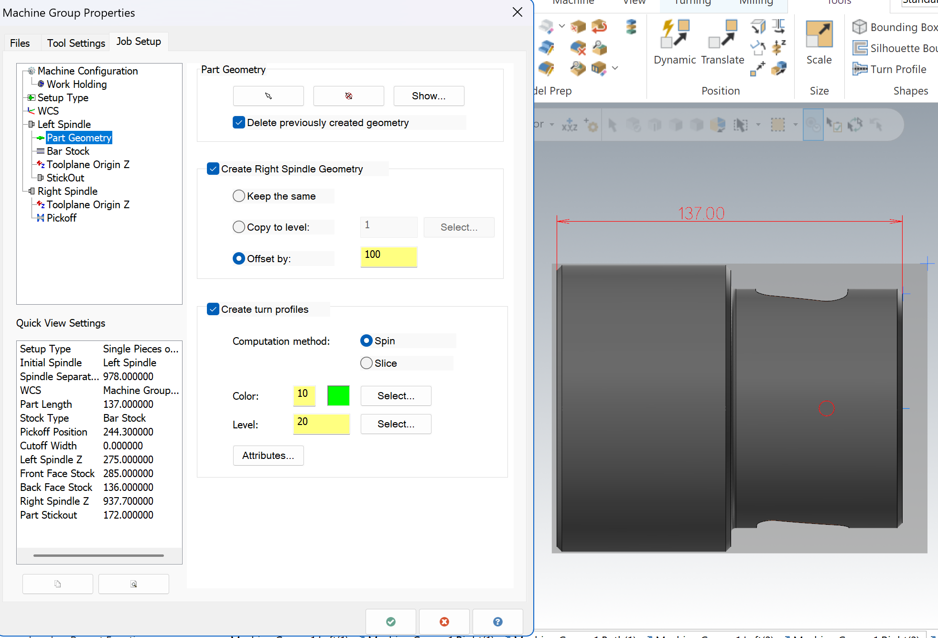
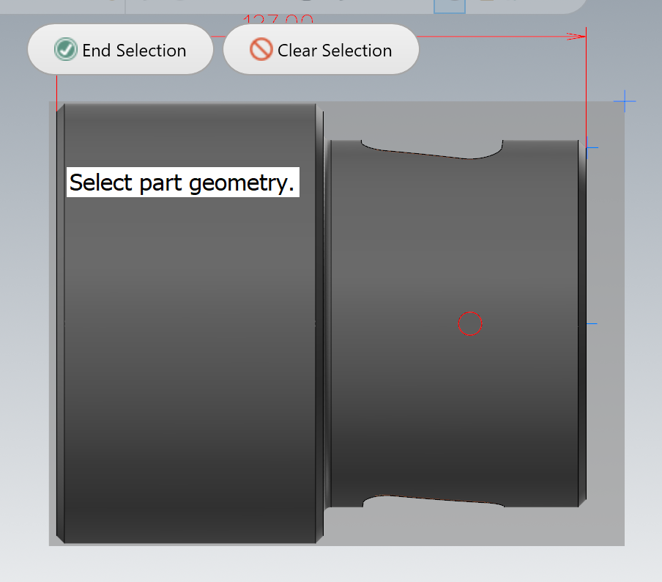
Set the Left Spindle for Part Geometry
1.) select the Arrow
2.) Click on the workpiece
3.) End Selection and the rest just follow as picture show .

Slide 12
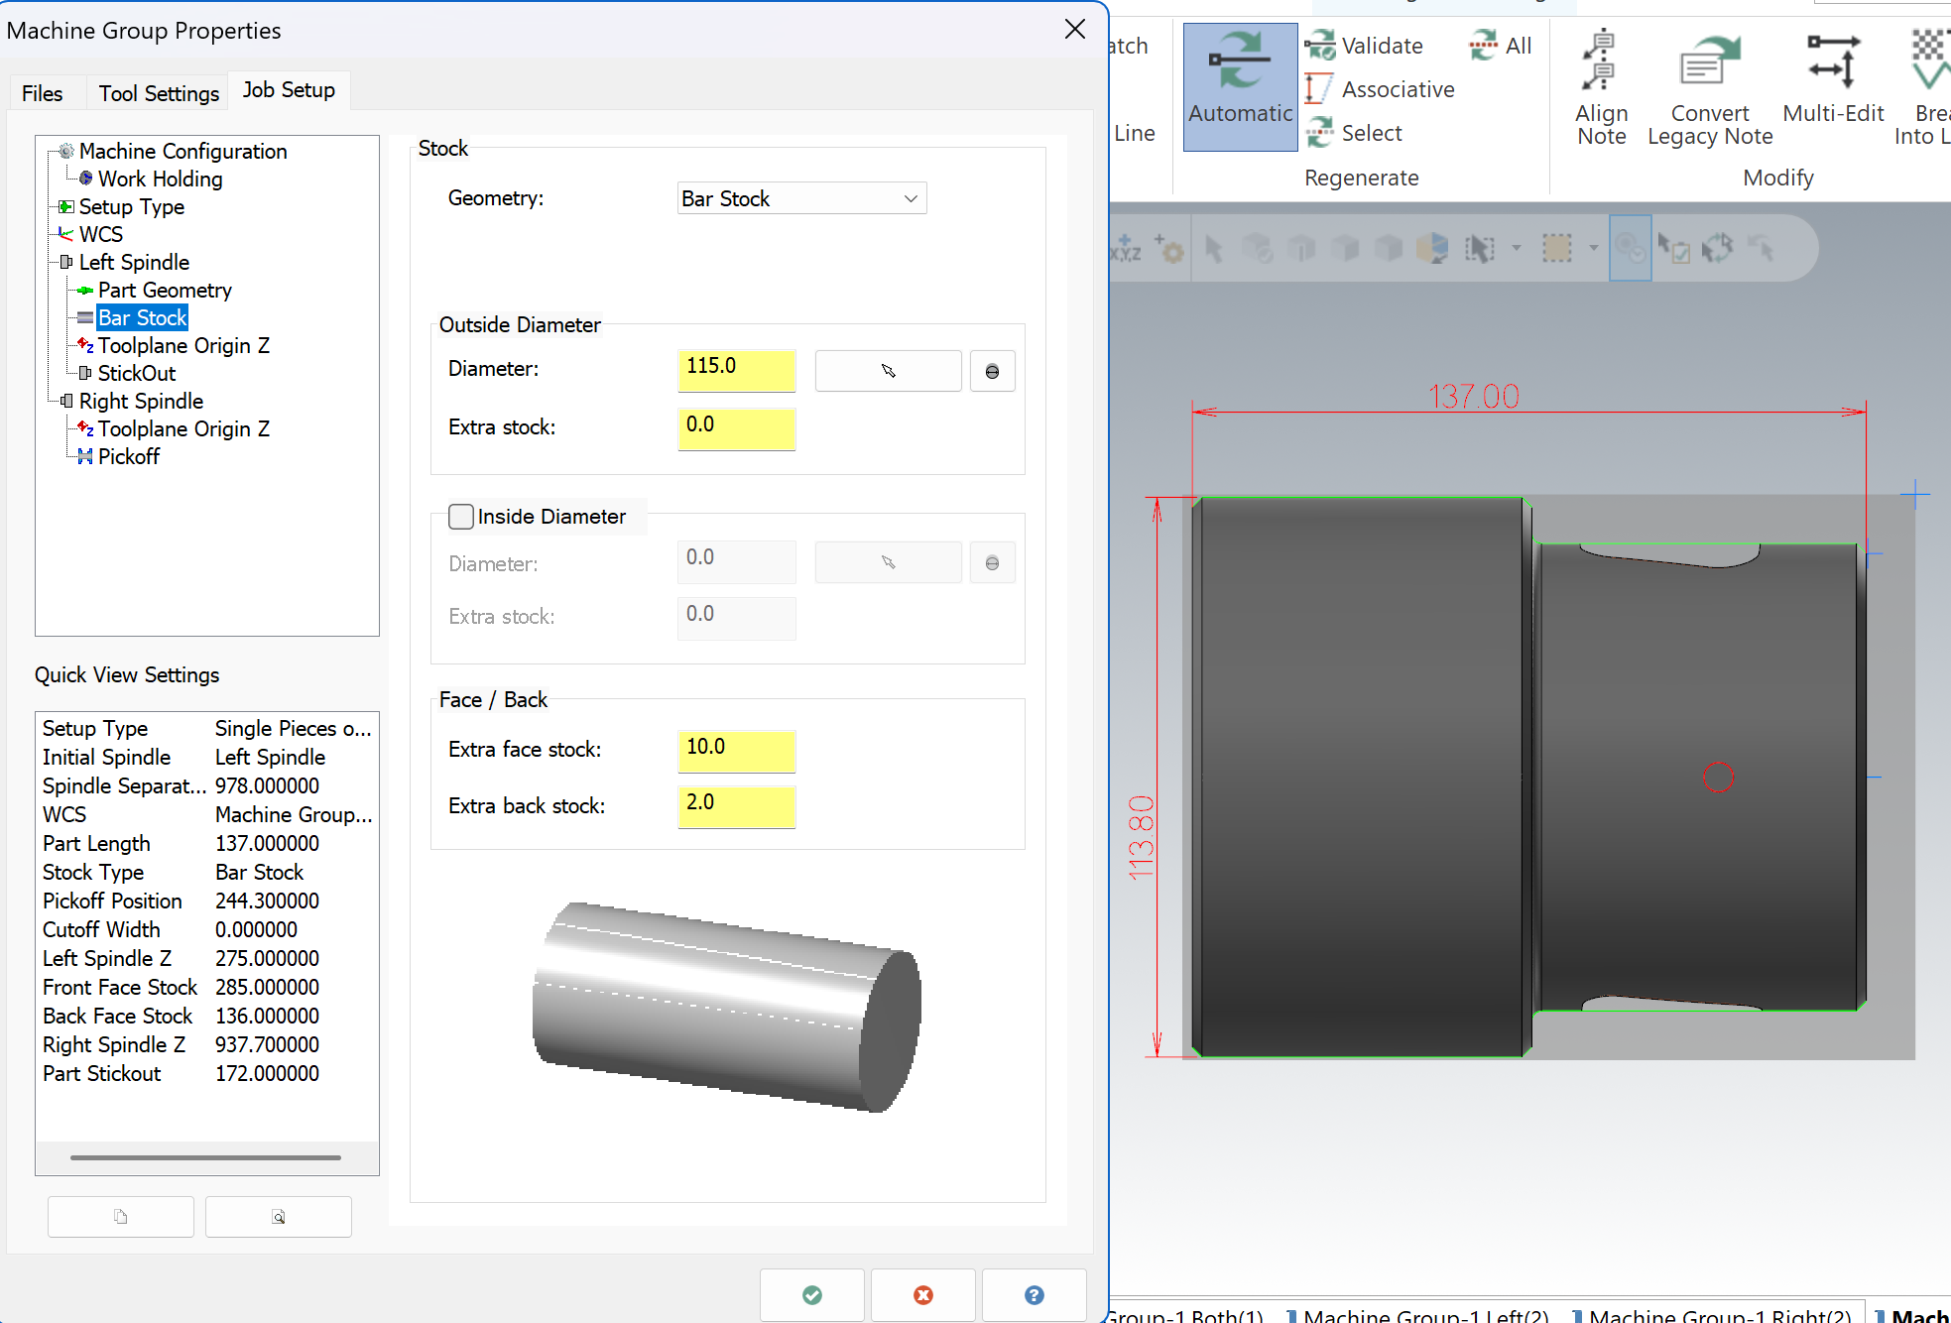
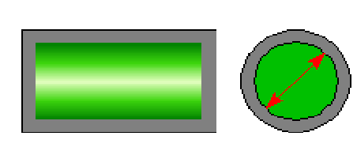
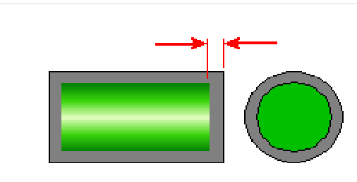
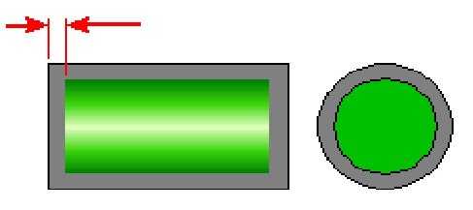
Set Bar Stock Size accordingly show as the picture

Slide 13
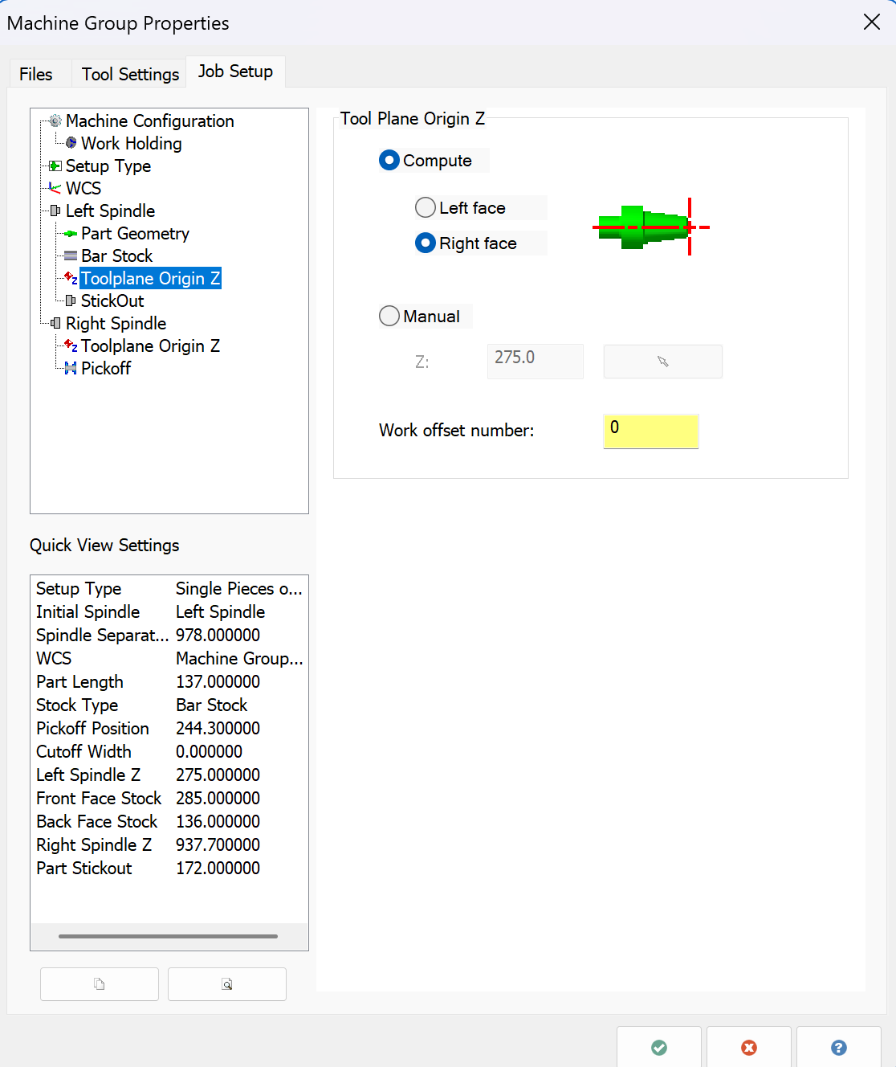
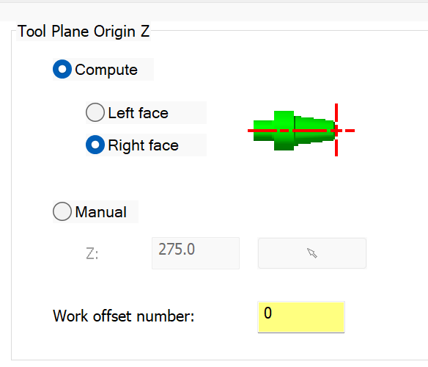

Set Toolplane Origin Z as below picture
Work offset number Zero (0) is for G54

Slide 14
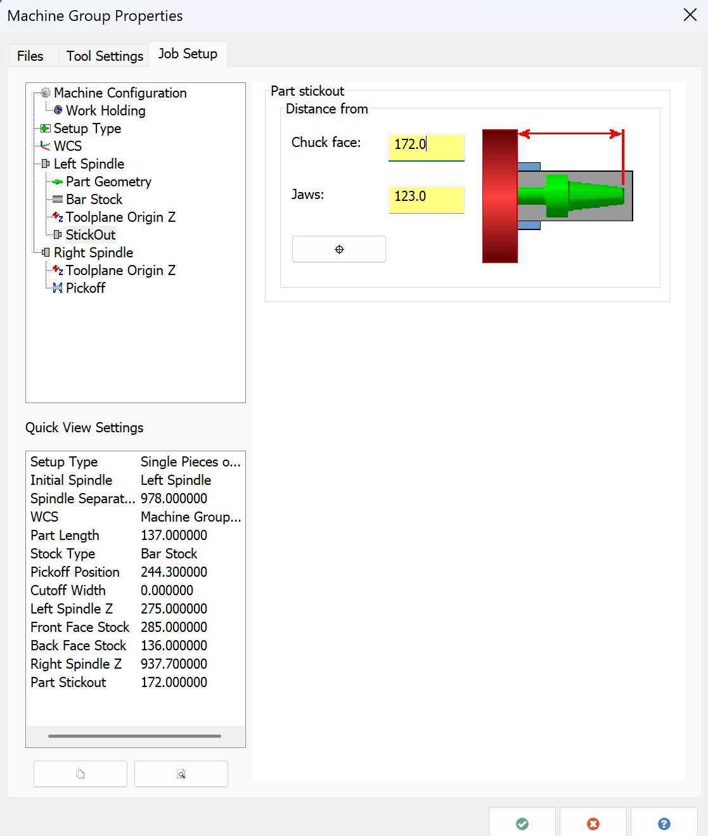
Set Stickout length as picture show

Slide 15
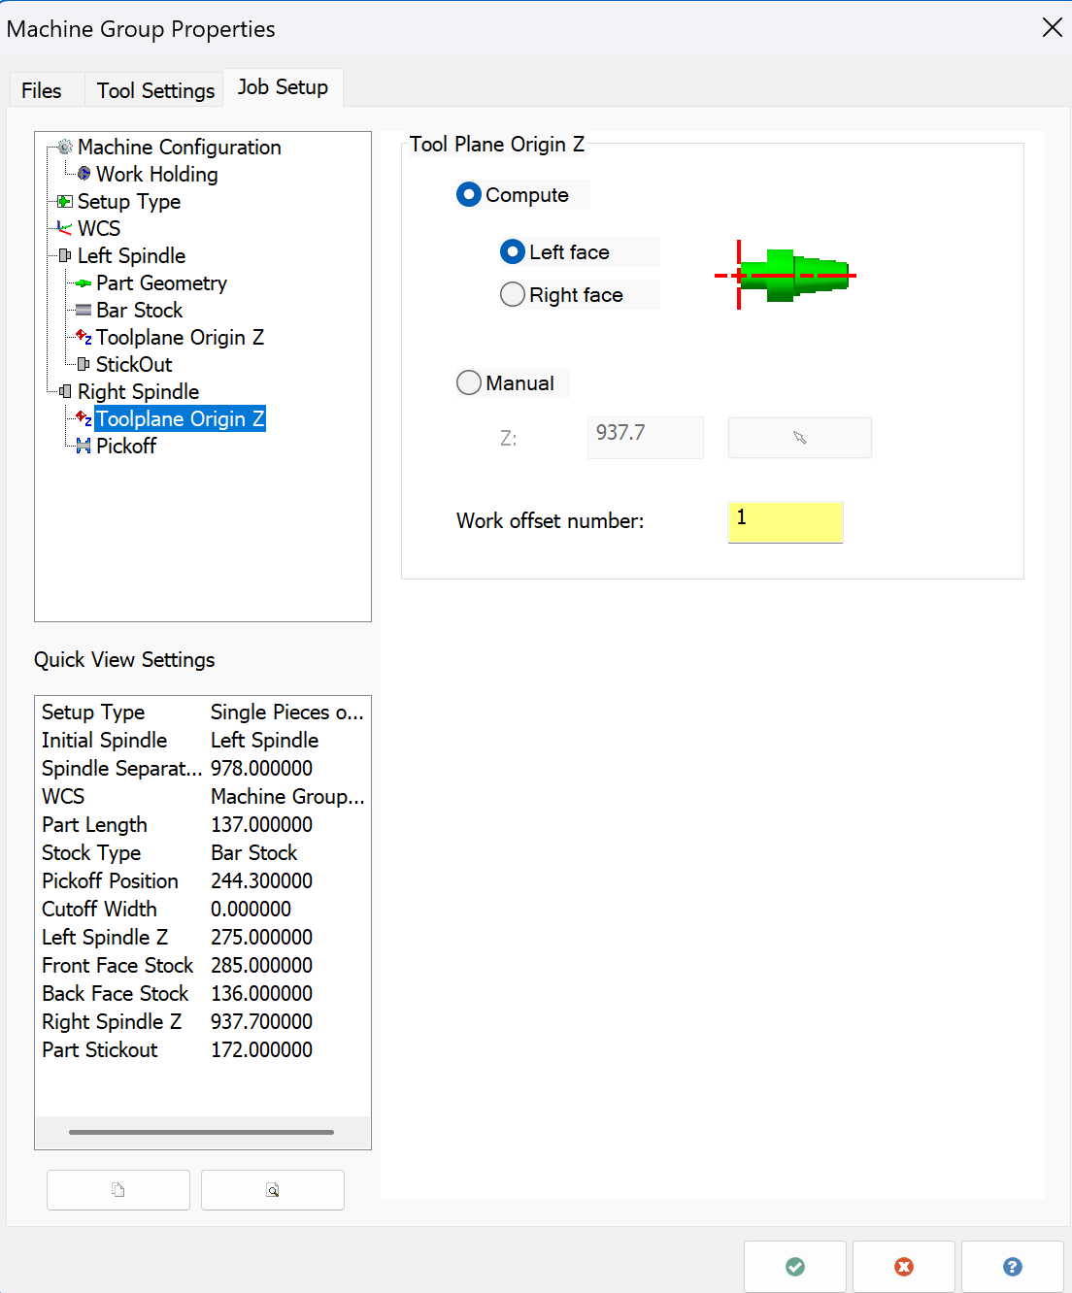
Set Right Spindle Toolplane Origin Z as picture below
Work offset number one(1) is for G55

Slide 16
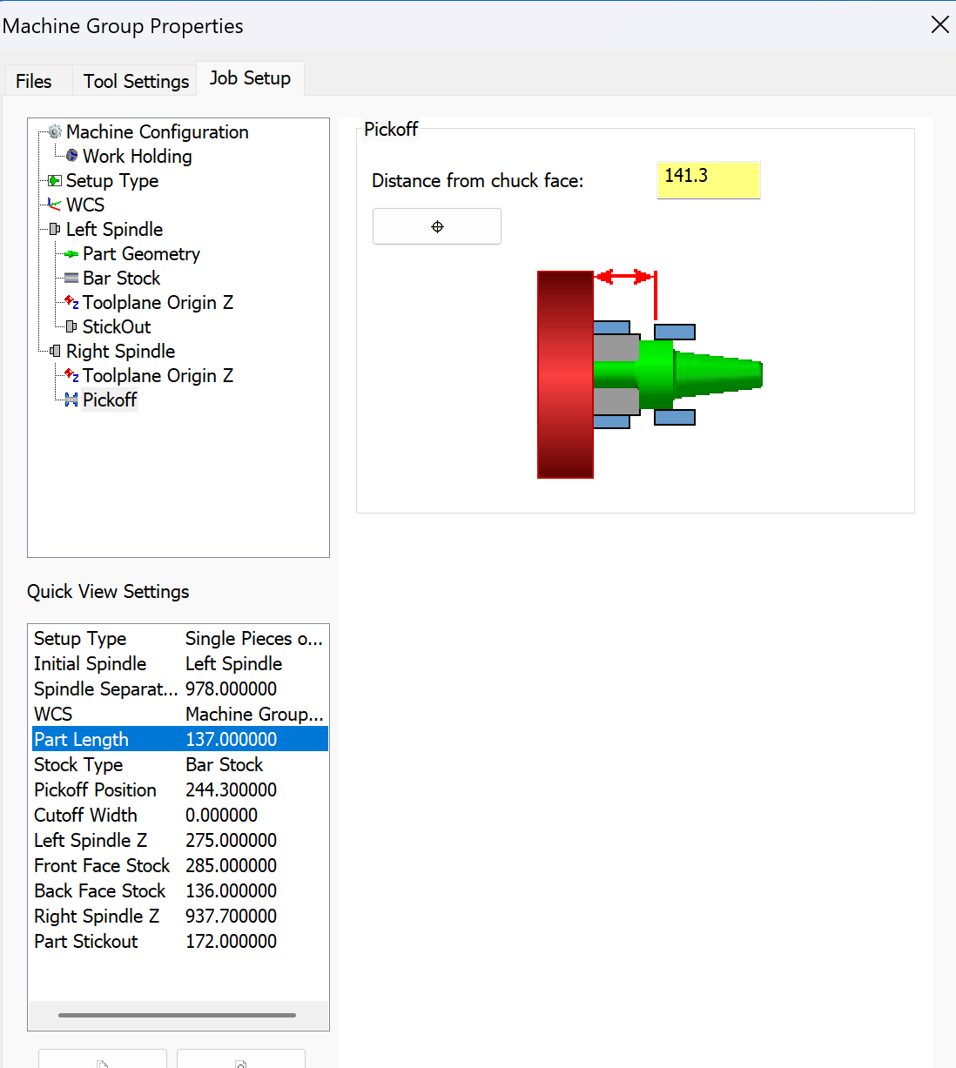
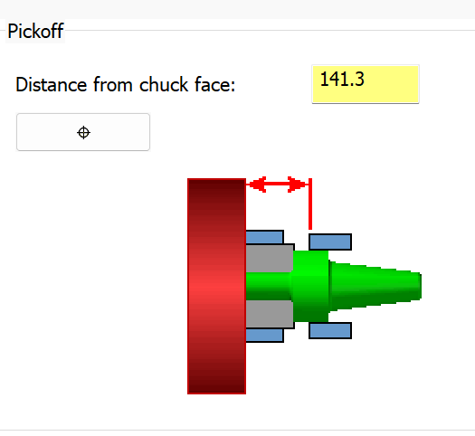
Set the Right Spindle pickoff point value as show on the picture

Slide 17
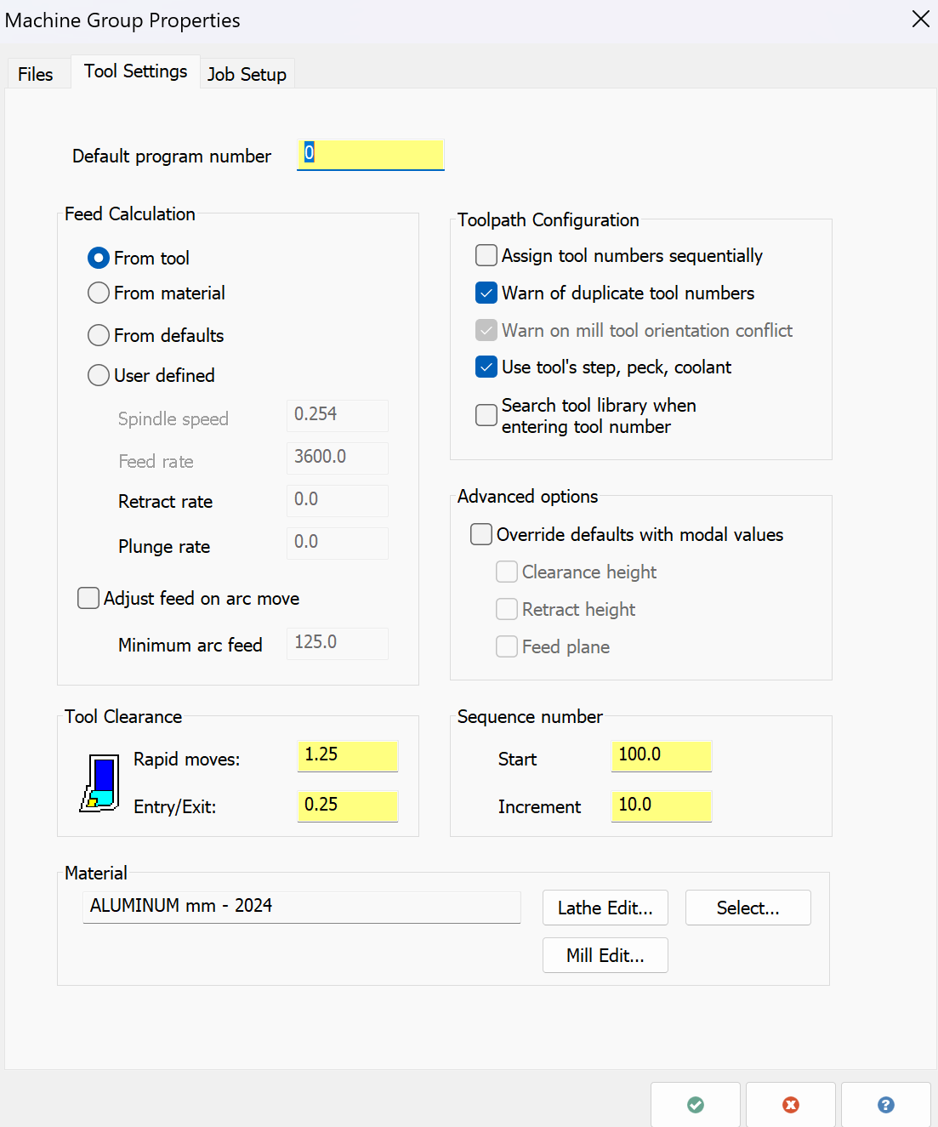
Prepare Tooling and ready to Cut
Check items needed accordingly from the picture

Slide 18
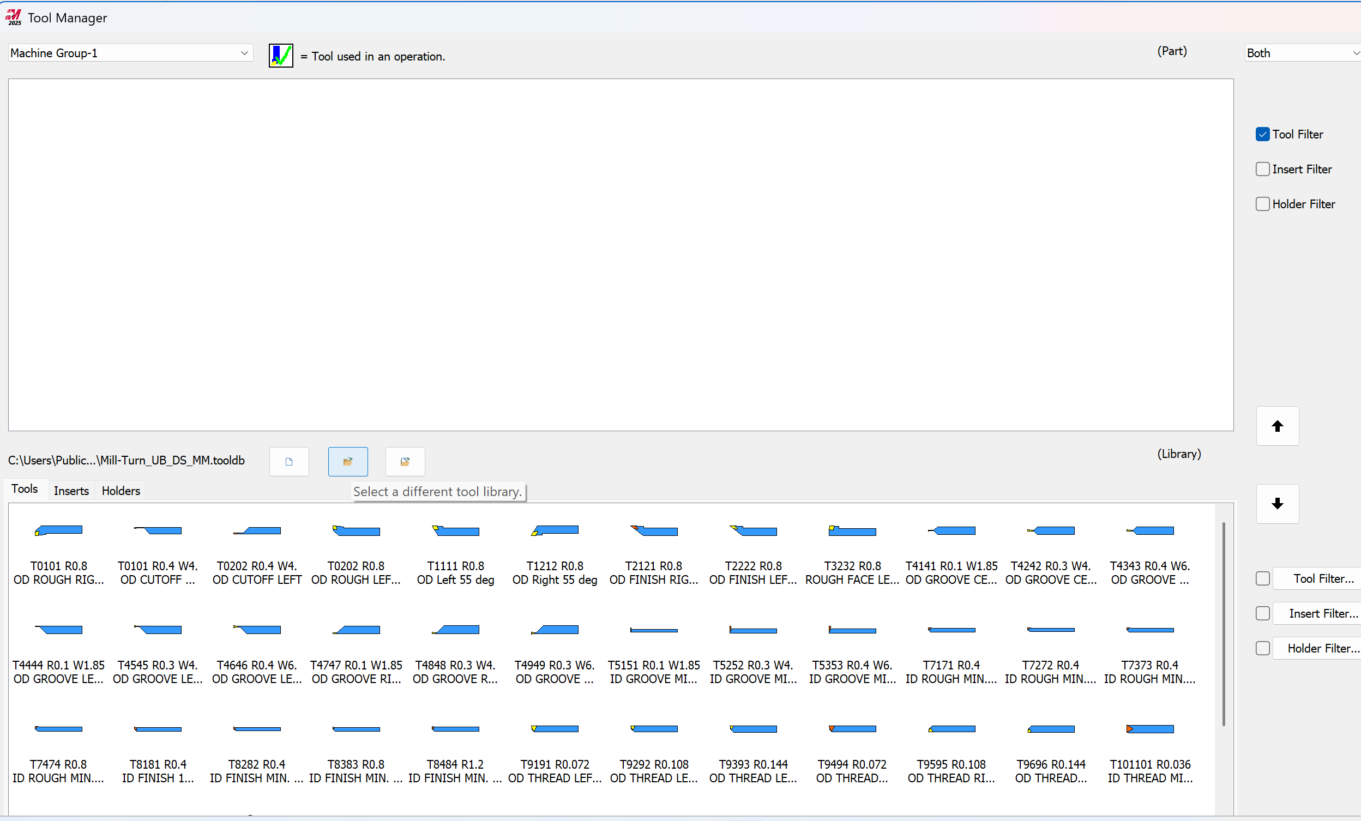
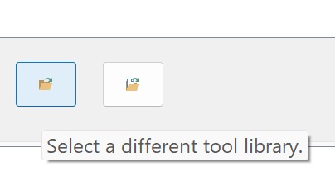
Select Tool library (CET_AND_PET_MT.TOOLDB) for this project

Slide 19
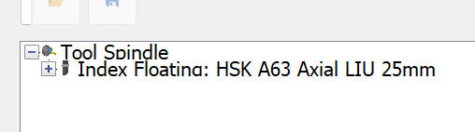
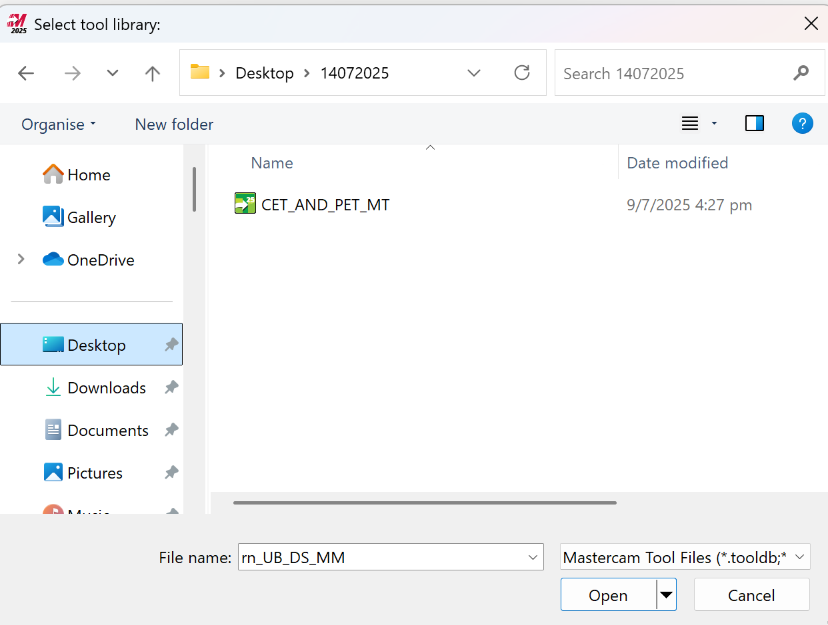
Select Tool library (CET_AND_PET_MT.TOOLDB) for this project

Slide 20
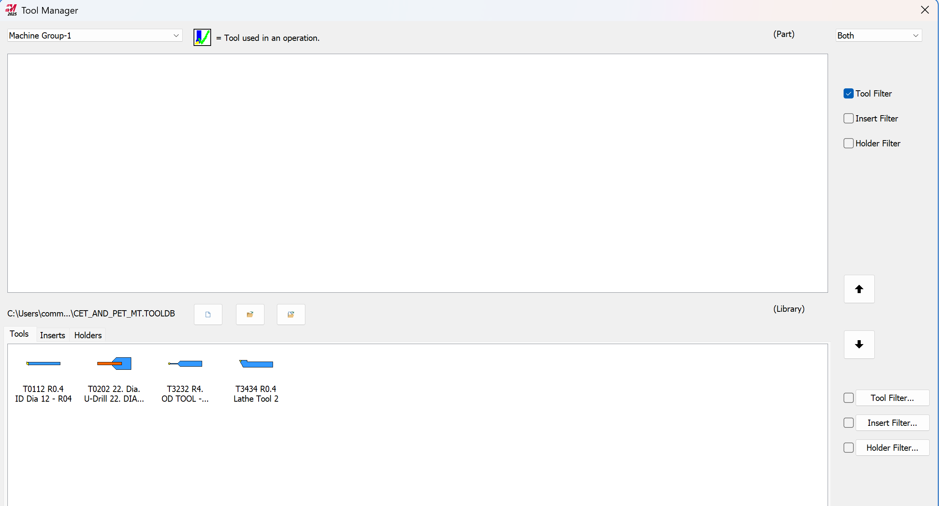
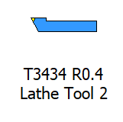
Drag T3434R0.4 Lathe Tool to Tool Manager window
Tool Manager window
Drag T3434R0.4 Lathe Tool

Slide 21
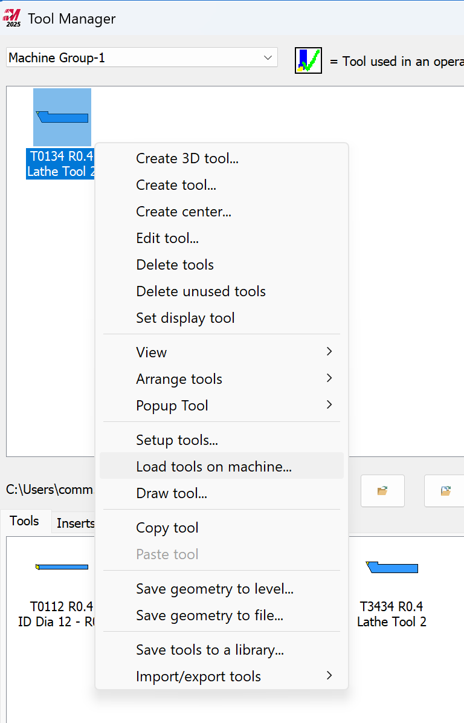
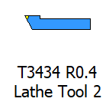

Right click and select Load tool on machine

Slide 22
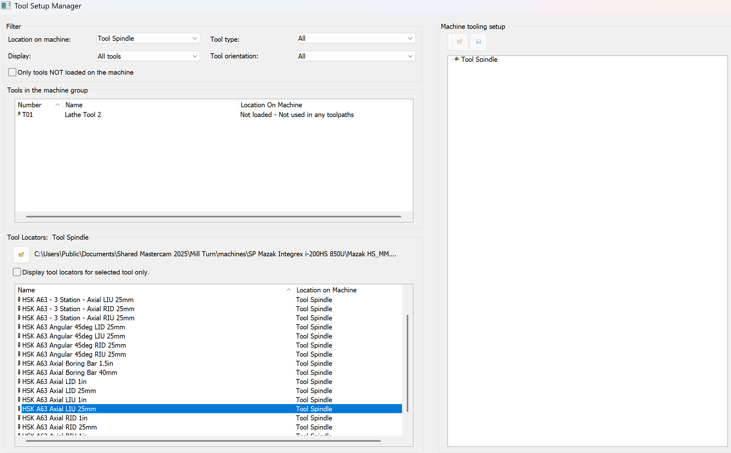


Drag HSK A63 Axial LIU 25mm holder to Tool Spindle location
Drag HSK A63 Axial LIU 25mm to Tool Spindle location

Slide 23
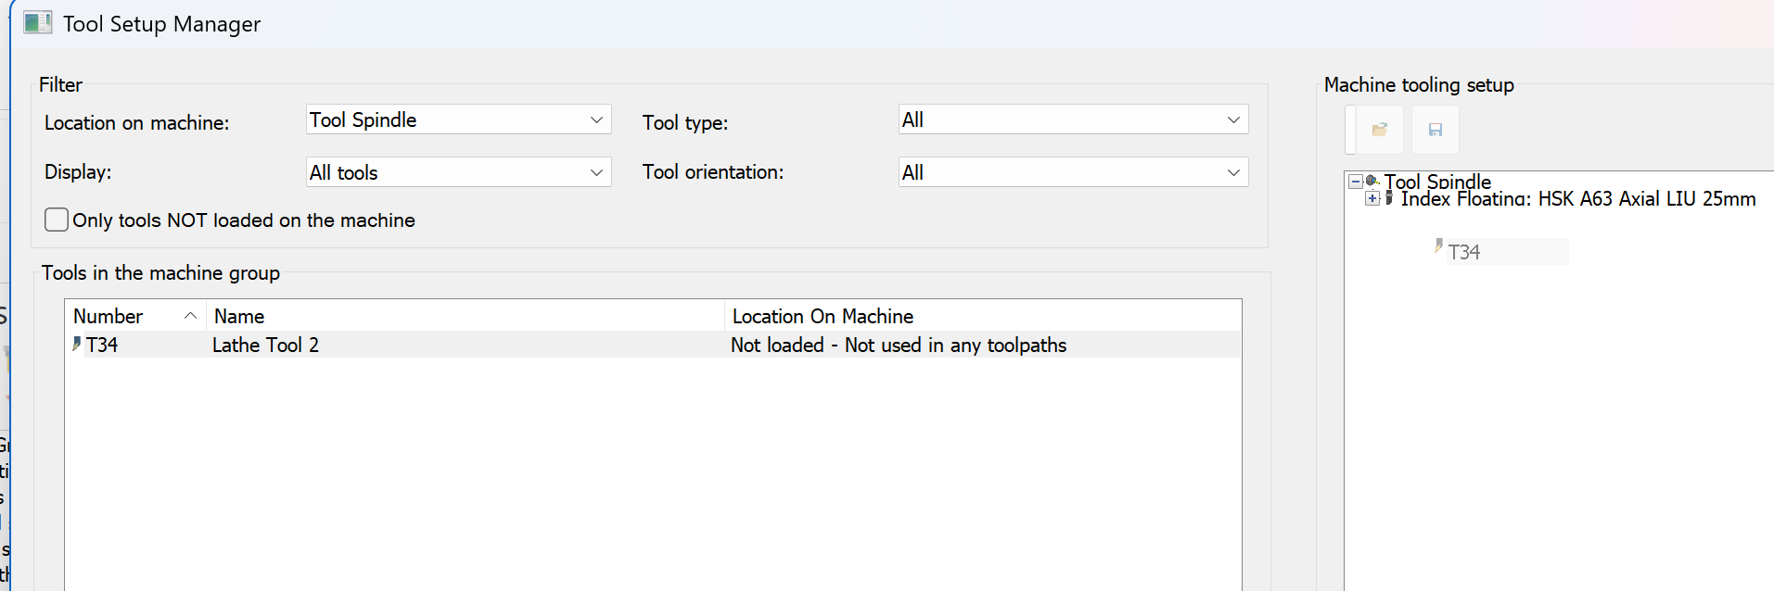
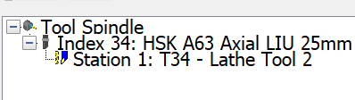
Drag T34 OD Tool to Tool Index Floating location
Drag T34 to Index Floating location

Slide 24
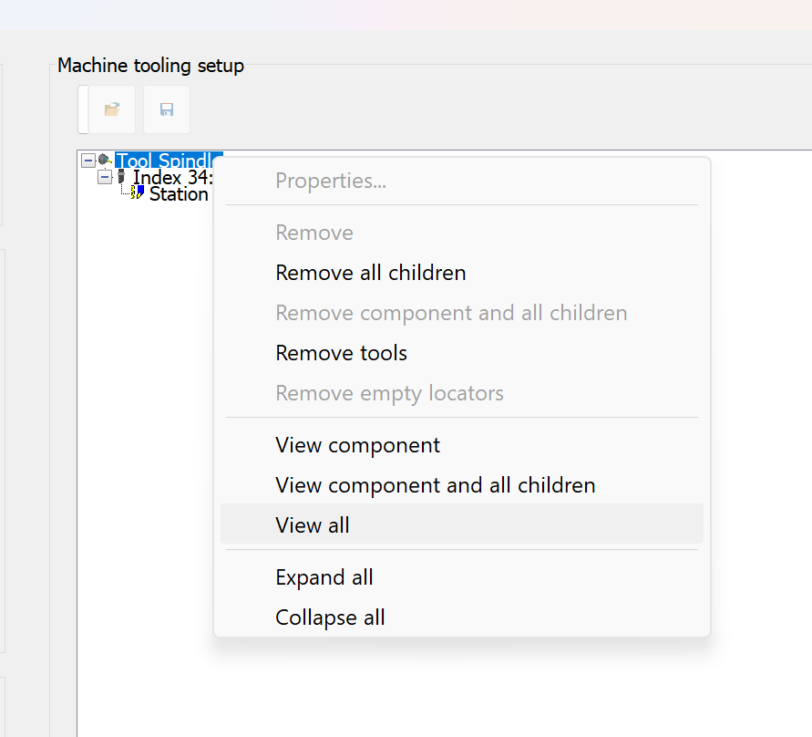
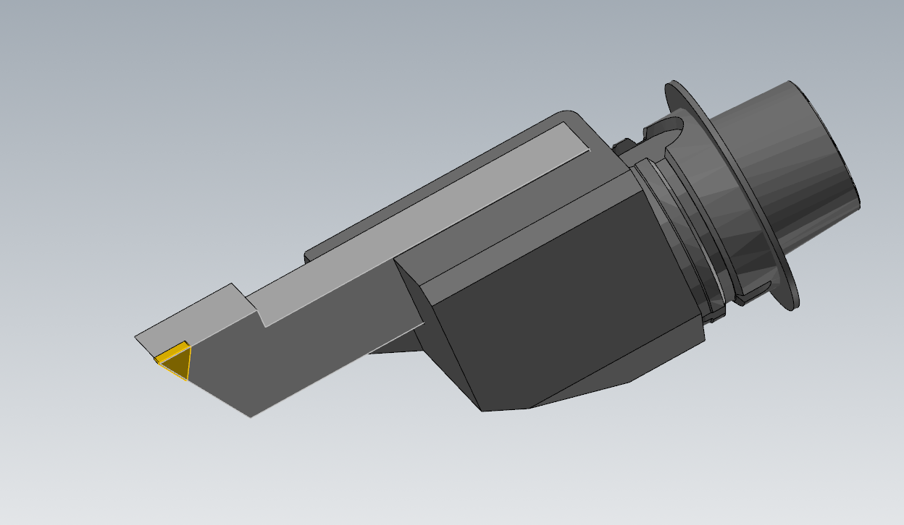
Right click on Tool Spindle location and select view all to see the whole tooling assembly
Right click Tool Spindle
Display Tool assembly on the Screen
Select View all

Slide 25
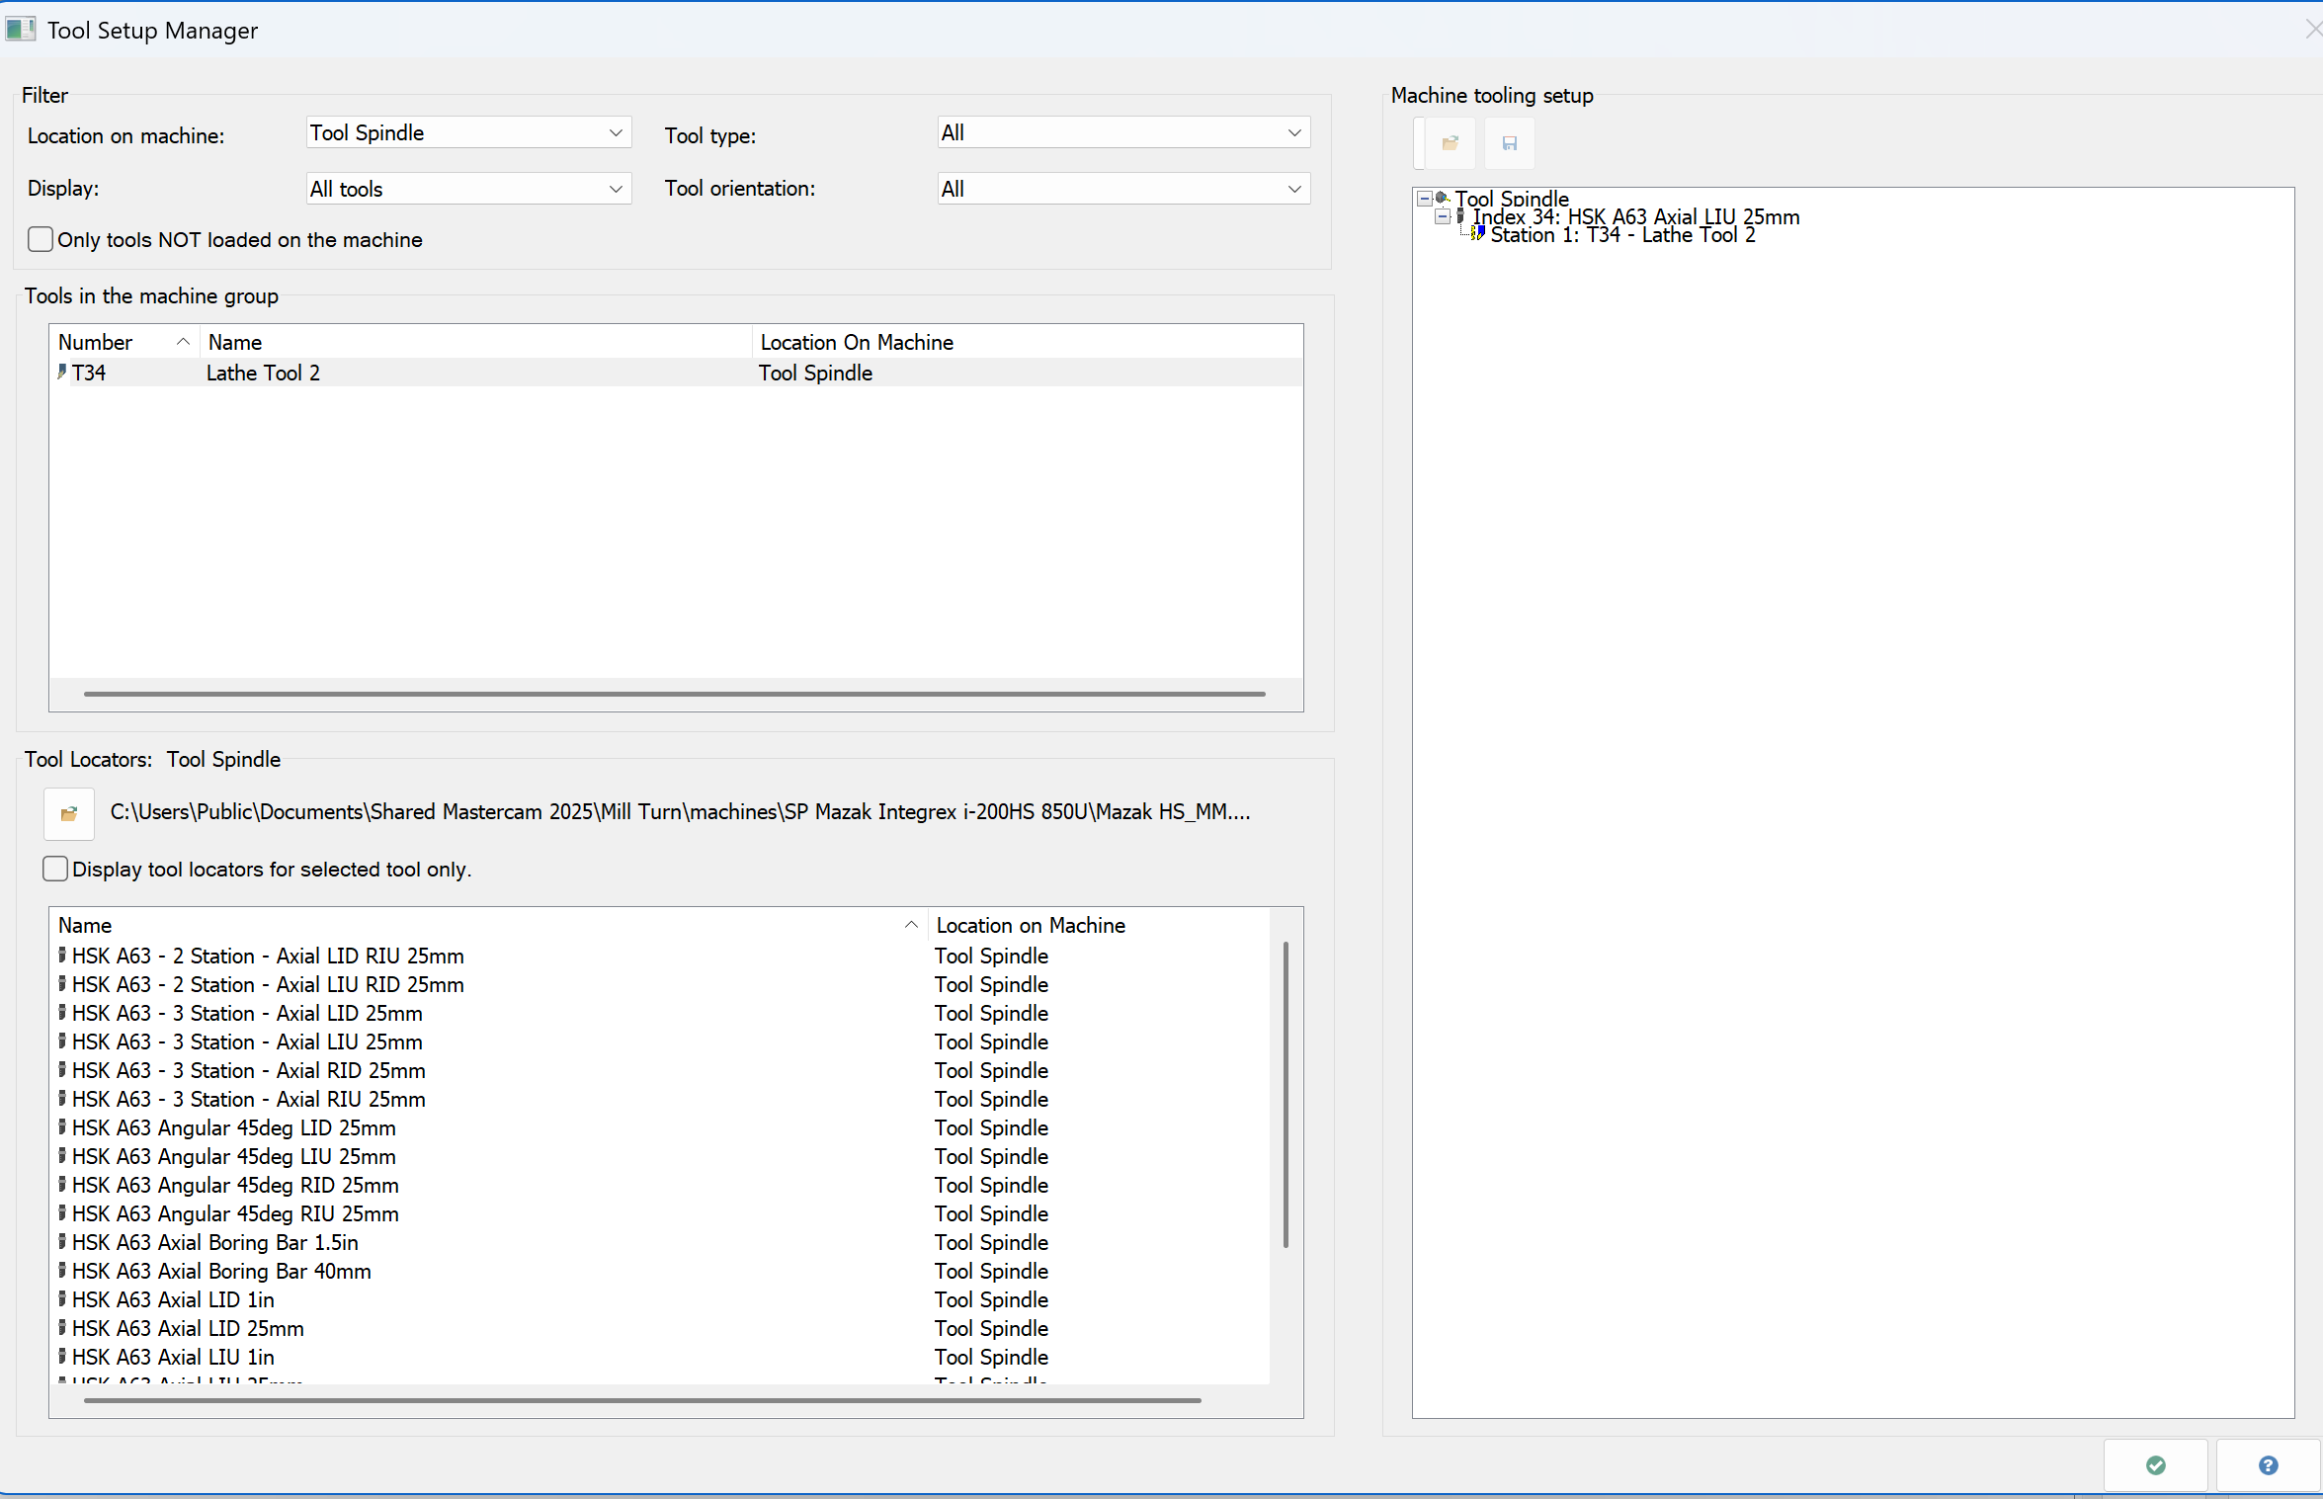
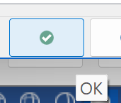
Select 'OK' and use this tool to practice your toolpaths for OD Facing, OD Roughing, and OD Finishing operations
OK and close the Tool Manager page

Slide 26
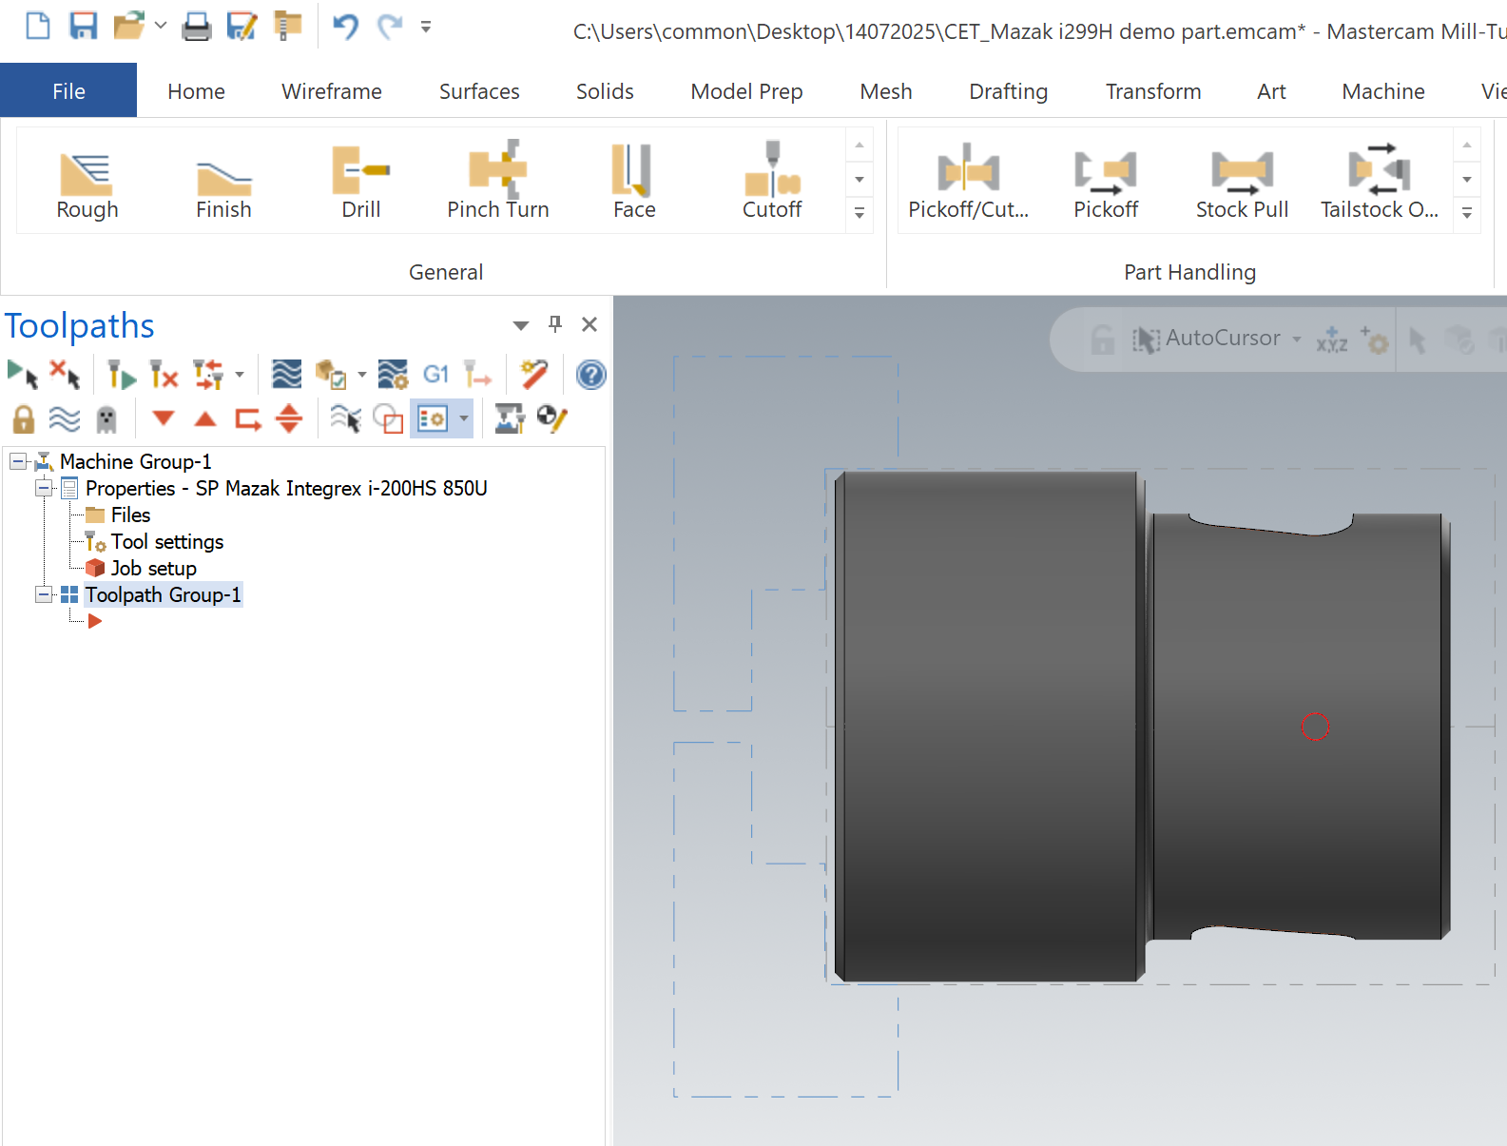

Change the name of Toolpath Group 1 to Left Spindle Lathe cutting WCS G54
After
Before
Left click on Toolpath Group 1 and key the Left Spindle Lathe cutting WCS G54

Slide 27
Create Lathe Toolpath operations

Slide 28

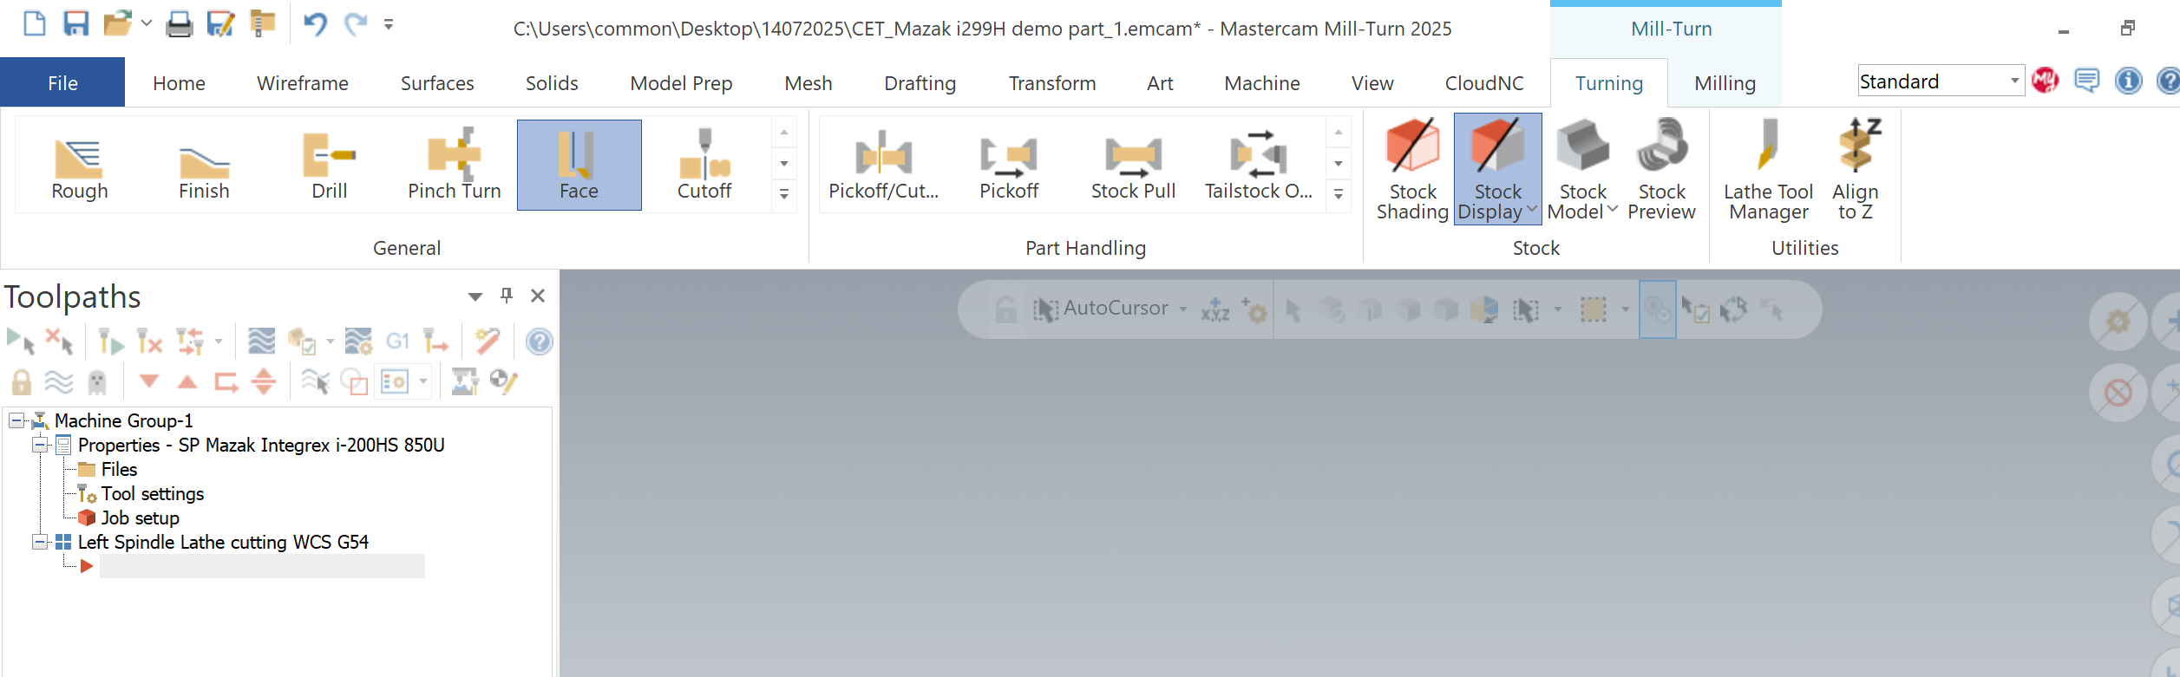
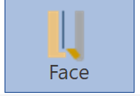
Click on Turning and select Face
1.)
2.)

Slide 29
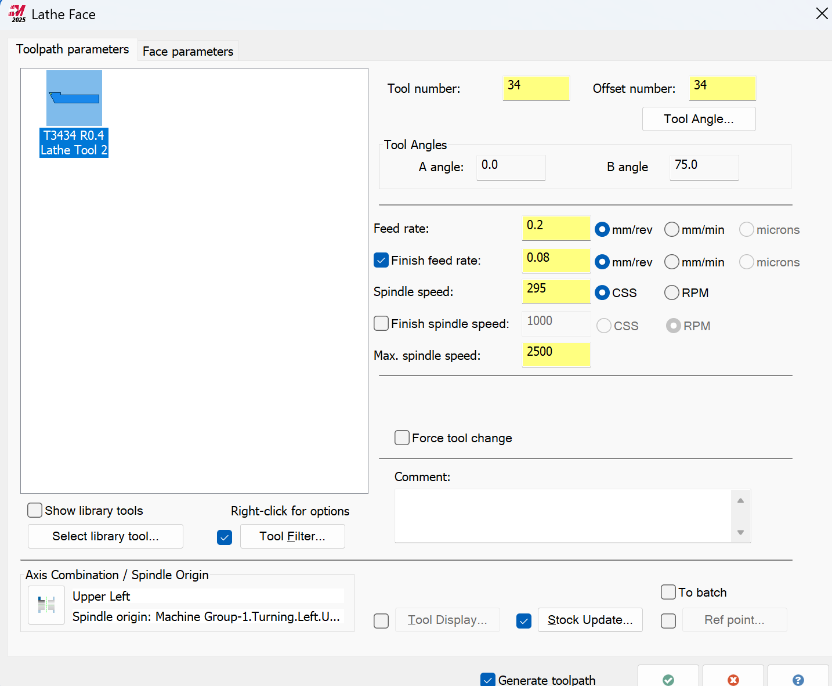
Select Tool Angle to change for left spindle cutting and the rest of the parameters follow accordingly as picture show

Slide 30
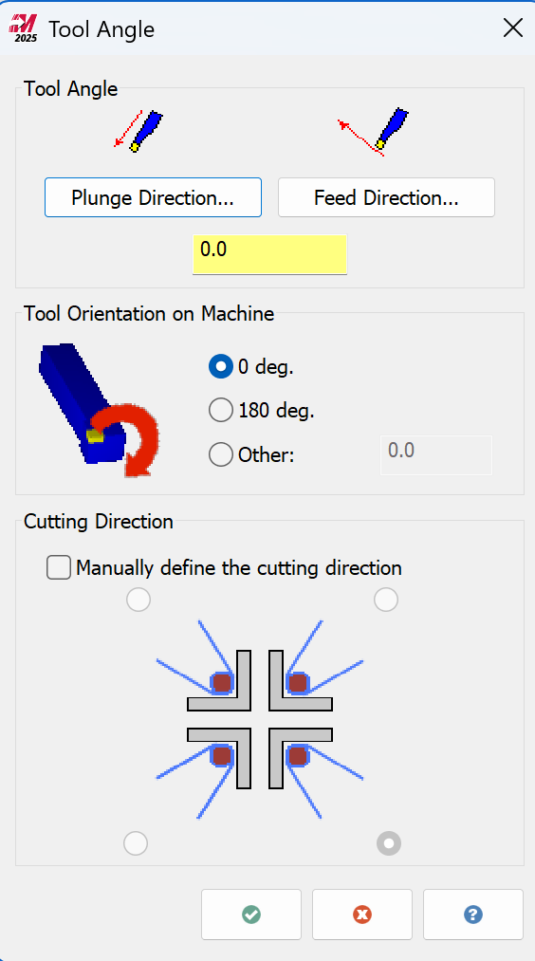
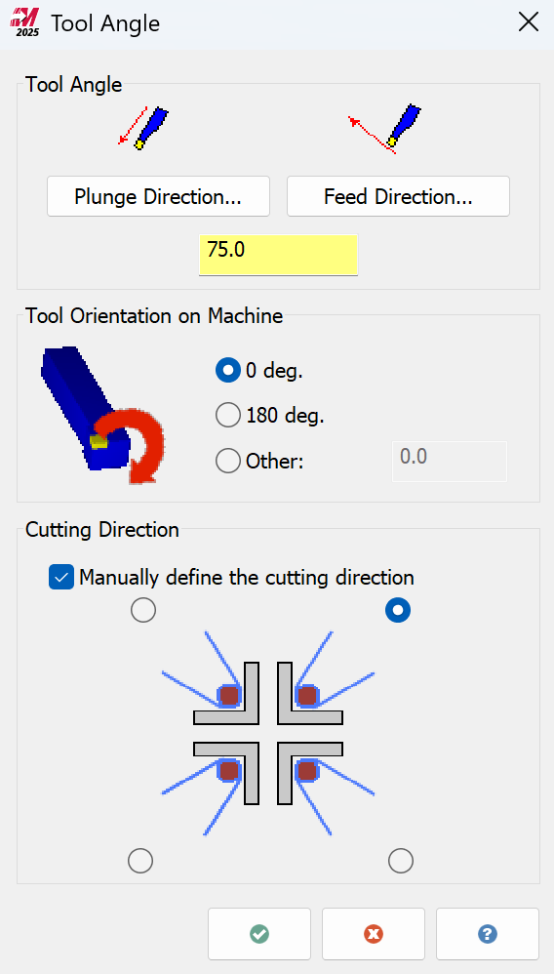
Change Tool Angle parameters as picture show
Before
After

Slide 31
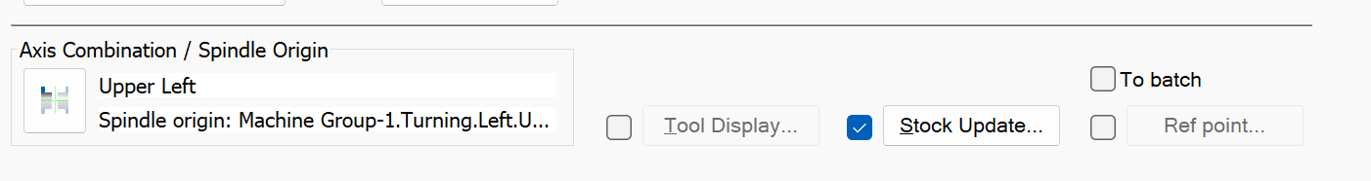
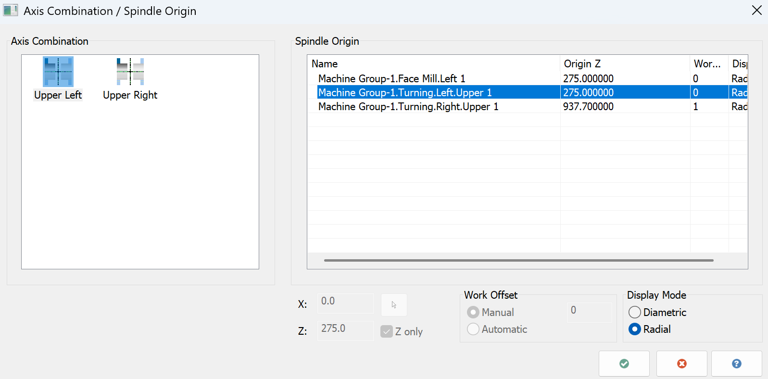
Information for Upper Left spindle Origin

Slide 32


Input Ref point as below picture

Slide 33


Key the Face parameters follow accordingly as picture show than O.K

Slide 34

Select G1 Working with the Sync Manager

Slide 35

Some Machine Group parameters Show on Sync Manager page
This G53 must be check so can writing on the NC programs for B axis reference return. When using rotate the B axis feature on turning function for the toolpath.

Slide 36

Some Lathe Face Turning parameters Show on Sync Manager page

Slide 37

Some Lathe Face Turning Approach parameters Show on Sync Manager page

Slide 38

Some Lathe Face Turning Retrach parameters Show on Sync Manager page

Slide 39

Continue the rest of the lathe operations, any issue can refer to the Mastercam part file with completed toolpaths.

Slide 40
Create Stock Model after lathe operations to apply on some Milling functions

Slide 41

Create Stock Model select Icon as below diagram

Slide 42


Select all Source Operations as below picture

Slide 43



Input the Stock Definition parameters as below

Slide 44
Develop the milling toolpaths required to complete first-side machining for the job

Slide 45

Select the milling method for tool preparation.

Slide 46



Prepare the mill tooling before starting the milling toolpath development show as below picture .

Slide 47

Drag all using tools to the Tool Manager page window.
Drag All Milling Tools to the Tool Manager widows

Slide 48

All Mill tools are ready to use to development the milling toolpaths.

Slide 49


Create a New Toolpath group to start the Milling operation maintain a good housekeeping .
Right click on the Machine group
Select
Select
Left click on the Group Rename the Group to Left Spindle mill WCS G54

Slide 50
Now we will start Mill operations at left Spindle

Slide 51



Create the two holes with Advanced Drill function this method will simplify off to create the plane and vector, it auto define the drill direction for you
So yes—it can auto-define the direction, but it’s always smart to verify the arrow direction after selected the solid face inside the holes or simulation before posting.

Slide 52


Selected the Hole solid face you need to drill and check Green Arrow direction before check O.K
Selected the hole's solid face here. After Click the O.K button
👆 if you're selecting a cylinder face in Mastercam and want to control or change the drill direction using a vector.

Slide 53


After Check O.K 3D model will show as below picture

Slide 54


Select Tool with diameter 6 drill for drilling operation

Slide 55

Select the Holder as below Picture

Slide 56


You can create depth of cut per step at this cut parameters page at the Advanced drill function
Total depth was 15mm and for this example we create per cut with 5mm and break the chip by Dwell 3ms until reached the end of dimension.

Slide 57

Tool Axis Control page

Slide 58

Linking Parameters show as below picture

Slide 59


Advanced Drill NC code

Slide 60


Continue the rest of the Mill operations, any issue can refer to the Mastercam part file with completed toolpaths.

Slide 61




Apply of Pickoff function
Before Pickoff
After Pickoff

Slide 63

Multi Axis Pocketing with Mastercam
Mastercam - Multiaxis Pocketing on an open shape
5 axis Roughing with Mastercam's Multi-axis Pocket
Mastercam MultiAxis Flow, Parallel, and Morph on Day 2 of Ron Week!
UNIFIED MULTIAXIS with Mastercam 2022

