Slide 1
Crime Rate Inference with Big Data
CPSC 8650
Yang Guo
Qi Xiao
4/11/2017

Slide 2
Background Introduction
Crime Rate Inference Problem:
Features
Inference Models
Result Evaluation
Conclusion

Slide 3
Background
Understand how to control crime and the neighborhood context of crime is very important.
The paper focuses on the problem of crime rate inference of communities: estimate crime rate in one community using crime rate of other communities by considering the features of communities.

Slide 4
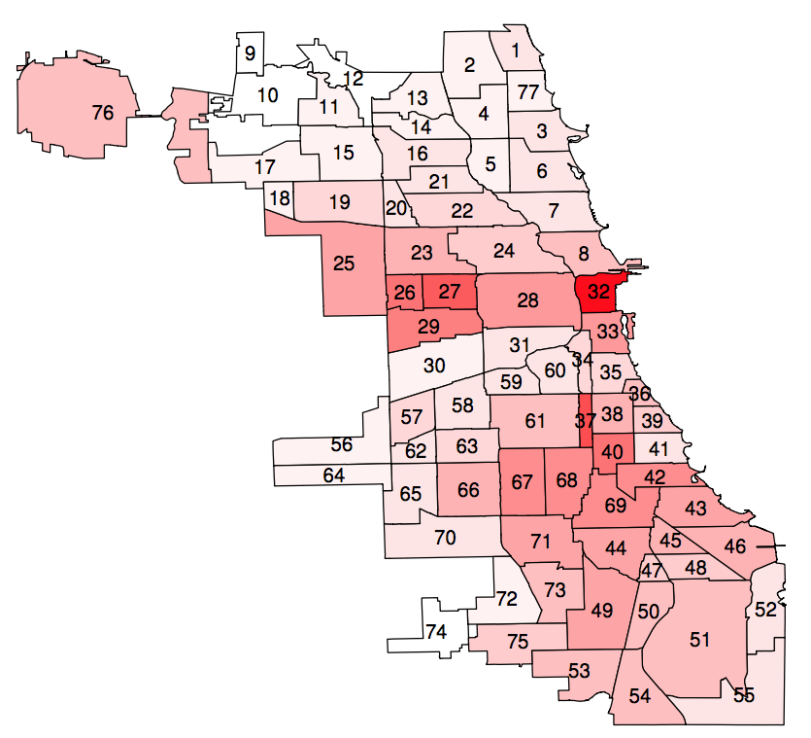
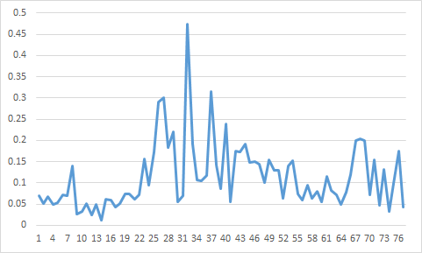
Chicago Community Area Map with crime rate
Notes:
Shows crime rate by community area.

Slide 5

Crime Rate Inference Problem
Features
Inference Models

Slide 6
Features
We consider two types of features X for inference:
Nodal feature
Demographics
Point-of-Interest(POI)
Edge feature
Geographical influence
Hyperlink by taxi flow

Slide 7
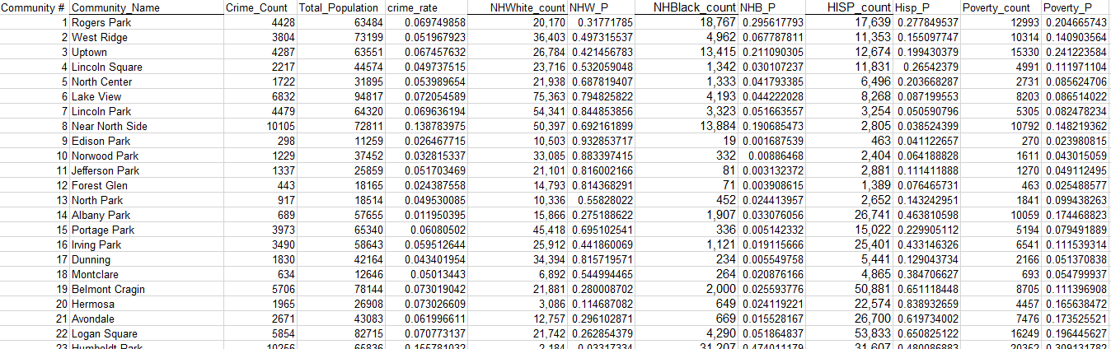
Demographics
Feature | Correlation with crime rate | p-value
Total population | -0.180000392490147 | 0.117234718388481
Poverty Index | 0.522318571068164 | 1.10340078410944E-06
Percentage of NHB | 0.62961506243669 | 8.57758210567115E-10
Percentage of NHW | -0.472578450495678 | 0.0000142734615258744
Percentage of Hispanic | -0.392972969 | 0.000407342672775797
We search and collect demographics from website and use year 2000 demographic data.

Slide 8
POI
We collect POI from FourSquare.
Here shows an example result using FourSquare API:
https://api.foursquare.com/v2/venues/explore?ll=41.644543,-87.940114&limit=2&radius=300
41.642549, -87.939568 Struggle Bus Bus Station
41.642590, -87.937772 Homer Glen Farmers Market Farmer’s Market

Slide 9
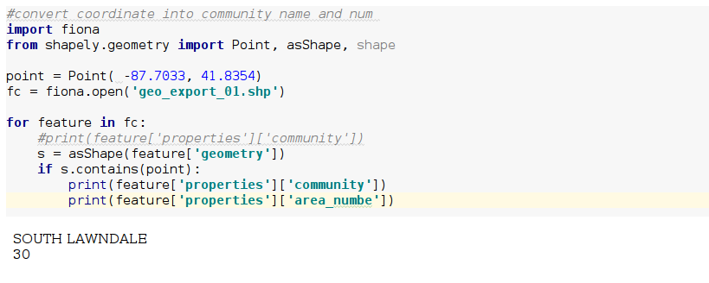
POI Pre-Processing
For the reason that the location info of POI is coordinate, first we should convert it into specific community name and number using shapely and fiona.
Classify POI data into 10 major categories.

Slide 10
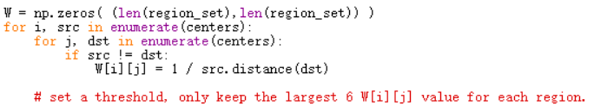
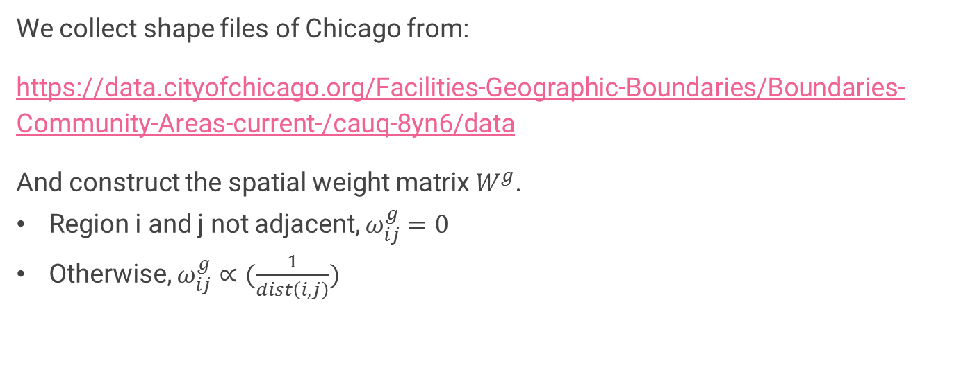
Geographical Influence
We collect shape files of Chicago from:
https://data.cityofchicago.org/Facilities-Geographic-Boundaries/Boundaries-Community-Areas-current-/cauq-8yn6/data
And construct the spatial weight matrix $W^{g}$.
Region i and j not adjacent, $ω_{ij}^{g}=0$
Otherwise, $ω_{ij}^{g}∝(\frac{1}{dist\left(i,j\right)})$

Slide 11
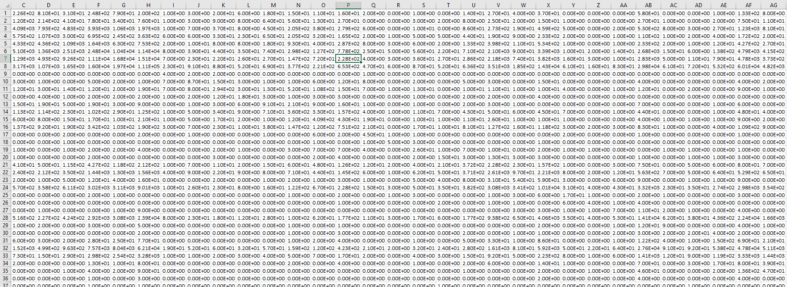
Hyperlinks by Taxi Flow
We download taxi trips dataset between October and December in 2013 from:
https://data.cityofchicago.org/Transportation/Taxi-Trips-Dashboard/spcw-brbq
Then preprocess the data, convert centroid coordinate into specific community area name and number just like what we did in POI Preprocessing.
After that, we can get the taxi flow between communities.

Slide 12
Inference Models
Linear Regression
Negative Binomial Regression

Slide 13
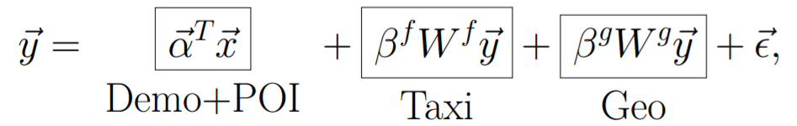

Linear Regression
The most straightforward prediction model is linear regression model:
Notes:
There is existing linear_model from sklearn library.
l_model = linear_model.LinearRegression()
res = l_model.fit(features, Y)

Slide 14

Negative Binomial Regression
Poisson regression is more appropriate for non-negative count data than linear regression.
However, poisson regression enforces the mean and variance of dependent variable y to be equal, which may not be the case for real data.
Negative binomial regression / poisson-gamma model where mean of poisson distribution is a random variable having a Gamma distribution.
Notes:
There is existing negativeBinomialRegression from NegBinStatModel lib.
res = negativeBinomialRegression(f, Y)

Slide 15
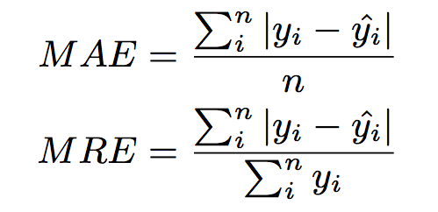
Results: Performance Evaluation
Mean Absolute Error
Mean Relative Error

Slide 16
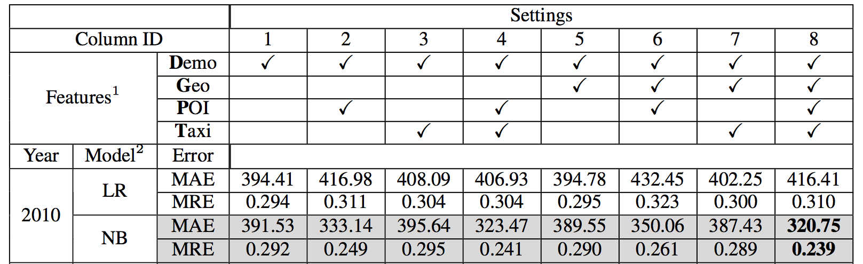

Slide 17
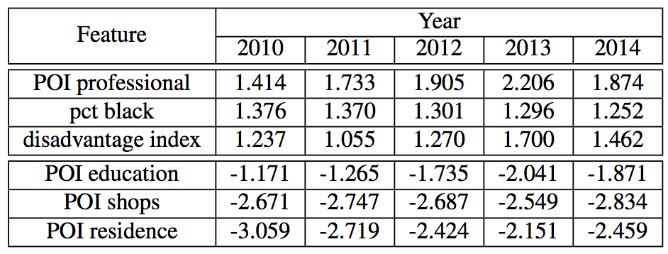
Feature Importance

Slide 18
Conclusion
The paper solves the crime rate inference problem with two new features: POIs and taxi flow. They improve inference accuracy over traditional demographics and geographical feature.
Negative binomial model performs better than linear regression model for prediction.
In best scenario, POI distribution and taxi flow features reduce prediction errors by 17.6%.

Slide 19
Thank you!
Q&A

