Slide 1


Slide 2
Content
Anycast
Secure Anycast Tunneling Protocol (SATP)‏
Usage Scenarios
Anytun (a SATP implementation)‏
Demonstration

Slide 3
Anycast

Slide 4
Types of addresses in IP networks
Unicast
  1 IP address / host
  Data is sent to exactly that host
Broadcast
  1 IP address / network
  Data is sent to all hosts on the network
Multicast
  1 IP address for multiple hosts
  Data is sent to all hosts having the IP address

Slide 5
Types of addresses in IP networks
Anycast
  1 IP address for multiple hosts
  Data is sent to only one host
  Which host receives the data might change at any time
Why to use anycast?
  Load balancing
  Fault tolerance / redundancy
  Build scalable clusters
  Extend or shrink clusters while in operation

Slide 6
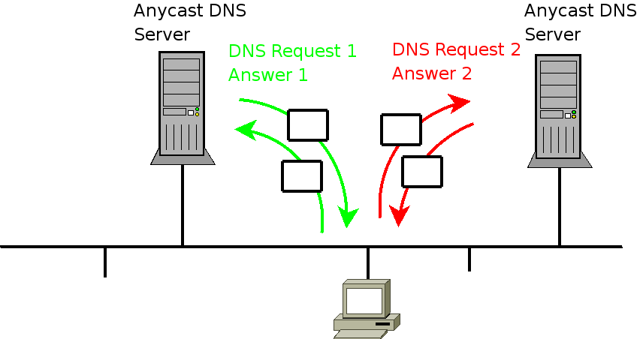
Anycast example (DNS)‏

Slide 7
How to realise anycast
The simple way
  Give two hosts in a LAN the same IP address
  Works but has many problems (ARP table cache timeouts ...)‏
The more powerful way
  Use a routing protocol to decide which host receives the data
  Works great
  Fault tolerance only the the anycast host runs a routing daemon

Slide 8
Routing in the Internet
What is the „Internet“ anyway?
  The Internet is an interconnect of independent networks
  Such independent networks are called Autonomous Systems (e.g. Telekom Austria, UPC, Geant, ...)‏
Where is routing done?
  Inside Autonomous Systems by interior gateway protocols like OSPF or ISIS
  Between autonomous systems by the exterior routing protocol BGP4 (border gateway protocol version 4)‏

Slide 9
What is an Autonomous System (AS)‏
An AS is multi homed
  Has a connection to at least two other AS
  (upstream ISPs, customers or peering partners)‏
An AS has it's own IP addresses
  At least /24 for IPv4 (256 addresses)‏
  At least /32 for IPv6 (65536 end customer networks = /48 )‏
Has an Autonomous System Number (ASN)‏
  IP addresses and ASNs for Europe are managed by RIPE

Slide 10
How to announce an anycast route?
Inside an AS
  Give 2 hosts the same IP address
  Connect the hosts to separate routers
  Announce the route in the routers
  The network will see only one multi homed host
Global
  Announce a whole network at different routers / locations
  Connect the anycast hosts to the routers
  Again it looks like a multi homed network to the Internet

Slide 11
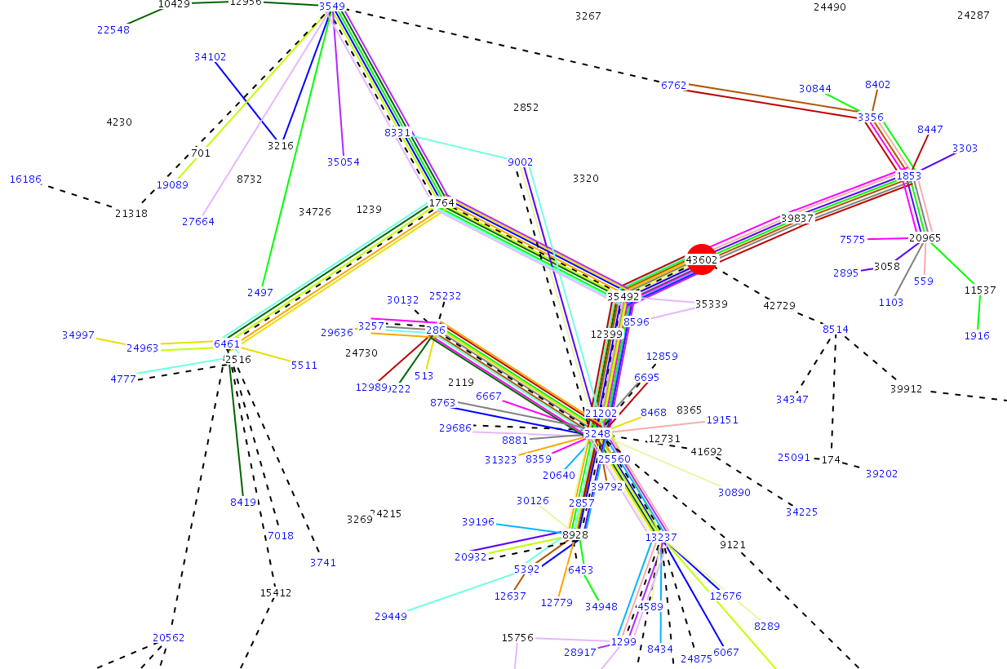
BGPlay

Slide 12
Why to do global anycast?
Anycast advantages
  Load balancing
  Fault tolerance / redundancy
  Build scalable clusters
  Extend or shrink clusters while in operation
anycast routing advantages
  Geographic load balancing
  Shortest route in the Internet
  minimum delay for the data

Slide 13
Secure Anycast Tunneling Protocol (SATP)‏

Slide 14
SATP
Encapsulation
Key Handshake / NAT Transversal
Crypto
Replay Protection
Synchronisation

Slide 15
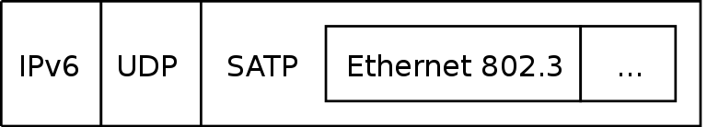
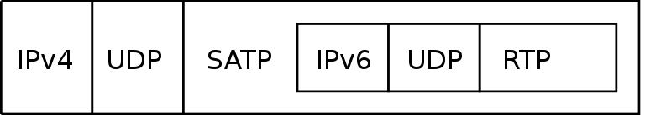
Encapsulation
SATP is a tunnel protocol similar to GRE or
IPSec ESP in tunnel mode

Slide 16
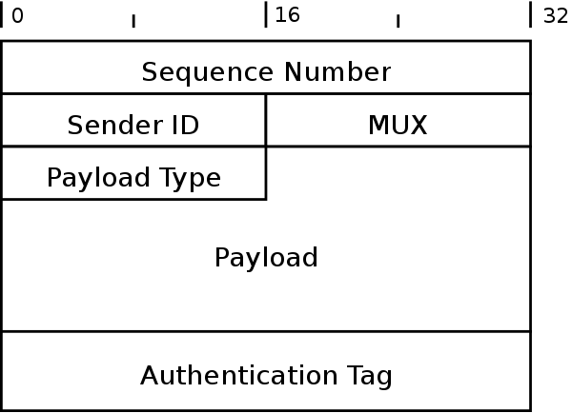
SATP Header

Slide 17
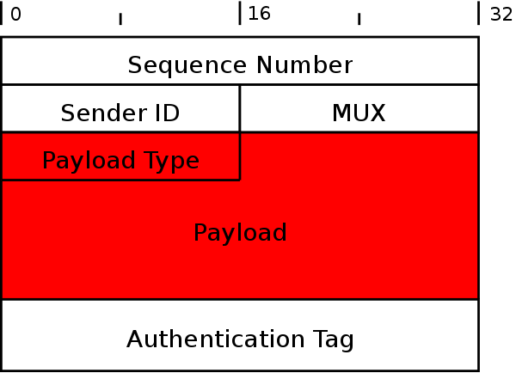
SATP – encrypted part

Slide 18
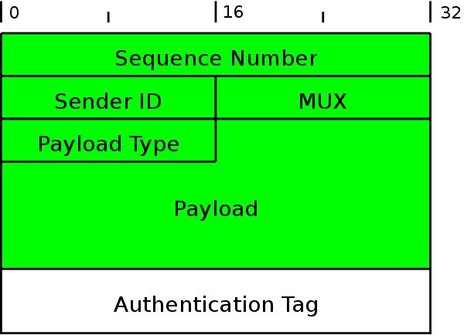
SATP – authenticated part

Slide 19
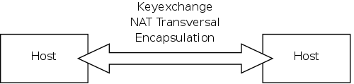
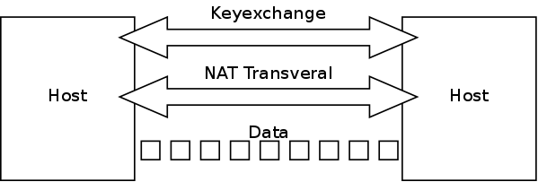
Keyexchange / NAT Transversal
OpenVPN
IPSec

Slide 20
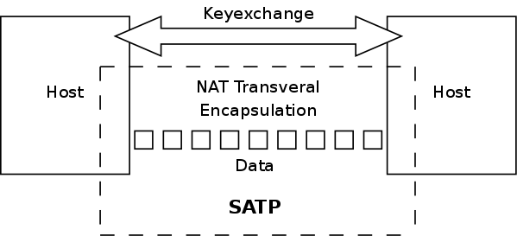
Keyexchange / NAT Transversal cont'd
SATP
  external Key Exchange (i.e. IKE)‏
  NAT Transversal and Encapsulation is done by SATP

Slide 21
Crypto - cryptographic context
used for key calculation
consists of packet independent and packet specific data
packet independent
  Master Key
  Master Salt
packet specific
  Sequence Number
  Sender ID
  Mux

Slide 22
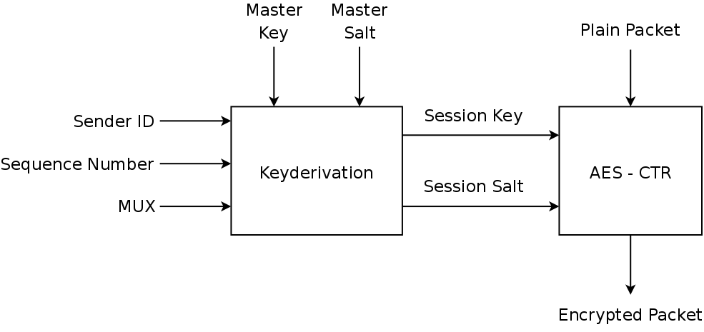
Crypto – Encryption

Slide 23
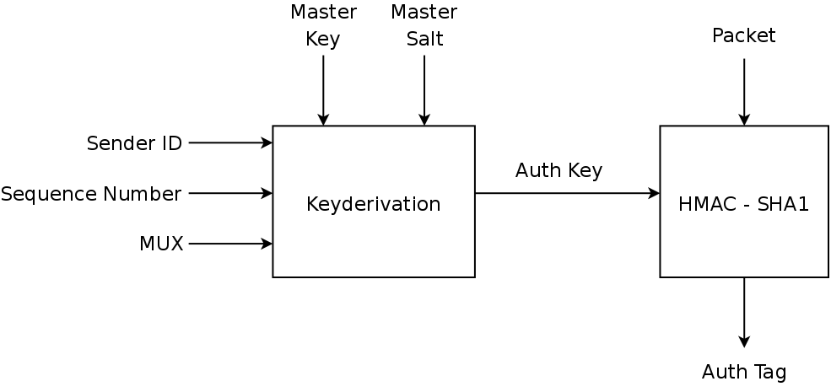
Crypto - Authentication

Slide 24
Replay Protection
attacker may record any packet and resend it to you
store all sequence numbers received in a list
use a sequence window to save memory

Slide 25
Replay Protection and anycast
anycast sender doesn't know about sequence numbers used by other anycast senders
sequence numbers would have to be synchronised
every anycast sender would have to send a synchronise packet to every other anycast send for every packet it sends out
on the internet this is too much overhead

Slide 26
SATP - Replay Protection
own sequence window for each sender
for anycast sender the sender id is used to distinguish between sequence windows
IPSec doesn't have sender id's therefore you can't use replay protection and anycast

Slide 27
Syncronisation
synchronisation has to be done between anycast senders
only view information has to be synchronised
  master key and salt
  peers IP address and port
SATP only defines what to synchronise and not how

Slide 28
SATP
Usage Scenarios

Slide 29
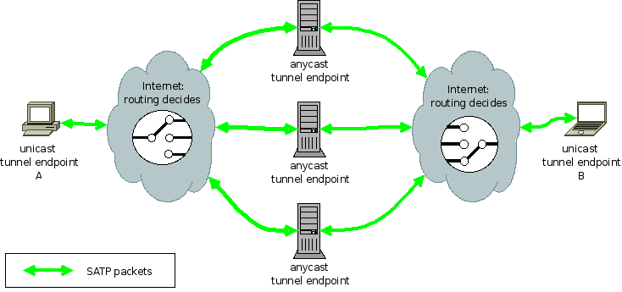
SATP applications: VPN

Slide 30
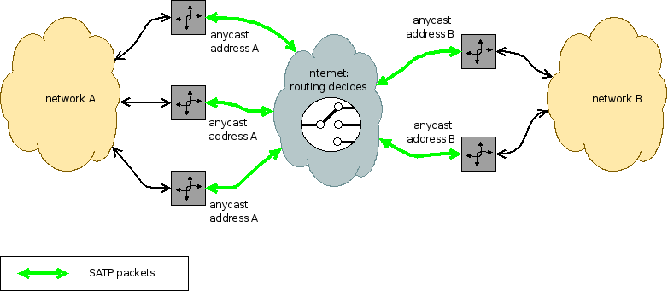
SATP applications: VPN

Slide 31
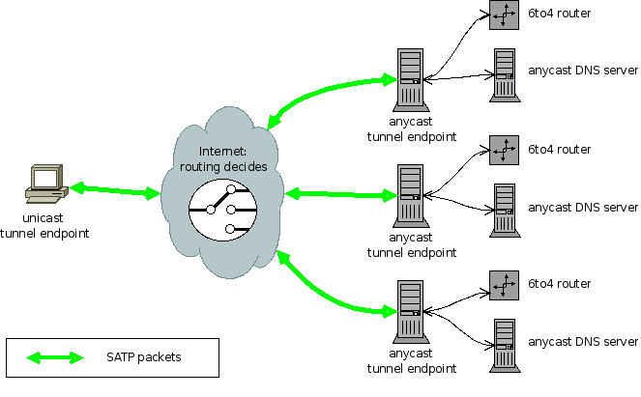
SATP apps: securing anycast services

Slide 32
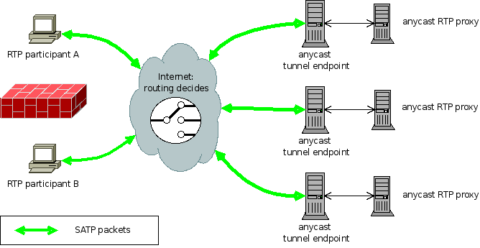
SATP apps: SIP/anyRTPProxy

Slide 33

Special Thanks
Netidee / Internet Privatstiftung Austria
Mur.at
  LIR: IP addresses, AS
  Server Housing (with BGP4)‏
FunkFeuer Vienna & Graz
  Server Housing (with BGP4)‏

Slide 34
Anytun
(a SATP implementation)‏

Slide 35
Anytun
SATP Reference Implementation
Implemented in C++
Similar Interface to OpenVPN
  tun / tap devices
Full customizable topology
  Client/server, P2P, mesh
Full customizable routing
  Access to the internal routing information

Slide 36
Anytun
Tunneling of IPv4, IPv6 and Ethernet over UDP
Support for NAT and changing IP addresses
Full support for cluster synchronisation
and load balancing
State of the art encryption
  AES encryption
  SHA1 authentication

Slide 37
Questions

Slide 38
Questions
What is anycast?
  1 IP address for multiple hosts
  Data is sent to only one host
  Which host receives the data might change at any time
Describe the advantages of anycast
  Load balancing
  Fault tolerance / redundancy
  Build scalable clusters
  Extend or shrink clusters while in operation

Slide 39
Questions
What are requirements for encryption used with anycast?
  The cryptographic context has to be present in every packet (e.g. sequence number) or has to be statically known (e.g. master key)‏
What is replay protection and why is it needed
  It's a list of received packages.
  Duplicate packages are ignored.
  It's needed to protect against data that is recorded by the attacker and replayed at a later time.

Slide 40
Questions
List 3 applications for anycast
  DNS
  6to4
  VPN
  anycast RTP-Proxy
How can anycast be realised (two variants)‏
  give 2 hosts the same IP address on the LAN
  announce the IP address multiple times in a routing protocol

Slide 41
Live Demonstration

