Slide 1
Outline
SATP applications
Special thanks
Anytun

Slide 2
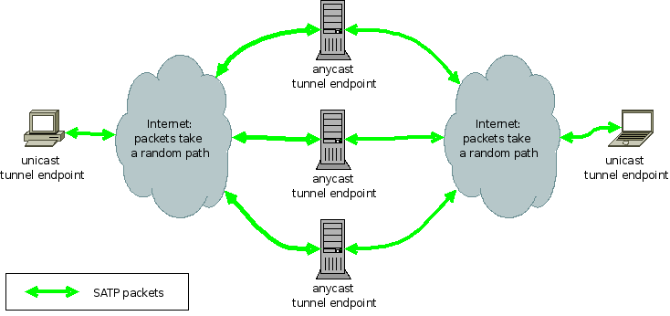
SATP applications: VPN

Slide 3
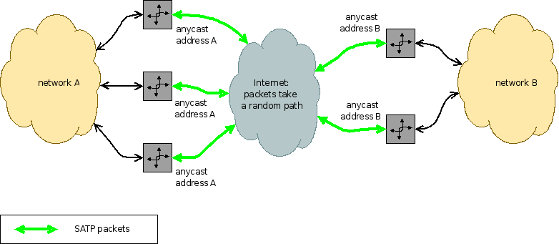
SATP applications: VPN

Slide 4
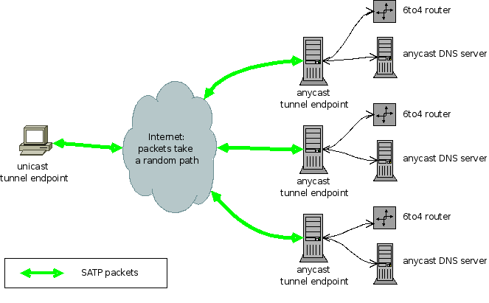
SATP apps: securing anycast services

Slide 5
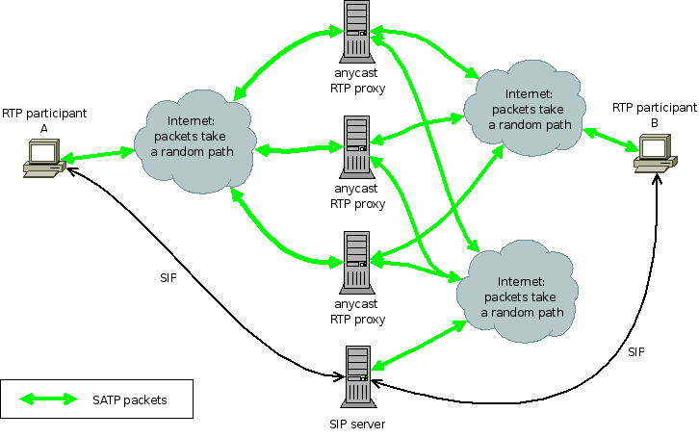
SATP apps: SIP/anyRTPProxy

Slide 6

Special Thanks
Netidee / Internet Privatstiftung Austria
Mur.at
  LIR
  Server Housing (with BGP)
FunkFeuer Vienna & Graz
  Server Housing (with BGP)

Slide 7
Anytun
SATP Reference Implementation
Implemented in C++
Similar Interface to OpenVPN (tun / tap devices)
Full customizable topology
Full customizable routing

Slide 8
Anytun
Tunneling of IPv4, IPv6 and Ethernet over UDP
Support for NAT and changing IP adresses
Full support for cluster synchonization
and load balancing
State of the art encryption

