Slide 1


Slide 2
Content
Anycast
Secure Anycast Tunneling Protocol (SATP)‏
Useage Scenarios
Anytun (a SATP implementation)‏
Demonstration

Slide 3
Types of addresses in IP networks

Slide 4
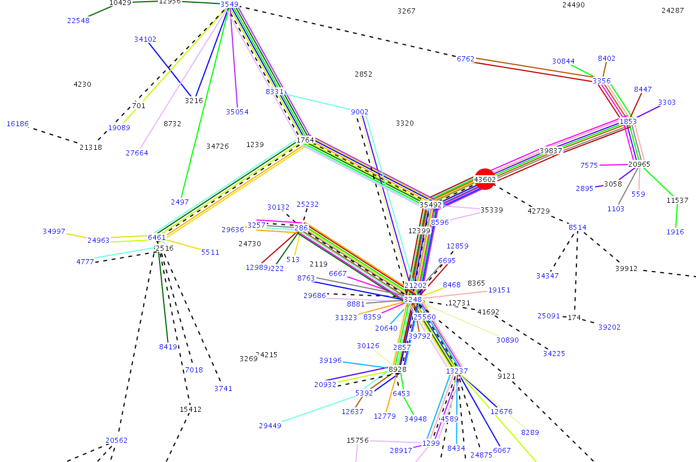
BGPlay

