Slide 1
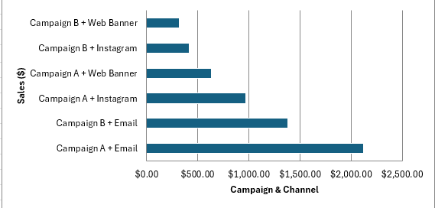
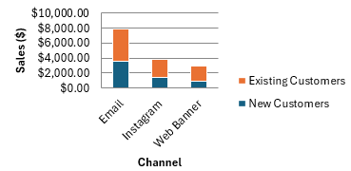
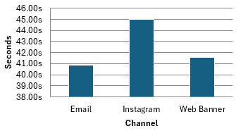
Marketing Campaign Performance & Growth Insights
Revenue by Channel & Customer Type
Avg. Time on Site for Non-Converters (sec)
New Customer Sales by Combo ($)
Recommendation:
Scale Email: Make Email the core conversion channel, using Campaign A’s messaging because it generated significantly higher new-customer sales.
Improve Instagram: Retarget high-engagement Instagram visitors and test Campaign A-style messaging to increase conversions.
Reallocate Budget: Reduce spending on low-performing Web Banners and Campaign B, shifting more budget toward Email and Instagram retargeting.

