Slide 1
Hidden
Markov Models

Slide 2
Hidden
Markov Models

Slide 3
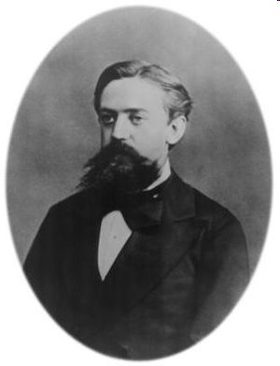
Modelling the evolution of a memoryless system
Андрей Андреевич Марков

Slide 4
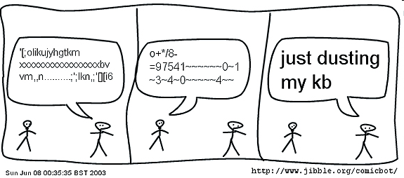
<Melanie> Monty, aren't you a cutseybot? <Monty> awww, love y'all l8r...........
* Melanie hugs Monty.
<Monty> that's valid
<MrTea|down> Monty, jibble for me
<Monty> Dudes, how so??
<MrTea|down> like a fish, Monty
<Monty> \/\/\/\/\/\/\/\/\/\/\/\/\/\/\/\/\/\/\/\/\/\/\/\/\/\/\/\/\/\/\/\/\/ \/\/\/\/\/\/\/\/\/\/\/\/\/\/\/\/\/\/
<jimbo> skillz monty, is that really a fish?
<Monty> STOP WORRYING ABOUT IT.
Notes:
http://www.jibble.org/montyquotes.php

Slide 5
Hidden
Markov Models

Slide 6
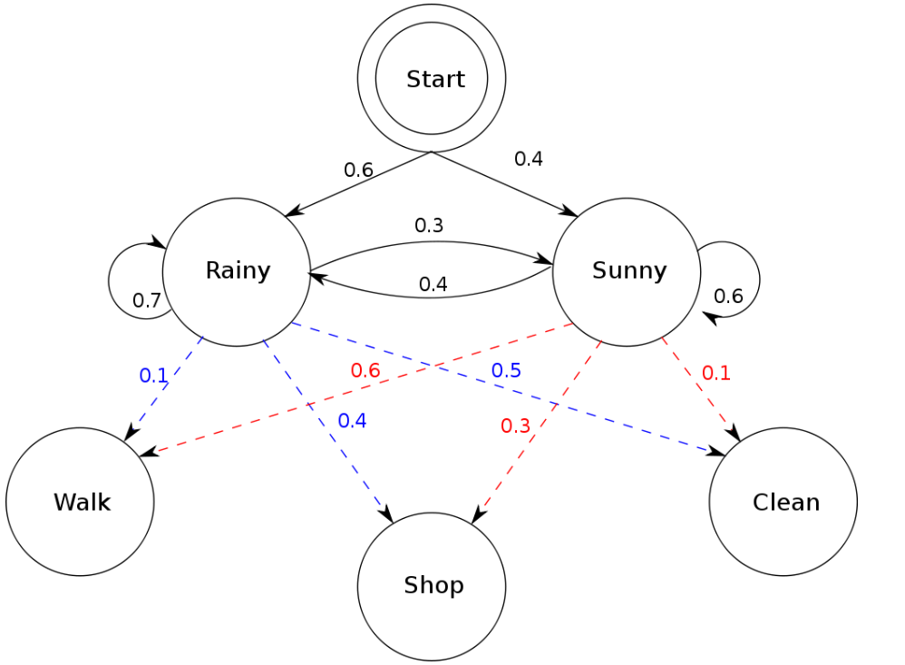
Notes:
A concrete example
Consider two friends, Alice and Bob, who live far apart from each other and who talk together daily over the telephone about what they did that day. Bob is only interested in three activities: walking in the park, shopping, and cleaning his apartment. The choice of what to do is determined exclusively by the weather on a given day. Alice has no definite information about the weather where Bob lives, but she knows general trends. Based on what Bob tells her he did each day, Alice tries to guess what the weather must have been like.
Alice believes that the weather operates as a discrete Markov chain. There are two states, "Rainy" and "Sunny", but she cannot observe them directly, that is, they are hidden from her. On each day, there is a certain chance that Bob will perform one of the following activities, depending on the weather: "walk", "shop", or "clean". Since Bob tells Alice about his activities, those are the observations. The entire system is that of a hidden Markov model (HMM).
Alice knows the general weather trends in the area, and what Bob likes to do on average. In other words, the parameters of the HMM are known.

Slide 7
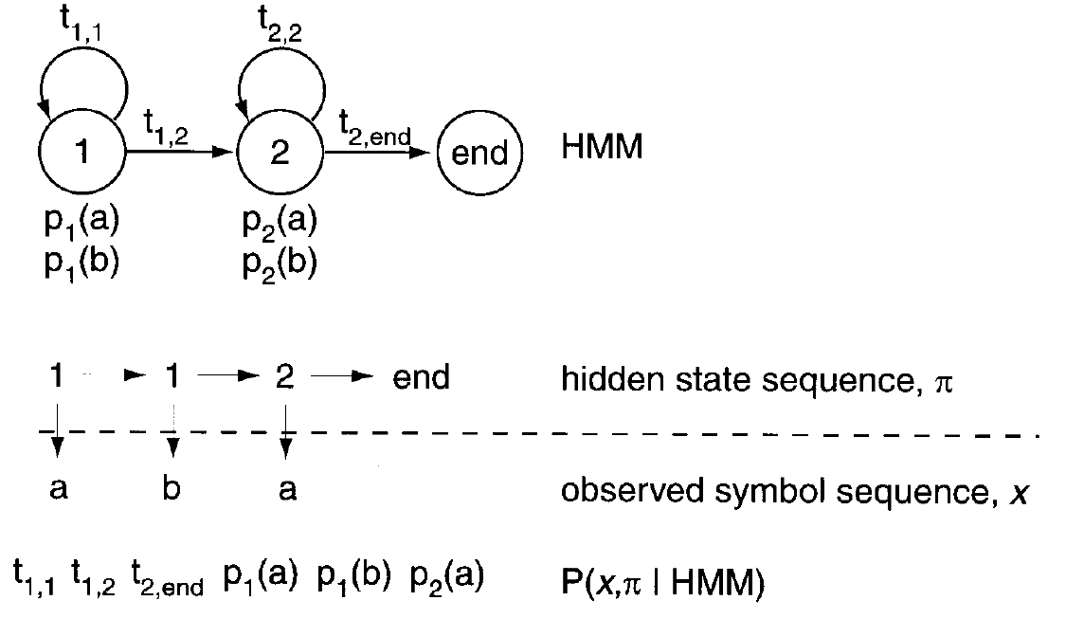
Eddy, 1998

Slide 8
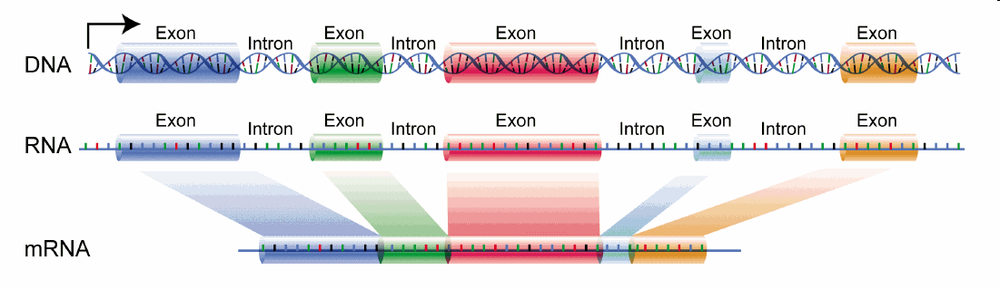
Notes:
http://de.academic.ru/pictures/dewiki/68/DNA_exons_introns.gif

Slide 9
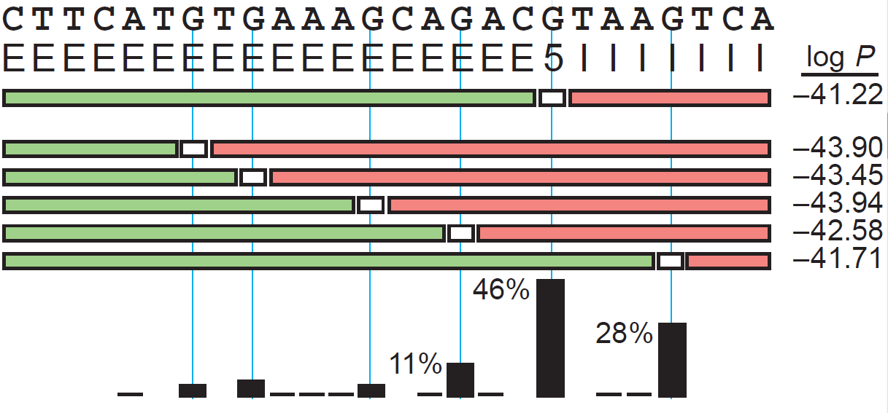
Notes:
Assume this DNA segment contains an exon, a 5’ splice site and an intron. The task is to identify where the exon stops and the intron starts, hence finding the splice site.

Slide 10
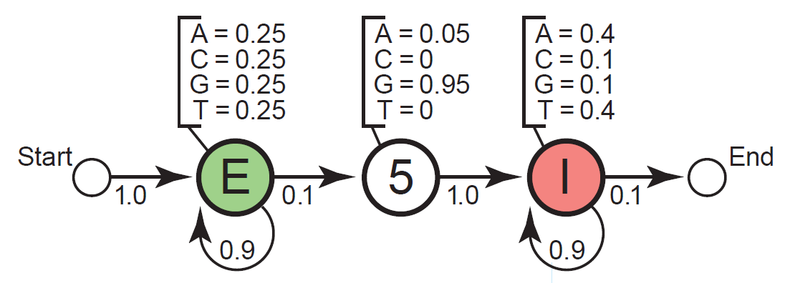
Exon
Splice
Intron
Notes:
In this example, assume that in exons, as coding regions, the probability of encountering any base is roughly the same. That is, there is a 25 % chance of encountering an A, G, C or T. A splice site is almost always a G (95%) and rarely an A (5%), but never a C or a T. Introns are mostly composed of A or T residues (each may be encountered with a probability of 40%) and sometimes C and residues (10% each).
As exons, splice sites and introns have different base composition with different associated probabilities governing their distribution, there is a means to resolve them using probalistic models.

Slide 11
Notes:
The HMM will try out possible state paths that could generated the observed sequence and score them using the probability information in the model. It will then select the most likely ones as potential hits.

Slide 12
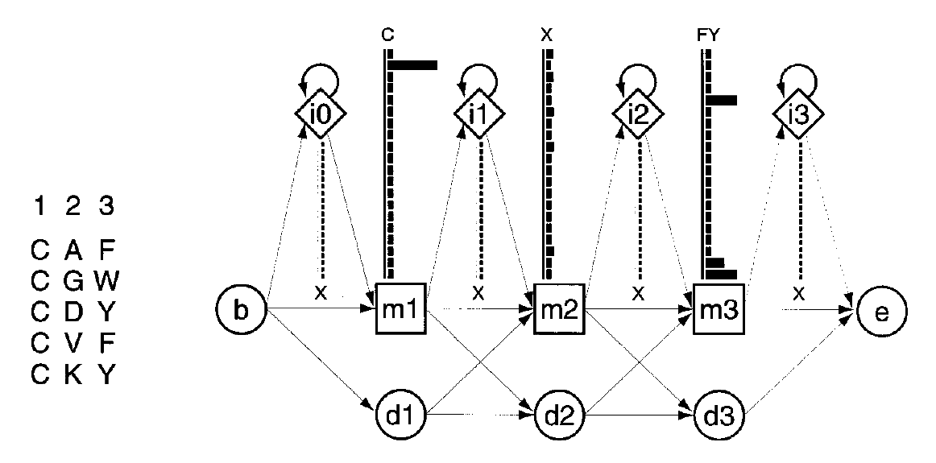
Eddy, 1998
Notes:
Here, an HMM with 3 states (one for each aa in the aligned sequences to the left) is trained using an alignment of 5 sequences. The histograms above each match state “m” indicate the probability distribution over all 20 aas (there are 20 bars; since in the first position there is an 100% chance of a cysteine showing up, it has a very prominent bar).

Slide 13
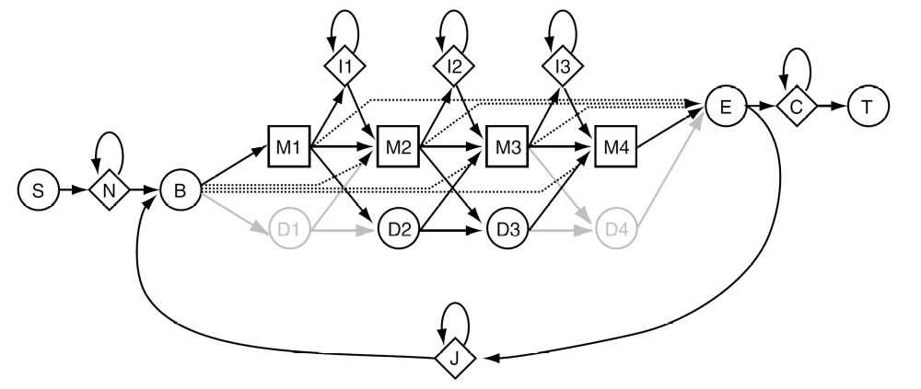
Plan 7
Notes:
The Plan 7 architecture
The Plan 7 architecture is substantially different from the original HMMER model architecture.
The abbreviations for the states are as follows:
Mx Match state x. Has K emission probabilities.
Dx Delete state x. Non-emitter.
Ix Insert state x. Has K emission probabilities.
S Start state. Non-emitter.
N N-terminal unaligned sequence state. Emits on transition with K emission probabilities.
B Begin state (for entering main model). Non-emitter.
E End state (for exiting main model). Non-emitter.
C C-terminal unaligned sequence state. Emits on transition with K emission probabilities.
J Joining segment unaligned sequence state. Emits on transition with K emission
probabilities.
The section of the model composed of M, D, and I states, and the B and E states, is essentially a
Krogh/Haussler profile HMM. I refer to this as the “main model”. A group of three states M/D/I at the same
consensus position in the alignment is called a “node”. The main model controls the data dependent features
of the model. The probability parameters in the main model are generally learned from data in a multiple
sequence/structure alignment.
Unlike the original Krogh/Haussler and HMMER model architecture, Plan 7 has no D ! I or I ! D
transitions. This reduction from 9 to 7 transitions per node in the main model is the origin of the codename
Plan 7. (The original HMMER architecture is called Plan 9 in parts of the code.)
The other states (S,N,C,T,J) are called “special states”. They (combined with special entry probabilities
from B and exit probabilities to E) control the algorithm dependent features of the model: how likely the
model is to generate various sorts of local or multihit alignments. The algorithm dependent parameters are
typically not learned from data, but rather set externally by choosing a desired alignment style.

Slide 14
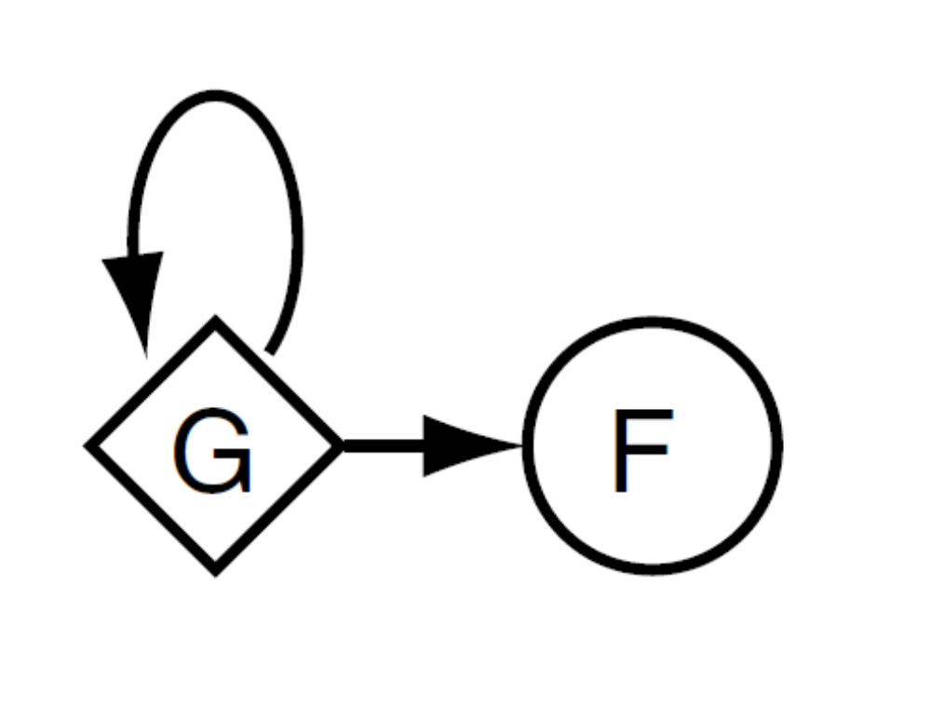
Notes:
When HMM alignments are scored, they are scored by a log-odds score relative to a “null model” of random
sequence composition (Barrett et al., 1997). In Plan 7, this model is now specified as a full probabilistic
model too:
The G state has a symbol emission probability distribution for K symbols in the alphabet. By default,
this distribution is set either to the average amino acid composition of SWISSPROT 34, or to 0.25 for each
nucleotide. The G ! G transition controls the expected length of observed random sequences; in practice,
this transition probability is so close to 1 that it has very little effect. The F state is just a dummy end state
like the T state in the Plan 7 architecture.

Slide 15
Local alignments
Notes:
Local alignments in Plan 7
The Plan 7 architecture models a complete sequence, regardless of how much of that sequence matches the
main model. All alignments to a Plan 7 model are “global” alignments, but some of the sequence may be
assigned to Plan 7 states (N,C,J) that generate “random” sequence that is not aligned to the main model.
Thus, the algorithm dependent parts of the model control the apparent locality of the alignments.
Local alignments with respect to the sequence (i.e., allowing a match to the main model anywhere
internal to a longer sequence) are controlled by the N and C states. If the N ! N transition is set to 0,
alignments are constrained to start in the main model at the very first residue. Similarly, if the C ! C
transition is set to 0, alignments are constrained to match the main model at the very last residue in the
sequence.
Local alignments with respect to the model (i.e., allowing fragments of the model to match the sequence)
are controlled by B!M “entry” transitions and M!E “exit” transitions, shown as dotted lines in the Plan
19
7 figure. Setting all entries but the B!M1 transition to 0 forces a partially “global” alignment in which all
alignments to the main model must start at the first match or delete state. Setting all exits to 0 but the final
M ! E transition (which is always 1.0) forces a partially global alignment in which all alignments to the
main model must end at the final match or delete state.
Multiple hit alignments are controlled by the E ! J transition and the J state. If the E ! J transition
is set to 0, a sequence may only contain one domain (one alignment to the main model). If it is nonzero,
more than one domain per sequence can be aligned to the main model. The J ! J transition controls the
expected length of the intervening sequence between domains; the lower this probability, the more clustered
the domains are expected to be.
The original HMMER1 search programs are encoded in Plan 7 models as follows:
hmms Simple global alignment. tNN and tCC set to tGG from the null model (see below).
tEJ set to zero. Internal entries and exits set to zero.
hmmls Akin to “profile” alignment (as Waterman and others call it): global with respect
to main model, local with respect to sequence, multiple nonoverlapping domains
allowed. tNN and tCC set to tGG from the null model. tEJ set to 0.5. Internal
entries and exits set to zero.
hmmsw Smith/Waterman alignment: fully local with respect to both the main model and
the sequence; single domain. tNN and tCC set to tGG from the null model. tEJ set
to zero. Internal entries are set to 0:5=(M 􀀀 1) for a model with M match states.
Exit probabilities are set such that the overall chance of exiting from an internal
match state is 0.5, and the posterior probability distribution over which match state
is exited is equal (I’m trying to word this carefully; the M!E probabilities are not
equal, because there’s a small compensation for the fact that if you can leave from
M5, then the chance that you’ll even get to M6 is reduced.)
hmmfs Multihit Smith/Waterman alignment. Same as the above, but tEJ is set to 0.5.
One advantage of Plan 7 is great flexibility in choosing an alignment style. Complicated alignment styles
are easily encoded in the model parameters without changing the alignment algorithm. For example, say
you wanted to model human L1 retrotransposon elements. Because of the way L1 elements are inserted by
reverse transcriptase (RVT), L1 elements tend to have a defined 3’ end (RVT starts replication at the same
place in each new L1) but a ragged 5’ end (RVT prematurely falls off a new L1 in an unpredictable fashion).
A specialized L1 model could define non-zero internal entry probabilities and zero internal exit probabilities
to model this biological situation.
One disadvantage of Plan 7 is that if you decide you want to do both local and global alignments, you
need two different models (or you need to do one search, then change the model). This wouldn’t be a terrible
burden except for the fact that the algorithm-dependent parameters strongly affect the values of the and
parameters that E-value statistics depend on. If the algorithm dependent parameters are changed, these
parameters are lost and the model should be recalibrated with hmmcalibrate – and hmmcalibrate is
relatively slow.

Slide 16
Wing retraction
Notes:
Wing retraction in Plan 7 dynamic programming
In the figure of the Plan 7 architecture, you may have noticed that the first and last delete states are greyed
out. Internally in HMMER, these delete states exist in the “probability form” of the model (when the model
is being worked with in every way except alignments) but they are carefully removed in the “search form”
of the model (when the model is converted to log-odds scores and used for alignments). This process is
called “wing retraction” in the code, by analogy to a swept-wing fighter changing from a wings-out takeoff
and landing configuration to a wings-back configuration for high speed flight.
The problem is that the Plan 7 model allows cycles through the J state. If a continuous nonemitting
“mute cycle” were possible (J, B, D states, E, and back to J), dynamic programming recursions would fail.
This is why special mute states like delete states must be handled carefully in HMM dynamic programming
algorithms; see (Durbin et al., 1998) for further discussion. The easiest way to prevent a mute cycle is to
make sure that the model must pass through at least one match state per path through the main model.
Wing retraction involves folding the probabilities of the terminal delete paths into the Plan 7 entry and
exit probabilities. For example, in wing retraction the “algorithm dependent” B ! M3 entry probability is
incremented by the probability of the “data dependent” path B ! D1 ! D2 !M3.
Having the wing retraction step, rather than always folding these probabilities together, is a design
decision, preserving a distinction between the “algorithm dependent” and “data dependent” parts of the
model.

