Slide 1


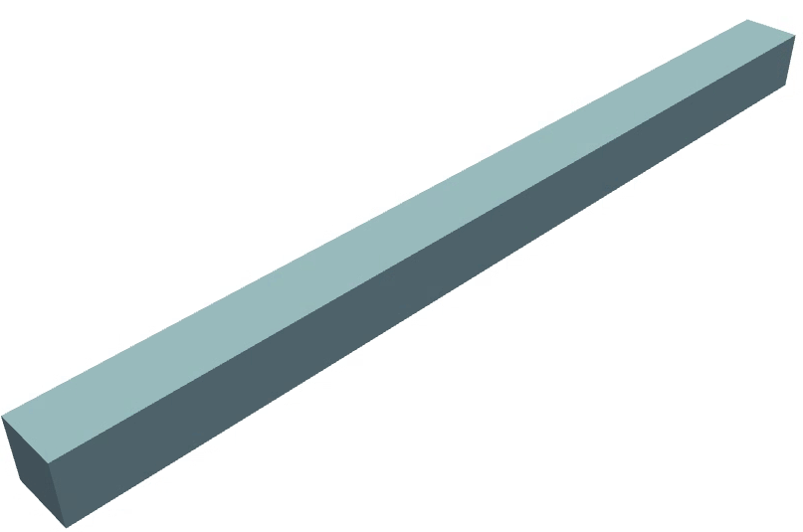
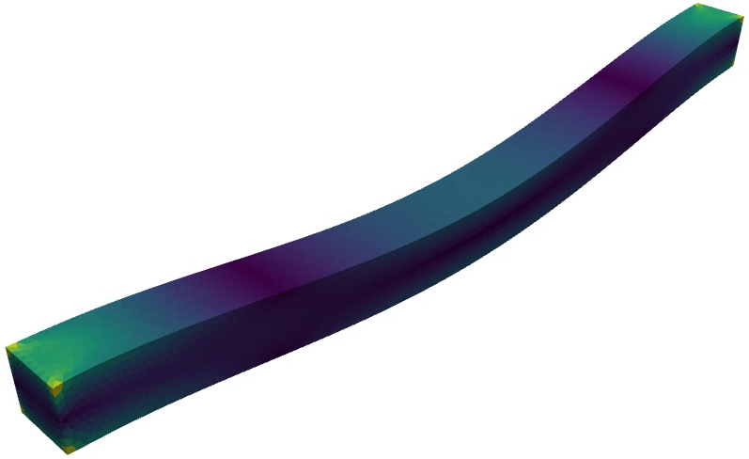
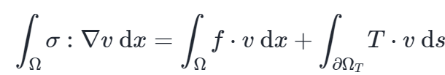
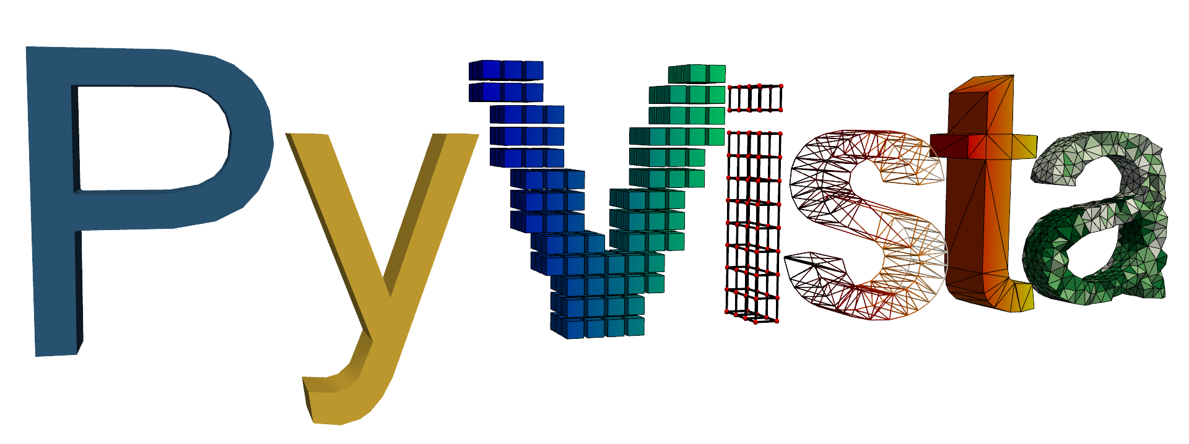


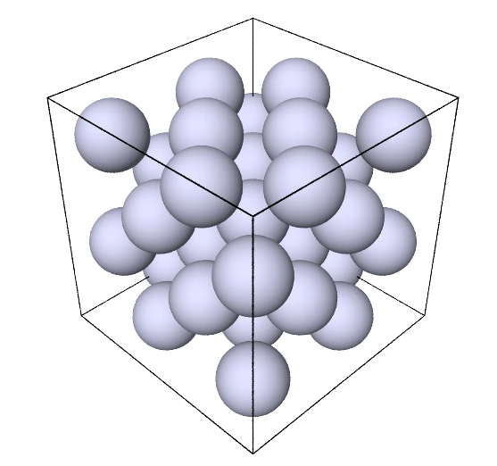
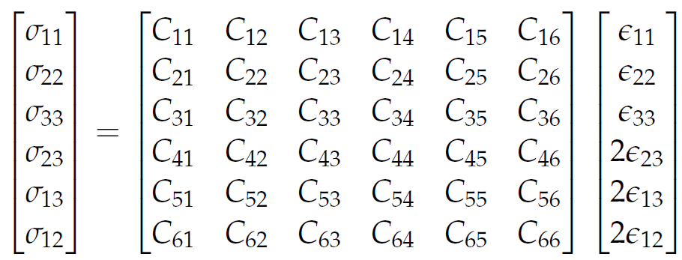

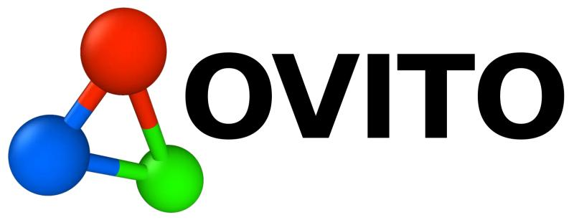

Deformation of a silver bar: from atomistic to continuum (FEM)
Traction
Clamp
Gravity
Clamp
Strain and fit
To Tilmann for MSE 2024
Tara

Slide 2
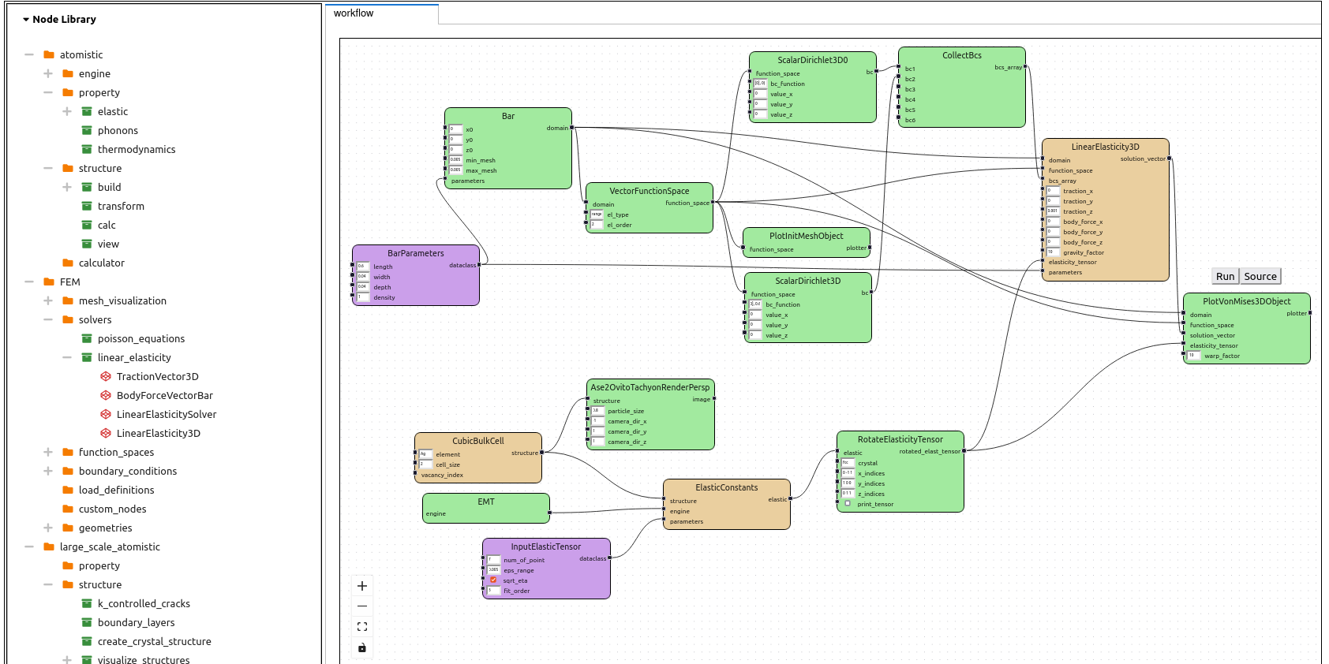
Setting up the workflow and execution
FEM
Select desired nodes
Atomistic
To Tilmann for MSE 2024
Tara

Slide 3
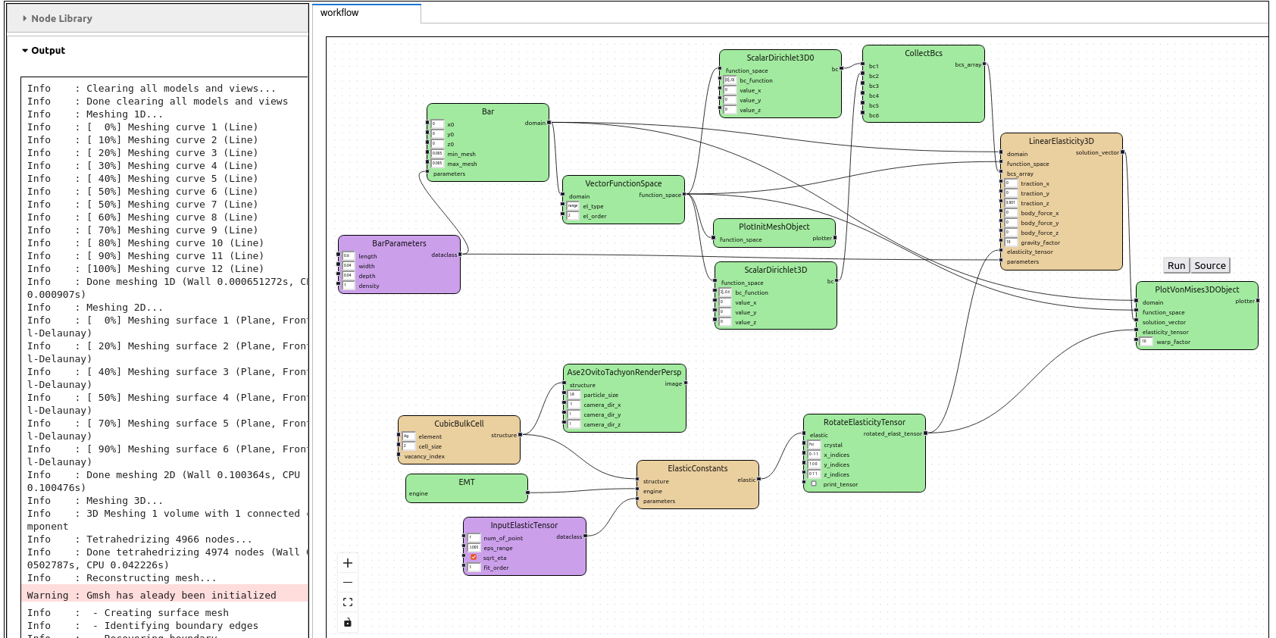
Setting up the workflow and execution
View output/source
FEM
Click run to view output – executes the selected node and all previous conneced nodes
Click source to view source code
Atomistic
To Tilmann for MSE 2024
Tara

Slide 4
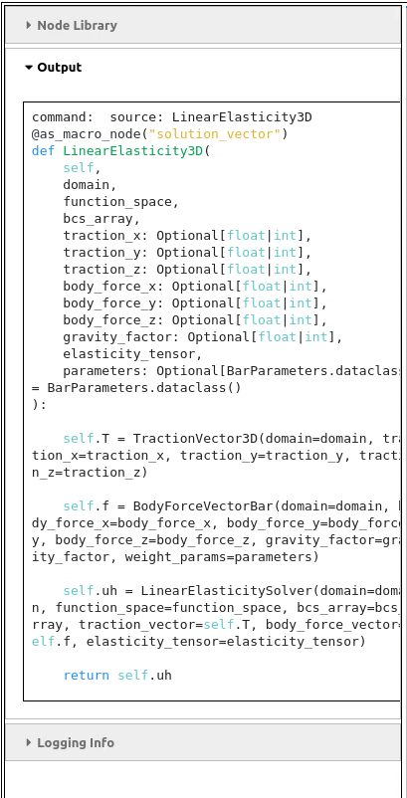
Setting up the workflow and execution
View output/source
FEM
Click run to view output – executes the selected node and all previous conneced nodes
Click source to view source code
Atomistic
To Tilmann for MSE 2024
Tara

Slide 5
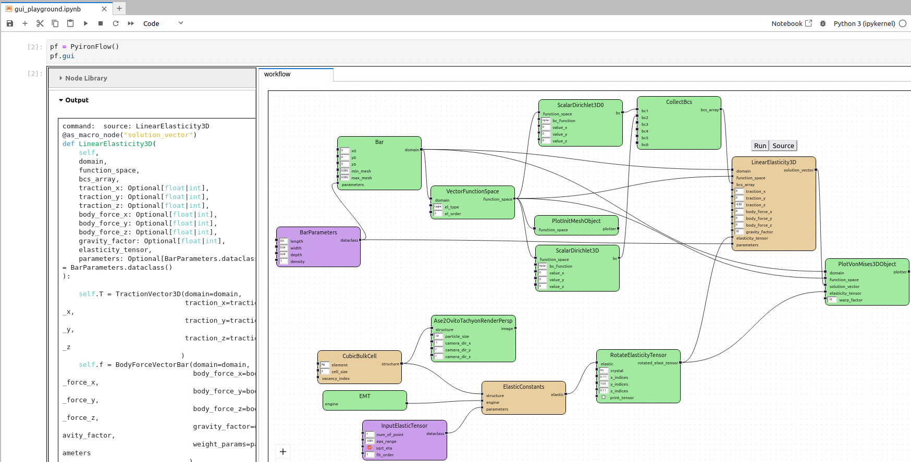
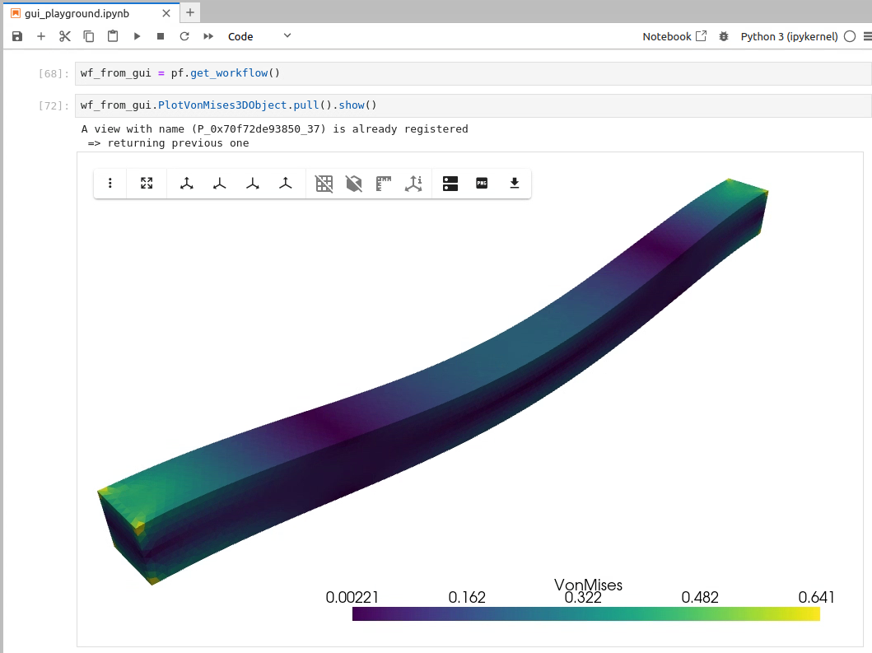
Extracting and visualizing results
To Tilmann for MSE 2024
Tara

Slide 6
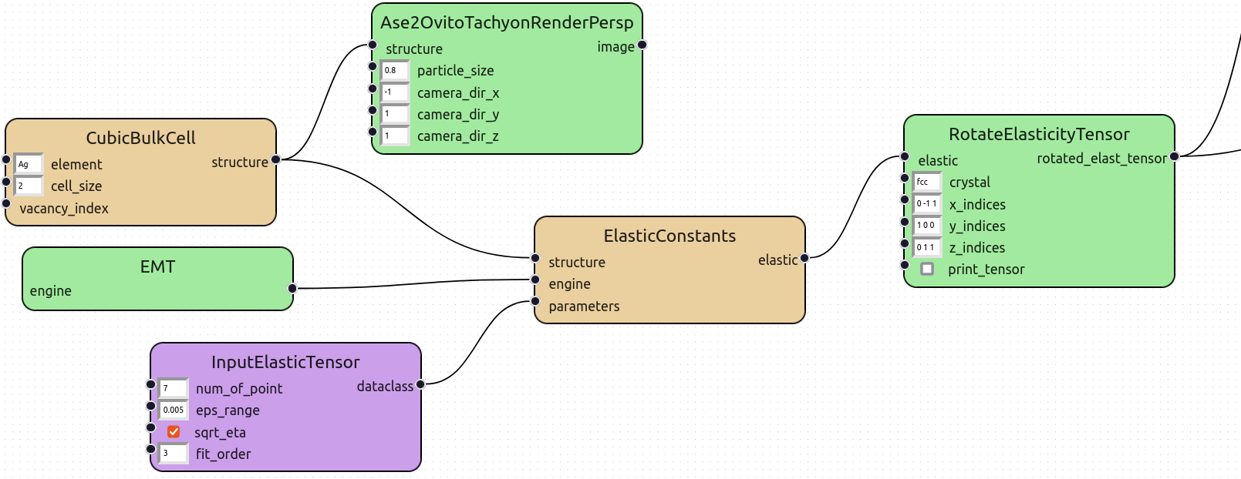
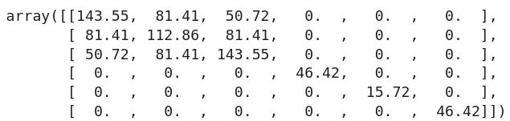
The atomistic workflow: nodes and tools involved
Green: function node
Orange: macro node
Violet: dataclass node
To Tilmann for MSE 2024
Tara

Slide 7
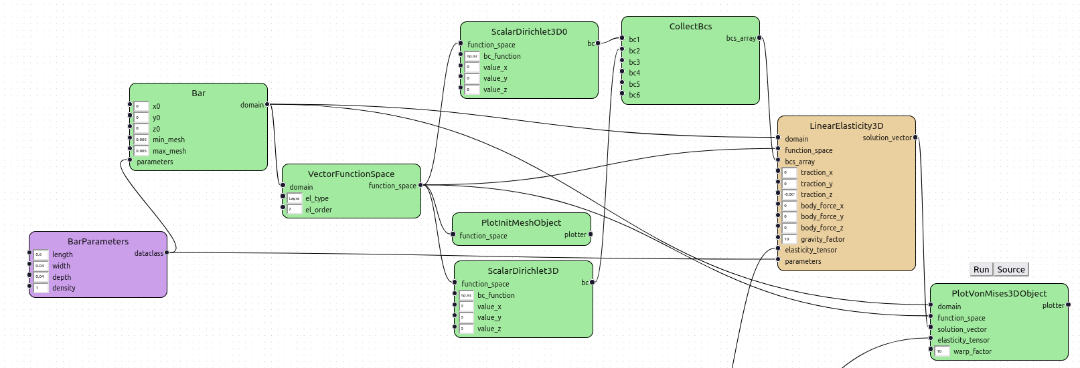
The FEM workflow: nodes and tools involved
Green: function node
Orange: macro node
Violet: dataclass node
To Tilmann for MSE 2024
Tara

