Slide 1
Prediction of Crystal Structure Class
Dunce Caps

Slide 2
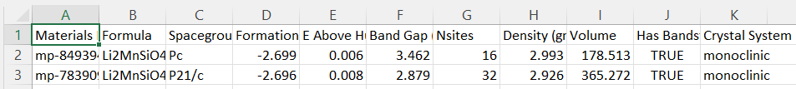
Goal
Take in some number of these features and predict a crystal structure for Li-ion electrodes
Also predicts the missing inputs from user:
User inputs ‘Formula’, ‘Formation Energy’, and ‘Density’
Model returns predicted crystal structure and ’Nsites’, ‘Band Gap’, ‘Volume’
Potential Features
Target

Slide 3
Demo 1
Demo 1: Undergraduate MSE student doesn’t want to buy Professor’s textbook for table of material values.
Question in homework is gives formula of semiconductor and Nsites but needs to find the formation energy associated with crystal structure.
Enter Model (live)

Slide 4
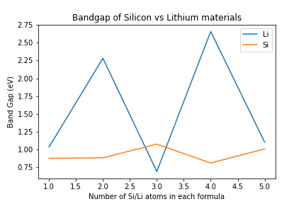
Demo 2
A PhD student wants to get a quick characterization of the performance of some batteries via band gap they are researching prior to buying the material for them.
They want to find general trends in data with increasing counts of Li vs increasing counts of Si
Larger band gap means it is more challenging for electrons to jump… need more voltage for electrons to jump
They carry out a literature review and find 5 materials based in Si and 5 materials based in Li
Enter model
Si has a much lower band gap and is a better semiconductor than Li

Slide 5
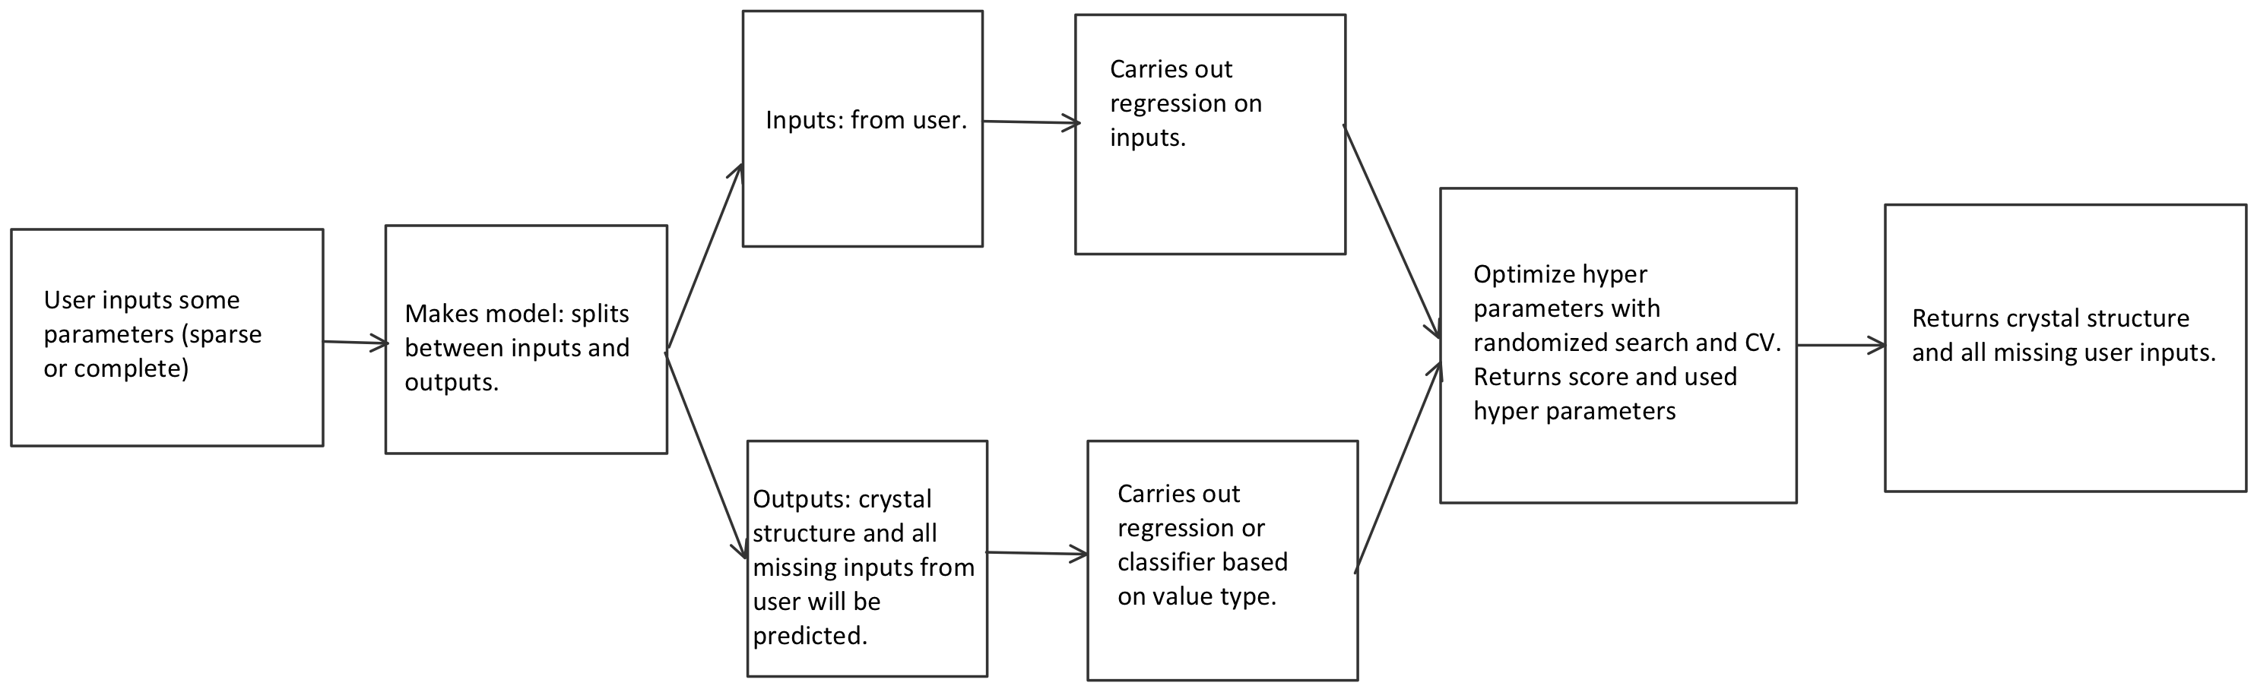
Workflow

Slide 6
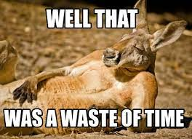
Artificial Neural Networks
Assign input “neurons” (parameters) and output ”neurons” with hidden layers in between
Multi-Class Classification using Keras
Pro: Ability to work with incomplete knowledge
After ANN training, the data may produce output even with incomplete information
Normalize data using StandardScaler
LabelEncoder to convert output labels into integers
Loss function: Sparse Categorical Crossentropy
Output activation function: Softmax
RandomizedSearchCV for hyperparameter tuning

Slide 7
Classifiers and Regressors
Decision Trees
In scikit-learn
Uses a decision tree to go from observations about an item (represented in the branches) to conclusions about the item's target value (represented in the leaves)
Con: Requires all parameters to be active
Random Forest
In scikit-learn
Classification algorithm consisting of many decisions trees.
Random bagging when building each tree to create an uncorrelated forest of trees whose collective prediction better than one.
Cons: Variations in data can have large impact
Gradient Boosting
In scikit-learn
It relies on the intuition that the best possible next model, when combined with previous models, minimizes the overall prediction error. The key idea is to set the target outcomes for this next model in order to minimize the error.
Cons: Overestimate outliers can cause Overfitting

