Slide 1
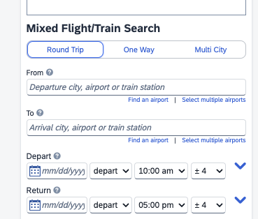
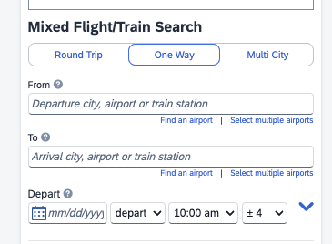
WPI_Airlines_Booking_T1
Search
Search

Slide 2
Send SOW with comments to help the RAD: Rod (1.1, 1.2, 1.3) Skyler (2.), Jac and Rod (3.0)
Saturday Jac and Rod to meet at 7 PM
Sunday 7 PM to make one doc, please bring in your work ready.
Jac to check how to seats, price, Lat, and Long (with Skyler)
Skyler to start the MySQL Model (Jac and Rod to Assist)
Jac to check AWS, try to deploy: Hello!
Jira will be the source for project and speed charts
The next meeting is on Tuesday

