Slide 1
Data Loading
Hyper-parameters Grid Search
Modeling Building
MLP w/ Keras
Evaluation Phase (F1, Precision)
Best Model Save
Performance check w/ Test Dataset
Model Selection

Slide 2
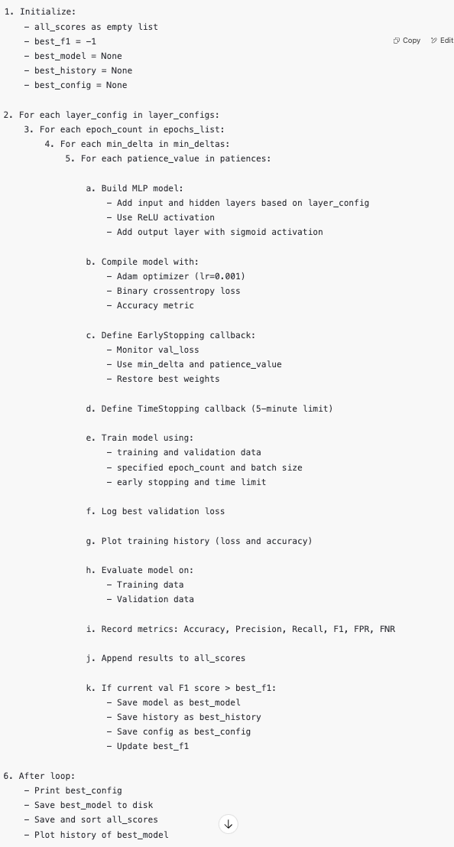

Slide 3
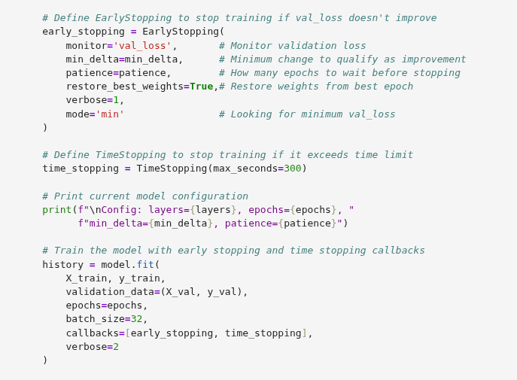
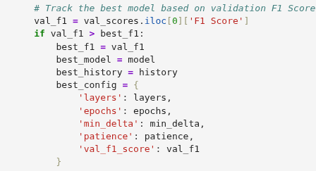

Slide 4
