Slide 1




Phishing Detection
Nathan Poch
Masters in Cyber Security
Maurisa Dacosta
Masters in Computer Science
Rodrigo Arguello
Masters in Computer Science

Slide 2

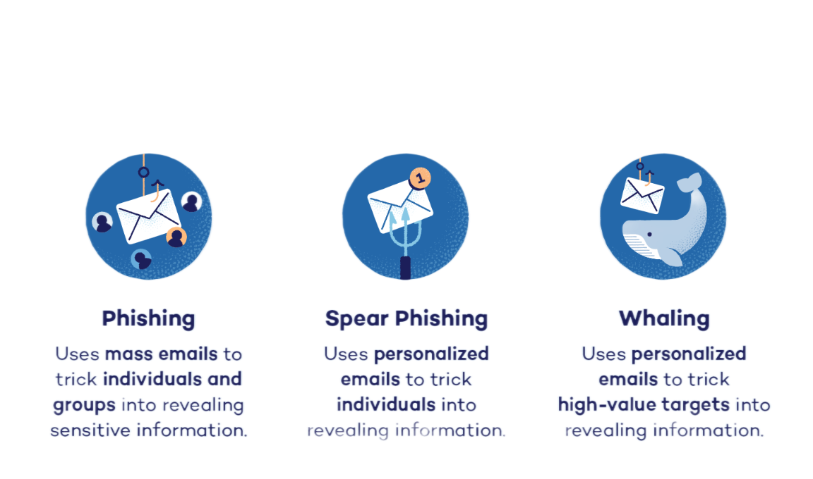
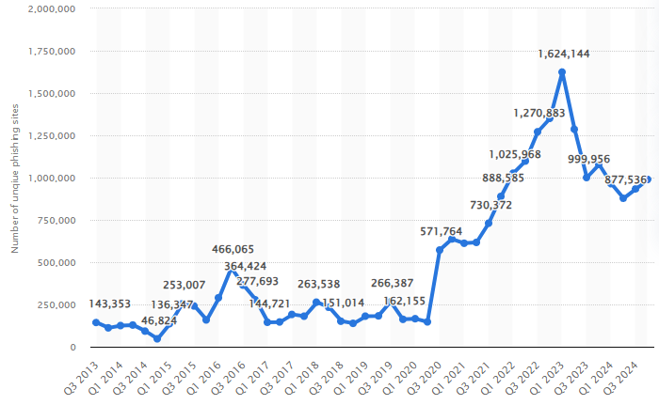

Common Phishing Types
The number of detected phishing sites across the world in each quarter from the 3rd quarter of 2013 to the 4th quarter of 2024 (Statista, 2025).
Notes:
Why Phishing Matters
Phishing, in cybersecurity, refers to an attempt by hackers to obtain a user's private information, such as passwords, credit cards, or bank account data (Burita et. al., 2021)
91% of system breaches start with phishing (Alkhalil et al.,2021)
$4M+ avg. cost per breach (Imber,2025)
3.4B spam emails daily; Google blocks 100M phishing emails/day
Project objectives
Detect phishing attempts from email/URL data
Compare effectiveness of 3 machine learning models (XG Boost, Random Forest, MLP)
Use DistilBERT for feature extraction

Slide 3

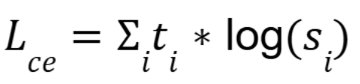
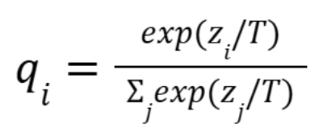

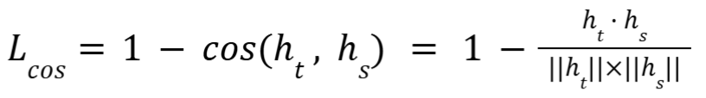
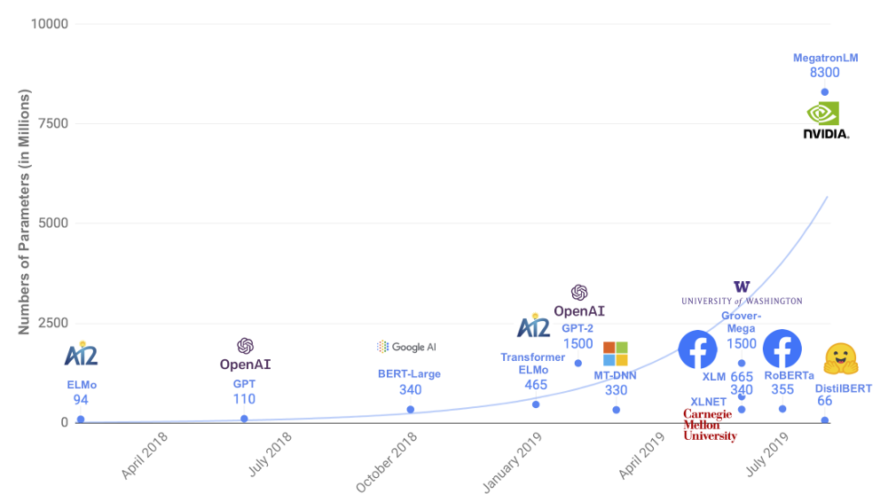
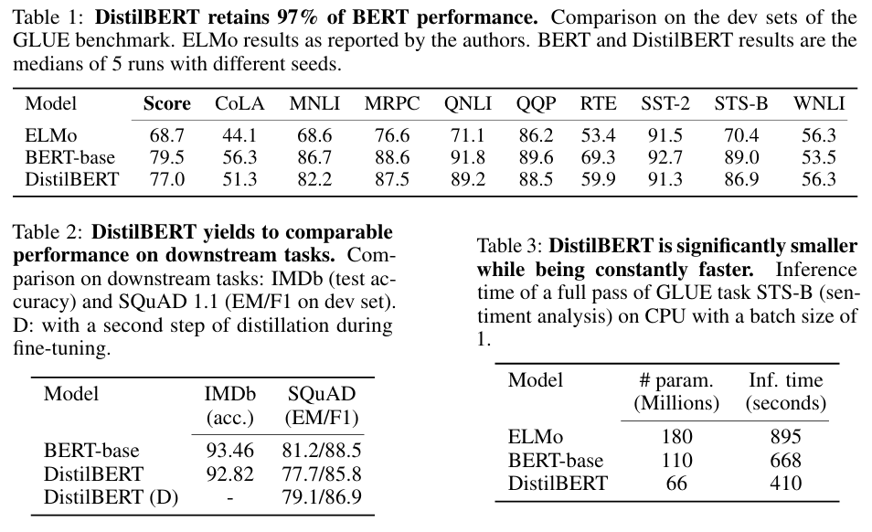
Feature Extraction Using DistilBERT
Softmax
40% smaller, 60% faster than BERT
97% of BERT’s performance
Extracts semantic features from phishing emails/URLS
Notes:
ELMo: Introduced in March 2018 by Peters et. al., courtesy of the University of Washington
Embeddings from Language Models (ELMo)
Derived from a bidirectional LSTM
1802.05365v2
BERT: Introduced in May 2019 by Google AI
Bidirectional Encoder Representations from Transformers
uses a "masked language model" (MLM) and bidirectional transformers
DistilBERT: Introduced by Hugging Face in 2019, with the final version of their paper being submitted in March 2020.
Bert, but smaller and faster.
40% the size, 60% faster, and 97% of the performance
Sanh et. al. DistilBERT, a distilled version of BERT: smaller, faster, cheaper, and lighter
We will use DistilBERT to extract semantic features from phishing emails

Slide 4
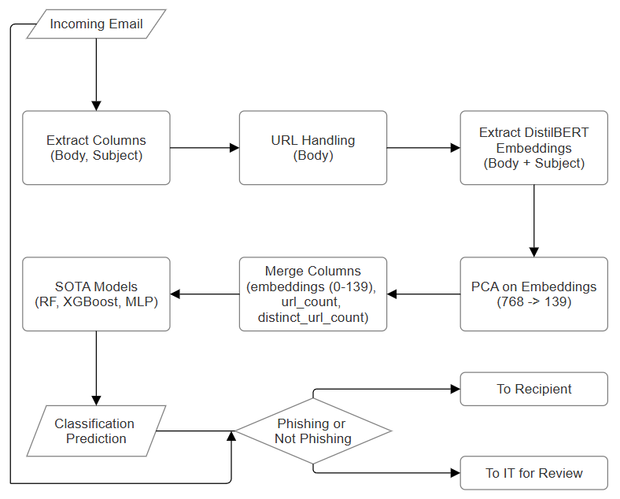
Architecture Overview

Slide 5
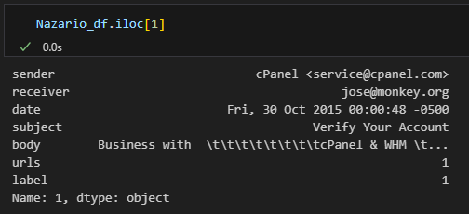
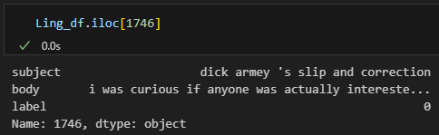
The Data (Pre-Cleaning)
https://www.kaggle.com/datasets/naserabdullahalam/phishing-email-dataset/data
1) Combined
(subject + " " + body).
2) Passed to DistilBERT for embeddings
3) Embeddings passed through PCA (95% entropy)
Drop
{
Drop
Drop
}
URL extraction and replacement (all URLs replaces with <url>)
Replace (url_count, distinct_url_count)

Slide 6
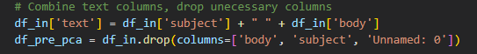
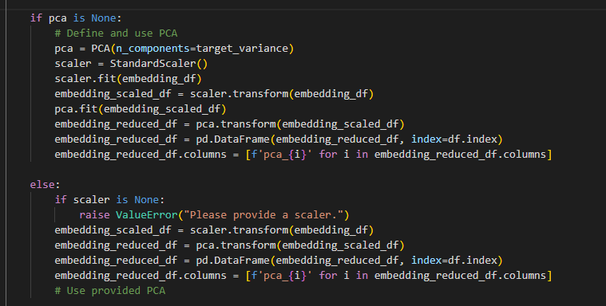
Feature Extraction with DistilBERT and PCA

Slide 7
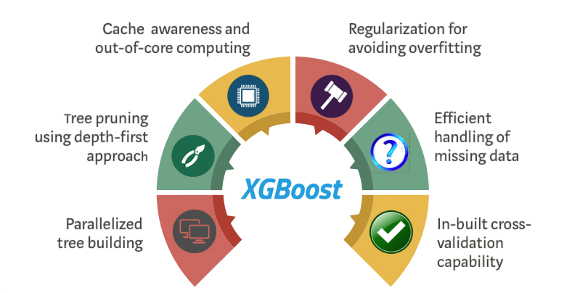
Why XG Boost ?
Notes:
-XGBoost (Extreme Gradient Boosting) is an optimized implementation of gradient boosting known for high performance and scalability (Shahrivari, Darabi, & Izadi, 2020)
-Builds an ensemble of weak learners, typically decision trees improving them iteratively to enhance performance (Shahrivari, Darabi, & Izadi, 2020)
-Scalable to large datasets suitable for both distributed systems and memory-constrained environments (Gu & Xu, 2022)
- Supports parallel and distributed computing, accelerating training and experimentation (Shahrivani, Darabi, & Izadi, 2020).
Regularization techniques reduce overfitting especially valuable in phishing detection (Gu & Xu, 2022)
Learning rate improves generalization on noisy or imbalanced datasets (Gu & Xu, 2022)
Flexibility allows for tailored optimization, making it ideal for phishing and email classification tasks (Gu & Xu, 2022)

Slide 8
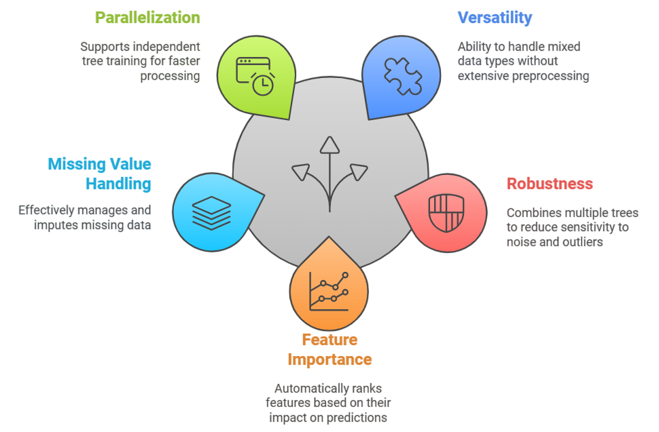
Why Random Forest ?
Notes:
Random forest is a supervised ML technique used in classification and regression problems (Dinesh et al.,2023)
Combines multiple decision trees tp increase accuracy and reduce overfitting through ensemble learning (Shahrivari, Darabi, & Izadi, 2020)
Performs well on large, imperfect data sets typical in phishing detection (Dinesh et al,, 2023)
Ensemble averaging reduces variance, as supported by the Central Limit theorem (Shahrivari, Darabi, & Izadi, 2020)

Slide 9
Random Forest & XGBoost Two-Stage Tuning Strategy
Tuning Stage | Random Forest | XG Boost
Randomized Search Parameters (3-fold Cross Validation | n_estimators: (300,600) max_depth: (5,30) min_samples_split: (5,15) min_samples_leaf: (2,15) | n_estimators: (100,300) max_depth: (3,8) learning_rate: (0.01,0.2) subsample: (0.6,0.4)
2. Grid Search Parameters (5-fold Cross Validation) | n_estimators: [400,420,442,462,482] max_depth: [17,19,21,23] min_samples_split: [8,10,12] min_samples_leaf: [3,4,5,6] | n_estimators: [225,245,265] max_depth: [5,6,7] learning_rate: [0.12, 0.135, 0.145, 0.15] subsample: [0.8, 0.845, 0.9]
Notes:
Library used: RandomForestClassifier from scikit-learn
Tuning: RandomizedSearchCV (3-fold cross validation)
Tuned parameters: n_estimators (number of trees)
max_depth (depth of trees)
min_samples_split (minimum samples to split a node)
min_samples_leaf (minimum samples per leaf)

Slide 10
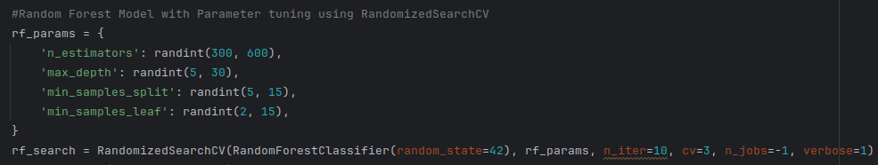
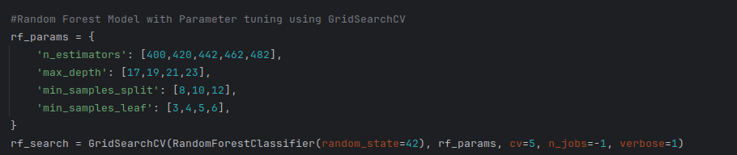
Random Forest Model
Stage 1: Tuning Hyperparameters with Randomized Search
Stage 2: Tuning with GridSearch Based on Performance of Randomized Search
Notes:
Library used: RandomForestClassifier from scikit-learn
Tuning: RandomizedSearchCV (3-fold cross validation)
Tuned parameters: n_estimators (number of trees)
max_depth (depth of trees)
min_samples_split (minimum samples to split a node)
min_samples_leaf (minimum samples per leaf)

Slide 11
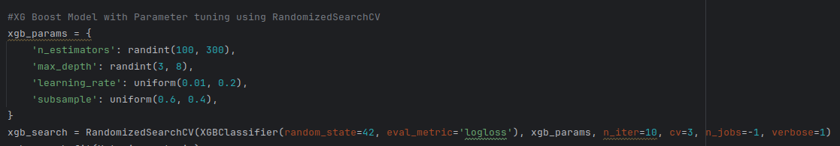
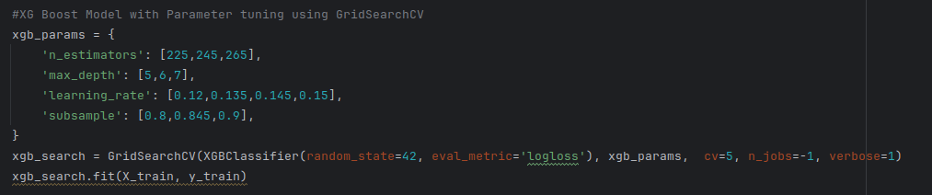
XG Boost Model
Stage 1: Tuning Hyperparameters with Randomized Search
Stage 2: Tuning with GridSearch Based on Performance of Randomized Search
Notes:
Library used: RandomForestClassifier from scikit-learn
Tuning: RandomizedSearchCV (3-fold cross validation)
Tuned parameters: n_estimators (number of trees)
max_depth (depth of trees)
min_samples_split (minimum samples to split a node)
min_samples_leaf (minimum samples per leaf)

Slide 12
Randomized Search Top Combinations
Legend Key
Parameters | max_depth | min_samples_leaf | min_samples_split | n_estimators
1 | 19 | 4 | 10 | 442
2 | 20 | 6 | 6 | 499
3 | 19 | 10 | 10 | 412
4 | 24 | 11 | 6 | 488
5 | 20 | 13 | 12 | 464
6 | 27 | 12 | 5 | 329
7 | 12 | 14 | 13 | 583
8 | 11 | 9 | 12 | 326
9 | 7 | 10 | 8 | 592
10 | 7 | 5 | 8 | 408
Legend Key
Parameters | learning_rate | max_depth | subsample | n_estimators
1 | 0.145 | 7 | 0.845 | 245
2 | 0.150 | 6 | 0.948 | 223
3 | 0.101 | 7 | 0.973 | 237
4 | 0.132 | 5 | 0.773 | 156
5 | 0.084 | 5 | 0.708 | 156
6 | 0.073 | 3 | 0.652 | 278
7 | 0.122 | 3 | 0.907 | 120
8 | 0.112 | 3 | 0.965 | 121
9 | 0.011 | 7 | 0.777 | 239
10 | 0.043 | 3 | 0.871 | 193

Slide 13
Randomized Search Metrics
Metric | Random Forest | XG Boost
Top Params | n_estimators: 442 max_depth: 19 min_samples_split: 10 min_samples_leaf: 4 | n_estimators: 245 max_depth: 7 learning_rate: 0.145 subsample: 0.845
Train / Val Accuracy | 99.83% / 96.88% | 100.00% / 98.14%
Precision | Class 0: 0.97 Class 1: 0.97 | Class 0: 0.98 Class 1: 0.98
Recall | Class 0: 0.97 Class 1: 0.97 | Class 0: 0.98 Class 1: 0.98
F1-Score | Macro: 0.97 Weighted: 0.97 | Macro: 0.98 Weighted: 0.98
Overall Accuracy | 96.88% | 98.14%

Slide 14
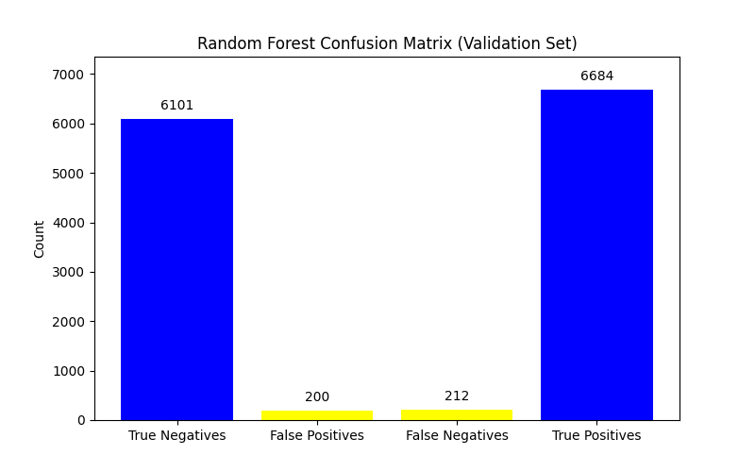
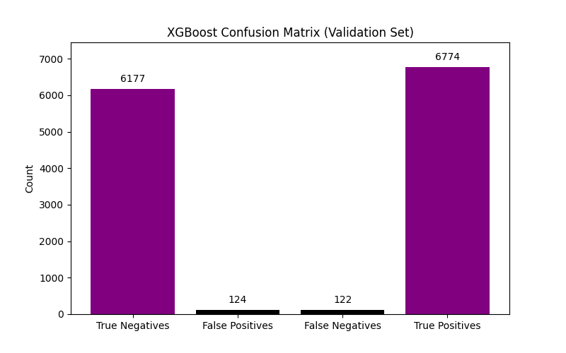
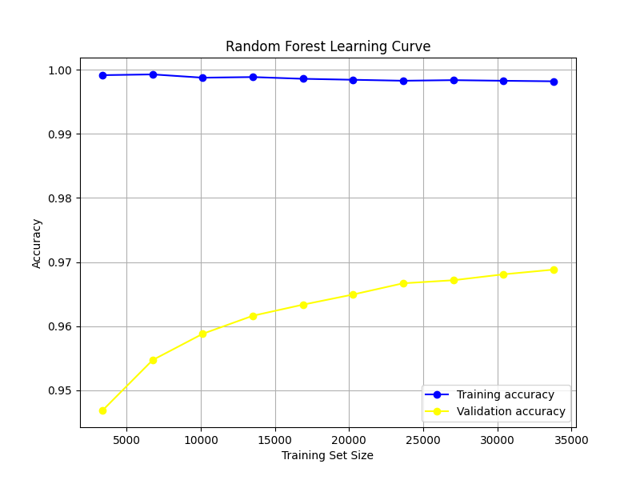
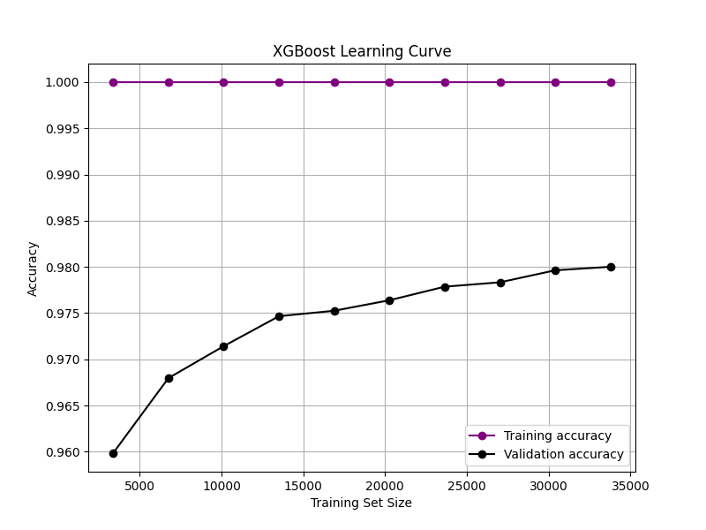
Randomized Search Insights

Slide 15


Grid Search Metrics & Insights
Metric | Random Forest | XG Boost
Top Params | n_estimators: 482 max_depth: 23 min_samples_split: 8 min_samples_leaf: 3 | n_estimators: 265 max_depth: 7 learning_rate: 0.15 subsample: 0.845
Train / Val Accuracy | 99.94% / 97.12% | 100.00% / 98.05%
Precision | Class 0: 0.97 Class 1: 0.97 | Class 0: 0.98 Class 1: 0.98
Recall | Class 0: 0.97 Class 1: 0.97 | Class 0: 0.98 Class 1: 0.98
F1-Score | Macro: 0.97 Weighted: 0.97 | Macro: 0.98 Weighted: 0.98
Overall Accuracy | 97.12% | 98.05%

Slide 16
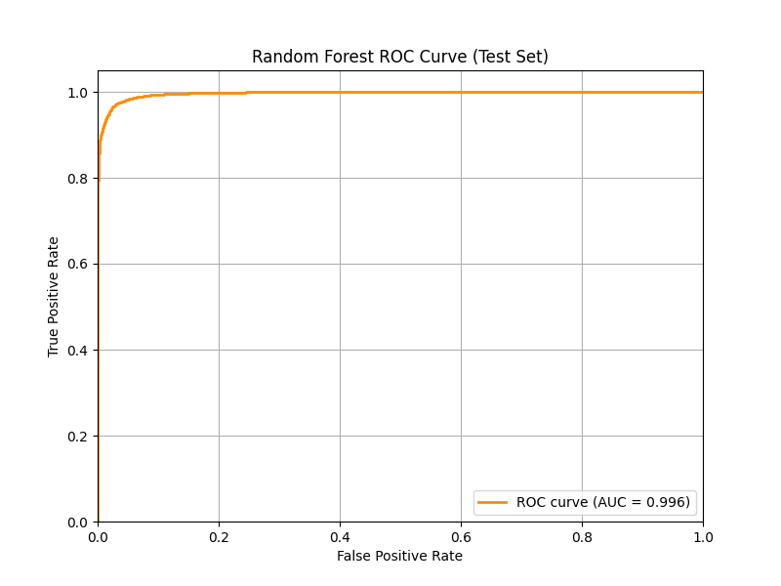
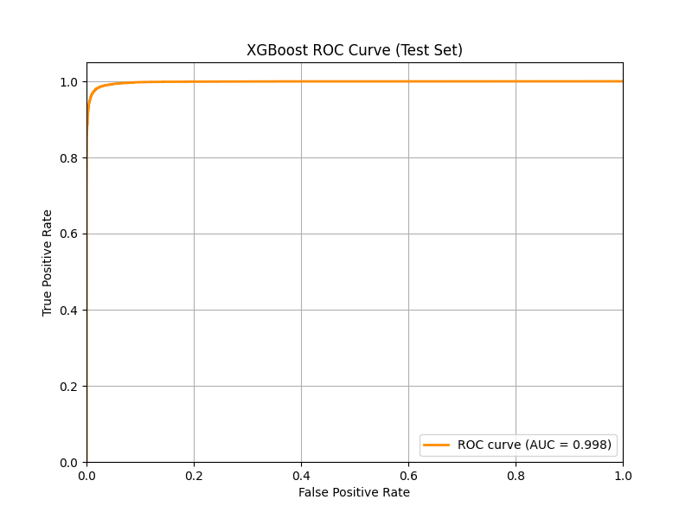
Performance of Tuned Models on Test Data
Metric | Random Forest | XGBoost
True Positives (TP) | 8245 | 8353
True Negatives (TN) | 7753 | 7823
False Positives (FP) | 223 | 163
False Negatives (FN) | 266 | 153
Precision | Class 0: 0.967 Class 1: 0.973 | Class 0: 0.981 Class 1: 0.981
Recall | Class 0: 0.971 Class 1: 0.969 | Class 0: 0.980 Class 1: 0.982
F1-Score | Macro: 0.970 Weighted: 0.970 | Macro: 0.981 Weighted: 0.981
Overall Accuracy | 96.98% | 98.08%

Slide 17

Why MLP ?
Adapts to new threats
Supports real-time detection with low false positives
Learns non-linear patterns, detects anomalies
Provides quick predictions after training
Works well with large input data
Notes:
MLP is a lightweight feedforward neural network widely used for classification and non-linear pattern recognition (Asani et al.,2024)
Capable of extracting features ,identifying anomalies, and defining non-linear decision boundaries (Reddy, 2023).
Especially suited for recognizing sophisticated phishing techniques that evade simpler models (Reddy, 2023).
Learns from updated datasets over time—improves accuracy and reduces false positives (Asani et al., 2024)
Supports real-time analysis, which is crucial in phishing detection (Asani et al., 2024).
Effective with proper parameter tuning and training on relevant phishing datasets (Reddy, 2023)

Slide 18
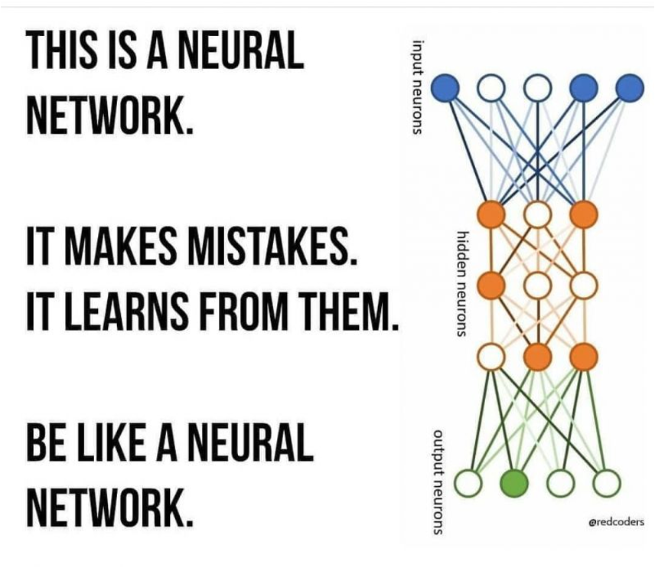
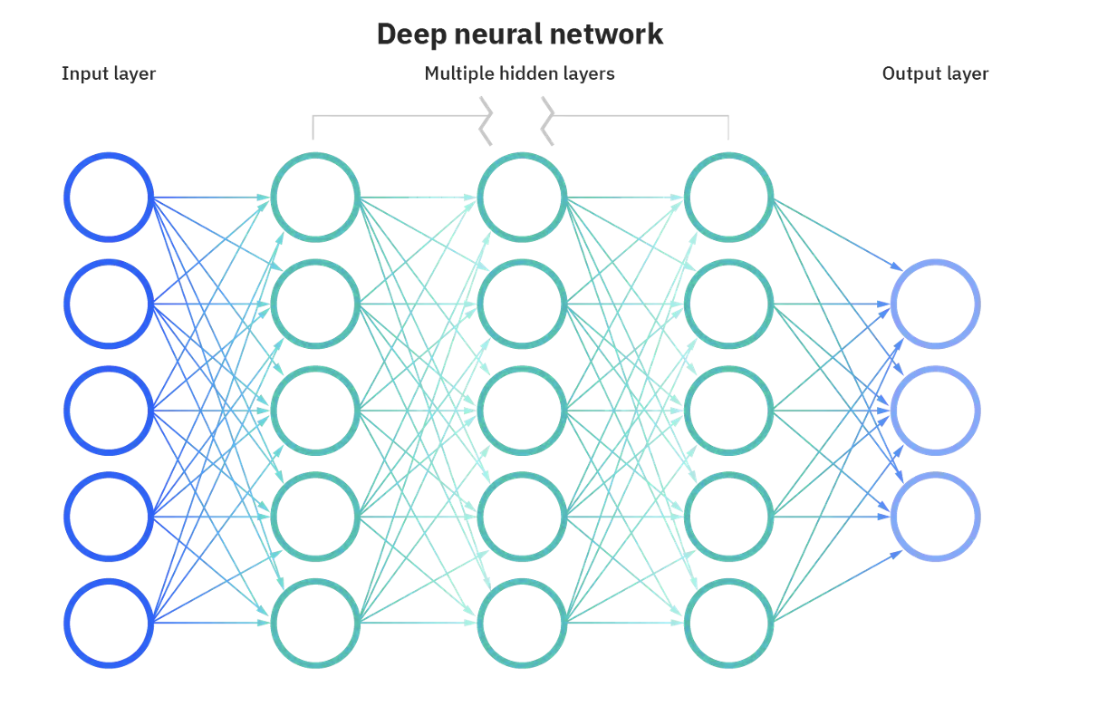
Multi-Layer-Perceptron Model (MLP)

Slide 19
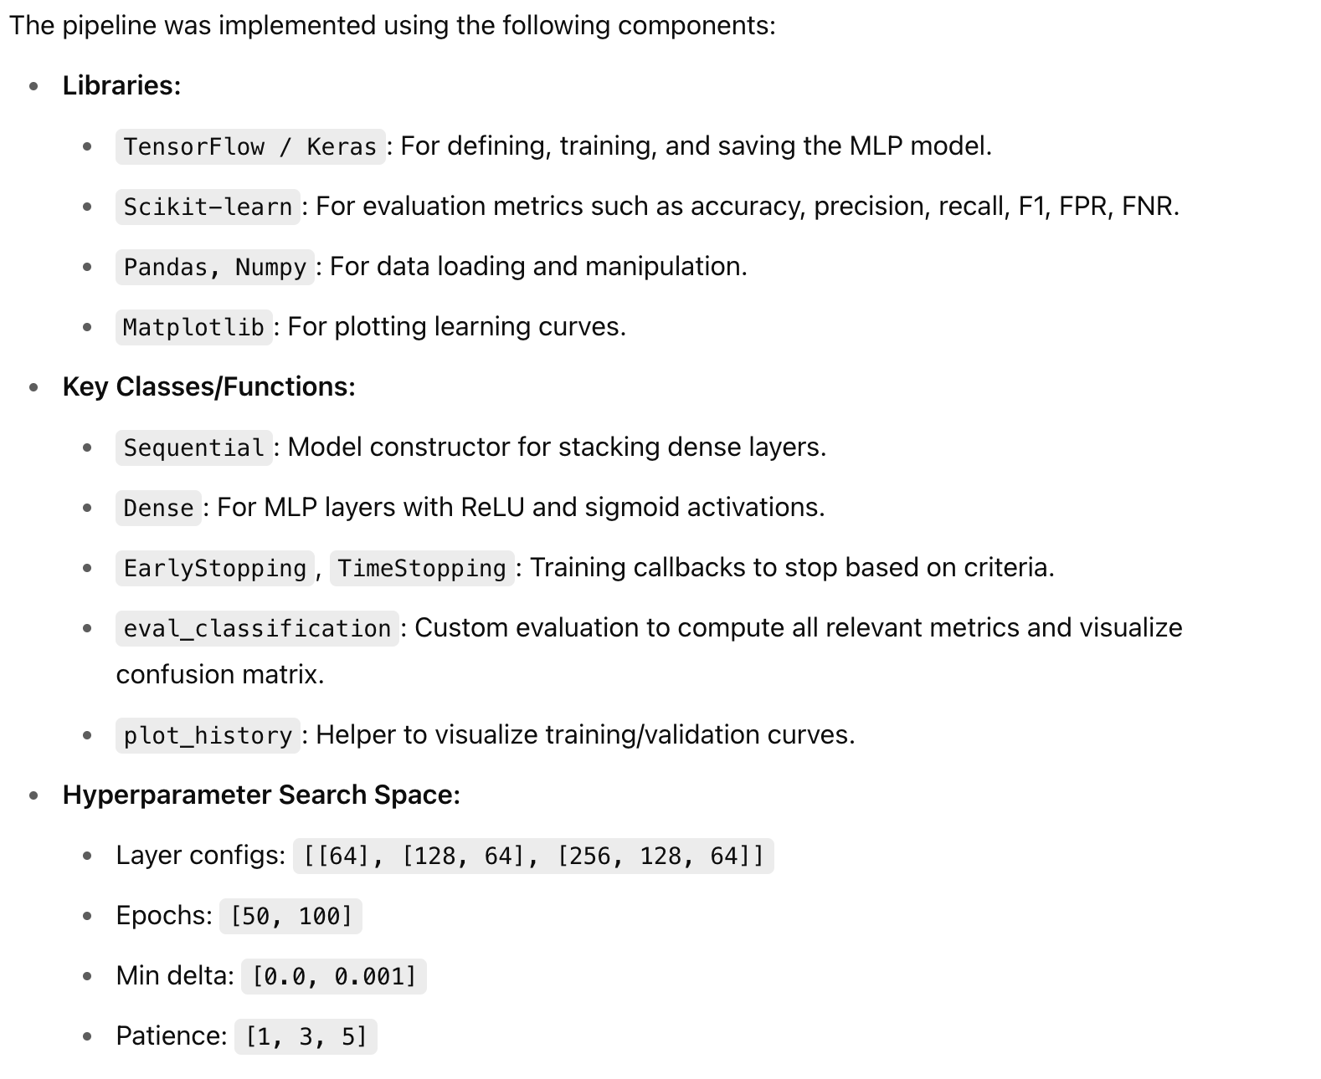
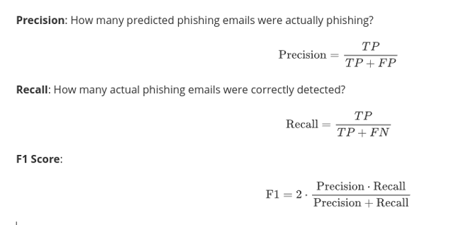
Multi-Layer-Perceptron Model - Metrics

Slide 20
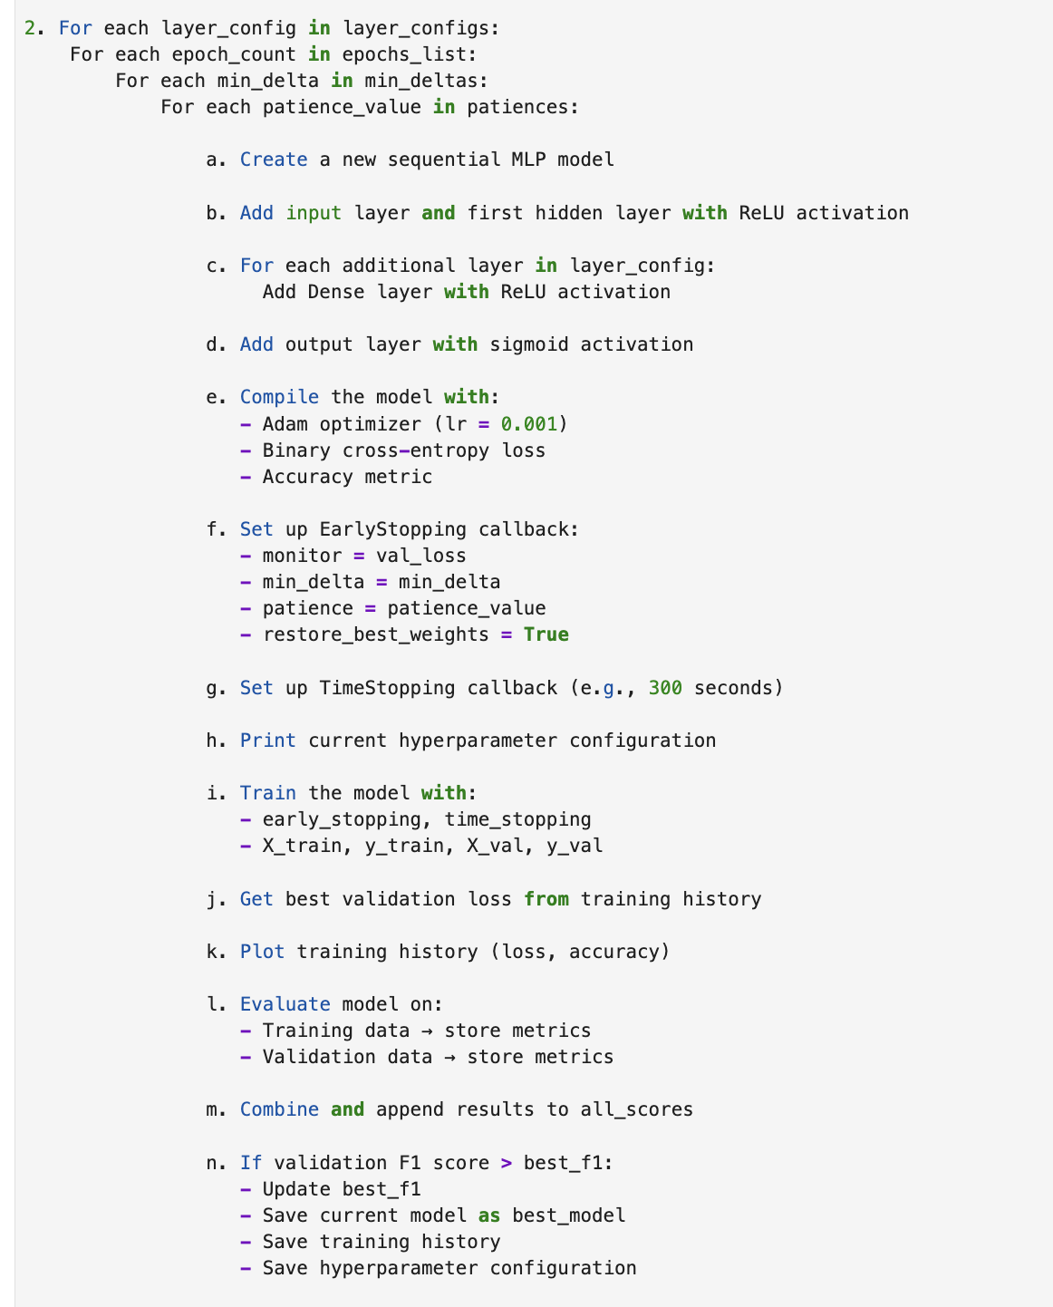
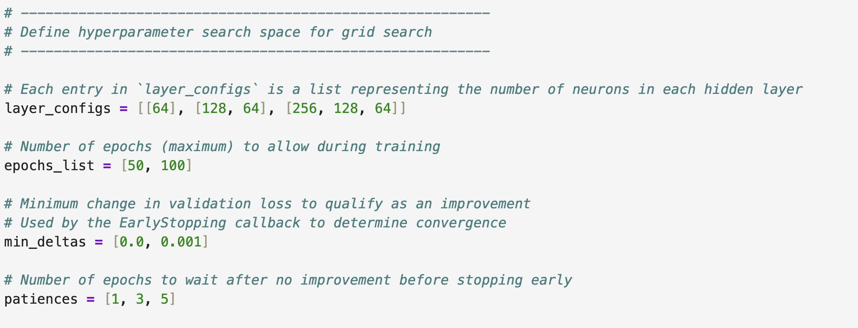
Multi-Layer-Perceptron Model - Code

Slide 21
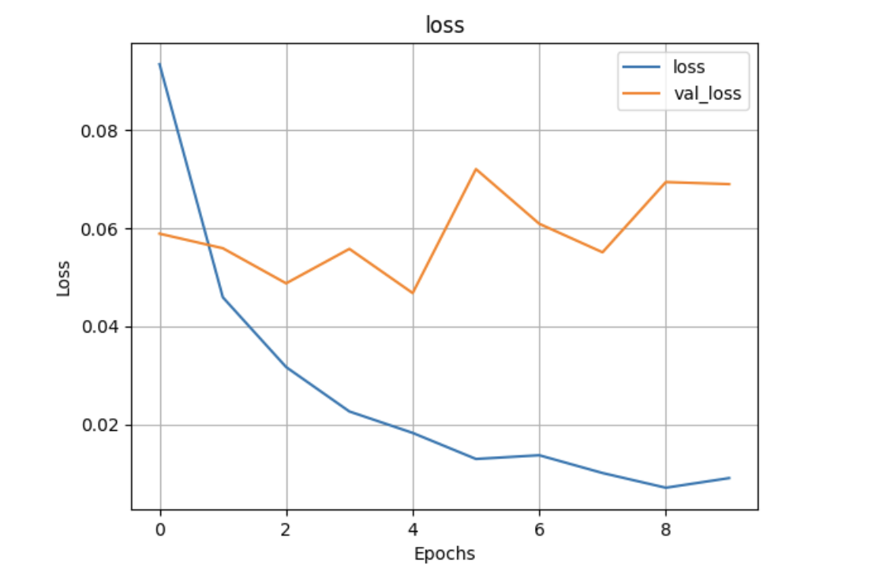

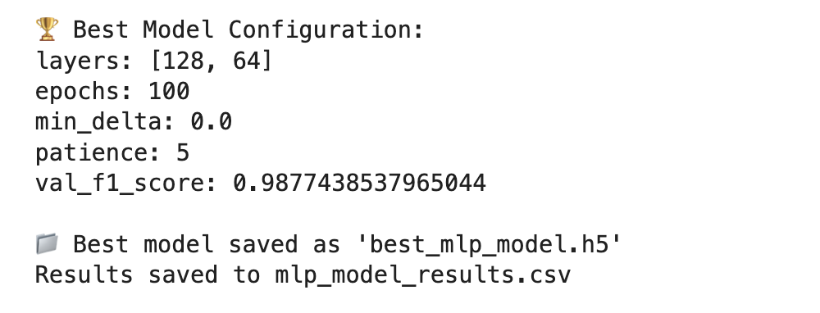
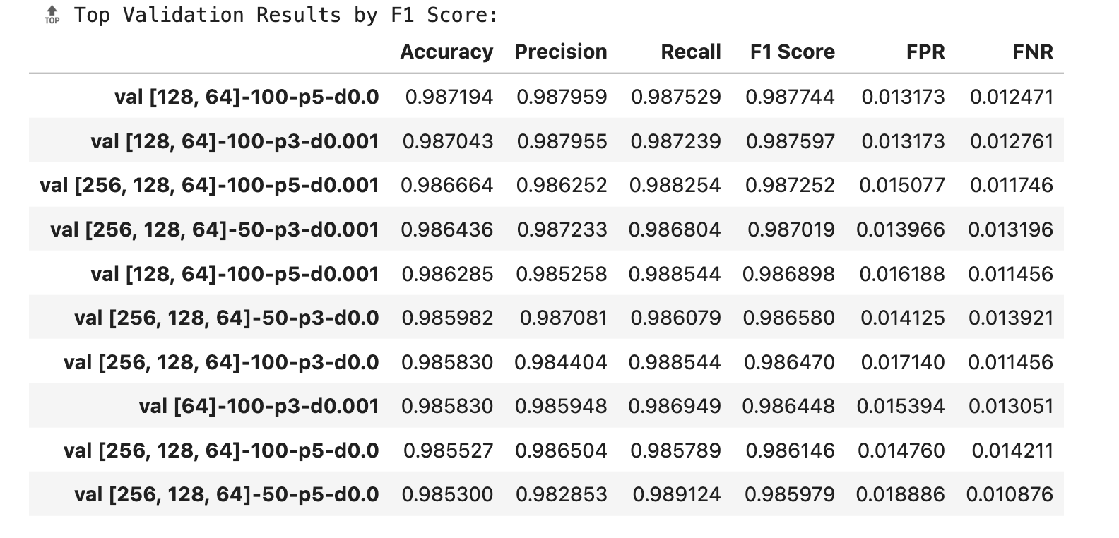
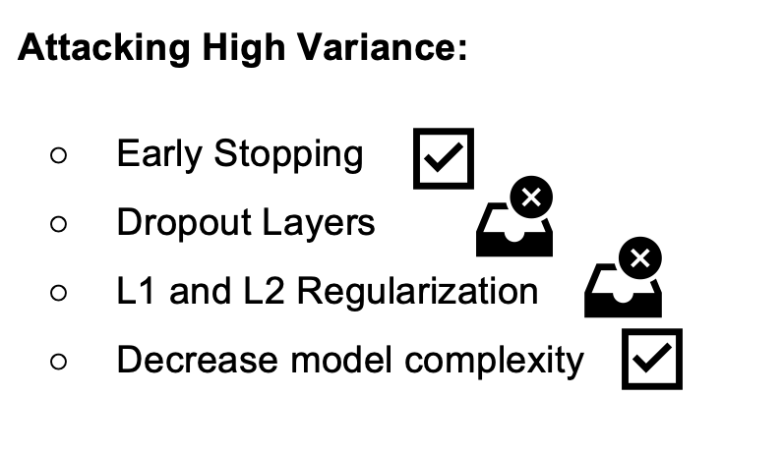
Multi-Layer-Perceptron Model Preliminary Results

Slide 22
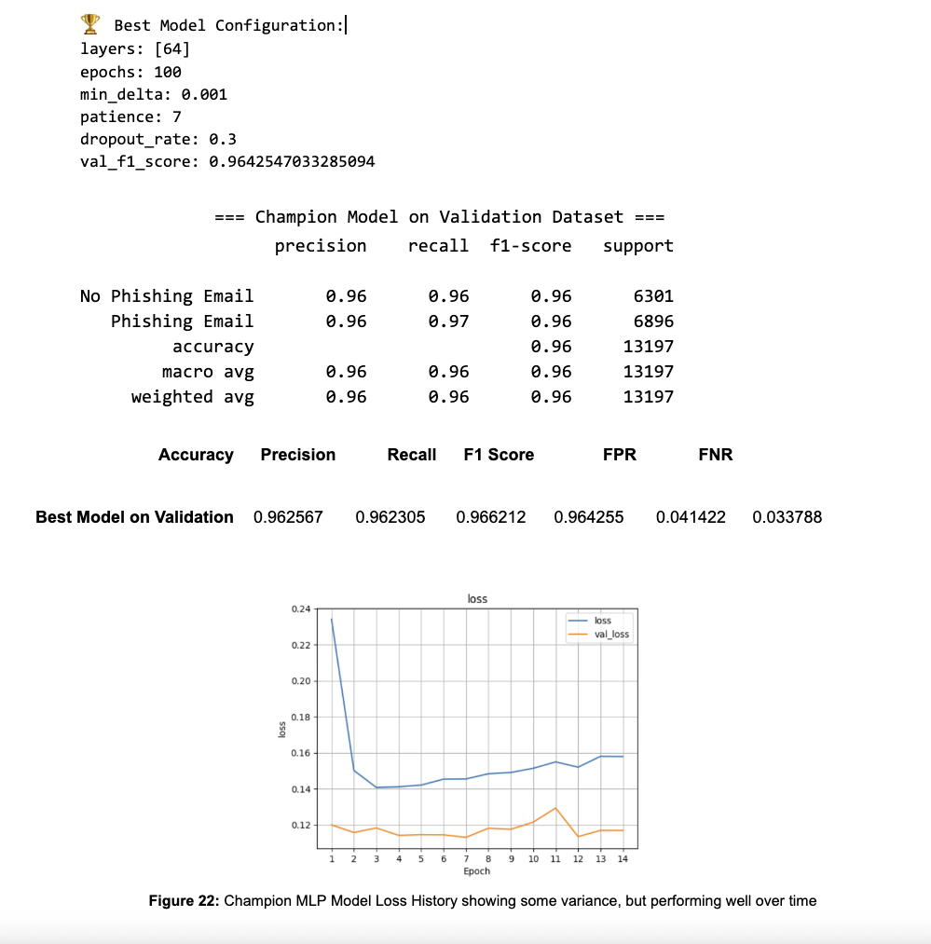
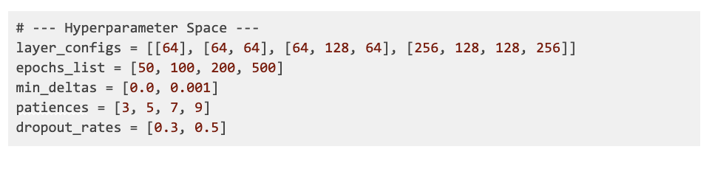
Multi-Layer-Perceptron Model Final Results

Slide 23
Lessons Learned,
Nathan Poch
Masters in Cyber Security
Rodrigo Arguello
Masters in Computer Science
Maurisa Dacosta
Masters in Computer Science
My background in mathematics, cybersecurity, and machine learning has helped me focus in on some of the small details during our data cleaning phase. While I have learned about DistilBERT and how to use it to turn textual data into model-ready tokens, the biggest lessons to learn came from the URL extraction portion of our work. The Top Level Domain based approach offered by URLExtract provided an output on the example email I was analysing that differed from the regular-expression based method in CyberChef. This led me to build a class for extracting URLs that used both URLExtract and RegEx, giving me the best of both worlds, and serving as a reminder to always test the solutions provided by others. Also, while fixing a minor bug in one of the classes I built for this phase, I realized how convenient it was to fix bugs in a class one time as opposed to fixing the same bug in several locations in the code, providing further incentive to take the hard route the first time. Many of my math professors told me, “The great thing about mathematicians is that they are lazy.” This was in reference to making and proving theorems and propositions so that they would not need to solve the same problem over and over again. This bug fixing experience showed me the connection between theorem proving in math and class building in computer science, which I think was a valuable lesson in software engineering.
Applying these AI and machine learning lessons can enhance aerospace manufacturing tests by improving anomaly detection, automating data analysis, and optimizing test processes. Understanding model tuning, performance metrics, and modular code design enables the development of smarter systems for identifying early faults, reducing test time, and increasing product reliability, ultimately ensuring higher safety and quality standards across complex aerospace production environments.
Coming from a chemistry background, this has been my first in depth experience with AI and machine learning. It has been exciting teaching myself how to build, train, and tune models as well as doing in depth research on what each hyperparameter means and how it influences a models performance. Also learning performance metrics and the significance behind them helped me broaden my technical skills. I developed a stronger understanding of a machine learning workflow and practiced executing these technical concepts in visualizations for presentations and documentation.

Slide 24
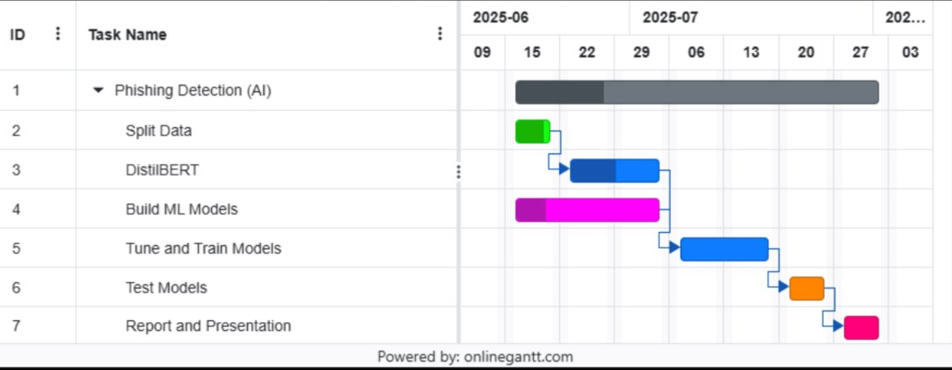
Conclusions & Future Work
" ….By the end of the semester, our group produced a working phishing-detection pipeline that, line-by-line and in every detail, matches the milestones we established in our initial project plan. We (i) integrated six unrelated e-mail corpora, (ii) constructed effective URL-based features, (iii) produced DistilBERT embeddings, (iv) dimensionally reduced them with PCA, and (v) trained and tuned three state-of-the-state classifiers—Random Forest, XGBoost and a lightweight MLP—any one of which now reaches ≥96 % accuracy and an AUC ≈ 0.99 on a previously unseen test set. All of our code compiles and executes end-to-end in a reproducible environment. We can show that the problem we selected was neither too grand nor too small: it fell within scope. Still, it yielded immediate applicability in a real-time e-mail-filtering scenario. Each task in our Gantt chart—from data ingestion (Week 2) to final documentation (Week 10)—was either accomplished ahead of schedule or exactly on time. Our Team 5 project meets the goals we established at its initiation." Team 5

Slide 25

References
Used in Presentation:
Sanh, V., Debut, L., Chaumond, J., & Wolf, T. (2019). DistilBERT, a distilled version of BERT: smaller, faster, cheaper and lighter. arXiv preprint arXiv:1910.01108.
Devlin, J., Chang, M. W., Lee, K., & Toutanova, K. (2019, June). Bert: Pre-training of deep bidirectional transformers for language understanding. In Proceedings of the 2019 conference of the North American chapter of the association for computational linguistics: human language technologies, volume 1 (long and short papers) (pp. 4171-4186).
Owen, A., & White, E. (2024). Evaluating the Effectiveness of AI-Based Phishing Detection in IoT Communication Protocols.
Morde, V. (2019, June 23). XGBoost algorithm: Long may she reign! Medium. https://medium.com/data-science/https-medium-com-vishalmorde-xgboost-algorithm-long-she-may-rein-edd9f99be63d
SitePoint. (2025). Random Forest algorithm in machine learning. https://www.sitepoint.com/random-forest-algorithm-in-machine-learning/
Gu, J., & Xu, H. (2022, January). An ensemble method for phishing websites detection based on xgboost. In 2022 14th international conference on computer research and development (ICCRD) (pp. 214-219). IEEE.
REDDY, K. T. (2024) Enhancing Phishing Detection Through Multilayer Perceptron in Cybersecurity.
Shahrivari, V., Darabi, M. M., & Izadi, M. (2020). Phishing detection using machine learning techniques. arXiv preprint arXiv:2009.11116.
Singh, P., & Maurya, H. ML TECHNIQUES FOR PHISHING DETECTION.
Dataset:
https://www.kaggle.com/datasets/naserabdullahalam/phishing-email-dataset/data

