Slide 1
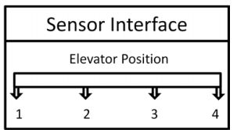
User/Entry Console (Input)
Elevator Call
Floor Selection
Door Buttons
Emergency
Simulation + Hardware Integration
Display Console (Output)
Timing
Location
Direction
Door Status
Simulation + Hardware Integration
Elevator
Read DB to read parameters
Monitors Sensor Interface
Update Elevator Location → Display Console
Get request from ← User Console
Emergencies response ← User Console
Sequences of Operation
Shutdown
DB
S + H
Config Sequence
Logging of
Timing and position
Controller
Controller
Business Logic
Error Engine
Log Files
CRUD
Sensor Interface (sensor, Telemetric)
Simulate Elevator Position
Simulation + Hardware Integration

Slide 2
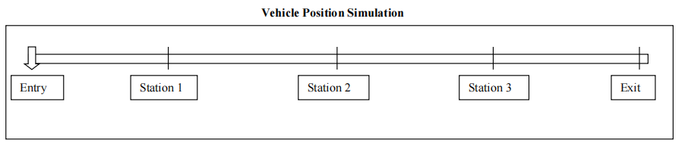
Car Wash
User/Entry Console (Input)
Elevator Call
Floor Selection
Door Buttons
Emergency
Simulation + Hardware Integration
Display Console (Output)
Timing
Location
Direction
Door Status
Simulation + Hardware Integration
Read the Configuration database to get timing data
Get the selected wash options from the Entry console
Start the washing process when user presses the Start button
Get vehicle position data and execute the wash function
Update the Wash Display console
DB
S + H
Config Sequence
Controller
Business Logic
Error Engine
Log Files
CRUD
Vehicle Position (sensor, Telemetric)
Simulate Elevator Position
Simulation + Hardware Integration

Slide 3
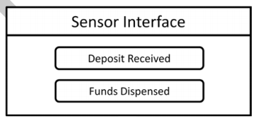
ATM
User Console
Elevator Call
Floor Selection
Door Buttons
Emergency
Simulation + Hardware Integration
Display Console
Timing
Location
Direction
Door Status
Simulation + Hardware Integration
Read DB to read parameters
Monitors Sensor Interface
Update Elevator Location → Display Console
Get request from ← User Console
Emergencies response ← User Console
Sequences of Operation: transactions
Shutdown
DB
S + H
Account
Controller
Business Logic
Error Engine
Log Files
CRUD
Sensor Interface (Sensor, Telemetric)
Simulate Elevator Position
Simulation + Hardware Integration

Slide 4



















Messaging Architecture
Clone Nested Actors
(Childs)
Event
Informing!
For Scalability
Nested Actors
(Childs)
UI
Console
SW Interface
Logging
Error Engine
Embedded DB
Root Actor
(Parent)
Message Distributor
Abstraction Layer
Abstraction Interface
Controller/Business-Logic
Client Interface
Request
Command

