Slide 1
CSC321: Neural Networks
Lecture 3: Perceptrons
Geoffrey Hinton
www.cs.toronto.edu/~hinton/csc321/notes/lec3.htm

Slide 2
The connectivity of a perceptron
The input is recoded using hand-picked features that do not adapt.
Only the last layer of weights is learned.
The output units are binary threshold neurons and are learned independently.
output units
non-adaptive
hand-coded
features
input units

Slide 3

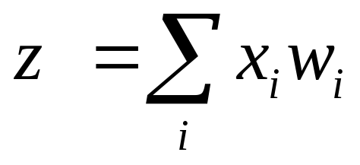
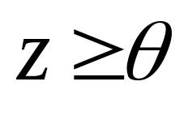
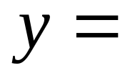
Binary threshold neurons
McCulloch-Pitts (1943)
  First compute a weighted sum of the inputs from other neurons
  Then output a 1 if the weighted sum exceeds the threshold.
1
1 if
y
0 otherwise
0
z
threshold

Slide 4
The perceptron convergence procedure
Add an extra component with value 1 to each input vector. The “bias” weight on this component is minus the threshold. Now we can forget the threshold.
Pick training cases using any policy that ensures that every training case will keep getting picked
  If the output unit is correct, leave its weights alone.
  If the output unit incorrectly outputs a zero, add the input vector to the weight vector.
  If the output unit incorrectly outputs a 1, subtract the input vector from the weight vector.
This is guaranteed to find a suitable set of weights if any such set exists.

Slide 5
Weight space
Imagine a space in which each axis corresponds to a weight.
  A point in this space is a weight vector.
Each training case defines a plane.
  On one side of the plane the output is wrong.
To get all training cases right we need to find a point on the right side of all the planes.
wrong
right
bad
weights
good
weights
right
wrong
an input
vector
o
origin

Slide 6
Why the learning procedure works
Consider the squared distance between any satisfactory weight vector and the current weight vector.
  Every time the perceptron makes a mistake, the learning algorithm moves the current weight vector towards all satisfactory weight vectors (unless it crosses the constraint plane).
So consider “generously satisfactory” weight vectors that lie within the feasible region by a margin at least as great as the largest update.
  Every time the perceptron makes a mistake, the squared distance to all of these weight vectors is always decreased by at least the squared length of the smallest update vector.
margin
right
wrong

Slide 7
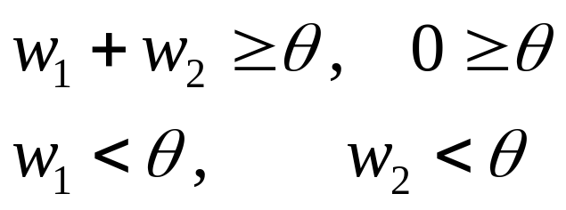
What perceptrons cannot do
The binary threshold output units cannot even tell if two single bit numbers are the same!
  Same: (1,1) → 1; (0,0) → 1
  Different: (1,0) → 0; (0,1) → 0
The following set of inequalities is impossible:
Data Space
0,1
1,1
weight plane
output =1
output =0
0,0
1,0
The positive and negative cases
cannot be separated by a plane

Slide 8
What can perceptrons do?
They can only solve tasks if the hand-coded features convert the original task into a linearly separable one. How difficult is this?
The N-bit parity task :
  Requires N features of the form: Are at least m bits on?
  Each feature must look at all the components of the input.
The 2-D connectedness task
  requires an exponential number of features!

Slide 9
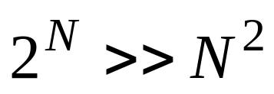
The N-bit even parity task
There is a simple solution that requires N hidden units.
  Each hidden unit computes whether more than M of the inputs are on.
  This is a linearly separable problem.
There are many variants of this solution.
  It can be learned.
  It generalizes well if:
+1
output
-2 +2 -2 +2
>0 >1 >2 >3
1 0 1 0
input

Slide 10
Why connectedness is hard to compute
Even for simple line drawings, there are exponentially many cases.
Removing one segment can break connectedness
  But this depends on the precise arrangement of the other pieces.
  Unlike parity, there are no simple summaries of the other pieces that tell us what will happen.
Connectedness is easy to compute with an iterative algorithm.
  Start anywhere in the ink
  Propagate a marker
  See if all the ink gets marked.

Slide 11
Distinguishing T from C in any orientation and position
What kind of features are required to distinguish two different patterns of 5 pixels independent of position and orientation?
  Do we need to replicate T and C templates across all positions and orientations?
  Looking at pairs of pixels will not work
  Looking at triples will work if we assume that each input image only contains one object.
Replicate the following two feature detectors in all positions
+
+
-
-
+
+
If any of these equal their threshold of 2, it’s a C. If not, it’s a T.

Slide 12
Beyond perceptrons
Need to learn the features, not just how to weight them to make a decision. This is a much harder task.
  We may need to abandon guarantees of finding optimal solutions.
Need to make use of recurrent connections, especially for modeling sequences.
  The network needs a memory (in the activities) for events that happened some time ago, and we cannot easily put an upper bound on this time.
    Engineers call this an “Infinite Impulse Response” system.
  Long-term temporal regularities are hard to learn.
Need to learn representations without a teacher.
  This makes it much harder to define what the goal of learning is.

Slide 13
Beyond perceptrons
Need to learn complex hierarchical representations for structures like: “John was annoyed that Mary disliked Bill.”
  We need to apply the same computational apparatus to the embedded sentence as to the whole sentence.
    This is hard if we are using special purpose hardware in which activities of hardware units are the representations and connections between hardware units are the program.
We must somehow traverse deep hierarchies using fixed hardware and sharing knowledge between levels.

Slide 14
Sequential Perception
We need to attend to one part of the sensory input at a time.
  We only have high resolution in a tiny region.
  Vision is a very sequential process (but the scale varies)
  We do not do high-level processing of most of the visual input (lack of motion tells us nothing has changed).
  Segmentation and the sequential organization of sensory processing are often ignored by neural models.
Segmentation is a very difficult problem
  Segmenting a figure from its background seems very easy because we are so good at it, but its actually very hard.
  Contours sometimes have imperceptible contrast, but we still perceive them.
  Segmentation often requires a lot of top-down knowledge.

