Slide 1
Python and Educational Sciences
Giel van Lankveld
/ 8

Slide 2








tracert / whoami?
Again?
/ 8
Notes:
Me
Educated as a psychologist (cognitive neuroscience = MRI & EEG & Robots/Machine Learning)
PhD in computer science and some post doc research projects afterwards
Then a teacher in Fontys University of Applied Sciences in Eindhoven, including teaching data science with Python
Now: Assistant Professor at Open University in Heerlen in the Technology Enhanced Learning and Innovation group (which is in the domain of Educational Sciences)

Slide 3

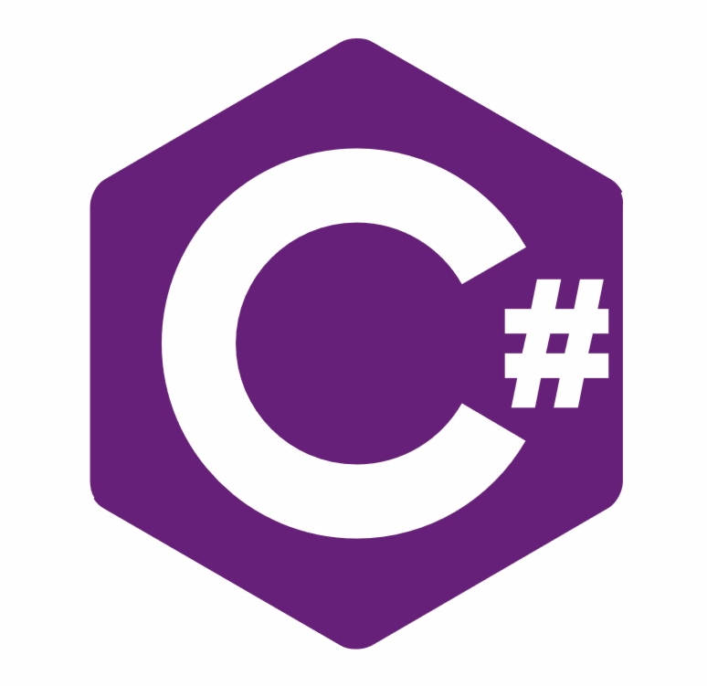










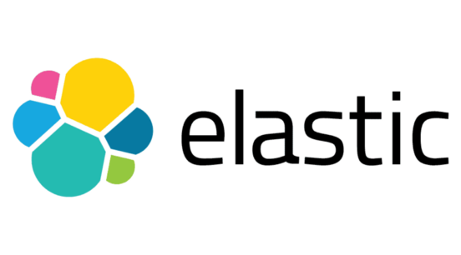





tracert / whoami?
/ 8
Notes:
Worked in Delphi, C#, C++, COBOL, Java, Go, R, Python, front-end scripting-like languages and packages (HTML, CSS, JavaScript, Angular, React, Vue) systems like the well known Jupyter Notebook, but also: ElasticSearch, Apache Storm, Hadoop, Unity3D

Slide 4
What are the Educational Sciences?
Educational Sciences
Educational
materials
Digital Learning Environments (DLE)
Massive Open Online Course (MOOC)
Assessment
Educational Theory
Technologies
Classroom
management
Multimedia (video, blog, podcast)
Course
design
Psychology
Educational Games
Optimizing
learning
effects
Virtual Reality / Augmented Reality
Student
Attributes &
circumstances
Student / Teacher support systems
/ 8
Notes:
Educational Sciences (what is it?)
The science of education and teaching
A mixed domain that combines elements based on Education Theory but also on Psychology
Educational Sciences has increasingly focused on digital technologies along with the rise of the internet. At first universities but now more and more schools have been using digital technologies in their curriculums. Most of you probably know digital learning platforms from your own education and anyone looking to educate themselves has probably run into multimedia (videos, blogs and podcasts) and maybe MOOCs as well. Maybe some of you have even played educational game. Behind all of the (professional) products on that list has been some consideration of didactics or pedagogy. The creators have thought about how to best use these materials to help the learners grow their knowledge. So there is Educational Science behind all of these

Slide 5
Educational Sciences @ Open University
Online Learning and Instruction
Social Learning
Conditions for Lifelong Learning
Technology Enhanced Learning and Innovation
/ 8
Notes:
At the Open University, Educational Sciences faculty we do research and we focus on four areas:
Online learning and instruction
Social learning
Conditions for life long learning
Technology enhanced learning and innovation
In all these areas, analysis is done, and dedicated applications are being developed

Slide 6
Where does Python come in?
SPSS
Classical statistics
Analysis in the Social Sciences
Bayesian statistics
R
Machine learning
Analysis in the Educational Sciences
Integration
Python
Prototyping
/ 8
Notes:
How does Python play a role in Educational Sciences?
Some of you may already know this: but there are 3 major groups of analysis in social sciences.
Classical (of frequentist) statistics
Bayesian statistics
Machine learning and AI
Most Psychology related fields (including Educational Sciences) traditionally use classical statistics. They used to do their analysis in dedicated programs such as SPSS but nowadays the R language is the main-stream. Classical statistics is still the main approach to analysis but Bayesian statistics is also building a strong following.
Educational Sciences differs a bit from the social sciences at large because we are also analyzing our digital learning environments (DLE) and MOOCs. These produce larger volumes of data and correspondingly, machine learning approaches are used in the analyses of these systems.
Python is a close competitor to R in these regards and I see that R is used more by those researchers that "just" do analyses and use R as a statistics package and Python is used in situations and project where the analysis has to be integrated with other systems. Such as in pipelines where data comes in from complex data producing systems or when the output is used to support students or teachers (such as in dashboards).

Slide 7
Python prototyping
Prototyping
Learning Analytics
Computer vision & speech
Integration
Chatbots
Dashboards
Serious games
/ 8
Notes:
Another area where Python is very important for Educational Sciences is in prototyping. Most of our scientific projects start off from a very prototypical point and Python is a strong candidate in these cases because of it's flexibility and high level of abstraction.
The sorts of projects that Python is used in is very diverse
As mentioned: learning analytics from DLEs and MOOCs is often done
In that case you van get integration with systems such as Apache Kafka or Spark
Dashboards for students and teachers that are based on interactions with the learning systems
Serious Games
Projects that use computer vision for facial recognition, emotion recognition or object recognition or speech processing
Chat bots

Slide 8
Python projects @ the Open University
Learning Analytics
RESTful APIs
Text analysis
Data analysis
Master student projects
DLE since 2015
Apps/Games/VR
Sentiment analysis
Classical statistics
Many different topics
Over 3300 course runs
Data drop-off
Argument analysis
Bayesian statistics
Over 310k enrolments
Machine learning
Millions of interactions
Kafka data lake
Dashboards
/ 8
Notes:
What projects am I using Python in?- My primary project is in using learning analytics
The OU has a DLE that has been active since 2015
Over 3300 courses have run since then
Over 310.000 course registrations have taken place and millions of course interactions have been done
In my project I'm processing this data in order to support students and teachers
We are looking at which factors influence whether a student can successfully complete a course
We try to provide some warning signals to students that are at risk of failing a course
We also try to provide insight to teachers. On students that might need extra help but also on the structure of their courses so they can make them more doable for students
The DLE data runs into a Kafka message queue along with data from other sources (such as student registrations etc.)
We use Python to generate static reports but also to stream live data and to generate dashboards that present this data and relevant insights to teachers
Next to my primary project I develop Serious Games and VR applications. These games and applications are part of experiments so I collect I prefer to use Python to write RESTful APIs to send the data to
Colleagues use Python for text analysis.
Finally, I and many colleagues use Python to do my analyses and to create visualizations of results
Students in our master course use Python to prototype their final projects and to do their experiments

Slide 9
Thank you! Questions?
/ 8

