Slide 1



Feed an AI-agentic beast with proper data
A hands-on workshop · 90 minutes
Jessica Eggen

Slide 2

01.
Welcome
02
Notes:
First of all, hi everyone
Brief introduction into the topic of how to prepare your data warehouse for agentic workflows,
Before we dive into the workshop itself, which exists of 5 exercises.
After that, we will wrap it up and we can enjoy a drink.

Slide 3



01 | Welcome
Introduction
My own background
Who are you?
My current work struggles
Prompt design vs data design
Notes:
I put work struggles here, but with the massive amount LLM’s are used, I encounter this is my personal life as well. Plan a 21 day vacation for me in Georgia, or at work, business users want to ask questions to LLM’s.
- workshop goal -> went in with selfish reasons, i find this incredibly important, because i’m curious by nature, and with you all being python developers, i think we are alike in curiosity. and to just let people that are not data-savvy go rogue with a LLM without understanding the underlying mechanisms, I find that a dangerous game to play. But there is an even bigger impact preparing your data and architecture can have : ....

Slide 4
Workshop goal:
Prepare your data and system architecture to enable
effective LLM reasoning and deliver trustworthy, accurate results.
04
Notes:
- workshop goal -> went in with selfish reasons, i find this incredibly important, because i’m curious by nature, and with you all being python developers, i think we are alike in curiosity. and to just let people that are not data-savvy go rogue with a LLM without understanding the underlying mechanisms, I find that a dangerous game to play. But there is an even bigger impact preparing your data and architecture can have : ....

Slide 5
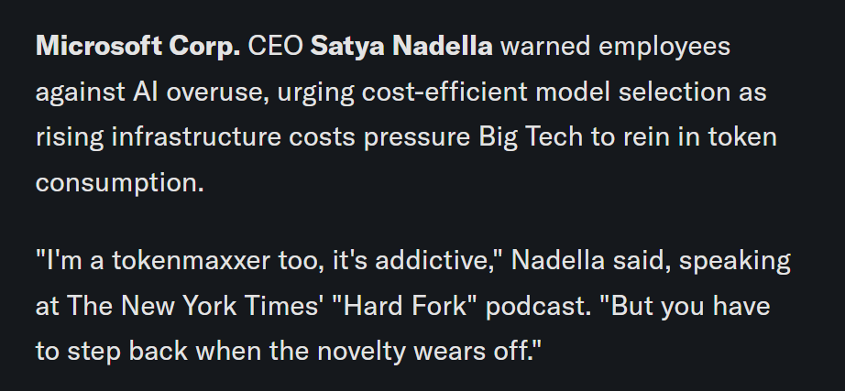
01 | Welcome
Introduction
Notes:
I put work struggles here, but with the massive amount LLM’s are used, I encounter this is my personal life as well. Plan a 21 day vacation for me in Georgia, or at work, business users want to ask questions to LLM’s.
- workshop goal -> went in with selfish reasons, i find this incredibly important, because i’m curious by nature, and with you all being python developers, i think we are alike in curiosity. and to just let people that are not data-savvy go rogue with a LLM without understanding the underlying mechanisms, I find that a dangerous game to play. But there is an even bigger impact preparing your data and architecture can have : ....

Slide 6
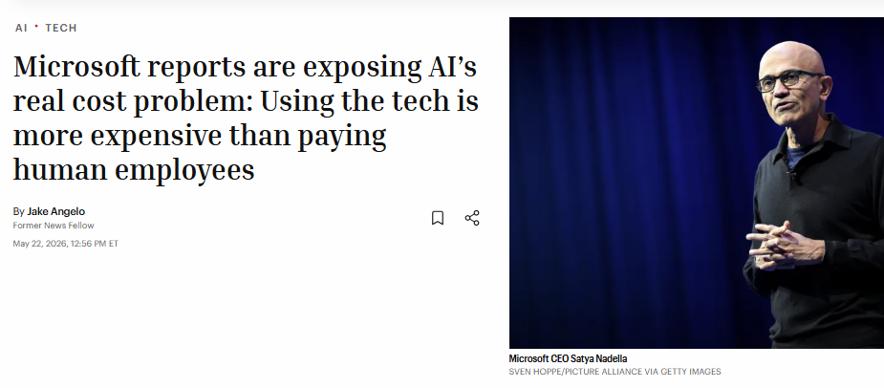
01 | Welcome
Introduction
Notes:
I put work struggles here, but with the massive amount LLM’s are used, I encounter this is my personal life as well. Plan a 21 day vacation for me in Georgia, or at work, business users want to ask questions to LLM’s.
- workshop goal -> went in with selfish reasons, i find this incredibly important, because i’m curious by nature, and with you all being python developers, i think we are alike in curiosity. and to just let people that are not data-savvy go rogue with a LLM without understanding the underlying mechanisms, I find that a dangerous game to play. But there is an even bigger impact preparing your data and architecture can have : ....

Slide 7
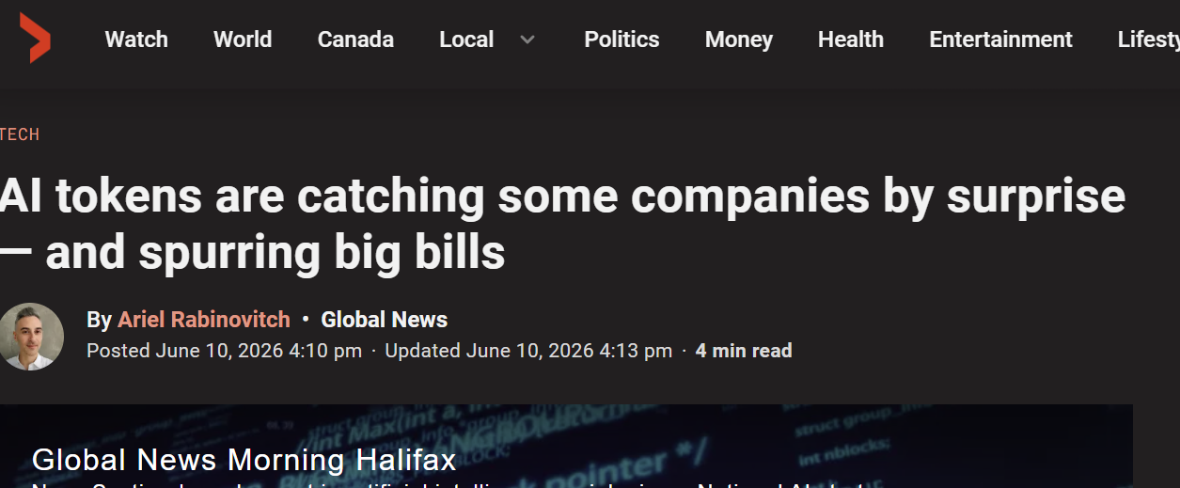
01 | Welcome
Introduction
Notes:
I put work struggles here, but with the massive amount LLM’s are used, I encounter this is my personal life as well. Plan a 21 day vacation for me in Georgia, or at work, business users want to ask questions to LLM’s.
- workshop goal -> went in with selfish reasons, i find this incredibly important, because i’m curious by nature, and with you all being python developers, i think we are alike in curiosity. and to just let people that are not data-savvy go rogue with a LLM without understanding the underlying mechanisms, I find that a dangerous game to play. But there is an even bigger impact preparing your data and architecture can have : ....

Slide 8
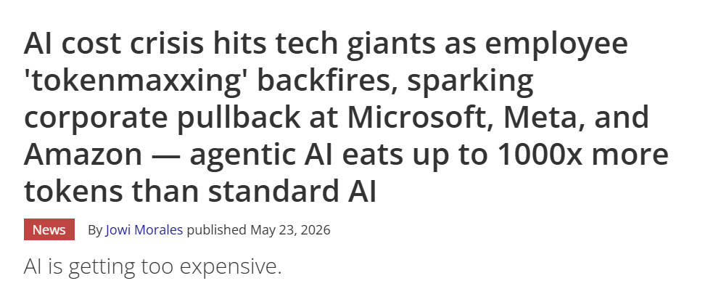
01 | Welcome
Introduction
Notes:
I put work struggles here, but with the massive amount LLM’s are used, I encounter this is my personal life as well. Plan a 21 day vacation for me in Georgia, or at work, business users want to ask questions to LLM’s.
- workshop goal -> went in with selfish reasons, i find this incredibly important, because i’m curious by nature, and with you all being python developers, i think we are alike in curiosity. and to just let people that are not data-savvy go rogue with a LLM without understanding the underlying mechanisms, I find that a dangerous game to play. But there is an even bigger impact preparing your data and architecture can have : ....

Slide 9




01 | Welcome
Introduction
What can we adjust
Data
Users
Prompt
LLM m1
LLM m2
LLM m3

Slide 10
01 | Welcome
Introduction
What can we adjust
Data
Users
Prompt
LLM m1
LLM m2
LLM m3
Notes:
Not using AI is actually not an option anymore
But what approaches we take, can drastically decrease the token usage and costs

Slide 11
02.
Let’s open the workbook!
05

Slide 12


02 | Workbook
Setup and exercise 1: Scrub before you send
Let me, or your neighbour, know if any questions pop up.
Go through the DISCUSS items with one of your neighbours!
08

Slide 13
02 | Workbook
Setup and exercise 1: scrub before you send
Everyone knows: data has to be cleaned.
Scrubbing PII Is only 1 part, but there are silent NaN drops, unexpected and incorrect values, averages vs medians, abbreviations, missing units, duplicates and many more. But what is worth fixing?
There is a difference in cleaning for AI vs cleaning for a ML model or a dashboard.
Dasbhbaord = visual correctness
ML model = statistical distribution
LLM input = semantic clarity
AI needs richer context than ML. Here’s a 4-step pipeline:
1. Clean — fix errors, nulls, and inconsistencies
2. Contextualise — add table descriptions, business meaning and semantic context (what does this value mean?)
3. Chunk — split into pieces the LLM can process
4. Verify — validate output quality before sending to production
08
Notes:
Everyone knows, data has to be cleaned, however with big batches being uploaded in LLMs, this step is often skipped. and I get it, most people don’t find it the most exciting part. However, it is good to know that there is a difference between cleaning for AI, or cleaning for a ML model or a dashboard.
For a LLM, we need to think about the value that it means in the business.

Slide 14
02 | Workbook
Exercise 2: Minimum viable context
Let me, or your neighbour, know if any questions pop up.
Go through the DISCUSS items with one of your neighbours!
08

Slide 15
02 | Workbook
Exercise 2: Minimum viable context
Avoid
Better
Let the LLM do the groupby
Pre-aggregate to match the question
Sending raw rows and asking the LLM to aggregate is slow, expensive, and error-prone. The model may miss groups, apply wrong logic, or run out of context window. Don’t make the LLM do your pandas work.
Match the granularity of your aggregation to the granularity of your question. Pre-aggregate over the dimensions of the question.
09
Notes:
For tabular data
What is it for documents? naive chunking vs semantic chunking

Slide 16
02 | Workbook
Exercise 3: Right context, right question
Let me, or your neighbour, know if any questions pop up.
Go through the DISCUSS items with one of your neighbours!
08

Slide 17
02 | Workbook
Exercise 3: Right context, right question
Irrelevant columns cost tokens and add noise.
When LLM decides on columns it requires good column descriptions. The semantic layer is extremely important for efficient LLM use.
08
Notes:
What we see: irrelevant columns cost tokens, but aside from that, they add noise. The model has to figure out what to ignore, and sometimes it doesn't.
Data documentation is essential for the LLM to understand what the columns mean.

Slide 18
02 | Workbook
Exercise 4: When the LLM transforms the data
Let me, or your neighbour, know if any questions pop up.
Go through the DISCUSS items with one of your neighbours!
08

Slide 19
02 | Workbook
Exercise 4: When the LLM transforms the data
Real-life issue
parse_llm_json might be irrelevant for the state-of-the-art LLM models out there, however those are more costly.
Can create a dead-letter queue for rows that never pass
Storing raw_results This holds what the LLM said before parsing. In production, storing that alongside the parsed result means if you change your schema or validation rules later, you can revalidate old extractions without paying for new API calls
08
Notes:
I have worked at multiple retail companies, and this was an issue in every company. parse_llm_json, more costly, this is another side of the coin, we can also make use of a smaller LLM if our data structure is very solid for AI usage

Slide 20
02 | Workbook
Exercise 5: Numbers they can trust
Let me, or your neighbour, know if any questions pop up.
Go through the DISCUSS items with one of your neighbours!
08

Slide 21
02 | Workbook
Exercise 5: Numbers they can trust
This is how production analytics AI works Databricks and Tableau use text-to-SQL. Business user → question → Tableau → writes SQL → database runs it → LLM explains the result.
The failure in the naive approach is a cognitive task mismatch, not a knowledge gap. The model is like a brilliant analyst who can’t do maths in their head, but with a calculate (the database) it is fine.
The LLM writes SQL based on what you tell it about the table. Where good documentation was first a nice-to-have, now it directly affects answer correctness
08
Notes:
This is how production analytics AI works
Tools like Databricks and Tableau use text-to-SQL under the hood. When a business user asks Tableau "why did revenue drop in Q3?" — it writes SQL, the database runs it, and the LLM explains the result. The exercise you just did is the same architecture
The failure in the naive approach is a cognitive task mismatch, not a knowledge gap. The model is like a brilliant anaytst who can’t do maths in their head, but with a calculate (the database) it is fine.
The LLM writes SQL based on what you tell it about the table. This shows the great importance of dbt descriptions, data catalogs and semantic layers, especially when you add a LLM to your stack.
Where good documentation was first a nice-to-have, now it directly affects answer correctness

Slide 22
PyLadies Workshop
The AI-beast has been fed
Get in touch with
Jessica jessica.eggen@xomnia.com https://www.linkedin.com/in/jessica-eggen-579b50155
Xomnia Denise
info@xomnia.com
PyLadies
Una or Giulia
amsterdam@pyladies.com
Thank you for joining!
Today we covered how data flows through an LLM and explored practical data preparation techniques. The notebook has everything you need to keep practising.
Resources:
Presentation on Github
Youtube recording
Notebook on GitHub
All exercises are in the shared notebook. Fork it and keep experimenting.
Xomnia — Your Data & AI Partner
Notes:
only 90 minutes, but I always got a gazillion ideas, so if you feel like talking more about this topic, please find me during the drinks or you can contact me via email or linked in,

