Slide 1
An Introduction to Fairness in Machine Learning Using Fairlearn
Hilde Weerts
Artificial Intelligence Engineer
Eindhoven University of Technology

Slide 2
Agenda
Algorithmic Fairness
Introduction to Tutorial
Notes:
Quick overview to help the audience brace themselves. Remember to change “Concept <x>” to a phrase that describes the concept you will explain.

Slide 3
Introduction Algorithmic Fairness

Slide 4
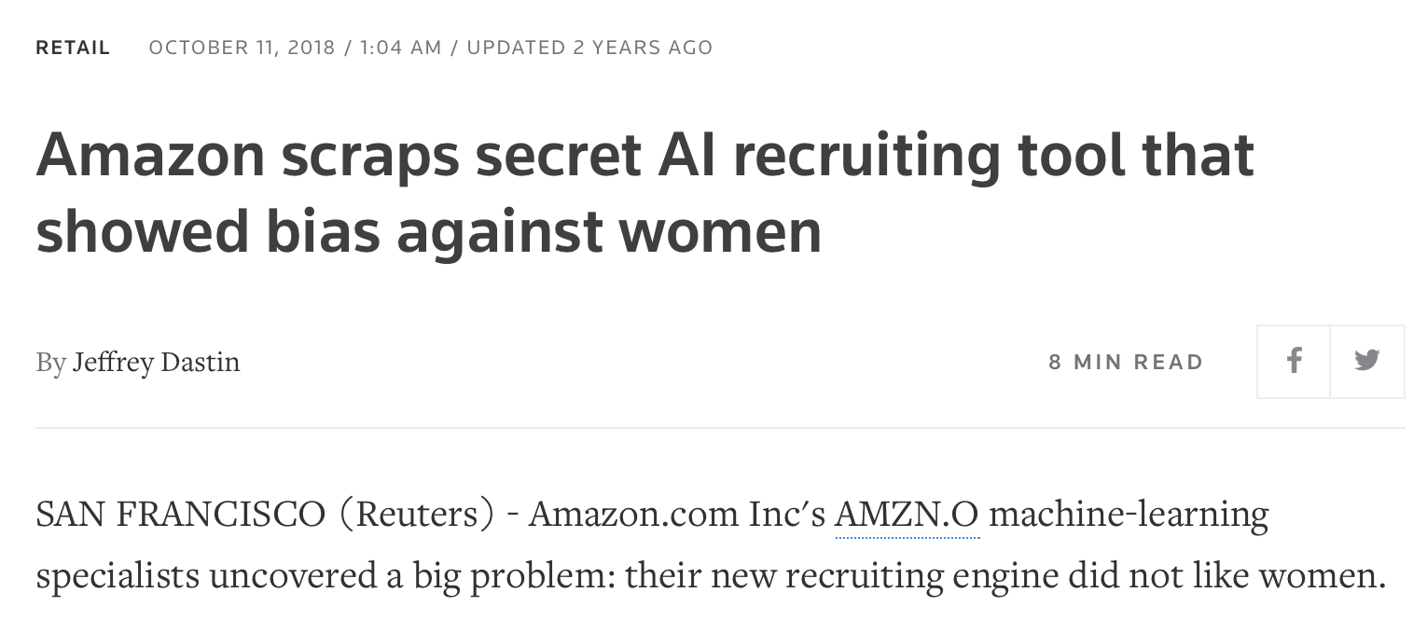
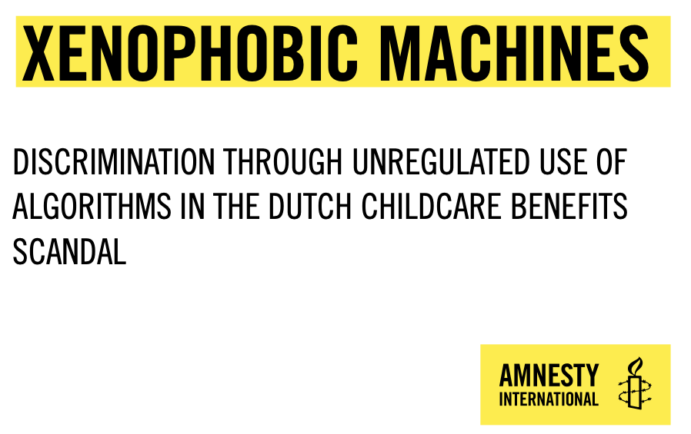
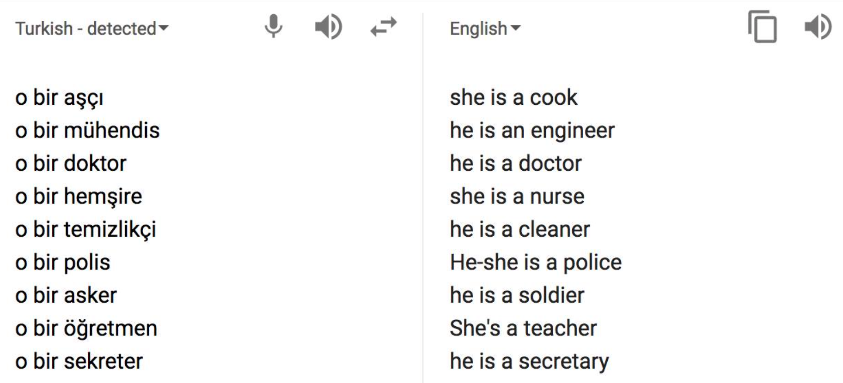
Algorithmic Fairness
The idea that algorithmic systems should behave or treat people without unjust or prejudicial treatment on the grounds of sensitive characteristics.
Hiring
Fraud Detection
Translation
Source: https://www.reuters.com/article/us-amazon-com-jobs-automation-insight-idUSKCN1MK08G
Source: https://www.amnesty.nl/content/uploads/2021/10/20211014_FINAL_Xenophobic-Machines.pdf?x42580
Source: https://qz.com/1141122/google-translates-gender-bias-pairs-he-with-hardworking-and-she-with-lazy-and-other-examples/

Slide 5
Types of Harm
Majority of fairness research focuses on these two harms
Allocation
Quality-of-Service
Representation
The system extends or witholds opportunities, resources, or information.
The system does not work equally well for all groups.
The development/usage of the system overrepresents or underrepresents certain groups.
Stereotyping
Denigration
Procedural
The system reinforces stereotypes.
The system is actively derogatory or offensive.
The system makes decisions in a way that violates social norms.
Most prevalent in unstructured data
Closely related to interpretable machine learning
Notes:
Today we will focus mostly on allocation harm and quality-of-service harm.

Slide 6
What are we optimizing for?
The Real World
Make Decisions
Problem Formulation
Collect Data
impact
The Modeled World
Train
Model
Make
Predictions
Training Data
Model
Predictions
Notes:
In each step of the machine learning development process, we make many small decisions that shape what the final system will look like.
In many cases, these decisions are made implicitly; guided by practical considerations such as the availability of a particular dataset.
And this is where problems can arise.

Slide 7
What are we optimizing for?
Does our problem formulation reflect the real-world context and our (moral) values?
Does the system produce fair outcomes?
Is the data a good representation of reality?
The Real World
Make Decisions
Problem Formulation
Collect Data
impact
Are we optimizing for the right performance metric?
Does the model make fair predictions?
The Modeled World
Train
Model
Make
Predictions
Training Data
Model
Predictions
Notes:
Problem formultion: which problems do we choose to solve? How do we formulate the problem? What business KPI’s are relevant?
Is the data a good representation of reality, or what we want reality to look like?
What are we optimizing for (in the actual ML optimization sense ☺)
Does the model behave the way we expect it to? What effects does it have in the actual world.
The underlying theme of these questions is a mismatch between what we optimize for and what we actually value.

Slide 8
Group Fairness
Notions of fairness that compare the behavior or performance of a model across sensitive groups.
Group A
Group B
Group C
A group fairness metric measures the extent to which a particular group statistic differs across groups (e.g., maximum difference between groups).

Slide 9
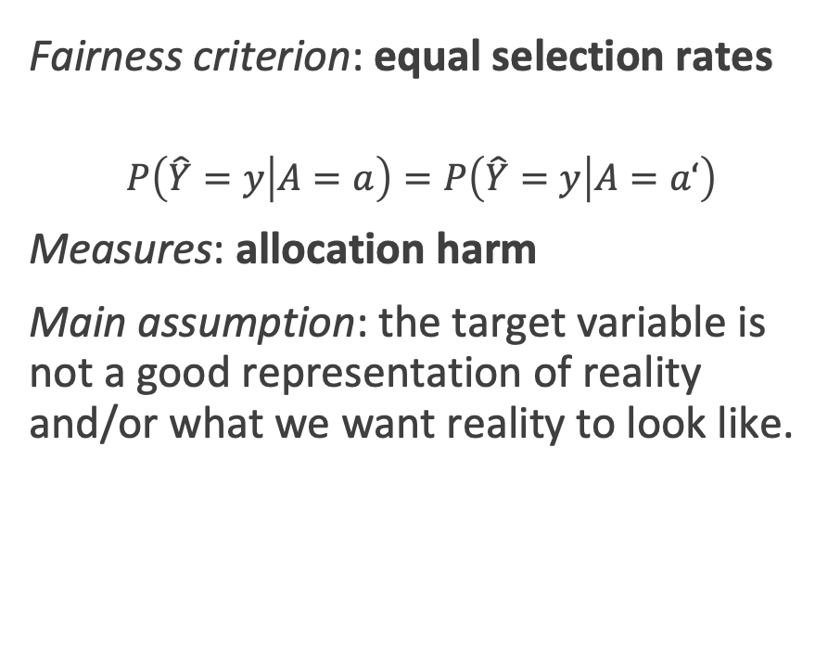
Demographic Parity
Group 1 SR = 3/5 = 0.6
Group 2 SR = 2/3 = 0.67
Fairness criterion: equal selection rates
$$P\left(\hat{Y}=y | A=a\right)=P\left(\hat{Y}=y | A=a‘\right)$$
Measures: allocation harm
Main assumption: the target variable is not a good representation of reality and/or what we want reality to look like.
predicted positive
predicted negative

Slide 10
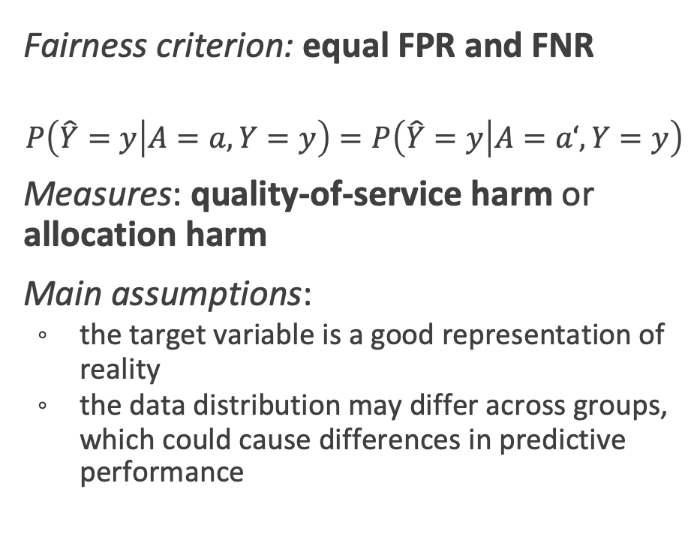
Equalized Odds
Group 1 FPR = 3 / (3+7) = 0.3 FNR = 1 / (1+9) = 0.1
Group 2 FPR = 3 / (3+4) = 0.43
FNR = 0 / (0+5) = 0
Fairness criterion: equal FPR and FNR
$$P\left(\hat{Y}=y | A=a, Y=y\right)=P\left(\hat{Y}=y | A=a‘, Y=y\right)$$
Measures: quality-of-service harm or allocation harm
Main assumptions:
the target variable is a good representation of reality
the data distribution may differ across groups, which could cause differences in predictive performance
-
-
-
-
-
-
-
+
+
+
+
+
-
-
-
-
+
+
+
+
+
+
+
+
+
-
-
-
+
-
-
-
+
true positive
+
false negative
-
true negative
-
false positive
Notes:
Note that it’s conditional on the positive class
Equal opportunity is a weaker variant that only focusses on equal true positive rate (i.e., equal false negative rates)

Slide 11
Fairness-Aware Machine Learning
Fairness as an optimization problem: technical approaches towards optimizing for fairness.
Preprocessing. Change the data such that the sensitive feature cannot be deduced from the data, but all other information is preserved as best as possible.
Constrained learning (‘in-processing’). Incorporate explicit fairness constraints in the learning algorthm.
Post-processing. Adjust an existing machine learning model or its predictions such that it adheres to fairness constraints.

Slide 12
Conclusion
Machine learning systems can reproduce, amplify, and introduce unfairness.
There are different types of fairness-related harms, today we will focus on:
allocation harm
quality-of-service harm.
Fairness-related harms can arise due to a mismatch between what we optimize for and what we actually value.
Fairness metrics can be used to measure potential fairness-related harms.
Fair-ml algorithms can be used to optimize for fairness metrics.

Slide 13

if questions:
try:
answer()
except RuntimeError:
pass
else:
print("Thank You.")
Notes:
Nervous for questions? Prepare a question and share it with the host. The host can ask you this question at the end of the presentation. This helps the host and breaks the ice for you to start answering questions more confidently.

Slide 14
Tutorial Pre-Trial Risk Assessment

Slide 15
Tutorial Measuring Group Fairness in Pre-trial Risk Assessment
Tutorial.
Goal: Measure notions of fairness using Fairlearn
Case study: COMPAS recidivism prediction
Learning Objectives. After completing this tutorial, you will be able to:
apply group fairness metrics in Python;
explain several trade-offs between different group fairness criteria;
explain how threats to construct validity may impact downstream fairness-related harms;

Slide 16
Context Pre-trial Risk Assessment in the United States
Arrest
Pre-Trial Risk Assessment
Await Trial
Trial
Assessment
Released
Bail
No Bail
Detained
Notes:
After somebody has been arrested, it will take some time before they go to trial. The primary goal of pre-trial risk assessment is to determine the likelihood that the defendant will re-appear in court at their trial. Based on the assessment, a judge decides whether a defendent will be detained or released while awaiting trial. In case of release, the judge also decides whether bail is set and for which amount. Bail usually takes the form of either a cash payment or a bond. If the defendant can't afford to pay the bail amount in cash - which can be as high as $50,000 - they can contract a bondsmen. For a fee, typically around 10% of the bail, the bondsmen will post the defendant's bail.
If the defendant cannot afford bail nor a bail bond, they have to prepare for their trial while in jail, which is very difficult*. The time between getting arrested and a bail hearing can take days, weeks, months, or even years. In some cases, the decision is between pleading guilty and going home. Consequently, people who cannot afford bail are much more likely to plead guilty to a crime they did not commit. If the judge's decision is a false positive, this has a big impact on the defendant's prospects. On the other extreme, false negatives could mean that dangerous individuals are released into society.

Slide 17
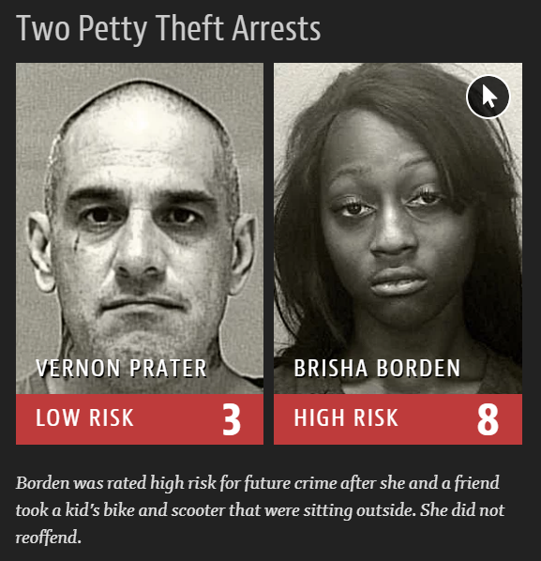
Propublica’s Analysis of COMPAS
In 2017, Propublica found that COMPAS, a recidivism prediction algorithm used by judges in the United States, failed differently for African-American defendants compared to white Americans.
 | White | African-American
False Positive | 23.5% | 44.9%
False Negative | 47.7% | 28.0%
Source: https://www.propublica.org/article/machine-bias-risk-assessments-in-criminal-sentencing

Slide 18
References
Fairness and Machine Learning - Limitations and Opportunities by Solon Barocas, Moritz Hardt, and Arvind Narayanan.
An Introduction to Algorithmic Fairness by Hilde Weerts.
Notes:
Add references as a slide so that you can share this with the audience. You don’t have to show this during the presentation.

