Slide 1
Introduction to Pyro
By Giulia Caglia of Objective Platform

Slide 2
Goals for Today
Understanding the basic building blocks of Pyro
Building a simple Linear Regression Model in Pyro
Understanding the difference between an Autoencoder and Variational Autoencoder
Building a Variational Autoencoder in Pyro
-> Keep the theory high-level -> Focus on practical coding exercises

Slide 3
Part 0: Setting up the Workspace

Slide 4
Setting up the Workspace
Option 1: Local Jupyter Lab
Git clone the repo to your local machine
[Optional] create a new virtual environment with your favourite environment management tool
Install python requirements with pip3 install -r requirements.txt or poetry install if you use poetry
[Optional] Install graphviz, e.g. with sudo apt install graphviz on Ubuntu
Start a local Jupyter server and get ready to hack!
Option 2: Colab Environment
Go to Google Colab
Click on File -> Open Notebook -> GitHub
Enter github URL: https://github.com/pyladiesams/pyro-may2023
Find the part I and II notebooks and copy this code into the first cell of each of them.
Execute the first two cells.

Slide 5
Part I: Linear Regression in Pyro

Slide 6
Introduction: What is Pyro?
Framework for probabilistic programing in Python
Thin wrapper around PyTorch -> Comparable usage and syntax
Flexible, lightweight framework
Allows us to reason about uncertainty
Accepts prior assumptions (i.e. prior distributions) across parameters
Facilitates regularization of parameters
Can perform well in very high dimensional but sparse environments
Estimates posterior distributions of parameters and predictions

Slide 7
Building Blocks of Pyro
PyroModule → Subclass or register torch modules as Pyro Modules (similar to torch.nn.Module)
PyroSample → Specify distribution to draw samples from
pyro.plate → Sample copies of a random variable
SVI → Main inference algorithm of Pyro

Slide 8
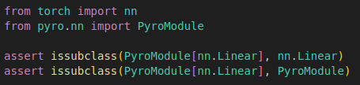
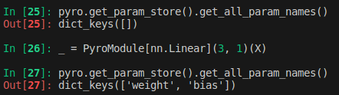
PyroModule
Used to subclass torch modules as Pyro modules
Parameters of PyroModules are registered with Pyro’s parameter store and can be regularized with PyroSample (see next slide)
Initialized Pytorch modules can also be registered with pyro with pyro.module(name: str, object: nn.Module)

Slide 9
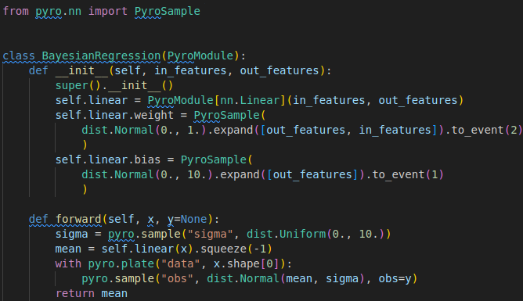
PyroSample
Initializes a tensor, that will draw a sample from a specified distribution whenever called!
Regularized through a Pyro distribution
Use expand and to_event to shape the output
Use PyroParam for PyroModules, or pyro.sample for other variables

Slide 10
PyroSample
Initializes a tensor, that will draw a sample from a specified distribution whenever called!
Regularized through a Pyro distribution
Use expand and to_event to shape the output
Use PyroParam for PyroModules, or pyro.sample for other variables

Slide 11
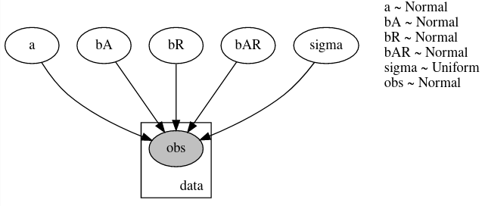
pyro.plate
Technical implementation of plate notation in graphical models
Context manager used to indicate repeated, independent sampling
Usage: with pyro.plate(name: str, n_samples: int)

Slide 12
pyro.plate
Technical implementation of plate notation in graphical models
Context manager used to indicate repeated, independent sampling
Usage: with pyro.plate(name: str, n_samples: int)

Slide 13
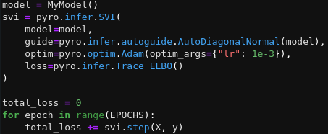
SVI
Stochastic Variational Inference as main inference algorithm of Pyro
Finds approximation of intractable posterior by maximizing ELBO
Facilitates flexible inference through guides
Basic use cases make use of Pyro’s Autoguides

Slide 14
Time to get coding!
→ Find the first tasks in “workshop/Part 1 - Linear Modelling with Pyro - Empty Template.ipynb”

Slide 15
Let’s take a break of ~15 minutes to ask questions, network, have a snack, …

Slide 16
Part II: Variational Autoencoders in Pyro

Slide 17
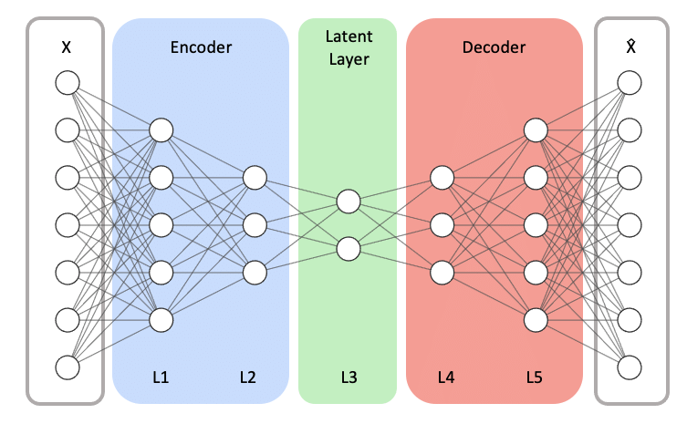
Autoencoders
Learns efficient data representations
Compresses input into a lower-dimensional space
Minimizes reconstruction error to learn meaningful features
→ E.g. used for dimensionality reduction
→ No regularization will lead to non-continuous latent space
Song, Youngrok & Hyun, Sangwon & Cheong, Yun-Gyung. (2021). Analysis of Autoencoders for Network Intrusion Detection. Sensors. 21. 4294. 10.3390/s21134294.

Slide 18
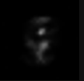




Original Digit
Reconstructed
Digit
Latent Space samples
Examples of Autoencoder Outputs

Slide 19
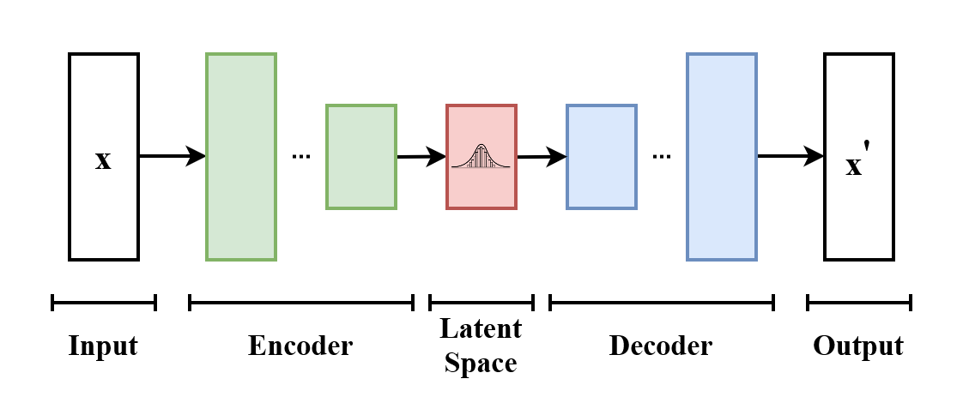
Variational Autoencoders
Variational Autoencoders (VAEs) are architecturally similar to regular Autoencoders
VAEs model a latent space as probability distribution
Probability distribution serves as regularization of latent space
→ Facilitates finite, complete and continuous latent space for interpolation and sampling
By EugenioTL - Own work, CC BY-SA 4.0, https://commons.wikimedia.org/w/index.php?curid=107231101

Slide 20
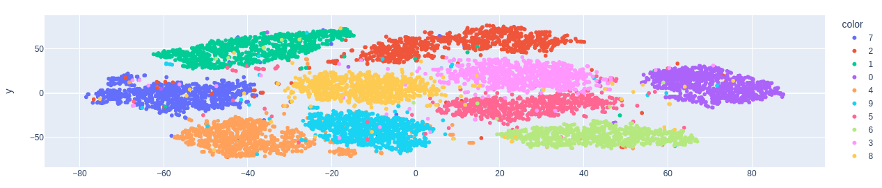
T-SNE Embedding of Latent Space of Variational Autoencoder

Slide 21







Original Digit
Reconstructed
Digits
Latent Space samples
Examples of VAE Outputs

Slide 22
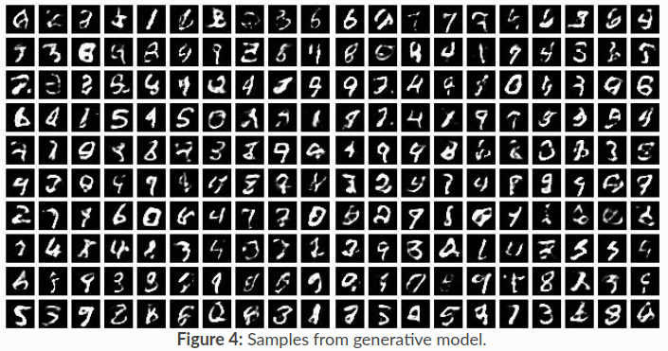
Samples from VAE in Pyro Docs

Slide 23
Time to get coding!
→ Find the second tasks in “workshop/Part 2 - Variational Autoencoder - Empty Template.ipynb”

Slide 24
Thank you for dropping by!

