Slide 1
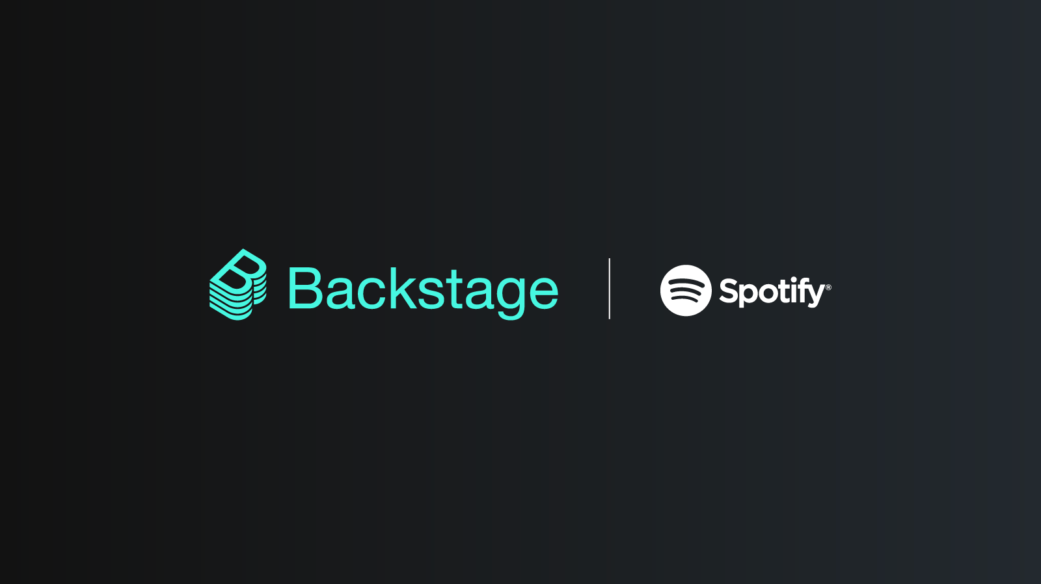
Developer Portal with Backstage
Asset and Template Management
Mansura Habiba

Slide 2
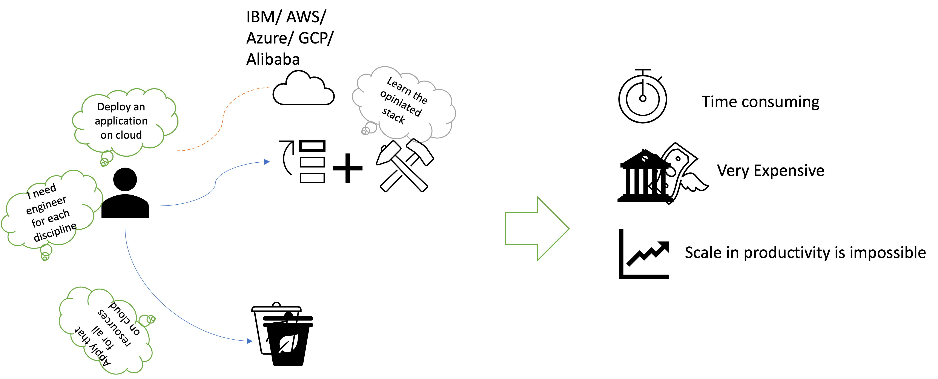
Infrastructure Management / Cloud Ops/ DevOps

Slide 3




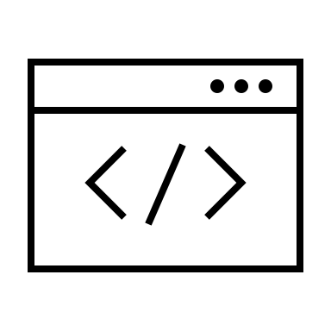





A New Way of Working !
Components
Pipeline
Resources
Cloud
Authenticated Web Portal
Documentation

Slide 4
A Developer Portal
One front end for entire infrastructure
One catalog for developer, DevOps, Cloud Ops and Platform Ops
Unifies all your tooling's, services,
Ensure standard, best practices across your organization
Reduce duplication of routine work.
Notes:
Building your developer portal
Its not another github tool, or another ci.cd tool It’s a tool that help to control the chaos and ensure the standard. Especially when an organization is growing

Slide 5
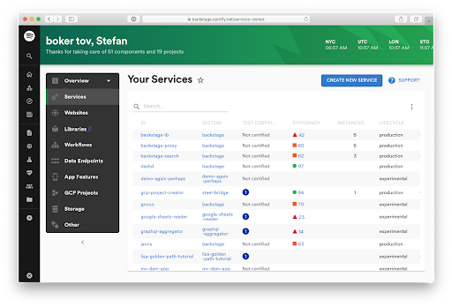
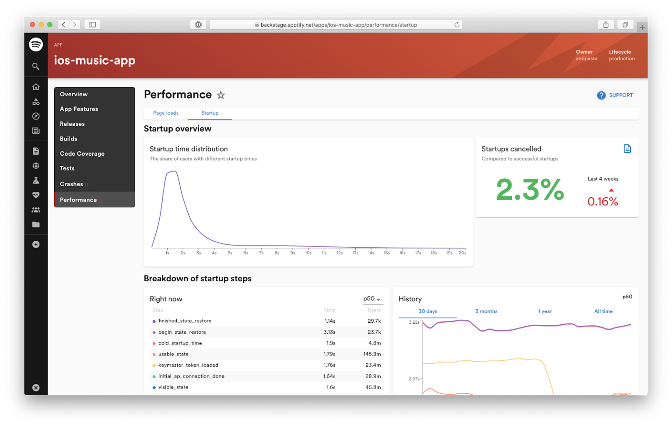
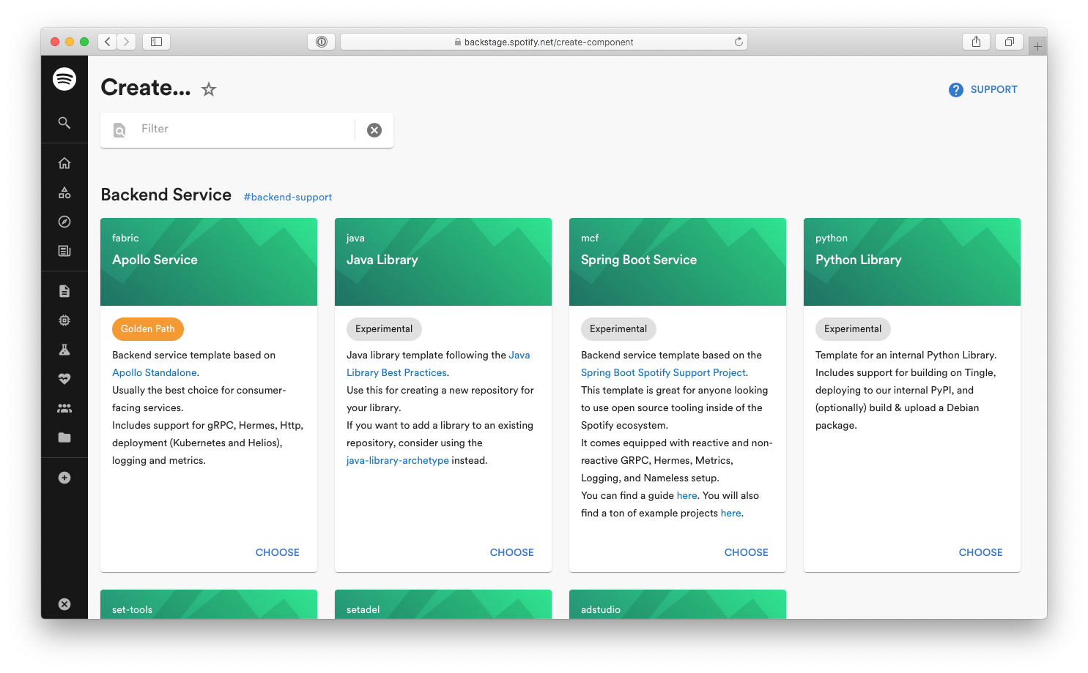
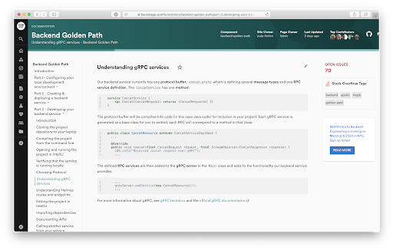
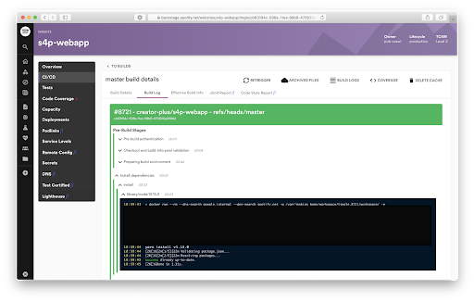
5
2
1
4
3

Slide 6
How does it look?

Slide 7
Why Backstage
Create at Speed
Manage at Scale
Explore with Standard

Slide 8
Todays Activity
How to setup a backstage application
How to configure different components
How to integrate template
How to configure documentation

Slide 9
How to setup a backstage application
Nodejs 16 || 18
Npm Latest
Any IDE – Sublime / Webstrom

Slide 10
How to configure different components
Catalog
User and Groups
Templates
API
Resources

Slide 11

How to integrate template
Create PAT on Github
Configure PAT in application-config.yaml
Create application from template and publish that in GitHub

Slide 12
How to configure documentation
Run Docker on the machine
Docker pull spotify/techdochs image
Click on the document navigation menu
Create index.md and place that in the same folder of mkdocs.yaml file

Slide 13

Demo
https://github.com/mansura-habiba/backstage-dev-portal

Slide 14
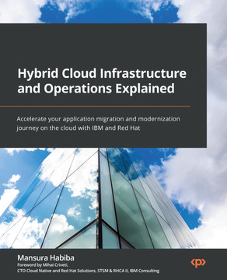
Hybrid Cloud Infrastructure and Operations Explained
by Mansura Habiba
Released August 2022
Publisher(s): Packt Publishing
ISBN: 9781803248318
https://www.packtpub.com/product/hybrid-cloud-infrastructure-and-operations-explained/9781803248318
Github (https://github.com/mansura-habiba/Hybrid-Cloud-Infrastructure-and-Operations-Explained)

Slide 15
Thank you

