Slide 1
Samira Korani
Efficient Deployment and Debugging of a Fine-Tuned Language Model Classifier Using Python SDK & Cloud Tool
Use Case: Tourism Knowledge Graph
Tripoh.ie

Slide 2
Introduction
AI-based products like sentiment analysis, market prediction, recommender systems, and search engines offer significant advantages to large businesses like Amazon and Google. However, their high cost has traditionally limited access for small businesses. The introduction of large language models (LLMs) has the potential to change this, making these powerful AI applications more affordable.
LLMs can analyze vast amounts of social media data, reviews, and online behavior to pinpoint crucial factors influencing the travel decision-making process.
Travel agents and service providers gain valuable knowledge about customer preferences, pain points, and emerging trends. By understanding customer similarities, LLMs enable targeted marketing campaigns and tailored travel experiences.
This means delivering the right offers to the right audience, boosting satisfaction and loyalty.
Tripoh.ie

Slide 3
Market Potential
The global tourism industry generated over $1.3 trillion in revenue pre-pandemic and is recovering strongly, highlighting substantial market size.
LLM Technology
LLMs are increasingly in demand by SMBs seeking cost-effective AI solutions, as evidenced by growing startup activity in this space.
User Taste
Leveraging social media data and reviews allows targeting the large subset of travelers who research/book online, increasing the addressable market.
Product Value
Personalized recommendations, optimized marketing, and deeper customer insights delivered by the LLMs could meaningfully impact SMB revenues and efficiencies.

Slide 4
Trip planning
Events in destination
Best Place to visit
Best place for food
Best way to spend the time
Tips to stay safe and secure
Local shops
Local Slang
Brief History of destination
Best Experience
Behavioral Tips
Market strategy
Price Strategy
Content Management
Transportation API
Accommodation API
Fine-Tuned LLM
Trip Oh!
Yelp API
Preprocess
End-User
Local Sites
Travel Social media
Trip Advisor, Instagram,

Slide 5
Objects
1. Train the model as a binary classification
2. Efficiently deploy trained Model
3. Debug the model
4. Deploy the model over Sage Maker
5. AWS Ecosystem Microservice
Running in
Container

Slide 6
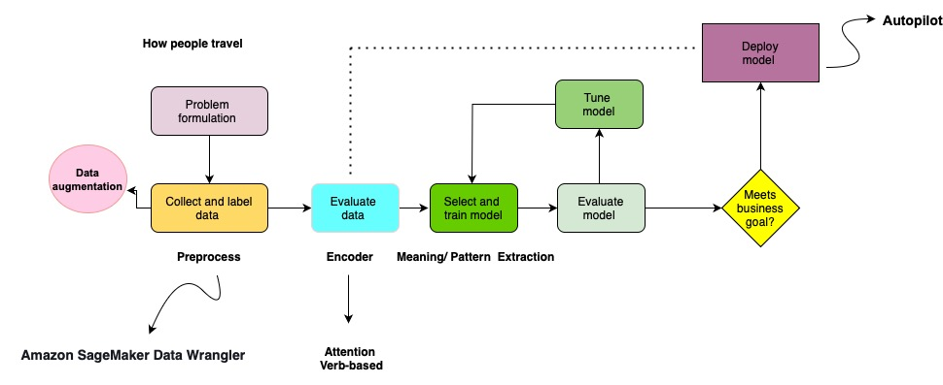

Slide 7
ML Problem
Is the Instagram account interested in traveling? (Yes/No)
What type of trip is preferred? (Options: Adventure, Cultural, Relaxation, Exploration, Business)
Will the user be traveling alone? (Yes/No)
Design a treasure hunt game at the destination. What features would make the game engaging? (Open-ended)

Slide 8
Data Set
Instagram Crawler
Tripadvisor Crawler
News about Travel
.
├── crawler
│ ├── instagram
│ └── tripadvisor
├── db_handler
├── nlp
└── normalizer
├── data
└── settings
* postgresql
* elasticsearch
* neo4j

Slide 9


Storing data in AWS
Amazon Simple Storage Service (Amazon S3)
Amazon Elastic File System (Amazon EFS)

Slide 10





Data Catalog
Crawler
Instagram
TripAdvisor
Extract
Load
Cleaning and Normalizing
Data Source
Training Data
‹#›
‹#›

Slide 11
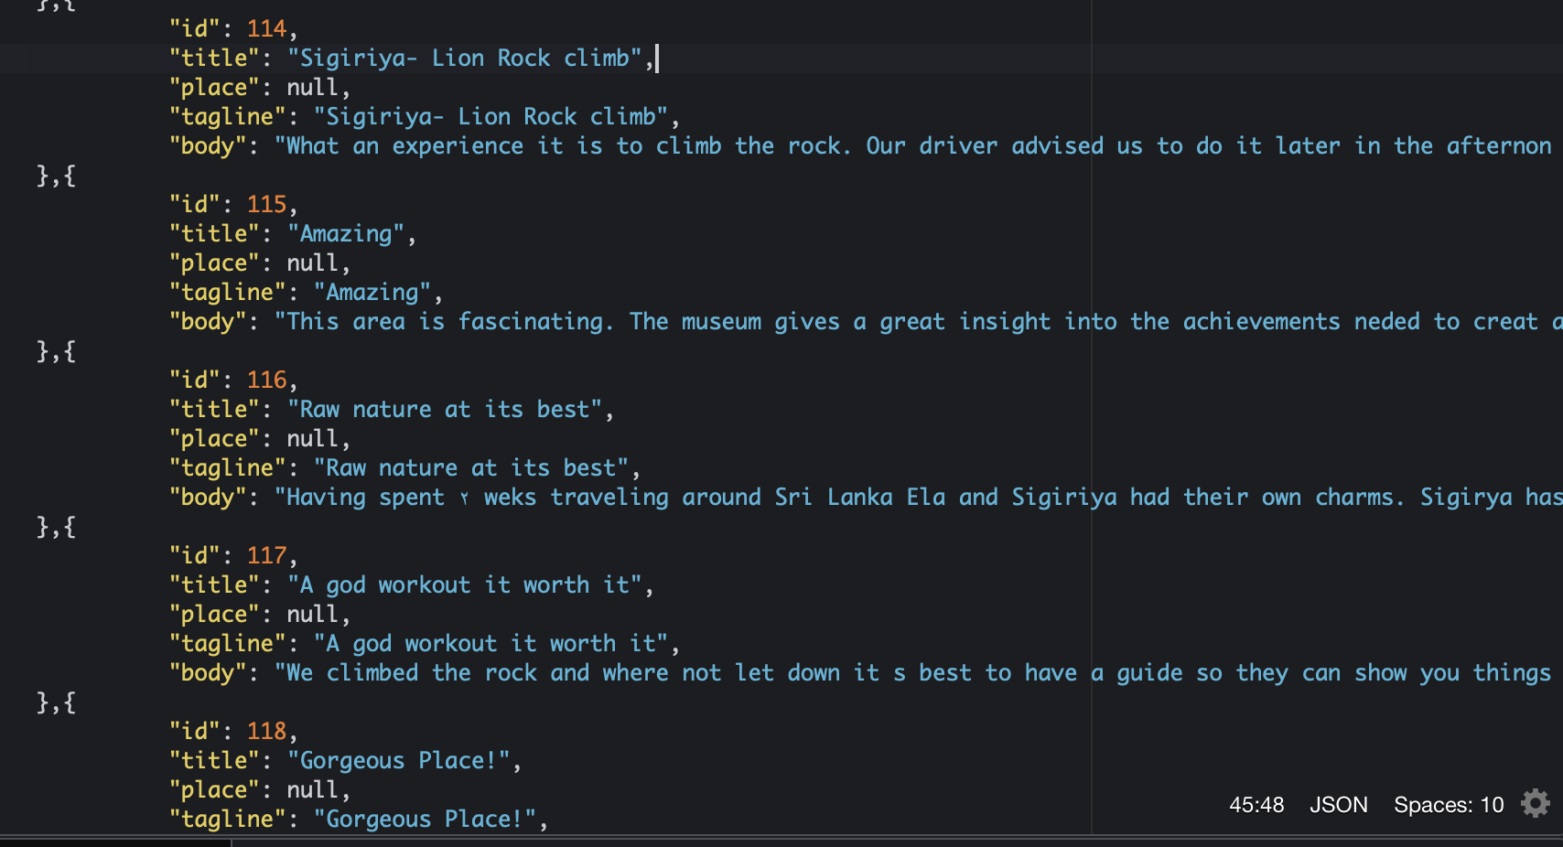
Tripadvisor Spider/ Instagram crawler

Slide 12
Preprocess
1. Sage Maker
2. NLTK
3. PyTorch

Slide 13
Text Embedding
Text embedding takes words and turns them into a mathematical form (like numbers or vectors) so computers can understand and work with them.
Words that are similar in meaning are represented by numbers that are closer together in mathematical space.
BERT, Fast Text

Slide 14

Global Attention Mechanisms
Global Attention calculates self-attention to consider the pairwise relationships between words in a sentences
A mechanism that enables the model to focus on the entire sentence when determining the relation between two entities.
It computes an attention weight for every word in the sentence.
Mathematically, for each word 𝑤_𝑖 , the attention weight 𝛼_𝑖 , 𝘦_𝑖 as the importance of words can be computed as Softmax function:
Higher attention weights to words that are more relevant to the current context,
Notes:
Mathematics: The attention weights are often computed using the softmax function.

Slide 15
Proposed Slot Attention Mechanisms
Slot attention computing self-attention based on position of entities and root in sentences.
Slot attention can be especially useful when dealing with entities in a sentence and their relations to a central "root".
For example, in the sentence "Alice gave Bob a book in the park," both "Alice" and "Bob" relate to the root action "gave."
Using slot attention, we can organize these entities into distinct slots.

Slide 16
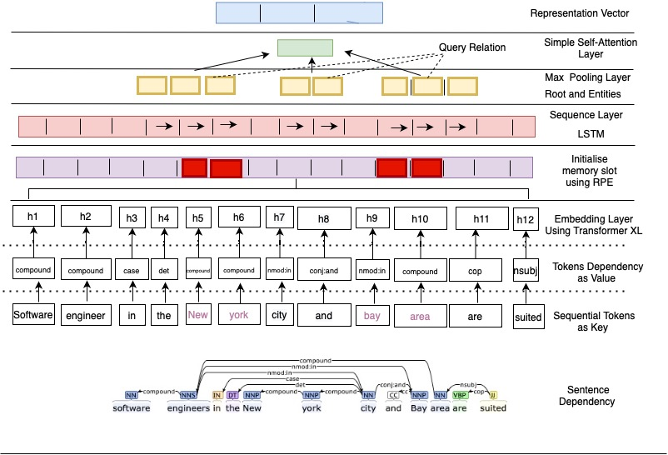
Encoder

Slide 17
ML model (LLM Fine-Tune)
Difference between Prompt Engineering Fine tuning model is that it makes it possible for you to give it a lot more data than what fits into the prompt so that your model can learn from that data rather than just get access to it.
fine-tuning can also help steer the model to more consistent outputs or more consistent behavior.
Retrieval augmented generation, or RAG, to connect more of your data, to selectively choose what kind of data goes into the prompt.
However, while using retrieval augmented generation can be great to connect your data, it will also often miss the right data,get the incorrect data and cause the model, to output the wrong thing.

Slide 18
Fine-Tuned Large Language Model
GPT
LLAMA
T5
Update all weights
Changing Model Behavior
Pre-train
Next Token Prediction
Fine-tuning, it's just text in, text out for LLMs.
Learned Language
Travel Data set
Self-Supervising
Trained Model
Learned Knowledge

Slide 19
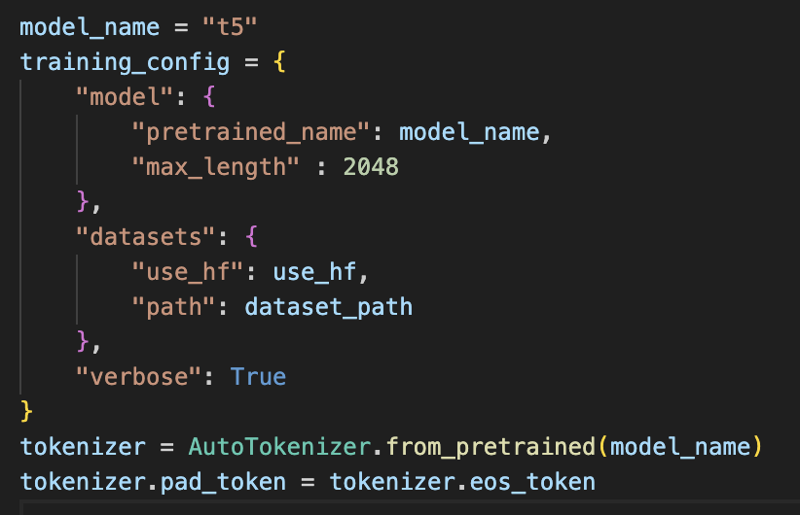
Fine-Tune Process
Training Process (add training data, calculate the loss, Backprop the model, update the weights),
Hyperparameters (learning rate, learning scheduler, various optimizer hyperparameters)
.

Slide 20

Fine-Tune the Model in Amazon SageMaker
2
{
Hyperparameter
}
{
Encode Data
}
{
Base Model
}
1
Fine-Tune code
S3 bucket training data
Helper code
Training code
3
Model training
on ML computer instances
Amazon Elastic Container Registry (Amazon ECR)
Amazon SageMaker

Slide 21
Two options for deployment
Amazon SageMaker hosting services
Batch transform
I used Pytorch Fast API on Cloud9
https://github.com/nogibjj/pytorch-fastapi-aws-apprunner

Slide 22




Client
Inference
request
Inference
response
Secure endpoint
Amazon SageMaker
Helper
code
Inference
code
Models
Helper
code
Training
code
Training
data

Slide 23
Python SDK
SDKs typically include one or more APIs (Application Programming Interfaces), programming tools, and documentation
Huggingface_estimator
Boto3

Slide 24
Monitoring and Logging for Software Systems
AWS CloudWatch
Dashbooards
Search
Alerts
Auto Insights
Server
Monitoring
Agent(s)
Logging Code
Instrumentation Code
Model
Server
CPU
Metrics
Memory
Metrix
Monitoring
Agent(s)
Logging Code
Instrumentation Code
Disk I/O
Metrics
Model
CPU
Metrics
Memory
Metrix
Disk I/O
Metrics

Slide 25
Provision
Create Infrastructure
Create S3
Bucket
No Change!
Idempotent Infrastructure
Build System
S3
Bucket
(Stays Same)
Trigger
Build
Deploy
Mutate Infrastructure
Test Code
S3
Bucket
Hosts Static Site
Change S3 Bucklet to Static
Website
Merge Code
Source Control
Repo
Delete
Destroy Infrastructure
Delete S3 bucket
Delete All
Infrastructure
Push
Code & IAC
Local Development Environment
IAC (Infrastructure as Code) Workflow

Slide 26
Idempotent and Reproducible Deployment
Build System
Configuration YAML
AWS ECR
Build on Push
AWS ECS
Infrastructure as Code
(IAC)
AWS Batch
SDK
Cloud Environment
Model
AWS Lambda
Dockerfile
AWS App Runner
AWS Code Build
Microservice
Running in
Container

Slide 27
Debugging System
1. Monitoring
https://sagemaker.readthedocs.io/en/stable/model_monitor.html
2. Rule Debugger
3. Monitoring Schedule

Slide 28
Question Time

