Slide 1

Unlocking the Power of Geospatial Data with Python
NAME: Safa Ridene
HOST: Pinterest HQ, Dublin
DATE: 17/09/2024

Slide 2





About me
GIS Python Developer at Entegro
Experienced in geospatial data processing, satellite imagery and python development.
Passionate about using geospatial data to solve real-world environmental challenges.
@safa0907
Safa Ridene
GIS Python Developer at Entegro

Slide 3
Agenda:
What is Geospatial Data?
Why Python for Geospatial Analysis?
Core Geospatial Python Libraries
Hands-On Demonstration
Best Practices
Conclusion – Key Takeaways

Slide 4
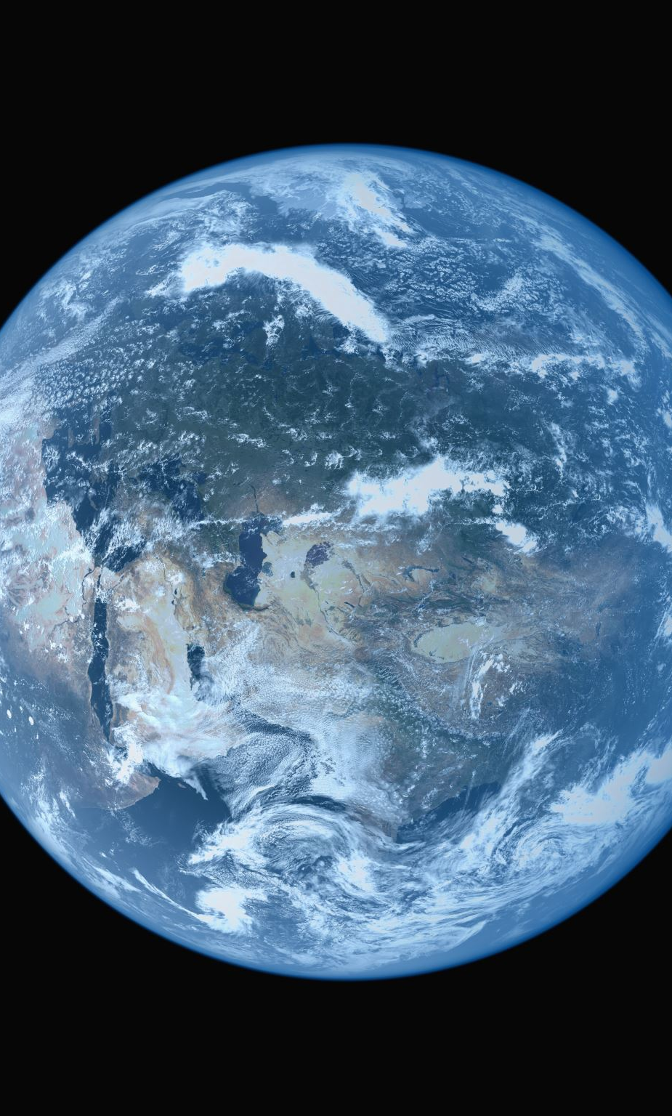
What is Geospatial Data?
Geospatial data refers to information that has a spatial aspect, meaning it’s related to specific locations on Earth.
It includes coordinates (Latitude and Longitude), shapes (Polygons representing areas) and attributes (population density, temperature…)
Types of Geospatial Data:
Vector: A point to represent a city, a line to represent a road and a polygon to represent a country.
Raster: Grid-based data like a satellite image showing vegetation density. A heatmap showing temperature distribution.

Slide 5
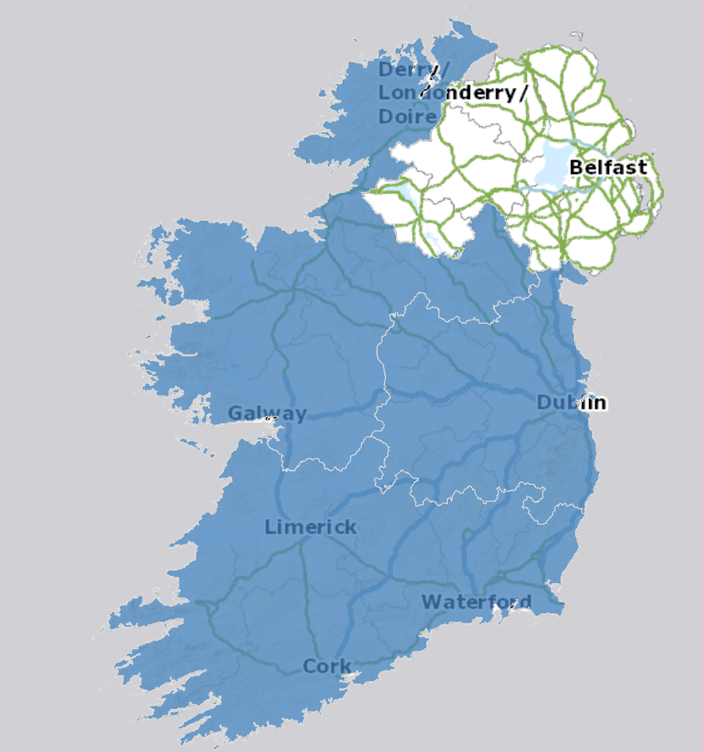
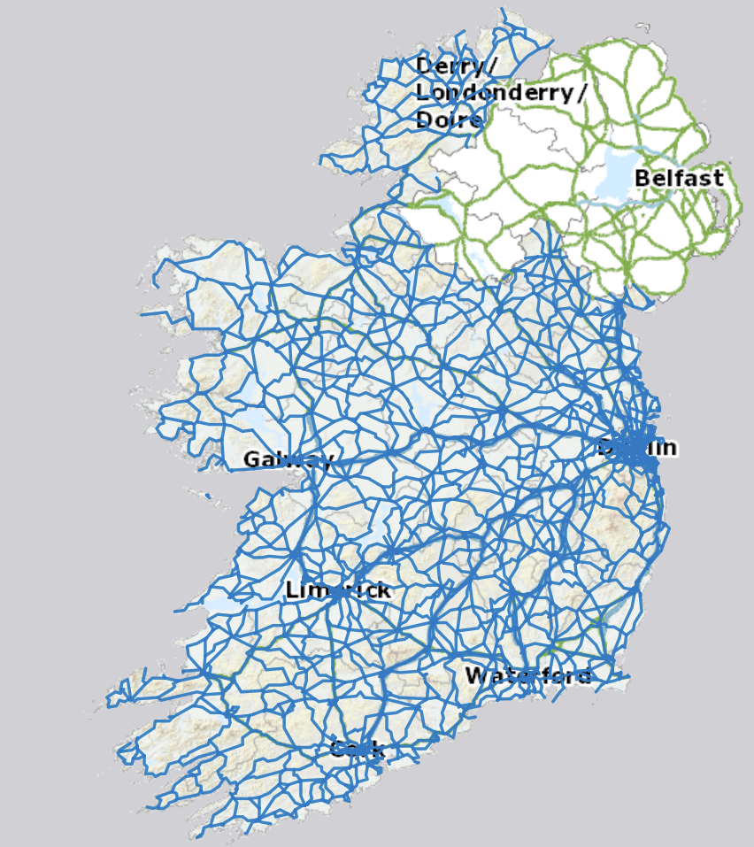
Examples of datasets
Polygon Shapefile of Regions
Line Shapefile of Roads
Source: https://data-osi.opendata.arcgis.com/

Slide 6
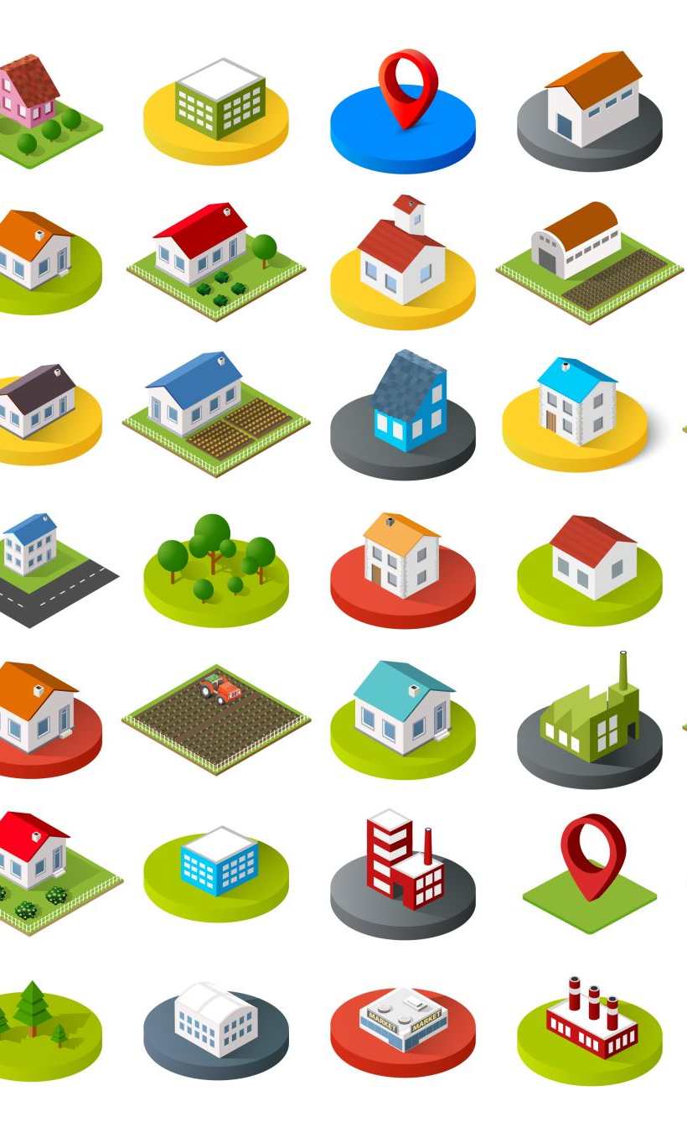
Why python for Geospatial Analysis?
Python is open-source, which makes it accessible for developers, researchers and governments.
Python has become a go-to language for this analysis due to its:
Ease of Use: Python has a simple syntax, making it easy to learn and adapt.
Extensive Ecosystem: Python has numerous libraries that handle geospatial data.
Integration with other tools: Python integrates seamlessly with other technologies and geospatial systems (Build web-GIS applications using GeoDjango and PostGIS as back-end).
Active Community: Python’s open source community is active in creating, maintaining and sharing geospatial libraries.

Slide 7

Core Geospatial Python Libraries
1. GeoPandas:
Handles vector data. Think of it as Pandas with spatial operations.
Best for: Working with shapefiles, performing spatial joins or filtering features.
2. Shapely:
A library for geometric operations. It provides a rich set of tools for handling geometric objects (points, lines and polygons). Performs operations like intersection, union and distance calculations.
Best for: Geometry manipulation (buffering, merging, splitting or intersections between shapes).
3. Fiona:
Handles reading/ writing of geospatial data in different formats.
Best for: Loading and saving shapefiles or GeoJSON files.
4 Rasterio:
Handles raster (grid-based) data.
Best for: Reading and manipulating raster data like satellite imagery (clipping raster data, reading pixel values).

Slide 8
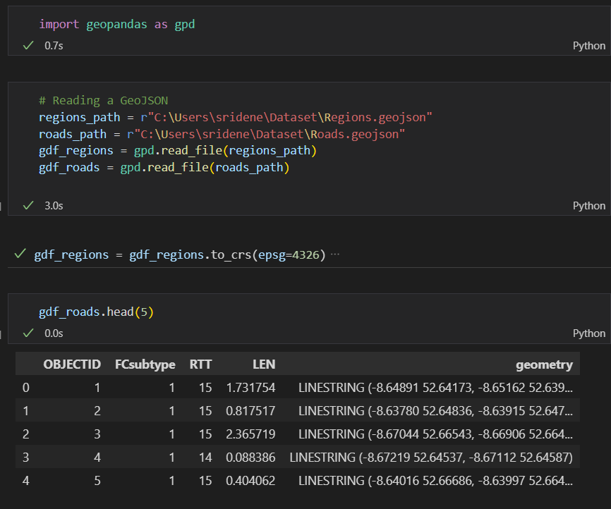
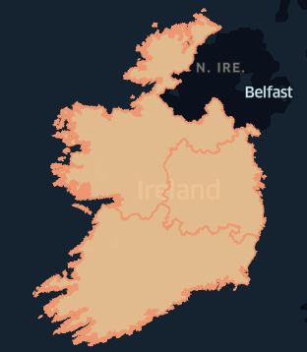
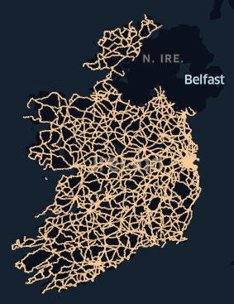
Hands-On Demonstration
Load GeoJSON files into GeoDataframes.
Visualize the data using plot() method from GeoPandas.
Perform spatial intersection between 2 GeoDataframes.
Writing GeoDataframe to Database.
Create a database view of spatial intersection between 2 tables.
Code Snippet
Regions
Roads
Data Source: https://data.gov.ie/

Slide 9

Best Practices in geospatial python
Efficient Data Management:
Use Geospatial Databases: When working with large datasets, consider using databases like PostGIS (a spatial extension for PostgreSQL) to manage spatial data efficiently. Python’s SQLAlchemy and GeoAlchemy can help integrate Python with PostGIS seamlessly.
Best Practice: For large-scale operations (querying, updating geospatial data), avoid storing data in multiple flat files (shapefiles, GeoJSON). Instead, centralize your data in a database for scalability.

Slide 10
Best Practices in geospatial python
Processing Large Raster Datasets:
Use Tiled Raster Porcessing: When working with large satellite images or DEMs, process data in chunks (tiles) rather than loading the entire file into memory.
Best Practice: For cloud-based workflows, use cloud-optimized geospatial formats like COGs (Cloud-Optimized GeoTIFFs) to enhance performance and accessibility.

Slide 11
Best Practices in geospatial python
Geospatial Data Standards:
Follow Standard Formats: Always ensure that your geospatial data is stored in industry-standard formats (GeoTIFF for raster data, Shapefile, GeoJSON or GPKG for vector data). This ensures compatibility with most GIS tools and applications.
Best Practice: Ensure metadata is always included with geospatial datasets, detailing projection information,
data of creation and data sources.

Slide 12
Conclusion – key takeaways
Python’s extensive ecosystem of libraries allows flexible geospatial data analysis, making it ideal for industries like urban planning and disaster management.
It can help solve critical problems like wildfire spread and land-use planning.
Python’s power and accessibility have opened new possibilities for geospatial analysis. Whether we’re working on local issues like flood risk or global challenges like climate change, Python’s tools can help us make informed, data-driven decisions.
Further Resources:
GeoPandas Documentation: https://geopandas.org/
Rasterio Documentation: https://rasterio.readthedocs.io/
Geospatial Python Tutorial: https://automating-gis-processes.github.io/2016/

