Slide 1
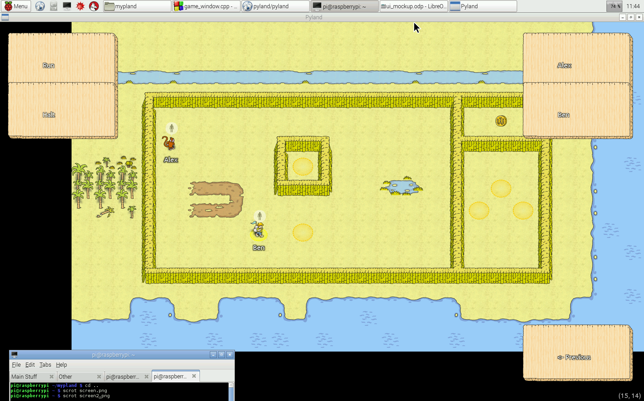
Standard
Pyland
Bag
Characters
Abilities
You
^
Scrolls
Alex
Items
Berries: 1/5
Level: 3
World: Beach
^
01. >
02. >
03. >
04. >
05. >
06. >
07. >
08. >
09. >
10. >
11. >
12. >
13. >
14. >
15. >
16. >
17. >
18. >
19. >
20. >
“”” This is the start of a python script! :D
Stuff in here should just be able to run! “””
print(“Testing”)
while(can_walk_east()):
walk_east()
print(“I've hit an edge!!!”)
make_change(500.00) #using the scroll Larry gave us!
walk_nroth()
the_meaning_of_life = 42
0
^
1
Testing
I've hit an edge!!!
500.00 can be made out of 10 £50 notes.
pyland: error, the function walk_nroth() on script 5 on line 13 doesn't exist, did you mean walk_north()?
2
3
4
5
6
7
^
8
Edit
Run
Speed
9

Slide 2
Standard
Pyland
Bag
Characters
Abilities
^
You
^
Scrolls
Banana
Alex
Orange
Orange
^
Berries: 1/5
Level: 3
World: Beach
^
^
01. >
02. >
03. >
04. >
05. >
06. >
07. >
08. >
09. >
10. >
11. >
12. >
13. >
14. >
15. >
16. >
17. >
18. >
19. >
20. >
“”” This is the start of a python script! :D
Stuff in here should just be able to run! “””
print(“Testing”)
while(can_walk_east()):
walk_east()
print(“I've hit an edge!!!”)
make_change(500.00) #using the scroll Larry gave us!
walk_nroth()
the_meaning_of_life = 42
0
^
1
Testing
I've hit an edge!!!
500.00 can be made out of 10 £50 notes.
pyland: error, the function walk_nroth() on script 5 on line 13 doesn't exist, did you mean walk_north()?
2
3
4
5
6
7
^
8
Edit
Run
Speed
9

Slide 3
Hotkeys

Slide 4
Pyland
01. > python code goes here
02. >
03. >
04. >
05. >
06. >
07. >
08. >
09. >
10. >
11. >
12. >
13. >
14. >
15. >
16. >
17. >
18. >
19. >
20. >

