Slide 1
INSURANCE
ANALYTICS
Insurance Claims &
Fraud Analysis
SQL + Power BI Capstone Project
Analyze claims • Identify risk patterns • Monitor fraud indicators • Support better decisions
Portfolio / Academic Capstone
Insurance Claims & Fraud Analysis | Capstone Project
1

Slide 2
1. Project Overview
What the project is, why it matters, and what the final solution delivers
What is the project?
Business problem
Final output
An analytics solution for insurance claims that combines SQL-based data analysis with interactive Power BI dashboards to understand claim volume, claim value, risk scores, fraud flags, status, type, region and demographics.
Insurance teams handle large numbers of claims. Suspicious patterns can be difficult to spot manually, while delays and inconsistent review can increase cost, leakage and operational workload.
A decision-support dashboard with an Executive Dashboard and Risk Analysis page, supported by reusable SQL queries, views and stored procedures.
End-to-end flow
Important terminology
Data → Data dictionary → SQL exploration → Aggregation & risk analysis → Power BI modeling/visuals → Interactive dashboard → Business insights
“Fraud claims” in this project means claims flagged as fraudulent according to the Fraud_Flag field. The dashboard supports investigation; it does not independently prove fraud.
Insurance Claims & Fraud Analysis | Capstone Project
2

Slide 3
2. Objectives & Scope
The questions the project is designed to answer
Measure total claim volume and total claim amount.
Compare fraud-flagged vs non-fraud-flagged claims.
Understand claims by status, claim type and region.
Analyze fraud risk scores across claim type, region and gender.
Compare average claim and premium amounts across business dimensions.
Create interactive dashboards that allow users to filter by Region and Claim Type.
Demonstrate practical SQL skills: aggregation, CASE, subqueries, window functions, views and stored procedures.
In scope
Claims, fraud flags, risk score, claim amount, premium amount, status, type, region and gender.
Out of scope
Automated fraud verdicts, production model deployment, real-time claim ingestion and financial-loss valuation not present in the dataset.
Success criteria
A clear, interactive dashboard that converts raw claim records into decision-ready summaries and supports drill-down thinking.
Insurance Claims & Fraud Analysis | Capstone Project
3

Slide 4
3. Dataset & Data Dictionary
What information is being analyzed
Claim_ID
Claim_Type
Region
Unique claim identifier — Example: used for COUNT of claims
Type/category of claim — Theft, Accident, Property, Medical
Geographic grouping — East, North, South, West
Gender
Claim_Status
Claim_Amount
Customer gender — Female / Male
Current claim status — Approved / Under Review / Rejected
Financial value of the claim — Used for SUM / AVG
Premium_Amount
Fraud_Risk_Score
Fraud_Flag
Premium-related amount — Used for AVG
Risk indicator — Used for average/distribution analysis
Fraud indicator field — Yes / No
Insurance Claims & Fraud Analysis | Capstone Project
4

Slide 5
4. Technology Stack & Architecture
Tools used and how they work together
MySQL / SQL
Core analytical layer
Data querying and analysis
Power BI
Dashboard & reporting layer
Interactive visualization
Power Query / BI modeling
Clean and structure data
Data preparation & shaping
DAX / Visual configuration
Business calculations & UX
Measures, KPIs and presentation
PowerPoint
Presentation / viva
Project communication
Insurance Claims & Fraud Analysis | Capstone Project
5

Slide 6
5. SQL Analysis Workflow
From basic exploration to reusable analytical components
1
Explore
2
Summarize
3
Classify
SELECT, DISTINCT, WHERE, BETWEEN, comparisons, ORDER BY
COUNT, SUM, AVG, MAX, MIN with GROUP BY
CASE expressions for risk/business categories
4
Deep dive
5
Rank
6
Reuse
Subqueries for above-average, highest/lowest and regional comparisons
RANK, DENSE_RANK, ROW_NUMBER and top-N analysis
Views and stored procedures for repeatable reporting
Insurance Claims & Fraud Analysis | Capstone Project
6

Slide 7
6. SQL Techniques — Examples
Representative queries used in the project
-- Aggregate claims by type
SELECT Claim_Type,
COUNT(Claim_ID) AS Total_Claims,
AVG(Claim_Amount) AS Avg_Claim_Amount
FROM insurance_claims_dataset
GROUP BY Claim_Type;
-- Rank claims within each region
SELECT Claim_ID, Region, Claim_Amount,
RANK() OVER (
PARTITION BY Region
ORDER BY Claim_Amount DESC
) AS Rank_In_Region
FROM insurance_claims_dataset;
-- Reusable fraud view
CREATE VIEW Fraud_Cases AS
SELECT *
FROM insurance_claims_dataset
WHERE Fraud_Flag = 'Yes';
-- Stored procedure example
CALL GetClaimsByRegion('South');
Why this matters
These techniques move the project beyond simple charts: the analysis is reproducible, reusable and scalable for additional business questions.
Insurance Claims & Fraud Analysis | Capstone Project
7

Slide 8
7. Fraud & Risk Analysis Approach
How the project turns claim data into risk-focused views
Fraud Flag
Fraud Risk Score
Financial Exposure
Separate claims into records flagged Yes vs No using the Fraud_Flag field.
Compare average risk scores by Claim Type, Region and Gender; inspect score distribution.
Compare claim and premium amounts by status, region, gender and claim type.
Example question
Example interpretation
Control point
Which claim types have higher average risk scores or higher claim amounts?
A high-risk segment can be prioritized for review, but the dashboard alone should not be treated as proof of fraud.
Use multiple dimensions together: status + region + type + risk + financial value.
Important
Risk analytics is decision support. Final fraud decisions require investigation, policy rules and appropriate evidence.
Insurance Claims & Fraud Analysis | Capstone Project
8

Slide 9
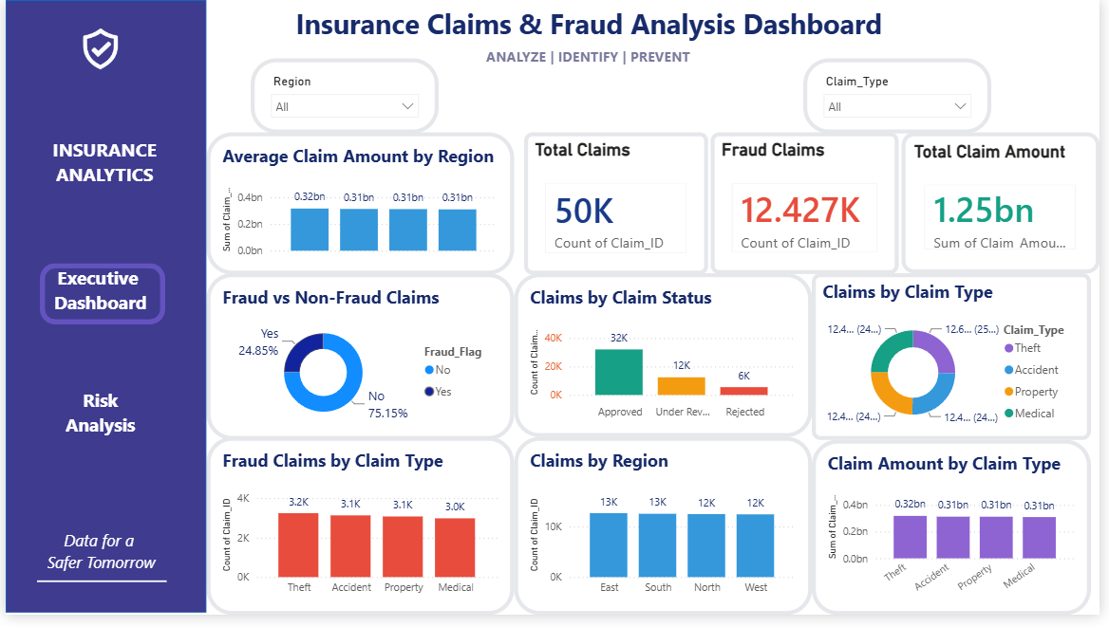
8. Executive Dashboard
Management view of volume, fraud flags, status, type, region and financial value
Top KPI outputs
50K total claims
Fraud-flagged claims
12.427K shown in the dashboard
Total claim amount
1.25bn shown in the dashboard
Key visuals
Fraud vs non-fraud • claim status • claim type • fraud claims by type • region • claim amount by type/region
Insurance Claims & Fraud Analysis | Capstone Project
9

Slide 10
9. Executive Dashboard — How to Read It
Practical interpretation and example decisions
Fraud vs Non-Fraud
Claim status
Claim type
The dashboard shows 24.85% flagged Yes and 75.15% flagged No in the captured view.
Approved is the largest status in the captured view, followed by Under Review and Rejected.
Theft, Accident, Property and Medical can be compared side-by-side for volume and financial patterns.
Example business question
Example action
Interactive controls
“Which claim types contribute the most flagged claims?”
Prioritize deeper review of segments that combine high volume, high value and elevated risk.
Region and Claim Type slicers let users focus the dashboard on a subset of claims.
Design principle
KPIs answer “How much?” while charts answer “Where?”, “What type?”, “What status?” and “What should we investigate next?”
Insurance Claims & Fraud Analysis | Capstone Project
10

Slide 11
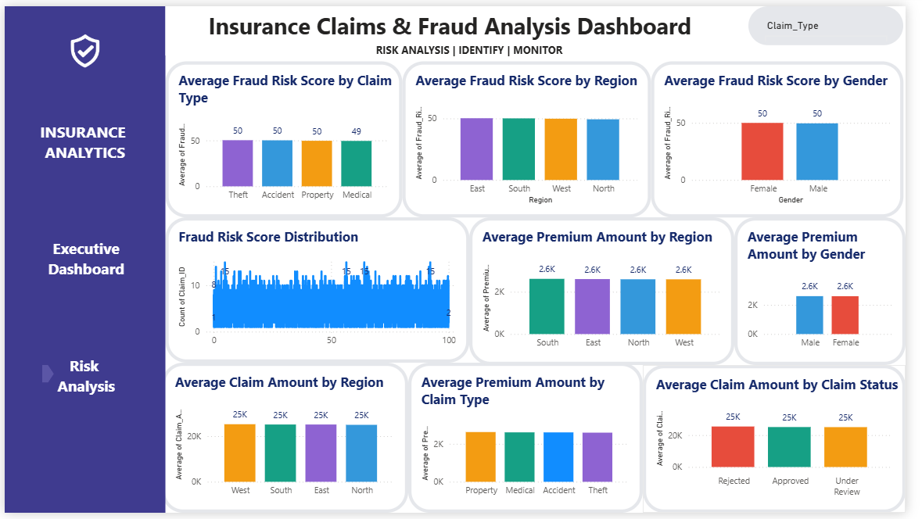
10. Risk Analysis Dashboard
Detailed view of risk scores, claim amounts and premium amounts
Risk score by type
Compare average fraud risk score across Theft, Accident, Property and Medical.
Risk score by region
Compare East, South, West and North to identify segment-level differences.
Risk score by gender
Compare the two gender categories without treating the result as causal.
Financial context
Claim amount and premium amount visuals add a financial lens to the risk analysis.
Insurance Claims & Fraud Analysis | Capstone Project
11

Slide 12
11. Key Findings From the Captured Dashboards
What can be stated directly from the screenshots
50K
12.427K
24.85%
Total claims shown in Executive Dashboard
Claims flagged Yes for Fraud_Flag in the captured view
Share of claims shown as Fraud_Flag = Yes
1.25bn
50 / 49
25K / 2.6K
Total claim amount shown
Average fraud risk scores displayed across several segments
Typical displayed average claim / premium amounts in Risk Analysis
Interpretation
The dashboard provides descriptive evidence for prioritization; it does not establish causation or prove that a flagged claim is fraudulent.
Insurance Claims & Fraud Analysis | Capstone Project
12

Slide 13
12. Business Uses, Benefits & Potential Losses
How an insurer could use the analysis
Operational use
Fraud prevention use
Financial use
Prioritize claims for review, monitor status mix, compare regions and understand workload patterns.
Surface segments with elevated fraud flags/risk indicators for investigation and rule-based follow-up.
Compare claim amounts and premium amounts to understand exposure and portfolio patterns.
Potential losses if ignored
Potential gain
Example
Claim leakage, avoidable investigation cost, delayed settlement, customer dissatisfaction and reputational impact.
Faster prioritization, more consistent monitoring, clearer management reporting and better use of analyst time.
If a region has many high-value claims and elevated risk indicators, the team can focus investigation capacity there first.
Insurance Claims & Fraud Analysis | Capstone Project
13

Slide 14
13. Limitations, Risks & Controls
What the current capstone does not claim
Data quality
Fraud flag ≠ proof
Dashboard conclusions depend on the quality, completeness and correctness of the source dataset.
Fraud_Flag is an input indicator. A flagged claim still needs investigation and evidence.
Descriptive analytics
Static snapshot
The project summarizes patterns; it does not include a production fraud ML model or causal inference.
The captured dashboard is not a real-time claims monitoring system.
Privacy & governance
Threshold risk
Real insurance deployment would require access controls, data minimization, audit trails and compliant handling of customer data.
Risk scores should not be used as a sole decision rule; thresholds require validation and business governance.
Control principle
Use the dashboard to support human review and investigation—not to automate a final fraud verdict.
14
Insurance Claims & Fraud Analysis | Capstone Project

Slide 15
14. Conclusion & Future Scope
From a capstone dashboard to a scalable analytics solution
What was achieved
Business value
Future scope
• Built SQL analysis from basic queries to window functions.
• Created reusable views and stored procedures.
• Built two Power BI pages: Executive Dashboard and Risk Analysis.
• Added KPIs, slicers, category labels and consistent visual design.
• Faster pattern discovery
• Better claim segmentation
• Clearer management reporting
• More focused fraud investigation
• Repeatable analytical workflow
• Add time-series claim trends
• Add drill-through claim detail
• Add automated alerts
• Add validated ML fraud prediction
• Add role-based security and refresh pipelines
One-minute project explanation
“I built an Insurance Claims & Fraud Analysis solution using SQL and Power BI. SQL was used to clean, aggregate, rank and segment claims, while Power BI converted the analysis into interactive Executive and Risk dashboards. The solution helps identify patterns in claim volume, financial exposure, status, region, type, fraud flags and risk scores so analysts can prioritize investigation and make better decisions.”
Thank You • Questions?
Insurance Claims & Fraud Analysis | Capstone Project
15

