Slide 1

Exploring
Struts Framework
Gordon Li
Senior Consultant
Notes:
Thank you for this opportunity to present our company, its value propositions and forward directions
“Enabling The New Digital World” is a Borland theme emphasizing our role as a company that helps leverage information technology for business success
All enterprises today do business in a digital world, some more than others but the ability to embrace technology as it evolves is critical.
During our entire almost 20 years in business, we have provided the solutions to do exactly that: leverage technology for business success

Slide 2
Exploring Struts Framework
Agenda
  Web Development- JSP model 1 and 2
  MVC Design Pattern
  Introducing Struts
  Controller Layer
  Model Layer
  View Layer
  How they work together
  Real Sample
  Q&A

Slide 3
Web Development- JSP model 1 and 2

Slide 4
Exploring Struts Framework
Java 2 web application options:
  Servlets
    + Great for Java people
    - Difficult to manage graphical changes in HTML layout.
  JSP
    + Great for web developers
    - Seductive tendency to write logic in the JSP page.

Slide 5
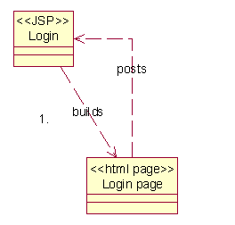
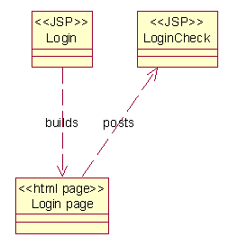
JSP Model 1
所有的Web應用程式都是使用JSP開發的
Option 1
Option 2

Slide 6
A Closer Look at JSP Model 1
JSP1
JSP3
優點是 :
  最容易的開發方式
缺點是 :
  客戶端GUI和企業邏輯程式碼是混雜在一起的
最糟糕的是 :
  無法重覆使用
JSP2
JSP4
Presentation
Logic
Ctrl
Presentation
Presentation
Logic
Ctrl
Present.
Logic
Present.

Slide 7
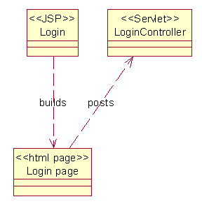
JSP Model 2
Web 應用程式使用JSP開發 GUI 端, 使用Servlet開發Web的企業邏輯程式碼
Notes:
This provides the base for a model view controller architecture.

Slide 8
Model 2
Logic
Control
優點是 :
  具有可重覆使用的可能
    其他的程式可以使用相同的servlet程式碼
缺點是 :
  客戶端的GUI不再具備一對一的程式碼
要注意的是 :
  需要更多事前的規劃
JSP1
JSP3
JSP2

Slide 9
MVC Design Pattern

Slide 10
MVC Design Pattern
MVC 代表 model / view / controller.
  一種軟體設計樣例, 把系統邏輯和客戶端GUI以及Model分開以得到更好的可重覆使用的可能
  MVC在早期Small Talk系統中便已被發現和使用
  在Design Pattern 4人幫(GoF)的書中有詳細的介紹

Slide 11
Web Application MVC Pattern
Model
  由物件或是beans提供系統資訊
View
  由JSP提供客戶端GUI
Controller
  Servlet提供控制邏輯,並且成為系統的控制者
1
Controller (Servlet)
2
Model
(Beans)
3
View
(JSPs)
4
View
(JSPs)
5
View
(JSPs)
View
(JSPs)
View
(JSP)

Slide 12
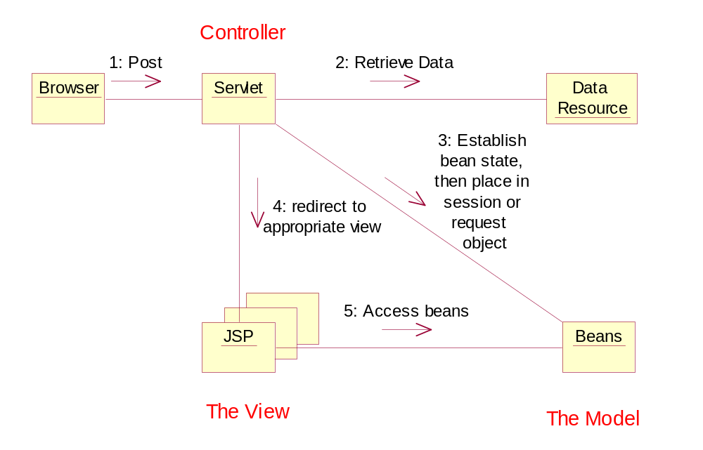
MVC Collaboration Diagram

Slide 13
Introducing Struts
We Built this city ~ StarShip

Slide 14
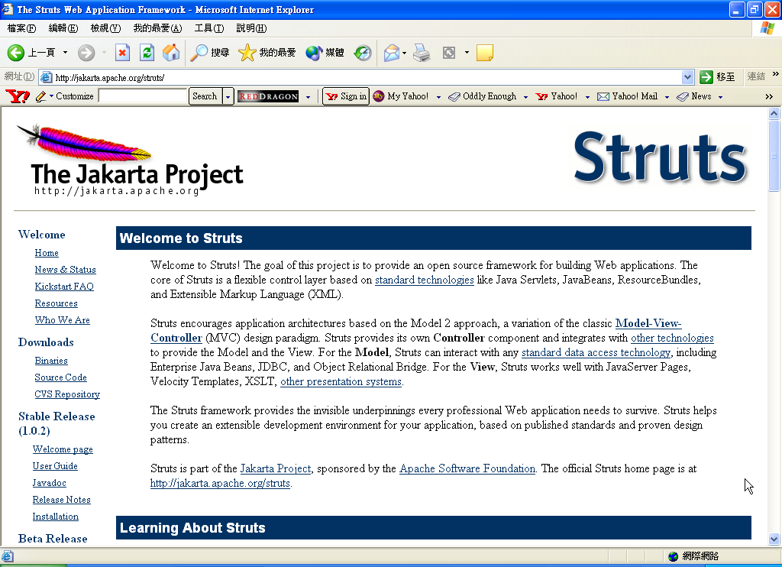

Slide 15
什麼是 Struts?
Apache的 open source Web應用程式專案, 提供一Web開發的Framework
應用MVC技術開發下一的Web應用程式

Slide 16
Struts Version
目前的Struts版本是 1.0.2
1.1 目前在 beta 2 階段
  Moves common packages out into another Jakarta sub project. Called the Jakarta commons
  Removes 0.5 file format support

Slide 17
Struts 的功能
Separating flow of control from business logic
Automating form validation
Creating multiple pages forms
Creating internationalized applications
Automatic cookie-less sessions

Slide 18
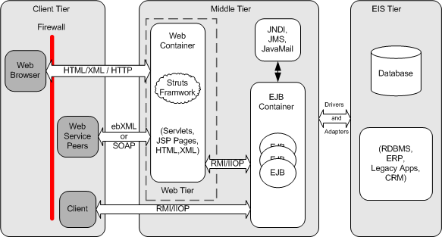
Struts 的執行架構

Slide 19
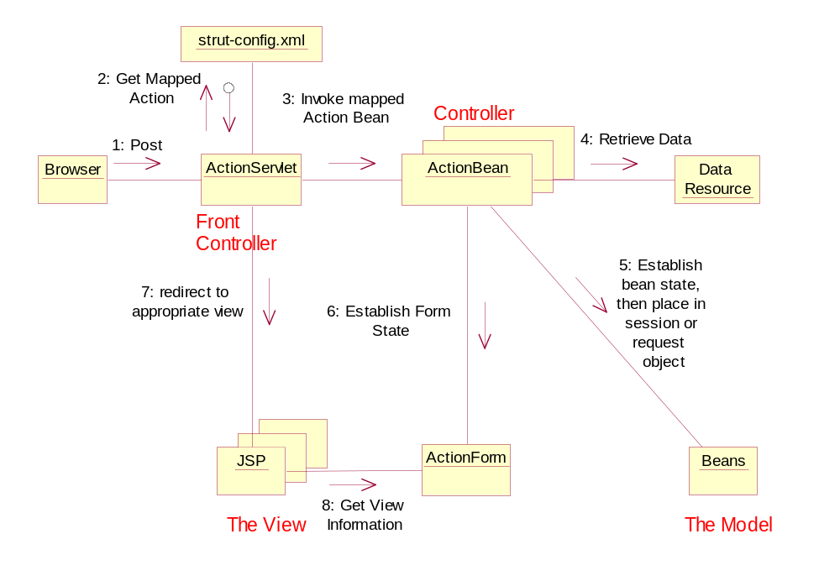
Struts Collaboration Diagram

Slide 20

The Controller Layer
We Built this city ~ StarShip

Slide 21
Controller Layer
攔截客戶端的請求
解釋並且根據struts-config.xml設定的內容分派請求到Model Layer
從business objects取得執行結果提供客戶端
根據目前狀態和執行結果決定啟動什麼View Layer以提供GUI給客戶端
STRUCTS Framework中的Front Controller是
org.apache.structs.action.ActionServlet類別

Slide 22

Controller Layer
Web Application如何Bootstrap STRUTS?
ActionServlet如何攔截客戶端的請求?
程式師需要寫ActionServlet嗎?
ActionServlet如何呼叫Businiess Object
(JavaBean, EJB, etc…)?
ActionServlet如何整合View Layer?

Slide 23
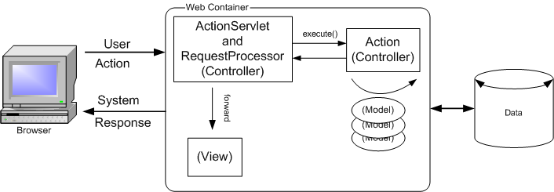
Controller Layer

Slide 24
Controller Layer
ActionServlet如何攔截客戶端的請求?
在Web.XML之中 :
<servlet>
<servlet-name>action</servlet-name>
<servlet-class>org.apache.struts.action.ActionServlet</servlet-class>
…
<servlet-mapping>
<servlet-name>action</servlet-name>
<url-pattern>*.do</url-pattern>
</servlet-mapping>

Slide 25
Controller Layer
ActionServlet如何攔截客戶端的請求?
public class ActionServlet
extends HttpServlet {
…

Slide 26
Controller Layer
程式師需要寫ActionServlet嗎?
可以直接使用STRUTS Framework的ActionServlet類別
也可以extends ActionServlet類別

Slide 27
Controller Layer
public class ExtendedActionServlet extends ActionServlet {
public void init() throws ServletException {
// Make sure to always call the super's init() first
super.init();
// Initialize the persistence service
try{
// Create an instance of the service interface
StorefrontServiceImpl serviceImpl = new StorefrontServiceImpl();
// Store the service into the application scope
getServletContext().setAttribute( IConstants.SERVICE_INTERFACE_KEY,
serviceImpl );
}catch( DatastoreException ex ){
// If there's a problem initializing the service, disable the web app
ex.printStackTrace();
throw new UnavailableException( ex.getMessage() );
}
}
}

Slide 28
Controller Layer
<servlet>
<servlet-name>storefront</servlet-name>
<servlet-class>
com.oreilly.struts.storefront.framework.ExtendedActionServlet
</servlet-class>
</servlet>

Slide 29
Controller Layer
ActionServlet如何呼叫Businiess Object
(JavaBean, EJB, etc…)?
藉由struts-config.xml之中的設定
ActionMapping

Slide 30
Controller Layer
public void doGet(HttpServletRequest request,
HttpServletResponse response)
throws IOException, ServletException {
process(request, response);
}

Slide 31
Controller Layer
protected void process(HttpServletRequest request,
HttpServletResponse response)
throws IOException, ServletException {
…
// Call the Action instance itself
ActionForward forward =
processActionPerform(actionInstance, mapping, formInstance,
…

Slide 32
Controller Layer
protected ActionForward processActionPerform(Action action,
ActionMapping mapping,
ActionForm formInstance,
HttpServletRequest request,
HttpServletResponse response)
throws IOException, ServletException {
ActionForward forward =
action.perform(mapping, formInstance, request, response);
return (forward);
}

Slide 33
Controller Layer
在struts-config.xml之中 :
<action-mappings>
<action path="/logon"
type="strutex.LogonAction"
name="LogonForm"
scope="request"
input="/logon.jsp">
<forward name="success" path="/success.jsp"/>
<forward name="failure" path="/failure.jsp"/>
</action>
<action path="/admin/addFormBean"
type="org.apache.struts.actions.AddFormBeanAction"/>
<action path="/admin/addMapping"
type="org.apache.struts.actions.AddMappingAction"/>

Slide 34
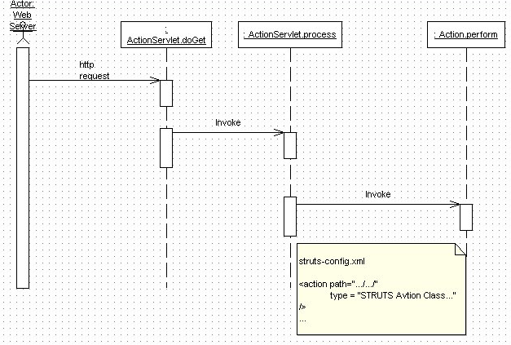
Controller Layer

Slide 35
Controller Layer
ActionServlet如何整合View Layer?
藉由struts-config.xml之中的設定
<action-mappings>
<action path="/logon"
type="strutex.LogonAction"
name="LogonForm"
scope="request"
input="/logon.jsp">
<forward name="success" path="/success.jsp"/>
<forward name="failure" path="/failure.jsp"/>
</action>

Slide 36
ActionServlet
<web-app>
<servlet>
<servlet-name>action</servlet-name>
<servlet-class> org.apache.struts.action.ActionServlet
</servlet-class>
<init-param>
<param-name>debug</param-name>
<param-value>2</param-value>
</init-param>
<init-param>
<param-name>config</param-name>
<param-value>/WEB-INF/struts-config.xml
</param-value>
…
</servlet>
<servlet-mapping>
<servlet-name>action</servlet-name>
<url-pattern>*.do</url-pattern>
</servlet-mapping>
ActionServlet is provided by the framework.
The Servlet must be mapped in the web.xml file.
  Must have configuration file mapped
Lastly, Map the *.do URI to the Action Servlet

Slide 37
strut-config.xml
<struts-config>
<!-- ========== Data Source Configuration === -->
<!-- ========== Form Bean Definitions === -->
<form-beans>
<form-bean name="LogonForm"
type="com.codementor.LogonForm"/>
</form-beans>
<!-- ========== Global Forward Definitions === -->
<global-forwards> </global-forwards>
<!-- ========== Action Mapping Definitions === -->
<action-mappings>
<action path="/logon"
type="com.codementor.LogonAction"
name="LogonForm"
scope="request"
input="/logon.jsp">
<forward name="success" path="/sucess.jsp"/>
<forward name="failure" path="/failure.jsp"/>
</action>
</action-mappings>
</struts-config>
XML configuration file
Allows for:
  DataSource definition
  Logical name definitions for Forms
  View mappings
    Local
    Global

Slide 38
The Model Layer
- The Adaptor
We Built this city ~ StarShip

Slide 39
The Action Class
org.apache.struts.action.Action類別是Struts中扮演Adaptor角色的Controller
Action隔離了Struts Controller和Business Objects
程式師從Action繼承實作Java Code, 在其中建立Business Objects,例如JavaBean, EJB等

Slide 40
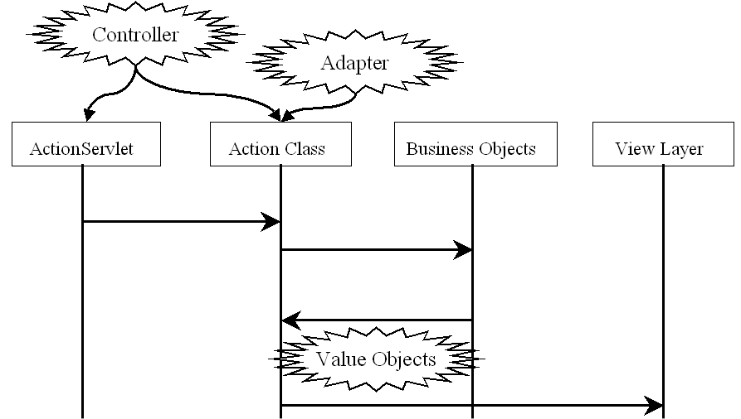
The Action Class

Slide 41
The Action Class
public class Action {
…
public ActionForward perform(ActionMapping mapping,
ActionForm form,
HttpServletRequest request,
HttpServletResponse response)
throws IOException, ServletException {
return (null); // Override this method to provide functionality
}

Slide 42
A Simple Demo
public class LogonAction extends Action {
public ActionForward perform(
ActionMapping mapping,
ActionForm form,
HttpServletRequest request,
HttpServletResponse response)
throws IOException, ServletException
{
LogonForm theForm = (LogonForm)form;
String forward="failure";
if(theForm.getUserName().equals("borcon"))
forward="success";
return mapping.findForward(forward);

Slide 43
A more Practical Demo
public class LoginAction extends Action {
public ActionForward perform( ActionMapping mapping,
ActionForm form,
HttpServletRequest request,
HttpServletResponse response)
throws Exception {
UserView userView = null;
// Get the credentials from the LoginForm
String accessNbr = ((LoginForm)form).getAccessNumber();
String pinNbr = ((LoginForm)form).getPinNumber();

Slide 44
A more Practical Demo
IAuthentication service = new SecurityService();
// Attempt to login
userView = service.login( accessNbr, pinNbr );
// Since an exception wasn't thrown, login was successful
// Invalidate existing session if it exists
HttpSession session = request.getSession(false);
if(session != null) {
session.invalidate();
}

Slide 45
A more Practical Demo
// Create a new session for this user
session = request.getSession(true);
// Store the UserView into the session and return
session.setAttribute( IConstants.USER_VIEW_KEY, userView );
return mapping.findForward( IConstants.SUCCESS_KEY );
}
}

Slide 46
The Info Carrier
- ActionForm
We Built this city ~ StarShip

Slide 47
The ActionForm Class
負責在Struts不同的Layer中傳遞客戶端的輸入資訊
可實作成一個Java Bean
<action-mappings>
<action path="/logon"
type="strutex.LogonAction"
name="LogonForm"
scope="request"
input="/logon.jsp">
<forward name="success" path="/success.jsp"/>
<forward name="failure" path="/failure.jsp"/>
</action>

Slide 48
The ActionForm Class
public abstract class ActionForm implements Serializable {
…

Slide 49
A Simple Demo
public class LogonForm extends ActionForm {
private String userName;
private String password;
public String getUserName() {
return userName;
}
public void setUserName(String userName) {
this.userName = userName;
}
public void setPassword(String password) {
this.password = password;
}
public String getPassword() {
return password;
}

Slide 50
A Simple Demo
public ActionForward execute( ActionMapping mapping,
ActionForm form, HttpServletRequest request,
HttpServletResponse response )
throws Exception{
// Get the user's login name and password. They should have already
// validated by the ActionForm.
String email = ((LoginForm)form).getEmail();
String password = ((LoginForm)form).getPassword();

Slide 51

A Round Tour
We Built this city ~ StarShip

Slide 52
Logon.JSP
<title>Logon Form</title>
<html:base/>
</head>
<body bgcolor="white">
<html:errors/>
<html:form action="logon.do" focus="username">
User Name: <html:text property="userName" size="16" maxlength="16"/>
password: <html:password property="password" size="16" maxlength="16" />
<html:submit property="submit" value="Submit"/>
<html:reset/>
</html:form>
</body>
</html:html>

Slide 53
Web.XML
<web-app>
<servlet>
<servlet-name>action</servlet-name>
<servlet-class>org.apache.struts.action.ActionServlet</servlet-class>
…
<servlet-mapping>
<servlet-name>action</servlet-name>
<url-pattern>*.do</url-pattern>
</servlet-mapping>

Slide 54
Struts-config.xml
<action-mappings>
<action path="/logon"
type="strutex.LogonAction"
name="LogonForm"
scope="request"
input="/logon.jsp">
<forward name="success" path="/success.jsp"/>
<forward name="failure" path="/failure.jsp"/>
</action>

Slide 55
The LogonAction
public class LogonAction extends Action {
public ActionForward perform(
ActionMapping mapping,
ActionForm form,
HttpServletRequest request,
HttpServletResponse response)
throws IOException, ServletException
{
LogonForm theForm = (LogonForm)form;
String forward="failure";
if(theForm.getUserName().equals("borcon"))
{
forward="success";
}
return mapping.findForward(forward);
}

Slide 56
The LogonActionForm
public class LogonForm extends ActionForm {
private String userName;
private String password;
public String getUserName() {
return userName;
}
public void setUserName(String userName) {
this.userName = userName;
}
public void setPassword(String password) {
this.password = password;
}
public String getPassword() {
return password;
}

Slide 57

Take a Break
Notes:
The company’s pedigree is in software development, and is unmatched in the history of the industry
With each new wave of technology, Borland products have been met with large scale adoption in the market place.
Borland C/C++ is still extremely well know to most us growing up in the industry in the 80s and 90s
Delphi is still the only major alternative to Visual basic on the Windows platform
VisiBroker is the dominant CORBA Object Request Broker (ORB) technology
JBuilder is the #1 selling Java development product in the market place today.
Kylix achieved #1 market share status within 6 months from its release according to Evans Data in 2001.In wireless, Borland is also number one with early product to market and strategic relationships with Nokia, Siemens and Ericsson

Slide 58
The Model Layer
We Built this city ~ StarShip

Slide 59
The Model Layer
STRUTS Framework可以和任何的Java元件架構結合, 由程式師決定使用什麼元件模型來實作Business Rules
程式師可使用JavaBean, EJB, JDO, etc…
問題是如何整合Java元件架構和STRUTS?

Slide 60
The Model Layer
在Action類別中呼叫程式師開發的Business Object
程式師定義服務介面, 再由Java類別實作此服務介面
並可結合Bridge和Adaptor等Design Pattern把STRUTS和Business Model以及Data Access Model分隔

Slide 61
The Model Layer
JavaBean
Action類別
Java服務介面
EJB Objects
STRUTS Framework
Reusable
Business Objects

Slide 62
The Model Layer
宣告一服務介面
public interface IBusinessRule
{
public List getSystemUsers() throw Exception;
public String getAdmin() throw Exception;
public ValueObject getDomainValueObject() throw Exception;
}

Slide 63
The Model Layer
使用JavaBean實作此介面
public class BusinessRuleImpl implements IBusinessRule
{
…
}

Slide 64
The Model Layer
public class LogonAction extends Action {
public ActionForward perform(
ActionMapping mapping, ActionForm form,
HttpServletRequest request, HttpServletResponse response)
throws IOException, ServletException
{
HttpSession session = request.getSession(false);
…
IBusinessRule ibr = new BusinessRuleImpl();
ValueObject vo = ibr. getDomainValueObject();
session = request.getSession(true);
session.setAttribute()IConstants,USER_Value_Object, vo);
…
return mapping.findForward(forward);
}
}

Slide 65

STRUTS and EJB
We Built this city ~ StarShip

Slide 66
The Model Layer And EJB
從服務介面實作一Delegate Class
在Delegate Class中Create EJB的Session Façade
STURTS的Action Class建立Delegate Class以使用EJB Model來完成Business Rule

Slide 67
The Model Layer And EJB
Session
Bean
Entity
Bean
Action類別
Java
服務介面
Session
Facade
…
Entity
Bean

Slide 68
The Model Layer And EJB
定義Session Façade的服務介面
public interface IEJBBusinessRule
{
public List getSystemUsers() throw RemoteException ;
public String getAdmin() throw RemoteException ;
public ValueObject getDomainValueObject(), RemoteException ;
}

Slide 69
The Model Layer And EJB
Session Façade的Remote Interface
import javax.ejb.EJBObject;
public interface EJBBusinessRule extends EJBObject, IEJBBusinessRule {
/**
* The remote interface for the EJBBusinessRule session bean. All methods are
* declared in the IStorefront Business Interface.
*/
}

Slide 70
The Model Layer And EJB
Session Façade的Session Bean
public class EJBBRBean implements SessionBean, IEJBBusinessRule {
private SessionContext ctx;
…

Slide 71
The Model Layer And EJB
Delegate Class
public class StorefrontEJBDelegate implements IBusinessRule
{
private IStorefront storefront;
public StorefrontEJBDelegate() {
init();
}

Slide 72
The Model Layer And EJB
private void init() {
try {
…
props.put(Context.INITIAL_CONTEXT_FACTORY,
"org.jnp.interfaces.NamingContextFactory");
props.put(Context.PROVIDER_URL, "localhost");
InitialContext ic = new InitialContext(props);
Object home = ic.lookup(
“EJBBRObject");
EJBBRHome ejbHome = (EJBBRHome)
PortableRemoteObject.narrow(home, EJBBRHome.class);
ejbBR = ejbHome .create();
…
}
catch (NamingException e) {
…

Slide 73
The Model Layer And EJB
public class LogonAction extends Action {
public ActionForward perform(
ActionMapping mapping, ActionForm form,
HttpServletRequest request, HttpServletResponse response)
throws IOException, ServletException
{
HttpSession session = request.getSession(false);
…
IBusinessRule ibr = new StorefrontEJBDelegate();
ibr.init();
ValueObject vo = ibr. getDomainValueObject();
session = request.getSession(true);
session.setAttribute()IConstants,USER_Value_Object, vo);
…
return mapping.findForward(forward);
}

Slide 74
The View Layer
We Built this city ~ StarShip

Slide 75
The View Layer
可使用JSP, HTML, XML等技術實作
View Layer可使用Value Object(Data Transfer Object Pattern)和Model Layer互動, 藉由Business Model執行的結果Render GUI結果
Custom Tags

Slide 76
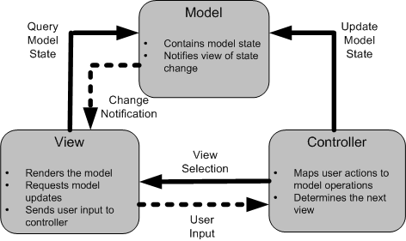
The View Layer

Slide 77
The View Layer
STRUTS提供了5個Custom Tag Libraries
  HTML Tag Library
  Bean Tag Library
  Logic Tag Library
  Template Tag Library
  Nested Tag Library

Slide 78
The View Layer
JavaServer Faces和STRUTS的整合

Slide 79
剖析 the Strut-config.xml
<action path="/logon“
type=“com.codementor.LogonAction”
name="LogonForm"
<forward name="failure"
path="/failure.jsp" />
<forward name="success"
path="/success.jsp" />
</action>
For requests that hit URL=“/logon”
The frame work will invoke perform() on an instance of class com.codementor.LogonAction
Store request parameters in form variable “LogonForm” which is defined in another location in the xml document.
If the logical name returned by perform() is “failure” go to page “/failure.jsp”
If the Logical name returned by perform() is “success” go to “/success.jsp”

Slide 80
Action Bean
import org.apache.struts.action.*;
public class LogonAction extends Action {
public ActionForward perform(
ActionMapping mapping,
ActionForm form,
HttpServletRequest request,
HttpServletResponse response)
throws IOException, ServletException
{
LogonForm theForm = (LogonForm)form;
String forward="failure";
if(theForm.getUserName().equals("borcon"))
{
forward="success";
}
return mapping.findForward(forward);
}
}
Action class’s perform is invoked by Action Servlet

Slide 81
Action Form
import org.apache.struts.action.ActionForm;
public class LogonForm extends ActionForm {
private String userName;
private String password;
public String getUserName() {
return userName;
}
public void setUserName(String userName) {
this.userName = userName;
}
public void setPassword(String password) {
this.password = password;
}
public String getPassword() {
return password;
}
}
Action Form has properties which map to the HTML page.
Additionally the form can:
  Reset
  Validate

Slide 82
Strut Powered JSP
<html:html locale="true">
<head>
<title>Logon Form</title>
<html:base/>
</head>
<body bgcolor="white">
<html:errors/>
<html:form action="logon.do" focus="username">
User Name: <html:text property="userName" size="16" maxlength="16"/>
password: <html:password property="password" size="16" maxlength="16"
<html:submit property="submit" value="Submit"/>
<html:reset/>
</html:form>
</body>
</html:html>

Slide 83

STRUTS
Performance
We Built this city ~ StarShip

Slide 84
STRUTS Performance
Load Testing and Profiling Your App.
  Borland OptimizeIt Suite
  Apache Jmeter
  Mercury Interactive LoadRunner
  …

Slide 85
Model 2X

Slide 86
Model 2X
Combines the power of struts with the power of xml
Article:
  http://www.javaworld.com/javaworld/jw-02-2002/jw-0201-strutsxslt.html

Slide 87
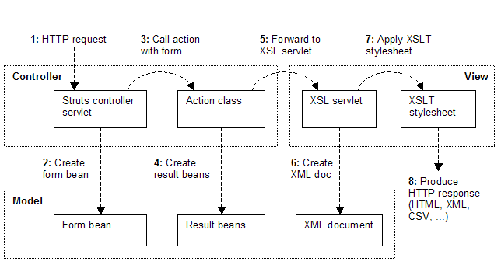
Model 2X

Slide 88
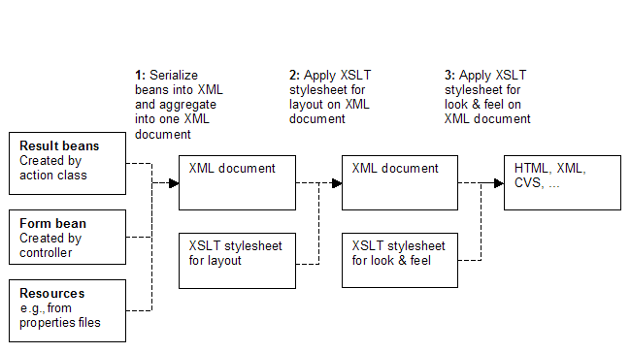
Model 2X Process

Slide 89
Additional Features of the Struts Framework

Slide 90
org.struts.apache.digester
This package is a specialized XML digester.
It is useful to be able to process an XML document in an "event driven" manner, where particular java objects are created (or methods of existing objects are invoked) when particular patterns of nested XML elements have been recognized.

Slide 91
org.struts.apache.util
This package is a set of bean utilities.
Beans and properties.
  A family of utility classes for manipulating JavaBeans, as well as getting and setting properties, without hard coding the names or data types of the property getter and setter methods.
Collection classes.
  A family of specialized classes supporting the collections API, designed for use in multithread environments where the vast majority of accesses are read only.
JDBC connection pool.
  A very simple connection pool that can be utilized in web applications or other environments that need to share a limited number of JDBC connections across a much larger number of active users.
Message resources.
  A family of classes that features access to internationalized message strings based on a message key coupled with a java.Util.Locale object representing a particular user's preferred language.

Slide 92
org.struts.apache.taglib
The package supports the JSP tag libraries. The custom tags will be discussed on the next slide.

Slide 93
Struts Custom Tags
struts-bean.tld
  Improves bean access such as reference a beans bean.
    Translates <struts:getProperty name="employee" property="address.city" /> to employee.getAddress().getCity()
struts-html.tld
  Enhances many of the html tags, as well provides the magic between the framework and the form for setting info
struts-logic.tld
  Provides many useful logic tags such as <logic:equal parameter="number" value="7">
struts-template.tld
  Useful in creating dynamic JSP templates for pages which share a common format

Slide 94
Additional Features
Automatic cookieless sessions
Multi-page forms

Slide 95
Testing
Struts Test Case
  http://strutstestcase.sourceforge.net/
  Mock Testing
  In-Container Testing
    Cactus

Slide 96
Using Struts With JBuilder

Slide 97
Strut Installation
Download the zip.
  http://jakarta.apache.org/builds/jakarta-struts/release/v1.0.2/
  Unzip and go!
  There really isn’t an “install”, however there are several files you’ll need.
  Readme.Txt has details.
Files of interest
  Struts.Jar
  *.tld
  Struts-blank.war

Slide 98
Software Requirements
Everything need is included with JBuilder out of the box. Required libraries:
  Servlet

Slide 99
Testing Your Environment
From the strut-blank.War file:
  Copy the ApplicationResources.Properties to the <webapp>\web-INF\classes directory
  Copy the index.Jsp to the <webapp>
Add the above files to JBuilder project.
Next web run the index.jsp file
At this point you should know you have a working environment!

Slide 100
JBuilder Setup

Slide 101
JBuilder Pre-setup
JBuilder 6 will run struts web applications out of the box.
JBuilder 4 and 5 require additional setup and / or opentool support to function.
  Reference material from last years talk at http://borland.com/conf2001/updates/3148/3148.zip

Slide 102
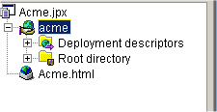
JBuilder 6 Setup
Setup the directories anyway you like
Create a new webapp

Slide 103
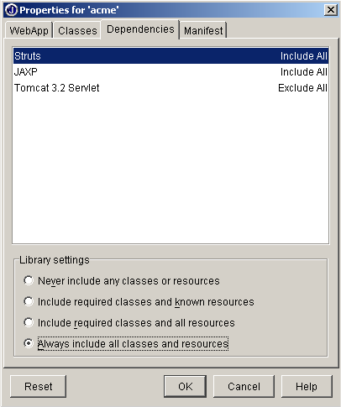
WebApp Properties
From the webapp properties, select the dependencies tab.
Select strut to allows be included.
  This puts this jar in the /lib directory of the webapp.

Slide 104
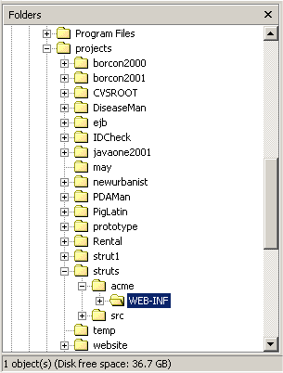
WEB-INF Directory
You may have to create the WEB-INF directory yourself or make your first class.
Copy the following files to this directory from the strut-blank.war.
  web.xml
  struts-config.xml
  struts-bean.tld
  struts-form.tld
  struts-html.tld
  struts-logic.tld

Slide 105
Testing Your Environment
From the strut-blank.War file:
  Copy the ApplicationResources.Properties to the source directory
  Add the file to dependency for webapp.
  Copy the index.jsp to the <webapp>
Add the above files to JBuilder project.
Next web run the index.jsp file
At this point you should know you have a working environment!

Slide 106
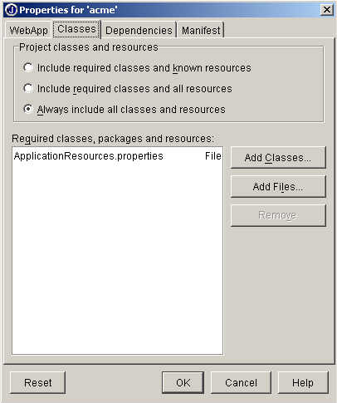
WebApp Properties – Classes
Add the properties file to the webapp classes

Slide 107
Steps to Building in JBuilder
Step 1: Build your JSP
  Its back to editing code.
Step 2: Write the matching ActionForm
  public class LogonForm extends ActionForm {}
Step 3: Write the Action Class
  public class LogonAction extends Action { }
Step 4: Register the entries in strut-config.xml
  <action path="/logon"
  type="com.codementor.LogonAction"
  name="LogonForm"
  input="/logon.jsp">
  <forward name="success" path="/sucess.jsp"/>
  <forward name="failure" path="/failure.jsp"/>
  </action>

Slide 108
Deployment
Create the WAR file with all your required jars in the /lib directory.
Deploy the WAR file.

Slide 109
Summary
JSP models
  We look at the difference as an introduction into MVC
Benefits of struts
  Internationalization
  XML driven web apps
  Good architecture
JBuilder and struts
End

Slide 110
Exploring STRUTS Framework
參考資料
  STRUTS Documents
  STRUTS Source Code
  O’Reilly’s STRUTS Book at www.theserverside.com

Slide 111

Some Comments
We Built this city ~ StarShip

Slide 112
Some Comments
The View Layer is not visualized.
The View Layer is a little too complex
The View Layer is not CBD(Component Based Design)
The productivity of View Layer is not good enough
Struts needs a more convenient mechanism to present the View
  For example IntraWeb For Java
No visualized editor tool for struts-config.xml
  Make it easy to make trouble
JBuilder 8 will support Struts development

Slide 113
Questions?

Slide 114

謝謝大家

