Slide 1
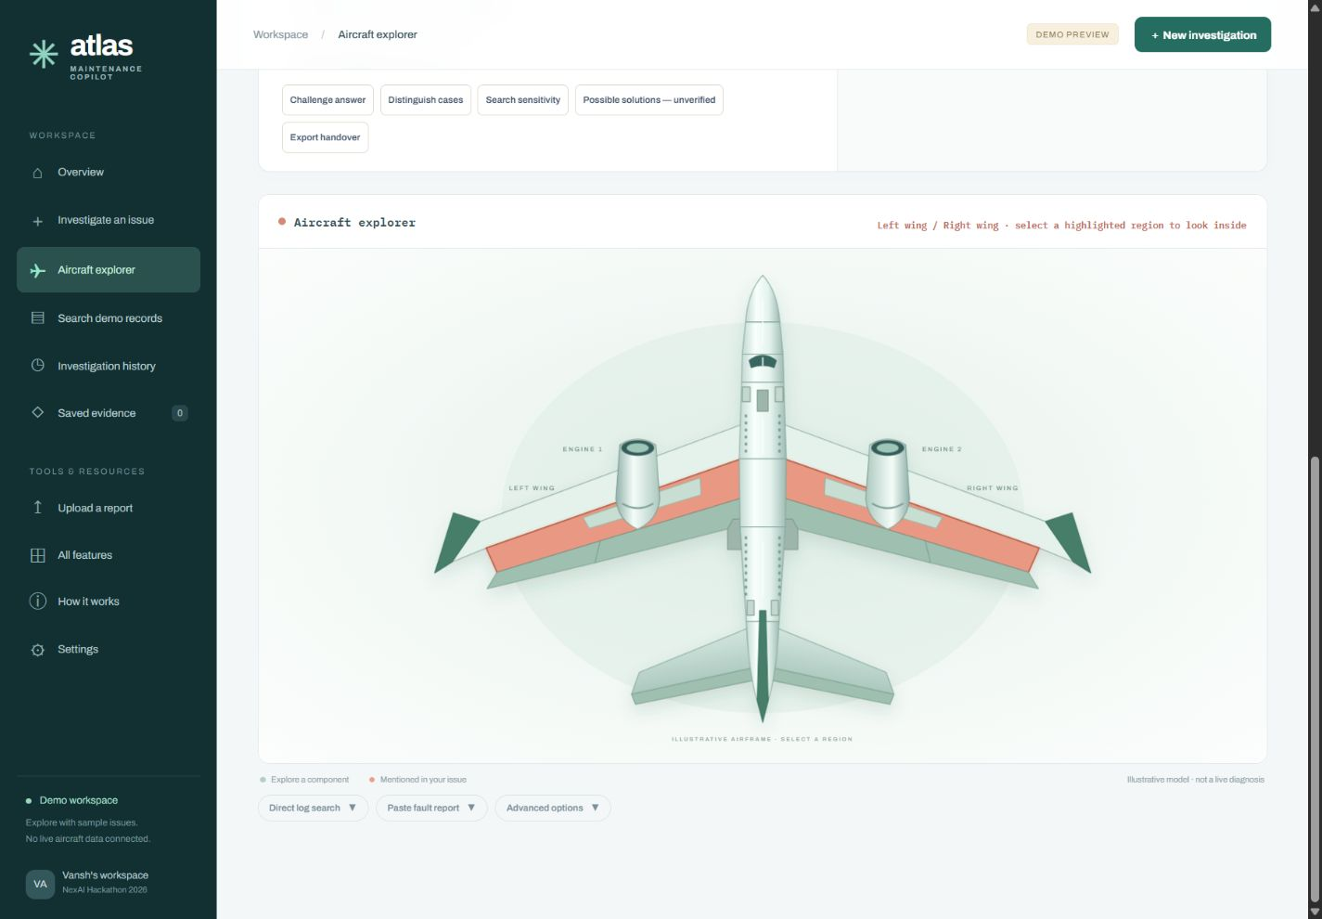
NEXAI 2026 / PS 1.3
Maintenance
Atlas
Agentic RAG over
maintenance logbooks
Vansh & Kushaan
Notes:
Presenter: Vansh
Atlas helps technicians investigate a reported fault using historical maintenance records. We retrieve relevant cases and show the evidence behind the answer. This is a six-slide overview, roughly four minutes.
Sources and scope:
Organizer PS 1.3 supplied in the conversation. Screenshot: docs/p2/previews/aircraft-explorer.png, explicitly demo.

Slide 2
The problem: buried maintenance history
6,169
ILLUSTRATIVE LOG WORDING
L/H ENG #2
INTAKE LEAKING.
aviation logbook records
Short entries contain abbreviations,
misspellings and incomplete context.
The challenge is finding useful precedent
and explaining exactly what it supports.
Similar wording can describe
different components or faults.
02
Notes:
Presenter: Vansh
The organizer supplies 6,169 aviation records. Terse wording makes simple keyword or semantic search alone unreliable. A technician needs similar historical complaints, their recorded actions and original evidence. Handoff: Kushaan will explain the retrieval pipeline.
Sources and scope:
Organizer problem statement, Data and Resources. INTEGRATION_HANDOVER.md and docs/p1/PERSON_2_HANDOFF.md. On-slide wording is illustrative and not an independently validated citation.

Slide 3
Hybrid retrieval pipeline
01
Normalize the query
Expand shorthand while preserving numbers, side and negation.
02
Search by words and meaning
BM25 lexical search runs alongside BGE semantic embeddings.
03
Fuse and compare results
Reciprocal Rank Fusion combines rankings. Compatibility checks
and duplicate grouping keep distinctions visible.
04
Fetch original records
Preserve corpus IDs, raw fields and source hashes.
Storage: PostgreSQL + pgvector on Supabase
03
Notes:
Presenter: Kushaan
Ingestion preserves original fields and builds normalized representations. BM25 handles exact terminology, while BGE embeddings retrieve similar meanings. Weighted RRF combines rankings. Compatibility checks preserve component, number, side and negation distinctions. PostgreSQL and pgvector store records and vectors. Explain implemented architecture, without claiming live laptop acceptance.
Sources and scope:
Branch integrate/atlas-ui-retrieval at 85998c2. maintenance/retrieval/engine.py, fusion.py, compatibility.py, maintenance/ingest/normalize.py, maintenance/db.py. Supabase results are reported in ANTIGRAVITY_INTEGRATION_HANDOFF.md and were not independently reproduced here.

Slide 4
The agent answers from fetched evidence
Tool use
Claim-level evidence gate
search_records
get_records
Source identity and corpus scope
Exact quotes and Unicode offsets
Field hashes and supported wording
The agent retrieves candidates, then
opens the original records before
constructing a structured answer.
“Insufficient evidence”
A valid outcome when support is weak.
04
Notes:
Presenter: Kushaan
The agent calls bounded tools and constructs structured claims from fetched originals. The release path checks evidence identity, exact spans and hashes and constrains wording. A valid quote does not automatically support a causal interpretation. Records are historical precedent. Public SSE events show workflow activity, not private model reasoning.
Sources and scope:
maintenance/agent_run.py, maintenance/tools.py, maintenance/answer_validation.py, maintenance/answer_rendering.py, maintenance/events.py, docs/prompts/maintenance_system_prompt.md. Complete live acceptance and semantic support behavior still require verification.

Slide 5
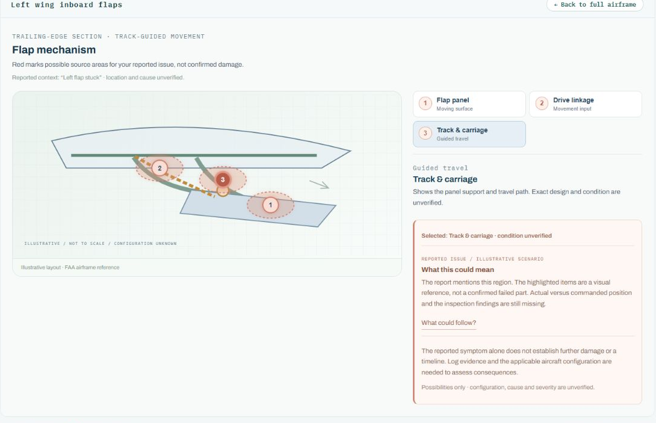
Investigation with every source in view
One conversation
Enter an issue and refine it
with follow-up questions.
Traceable answers
Open original records, save
evidence and inspect activity.
Component context
33 regions and dedicated
component cutaways.
05
Notes:
Presenter: Vansh
Show the single input, a result and an original-record citation. The aircraft has 33 selectable exterior regions. Dedicated wing, nose, cabin and tail cutaways show internal parts. Candidate highlights and educational complications remain unverified. The screenshot shows the demo interface.
Sources: docs/p2/previews/flap-cutaway.png, api/static/maintenance/index.html, component-explorer.mjs, wing-profiles.mjs and airframe-profiles.mjs.

Slide 6
Coverage and next checks
MVP implementation
Extensions
Normalization and hybrid retrieval
Search and record-fetch tools
Cited answers and refusal handling
Web UI with public activity trace
Facility-maintenance domain
Shorthand expansion
Recurring-pattern analysis
Recurring-defect acceptance still needs validation.
Next checks
Live end-to-end run, refusal cases and public deployment
06
Notes:
Presenter: Kushaan
Separate implementation from verification. The repository contains the retrieval platform, workflows, evidence release and UI. Facility support and shorthand normalization exist. Pattern services still need recurring-defect acceptance checks. Complete a real search, citation, session and refusal flow before claiming live end-to-end readiness. Close on faster access to traceable historical precedent.
Sources: Organizer PS 1.3 MVP and stretch goals, maintenance/features/patterns.py, normalization and retrieval modules, ANTIGRAVITY_INTEGRATION_HANDOFF.md. Live verification on this laptop and public deployment remain pending.

