Slide 1
Machine Learning-Based Prediction of the Specific Absorption Rate of Magnetic Nanoparticles
Md Golam Hafiz

Slide 2
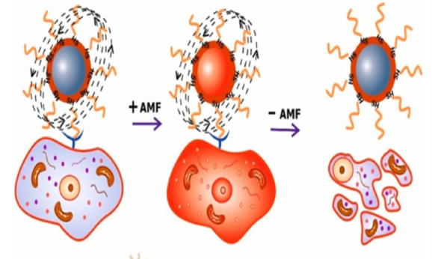


Motivation
Magnetic nano particles are useful in therapeutic techniques
Rotation of nanoparticles
Local heat 41°C - 47°C
Local destruction of tumour cells
Challenges:
heating efficiency depends on
Physical
chemical and
magnetic properties of the nano particles
Ahmad et al. (2026), https://doi.org/10.1007/s43994-025-00262-1

Slide 3
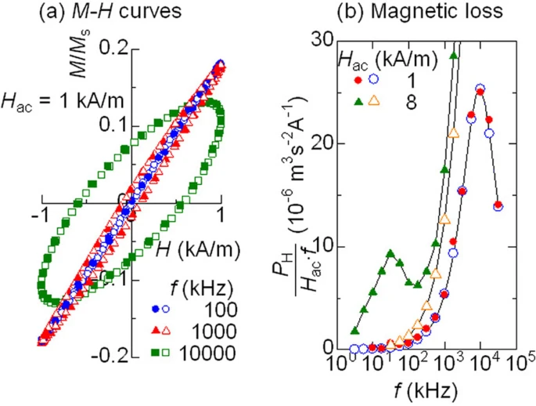
Research background
Specific absorption rate (SAR): heat generation rate per unit mass of magnetic material
Nano particles properties
Field condition and medium
SAR
Mamia et al. (2011), https://doi.org/10.1038/srep00157

Slide 4
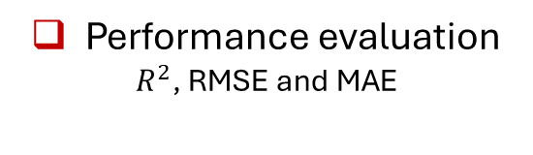
Methods
      Nanoparticle dataset
Physical, chemical, magnetic, coating and medium features
Data processing and splitting
Ridge regression
Linear baseline
Random forest
Nonlinear model
Performance evaluation
$R^{2}$, RMSE and MAE

Slide 5
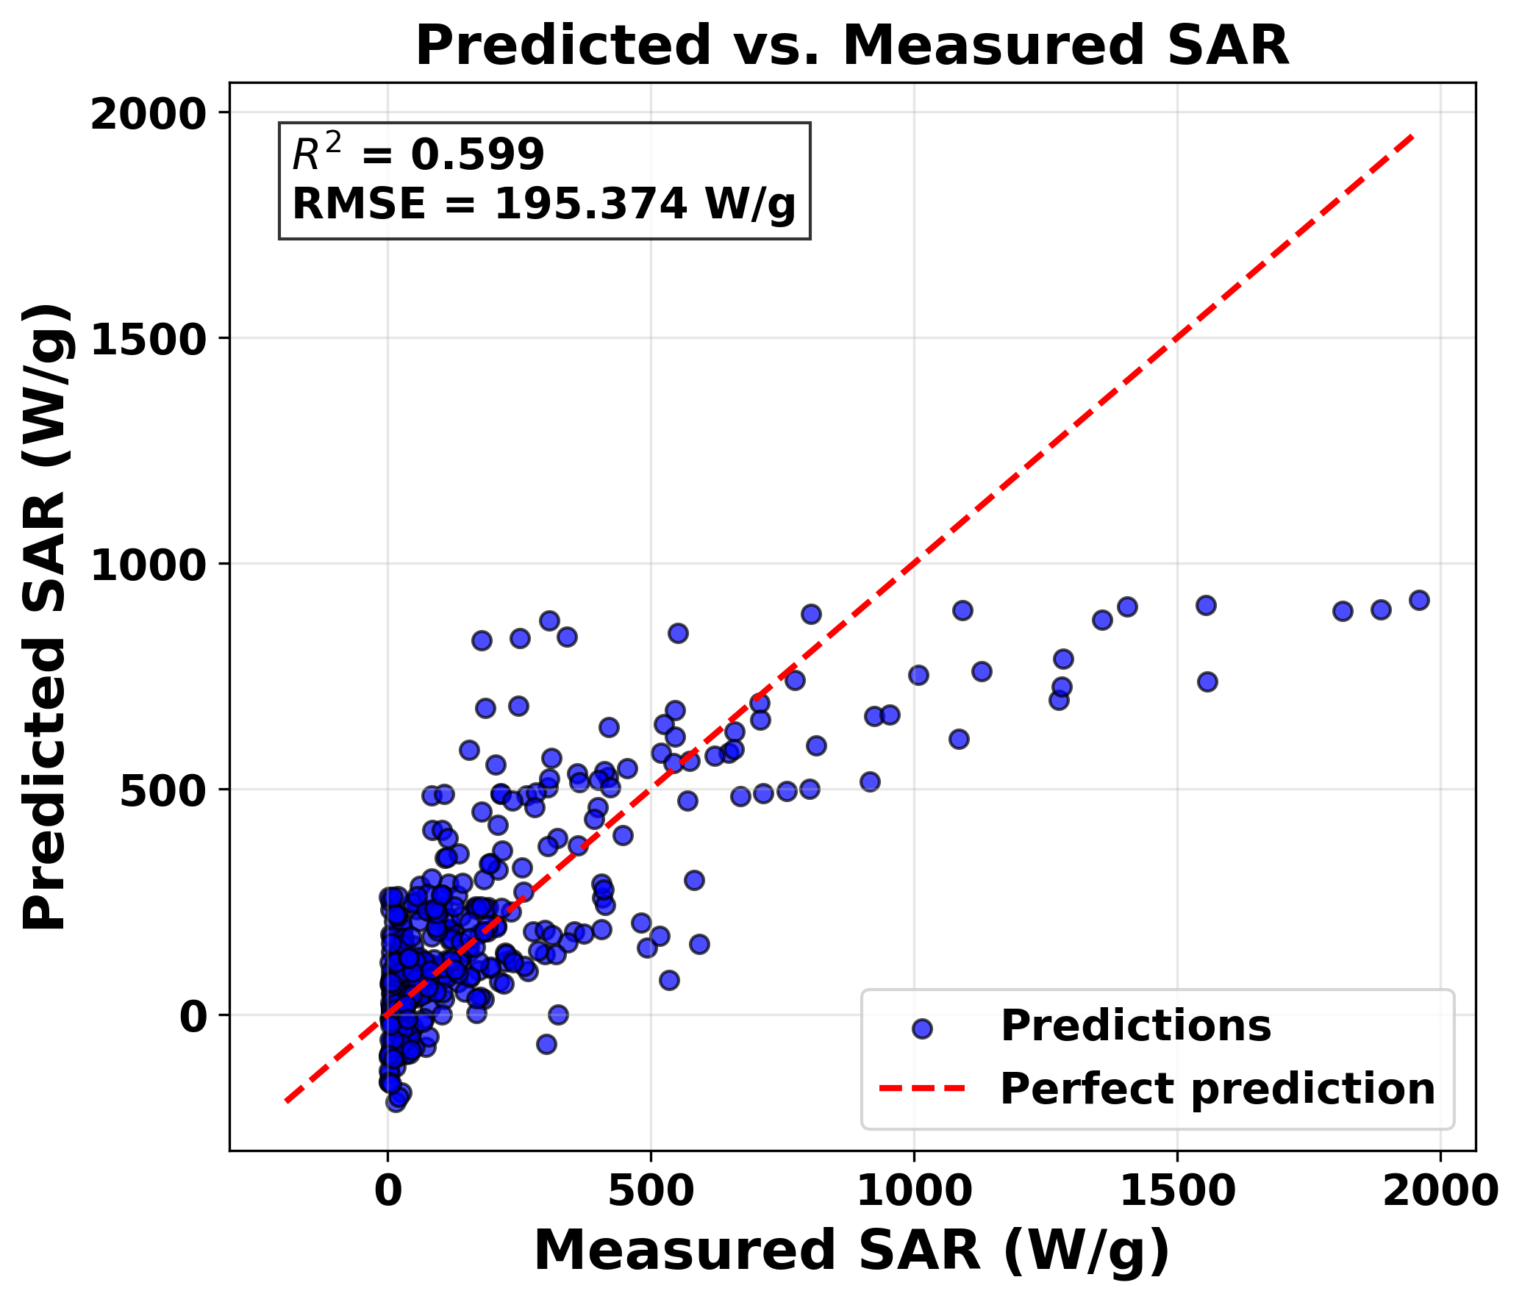
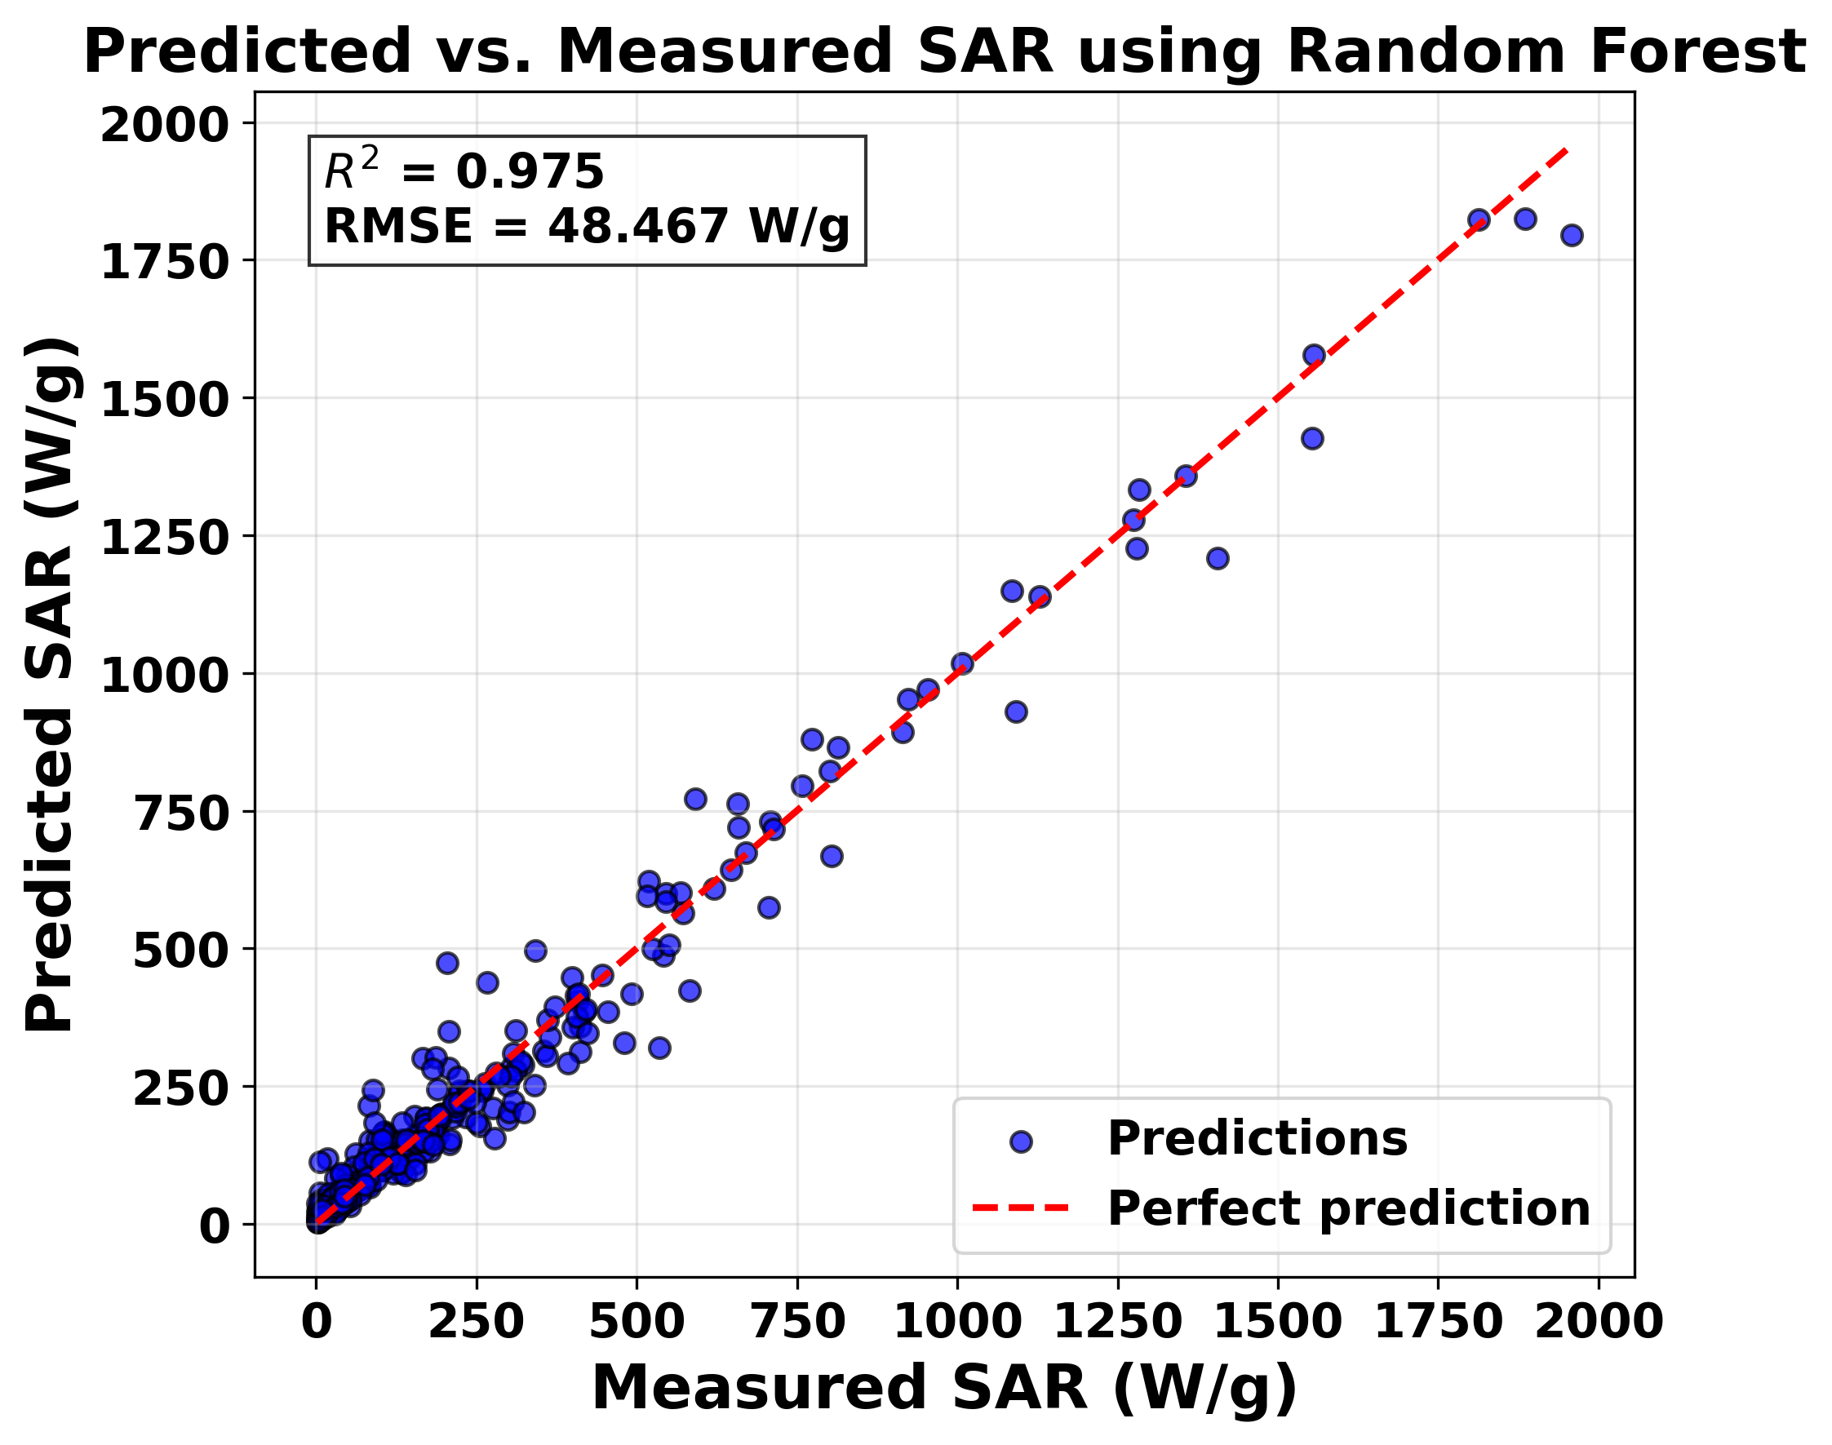
Research update
The random forest regression model outperforms Ridge regression

Slide 6
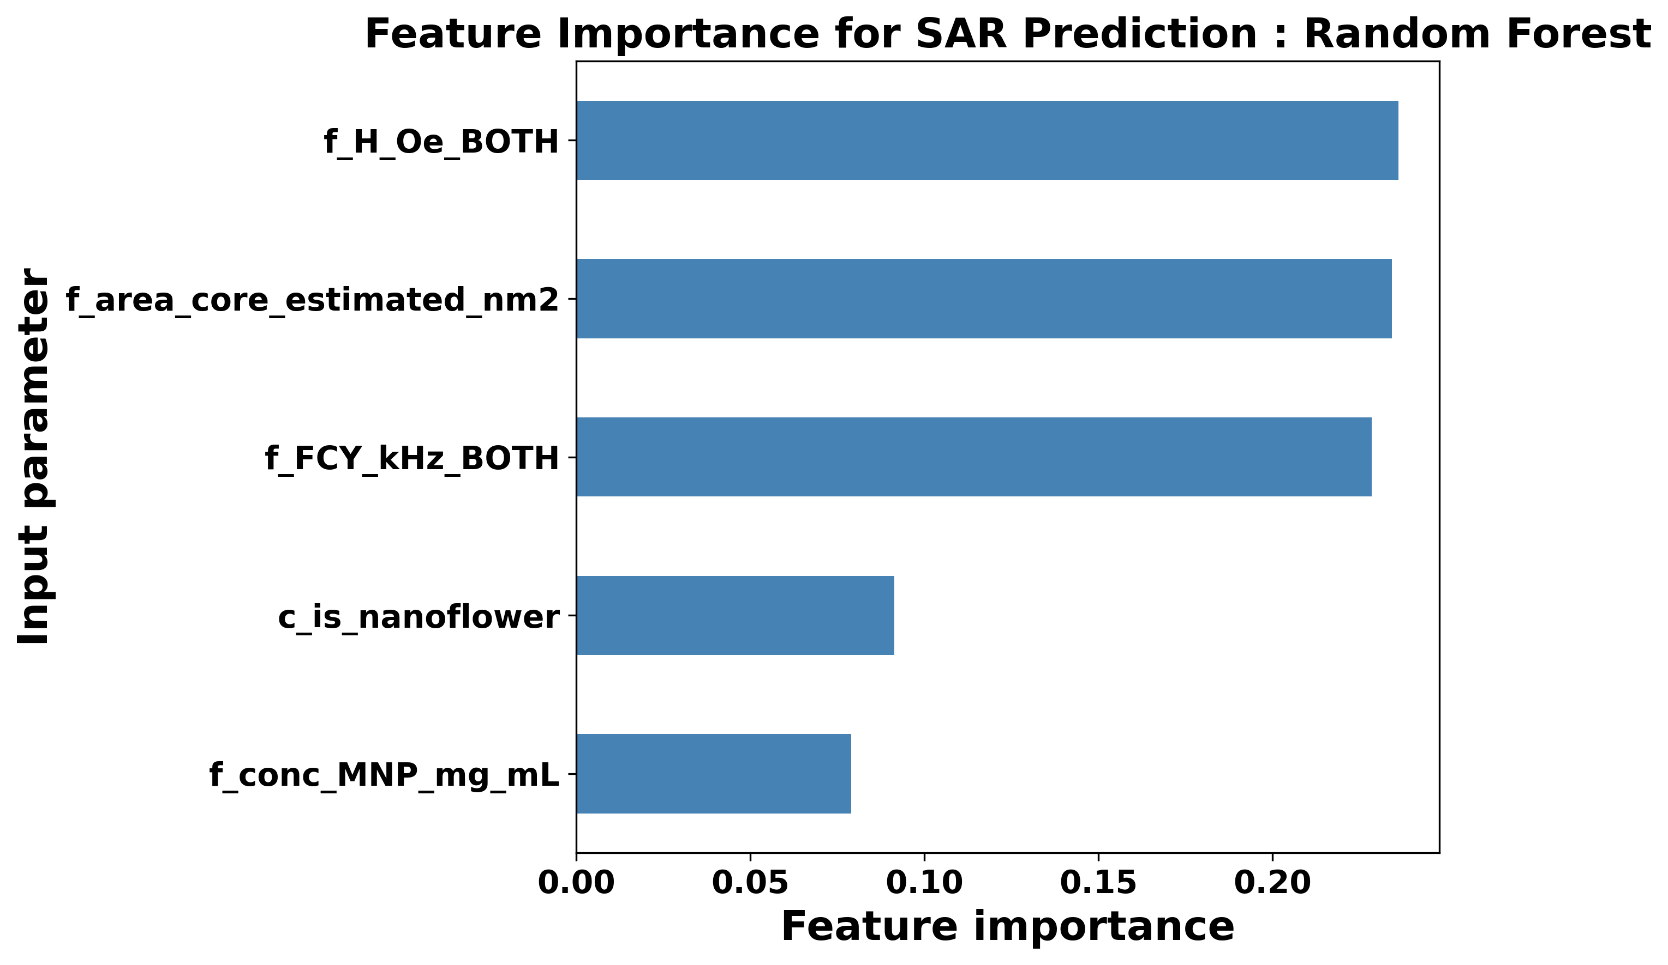
Research update
Particle core and coercive fields are important in SAR predictions
Top 5 parameters

Slide 7
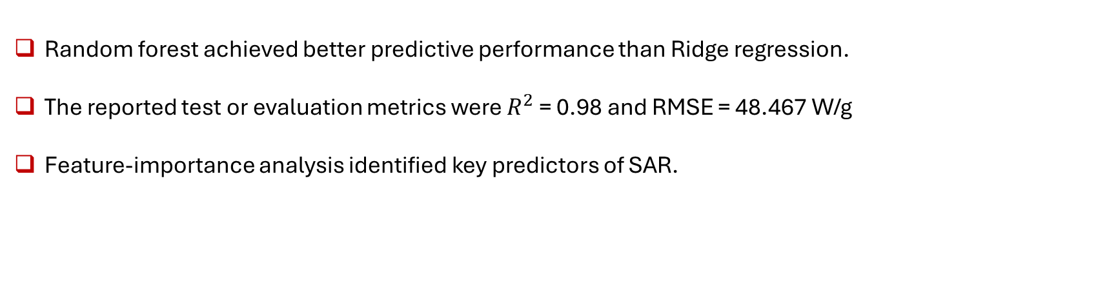
Summary and outlook
Random forest achieved better predictive performance than Ridge regression.
The reported test or evaluation metrics were $R^{2}$ = 0.98 and RMSE = 48.467 W/g
Feature-importance analysis identified key predictors of SAR.

Slide 8
Thank you

Slide 10
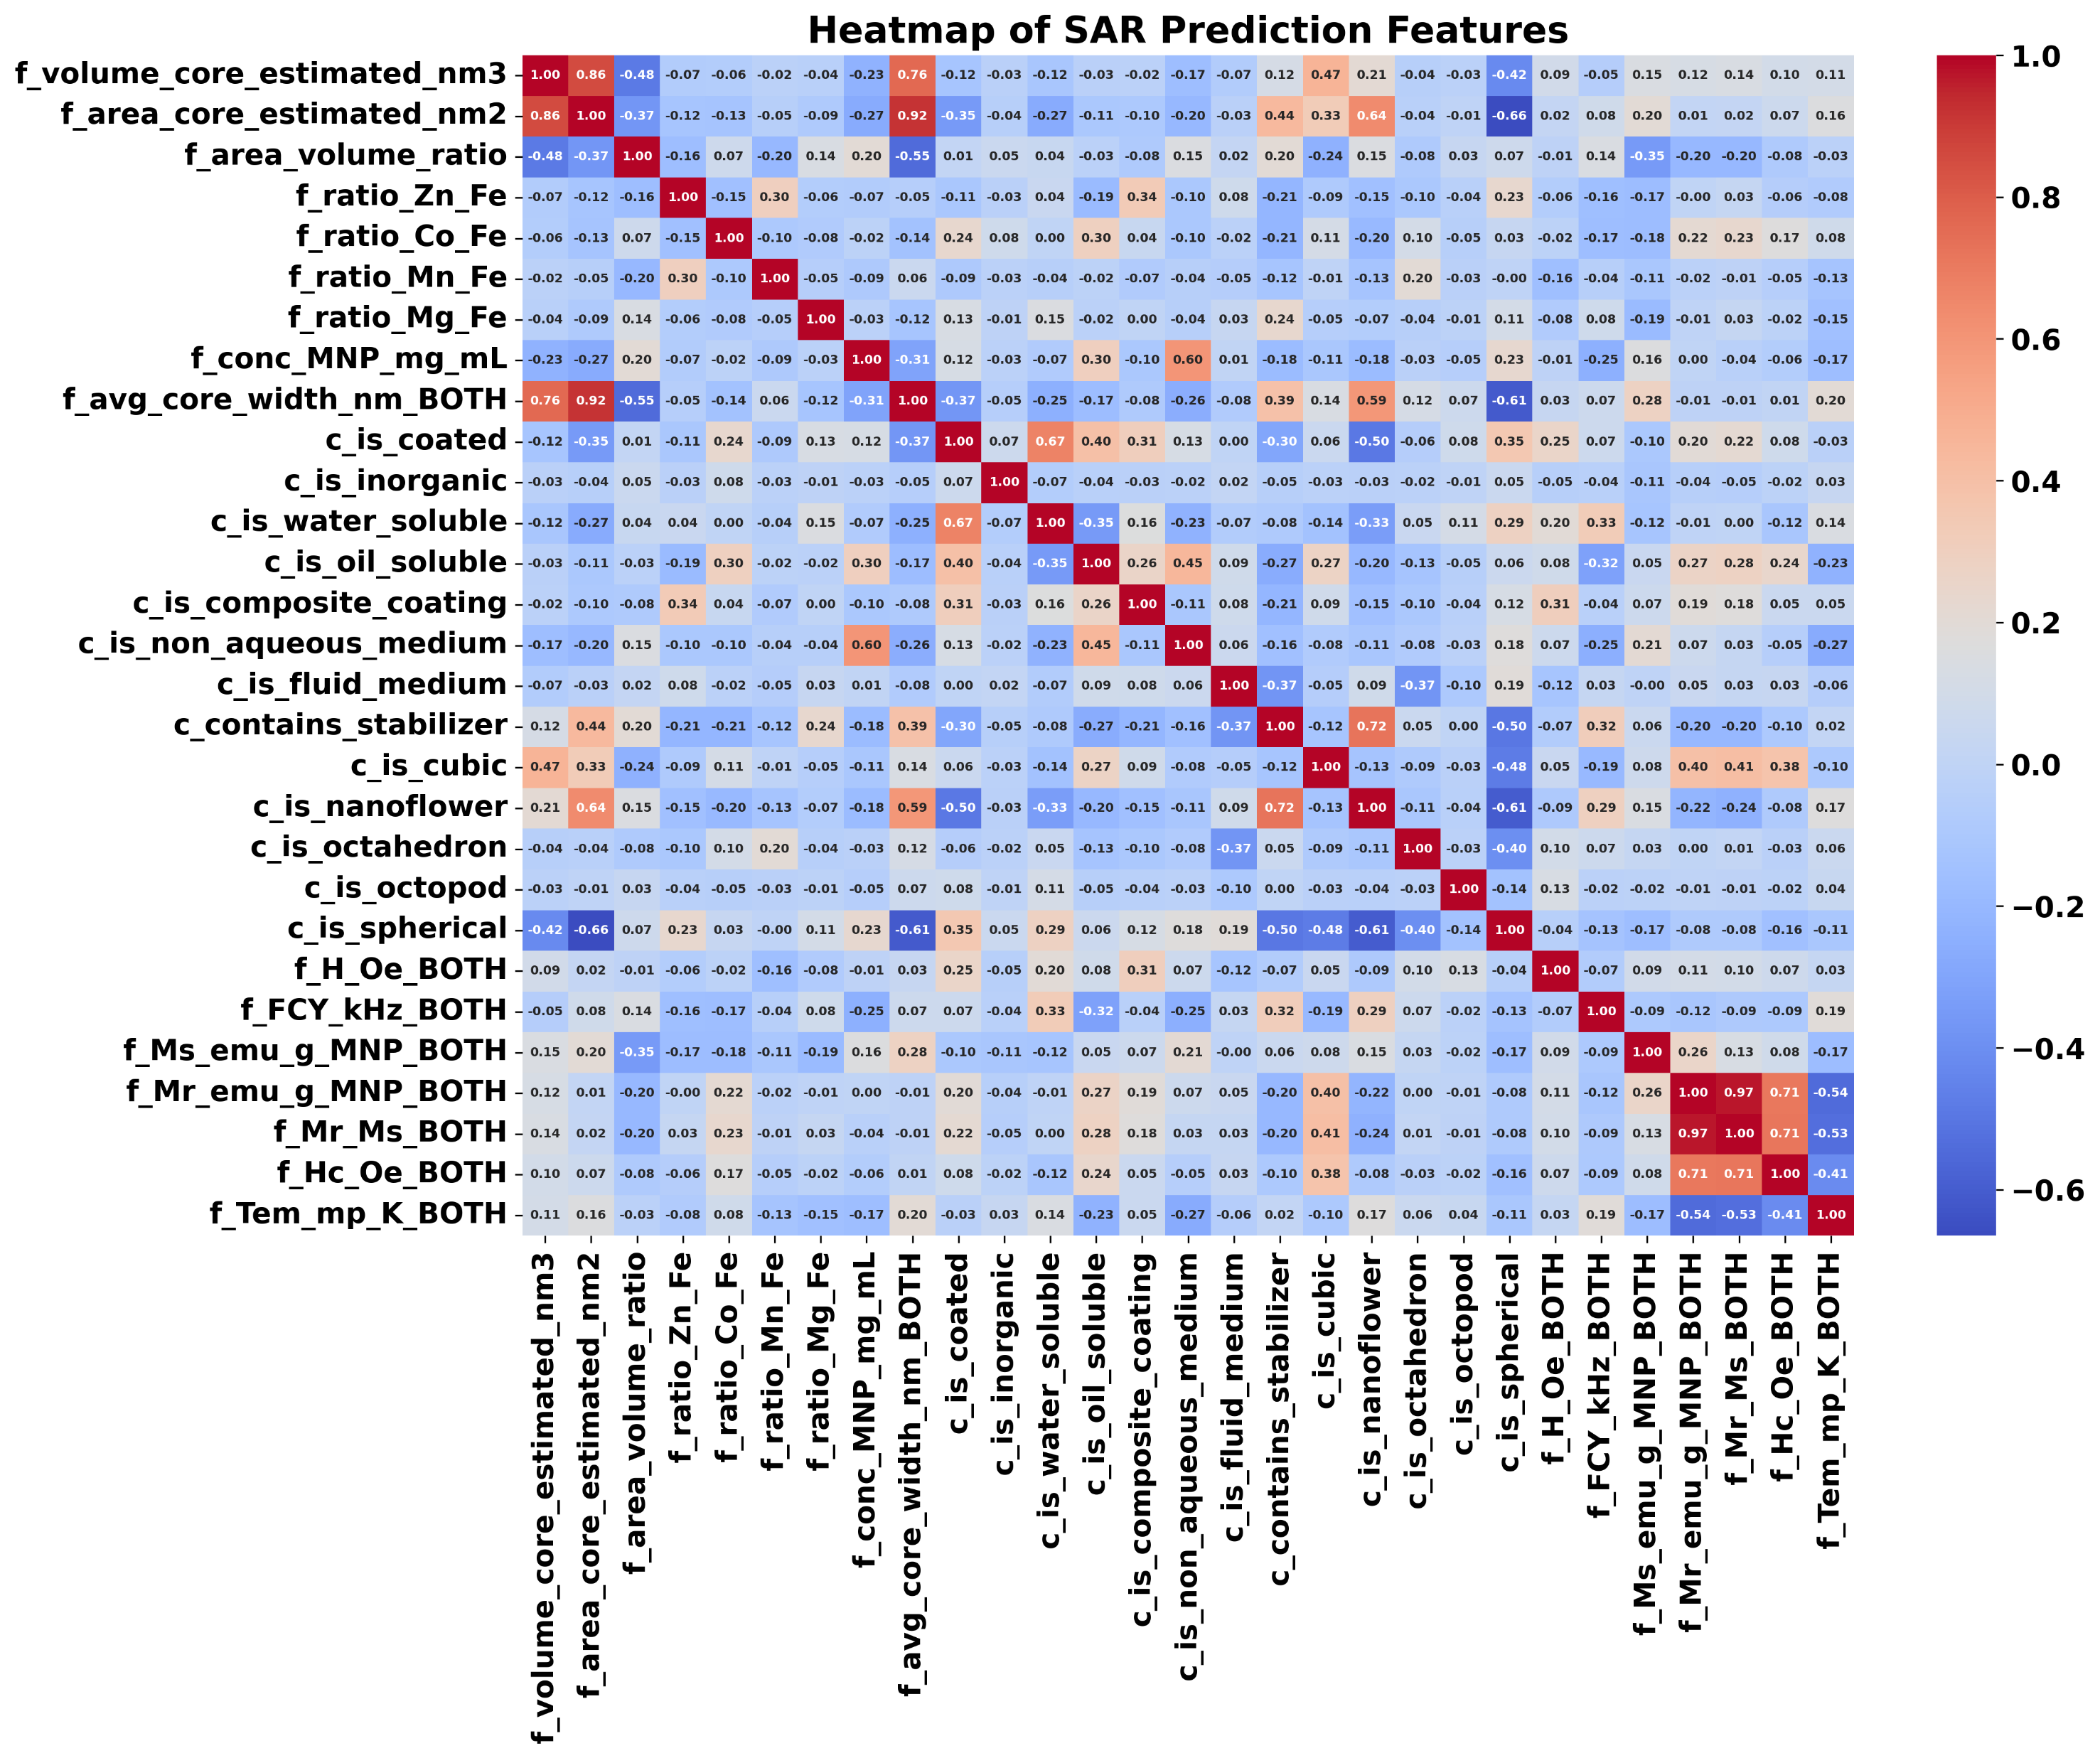
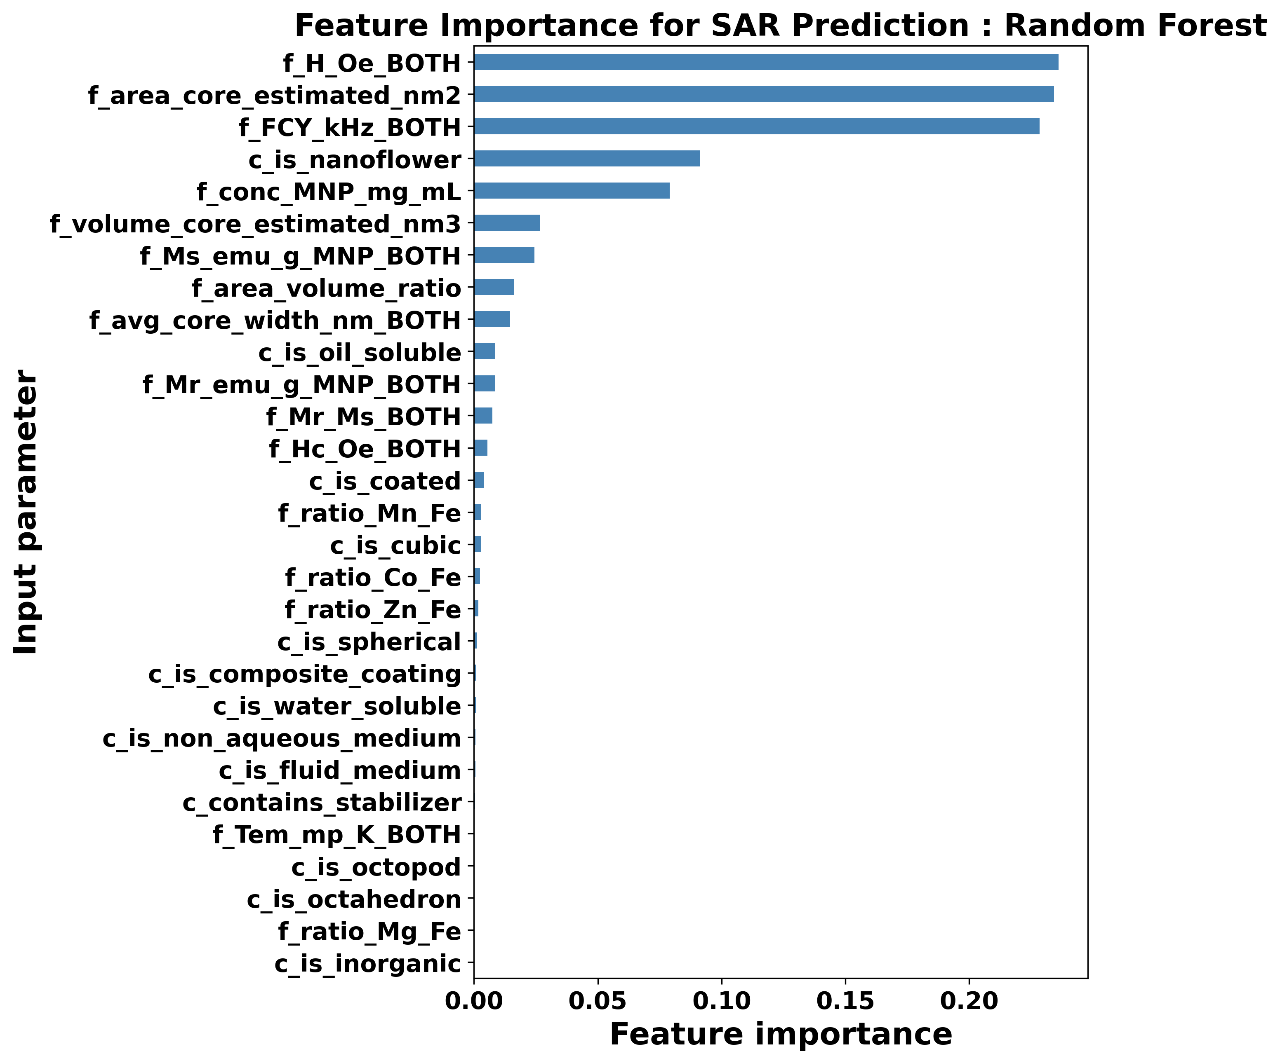
Research update
Particle core and coersive fields are important in SAR predictions

