Slide 1
NLP with Python
Authored by
M. Namgyal BRISSON
Independant Consultant for NXP
Python Mentor on OpenClassrooms

Slide 2
NLP with Python
One-Hot Encoding
Basic Features Extraction
  Readability Tests
    Flesch Reading Ease Score
    Gunning Fog Index Score
Tokenization & Lemmatization
Part-Of-Speech (POS) Tagging
Named Entity Recognition (NER)
Bag of Words (BoW)
N-grams
Chatbot Example
To go further

Slide 3
One-Hot Encoding
https://colab.research.google.com/drive/13X5jeN3oY3CFJL3ok5rwP6tifiRhIiz-
... | Gender
... | male
... | female
... | female
... | male
... | Gender_male | Gender_female
... | 1 | 0
... | 0 | 1
... | 0 | 1
... | 1 | 0

Slide 4
Basic Features Extraction
Words count
Characters count
Words average length
Pattern specific count (for instance, [hash]tags)
Other Features Extraction
Sentences count
Paragraph count
Capitalized words
Uppercased words
Quantities (Numerical)
Etc.

Slide 5
Readability Tests
Flesch Reading Ease Score
  Greater the average sentence length, harder the text is to read
    « Quick & short example »
    « Pretty much longer sentence, therefore harder to read »
  Greater the number of syllables in a word, harder the text is to read
    « I feel good at home »
    « I’m positively affected by being at my domicile »
Higher the score is, greater the readability is!

Slide 6
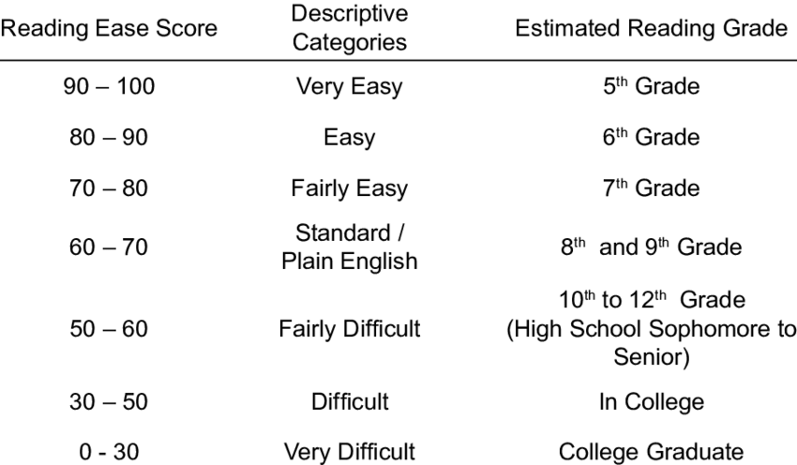
Readability Tests

Slide 7
Readability Tests
Gunning Fog Index Score
  Based on following principles:
    Average sentence length
    Percentage of complex words
Lesser the score is, greater the readability is!

Slide 8
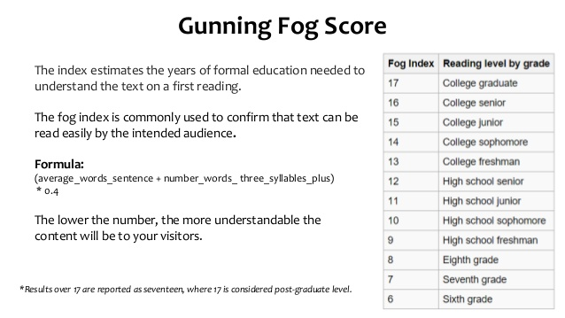
Readability Tests
https://colab.research.google.com/drive/1ZyIU1BZEP5WVS-EE1vghHJqMjgHWe1Uc

Slide 9
Tokenization & Lemmatization
Tokenization is splitting a sentence into its constituant parts
  « Hello, my name is Namgyal. »
  → [`Hello`, `,`, `my`, `name`, `is`, `Namgyal`, `.`]
Lemmatization is converting words into its base form
  « is », « am », « are » → « be »
  « deleting », « deletes », « deleted », « deletion » → « delete »
  « n’t » → « not »
  « ‘ve » → « have »
https://colab.research.google.com/drive/10HQ-OHeSSRHTcVkETPPaRkZqnQpm8mK4

Slide 10
Part-Of-Speach (POS) Tagging
Assigning every word, its corresponding part of speech.
Used for:
  Word-sense disambiguation
    « The bear is an animal »
    « Bear it up! »
  Sentiment analysis
  Question answering
  Opinion spam detection

Slide 11
Part-Of-Speach (POS) Tagging
WORD | POS
I | Pronoun
have | Verb
a | Article
cat | Noun
https://spacy.io/api/annotation#pos-universal
https://colab.research.google.com/drive/1i_Q-QNhCOUBtmNeE6_CmUdsB3nAvAVLo

Slide 12
Named Entity Recognition (NER)
Identifying & classifying named entities into predifined categories.
  Person
  Country
  Organization
  …
Can be used for:
  News article classification
  Efficient search algorithms
  Question answering
  Customer service
  …
  https://colab.research.google.com/drive/1Tyl_7tmz8j7ByUN_HjlQMRLIIKzilDiN

Slide 13
Bag of Words (BoW)
ML algorithms needs tabular data and numerical training features
  However, it is not the case for textual data (ie. movie reviews)
  Therefore one needs to convert words into vectors
Here comes the « Bag of words model »which allows to
  Extract word as token
  Compute the word tokens’ frequency
  Build a word vector out of these

Slide 14
N-Grams
BoW shortcomings
  « The moment was nice and not boring » → Positive
  « The moment was not good and boring » → Negative
In the BoW approach one will get the same vector as it contains exactly the same words!
Unfortuately, BoW approach looses the context of the words…
N-grams is a contiguous sequence of « n » elements and will help us to
handle those cases.

Slide 15
N-Grams
The BoW approach is nothing more than a n-gram model where « n » equals 1.
Let’s see some examples where « n » is superior to 1
If one says, « The movie was not good and boring » with n=2, it produces :
[
  « The movie »,
  « movie was »,
  « was not »,
  « not good »,
  « good and »,
  « and boring »
]
And so forth…
It adds context to the words, like here « was not »

Slide 16
N-Grams
Shortcomings
It increases the dimensions and in ML it will have a severe impact
It is known as the « Curse of Dimensionality »
It is then recommended to keep « n » small
https://colab.research.google.com/drive/1xQ6bwhRwaa7zBIZU82U6J1RVkHUjnhuS

Slide 17
Chatbot Example
Minimalistic chatbot based on flight suggestions.
Libraries & techniques used:
  RASA NLU
  SQL database
  Chatito data generation
https://github.com/nam4dev/chatbot_rasa_nlu_presentation

Slide 18
To go further
Not developped in this course:
  Tf-idf weight
  Cosine similarity
  …

Slide 19
Thanks for your attention :)

