Slide 1

FitBuddy
A fitness plan that adapts with you
Smart workouts built around your goals and your level.
01

Slide 2
THE CHALLENGE
Generic Plans Don't Survive Real Life
One-size-fits-all training breaks down fast.
ONE-SIZE-FITS-ALL
Real life changes. A rigid workout plan often doesn't.
Work, family, energy and availability can shift from day to day.
02

Slide 3

The FitBuddy Promise
Your Fitness,
Reimagined.
FitBuddy is a dynamic training partner that adapts to your progress, schedule, and challenges.
A plan that evolves with you.
03

Slide 4
THE PROBLEM
Generic Plans Don't Survive Real Life
Traditional plans assume a consistent schedule.
ONE-SIZE-FITS-ALL
LIFE CHANGES
Static plans often ignore changing schedules, energy levels, and real-life demands.
When work, family, or energy levels change, progress can quickly fall apart.
The plan should adapt — not ask life to stay the same.
04

Slide 5

The Problem
One-Size-Fits-All
Doesn't Work
Most fitness apps use static workouts that ignore your schedule and energy.
Life Changes. Your Plan Should Too.
When your goals or availability shift, a rigid plan becomes a roadblock.
05

Slide 6

THE FITBUDDY PROMISE
Your plan. Your goals.
Your progress.
Your Workout Source
A workout library with exercises and goal-specific programs ready to start today.
“What should I do today?” — answered instantly
“How do I get there?” — a clear path forward
06

Slide 7

Your Starting Point Becomes the Blueprint
FitBuddy meets you where you are. Choose your level and focus, and the right program appears.
🏁 PICK YOUR LEVEL
Beginner through expert — tailored to where you are now.
🎯 CHOOSE YOUR FOCUS
Body-part splits, full-body sessions, or targeted goals.
⚡ SAMPLE PROGRAMS
Ready-to-start options like weight loss and toning.
07

Slide 8
ADAPTIVE DESIGN
Training Principles, Not Vibes
Every program follows three core principles.
PROGRESSION
SPECIFICITY
INDIVIDUALIZATION
Gradually increase demands as you improve.
Train toward your goal, not a random muscle-of-the-day.
Plans should reflect each person’s needs and starting point.
08

Slide 9
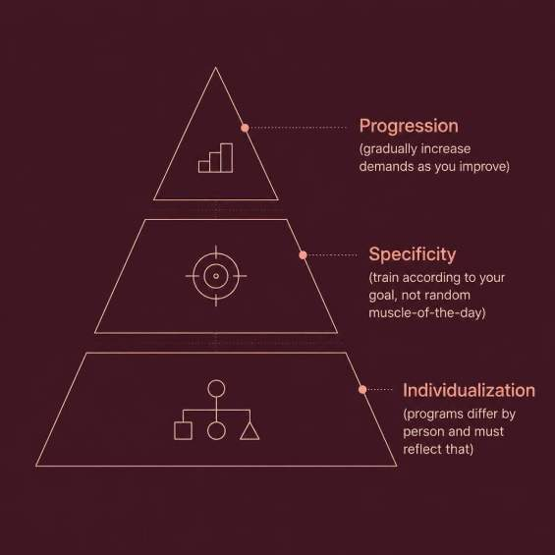
The “Today” Engine
Turn intention into an actual workout.
SELECT
Pick a premade plan or build your own.
STRUCTURE
Arrange warm-up, FITT main set, cool-down.
EVOLVE
Auto-update plans as you progress.
Every session is organized with purpose.
09

Slide 10
CONSISTENCY
When Motivation Drops, the Plan Compensates
Structure and variety keep sessions moving.
BUILT-IN VARIETY
CONSISTENCY BY DESIGN
Core, lower body, cardio, and stretches.
Structure and variety reduce drop-off.
GOAL-SPECIFIC TRACKS
Keep moving forward, even on low-energy days.
10

Slide 11

A Clear Case for Personalized Planning
Why Personalization Is Non-Negotiable
Long-term fitness success requires individualization and adaptation. A plan that ignores who you are won’t last.
FitBuddy tailors every workout by level and goal.
11

Slide 12
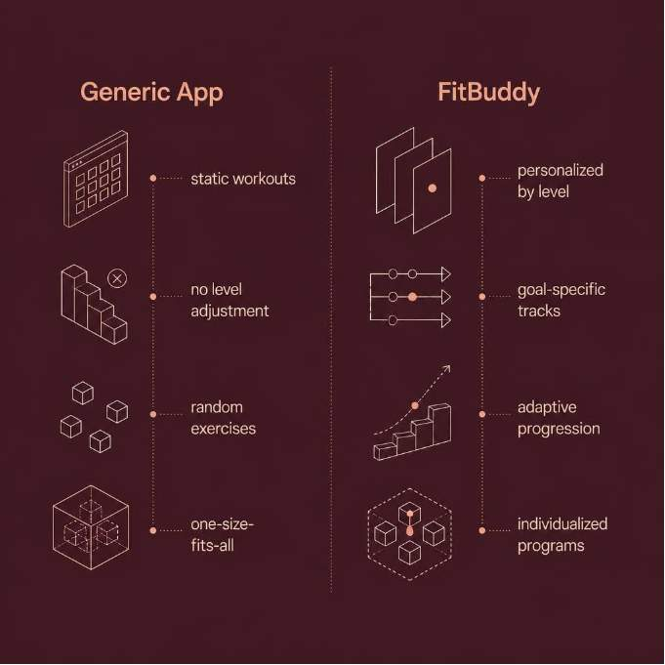
From Workout Library to Adaptive Partner
FitBuddy scales from single exercises to full programs — aligned to your goals.
01 SET YOUR GOAL
Choose weight loss, strength, toning, or endurance.
02 RUN STRUCTURED SESSIONS
Follow programs with warm-up, work, and cool-down phases.
03 UPDATE YOUR DIRECTION
As you improve, the plan adds new challenges.
12

Slide 13
ADAPTIVE JOURNEY
FitBuddy Adapts With You — So Your Fitness Can Too
🔄 YOUR PLAN ISN'T STATIC
🚀 START TODAY
EVOLVE TOMORROW
It evolves with your goals and progress.
Begin where you are.
FitBuddy adapts from there.
Your fitness journey keeps moving forward.
13

Slide 14

Unleash Your Potential with FitBuddy
More than a workout app — a personalized fitness partner designed to adapt to your journey.
PERSONALIZED TO YOU
Plans tailored to your level, goals, and preferences.
ADAPTS TO LIFE
Your program evolves with progress, schedule, and challenges.
BUILT FOR CONSISTENCY
Dynamic workouts designed to overcome motivation drops.
14

Slide 15

Keep moving.
Start where you are.
Evolve from there.
FitBuddy adapts with you.
Your goals. Your plan.
15

Slide 16
THANK YOU
FitBuddy • A fitness plan that adapts with you
16

