Slide 1

FitBuddy
A fitness plan that adapts with you
Smart workouts built around your goals and your level.

Slide 2
The Problem: Generic Plans Don't Survive Real Life
One-size-fits-all training breaks down fast.

Slide 3

The FitBuddy Promise
Your Fitness, Reimagined.
FitBuddy is a dynamic training partner that adapts to your progress, schedule, and challenges.

Slide 4
The FitBuddy Promise
Your Fitness, Reimagined.
FitBuddy is a dynamic training partner that adapts to your progress, schedule, and challenges.

Slide 5

The Problem: Generic Plans Don't Survive Real Life
Traditional fitness plans are often one-size-fits-all and assume a consistent schedule.
When work, family, or energy levels change, progress can quickly fall apart.

Slide 6


The Problem: Generic Plans Don't Survive Real Life
One-Size-Fits-All Doesn't Work
Most fitness apps use static workouts that ignore your schedule and energy.
Life Changes. Your Plan Should Too.
When your goals or availability shift, a rigid plan becomes a roadblock.

Slide 7


The FitBuddy Promise
YOUR WORKOUT SOURCE
Your plan. Your goals. Your progress.
FitBuddy is your go-to workout library — with thousands of exercises and goal-specific programs ready to start today.
"What should I do today?" — answered instantly
"How do I get there?" — a clear path forward

Slide 8
Your Starting Point Becomes the Blueprint
FitBuddy meets you where you are. Choose your level and focus, and the right program appears.
🏁 Pick Your Level
🎯 Choose Your Focus
⚡ Sample Programs
Beginner through expert — tailored to where you are now.
Body-part splits, full-body sessions, or targeted goals.
Ready-to-start options like weight loss and toning.

Slide 9
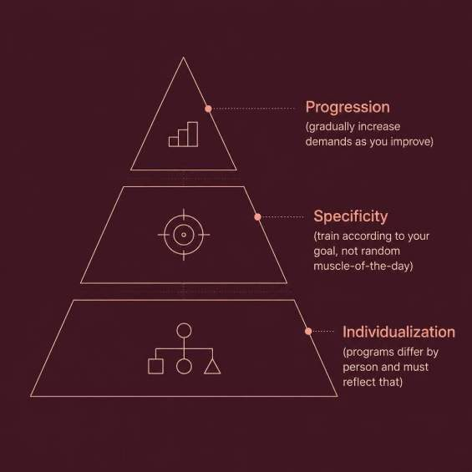

Adaptive Design: Training Principles, Not Vibes
FitBuddy is built on proven exercise science, not random workouts. Every program follows three core principles that make training effective and personal.
Progression
Specificity
Individualization
Gradually increase demands as you improve.
Train toward your goal, not a random muscle-of-the-day.
Plans should reflect each person’s needs and starting point.

Slide 10
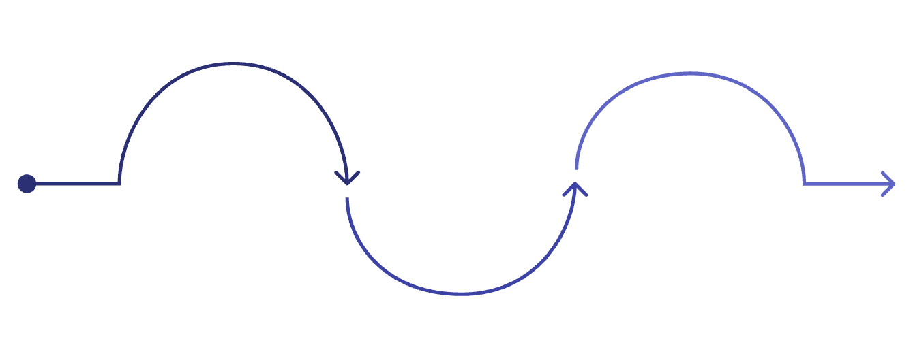
The "Today" Engine: Turn Intention Into an Actual Workout
FitBuddy removes the friction between wanting to work out and actually doing it.
Select
Evolve
Pick a premade plan or build your own
Structure
Auto-update plans as you progress
Arrange warm-up, FITT main set, cool-down
Every session is organized with purpose, so you can train smarter without extra planning.

Slide 11




When Motivation Drops, the Plan Compensates
Built-In Variety
Core, lower body, cardio, and stretches keep sessions fresh and consistent.
Goal-Specific Tracks
Your plan keeps you moving forward, even on low-energy days.
Consistency by Design
Structure and variety work together to reduce drop-off.

Slide 12
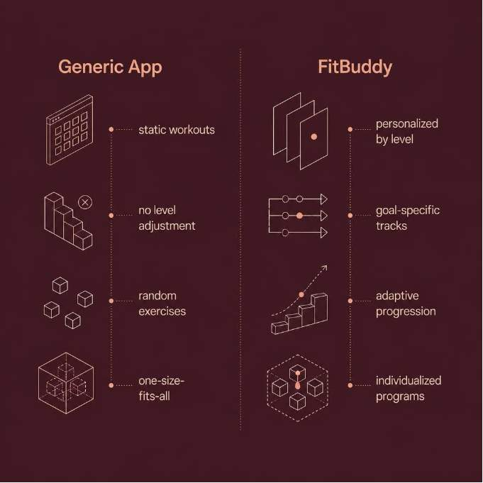
A Clear Case for Personalized Planning
Why Personalization Is Non-Negotiable
Long-term fitness success requires individualization and adaptation. A plan that ignores who you are won’t last.
FitBuddy tailors every workout by level and goal.

Slide 13






From Workout Library to Adaptive Partner
FitBuddy scales from single exercises to full programs — aligned to your goals.
Run Structured Sessions
Follow programs built with warm-up, work, and cool-down phases.
Set Your Goal
Choose weight loss, strength, toning, or endurance.
Update Your Direction
As you improve, the plan adds new challenges.

Slide 14

FitBuddy Adapts With You — So Your Fitness Can Too
🔄 Your Plan Isn't Static
It evolves with your goals and progress.
🚀 Start Today, Evolve Tomorrow
Begin where you are. FitBuddy adapts from there.

Slide 15

Unleash Your Potential with FitBuddy
FitBuddy is more than just a workout app; it's your personalized fitness partner, engineered to adapt to your unique journey and keep you on track towards your goals.
Personalized to You
Plans tailored to your level, goals, and preferences.
Adapts to Life
Your program evolves with your progress, schedule, and challenges.
Built for Consistency
Dynamic workouts designed to overcome motivation drops.

Slide 16
THANK YOU

