Slide 1
Plan for 3D Deep
Jungwon Kang, Maryam Jameela, Razieh Ramak
Sept 30 2018

Slide 2
Objectives
Building 1st Version Deep Network for Each Task
Task | Major Contributor | Objectives
Noise filtering (for Optech) | Razieh Ramak | Point cloud segmentation (Noise/Non-noise), non real-time
Point cloud segmentation (for Optech) | Maryam Jameela | Point cloud segmentation (N-class objects), non real-time
3D object detection (for Thales) | Jungwon Kang | Real-time 3D object detection

Slide 3
Schedule
Month | Task | Deliverable
Oct 2018 | • Problem definition • Dataset preparation • Literature survey | • Document describing problem definition, dataset, and literature survey • Visualization of dataset
Nov | • Practicing deep library • Design & implementation | • Document describing design
Dec | • Implementation | • Source code (Dec 31)
Jan 2019 | • Documentation | • Document describing implementation (Jan 15)
*Submission deadline of major conferences starts from March.

Slide 4
Management Policy
Regular meeting or discussion biweekly
Team website:
https://github.com/yorku-ausml/deep3d

Slide 5
To-do List
Written on Oct 1 2018
Problem definition, including
Cause of noise (Razieh)
Object classes (Maryam, Jungwon)
Dataset description, including
Existing Optech airborne dataset (Razieh)
Dataset size
Current repository
Visualization
Etc
Finding point cloud label tool (for making ground-truth)
Finding visualization tool

Slide 6
Key Literature
Written on Oct 1 2018
Point cloud segmentation
Large-scale point cloud segmentation with superpoint graphs https://github.com/loicland/superpoint_graph *Rank 1 in http://www.semantic3d.net/
PointNet++: deep hierarchical feature learning on point sets in a metric space https://github.com/charlesq34/pointnet2 *Rank 4 in http://www.semantic3d.net/
Object detection
Joint 3D proposal generation and object detection from view aggregation https://github.com/kujason/avod
*Literature list is also available at https://github.com/yorku-ausml/deep3d/wiki/Related-works

Slide 7
Current Progress
Oct 12 2018

Slide 8
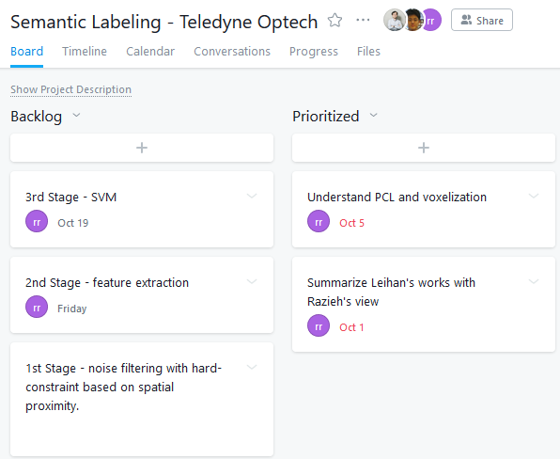
Asana Assignment

Slide 9
Progress on Noise Filtering
Razieh
Atmospheric noise filtering
Noise filtering Segmentation of raw point cloud using voxelization Pre-classification by defining special rules
Feature extraction Using Eigen library and programming
Classification sing SVM Using “libSVM”
Understanding PCL and voxelization
PCL A large scale, open project for 2D/3D image and point cloud processing. However, there is no PCL in noise filtering application
Voxelization A data structure used to represent a collection of multi-dimensional points and is commonly used to represent three-dimensional data

Slide 10
Clarifying the Task
Dataset used for training?
What kind of dataset will be used? Mobile data / airborne lasers / hybrid dataset mixture of both.
What kind of environment? Indoor / Outdoor or Urban / Rural / Forest
Which object classes?

Slide 11
Key Papers
Point cloud segmentation
PointNet: Deep Learning on Point Sets for 3D Classification and Segmentation https://github.com/charlesq34/pointnet *Both used in the two following papers
PointNet++: deep hierarchical feature learning on point sets in a metric space https://github.com/charlesq34/pointnet2 *Rank 4 in http://www.semantic3d.net/
Large-scale point cloud segmentation with superpoint graphs https://github.com/loicland/superpoint_graph *Rank 1 in http://www.semantic3d.net/

Slide 12
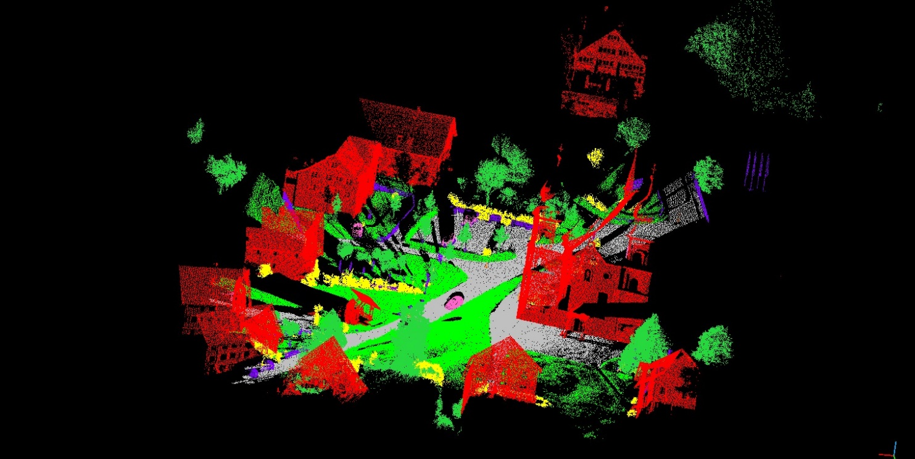
Publicly Available Dataset ^{(1/3)}
Semantic3D
LiDAR dataset with over 3 billion points from a variety of urban and rural scenes.
http://www.semantic3d.net/
Managed by ETH (http://www.prs.igp.ethz.ch/)
8 class labels, namely {1: man-made terrain, 2: natural terrain, 3: high vegetation, 4: low vegetation, 5: buildings, 6: hard scape, 7: scanning artefacts, 8: cars}.

Slide 13
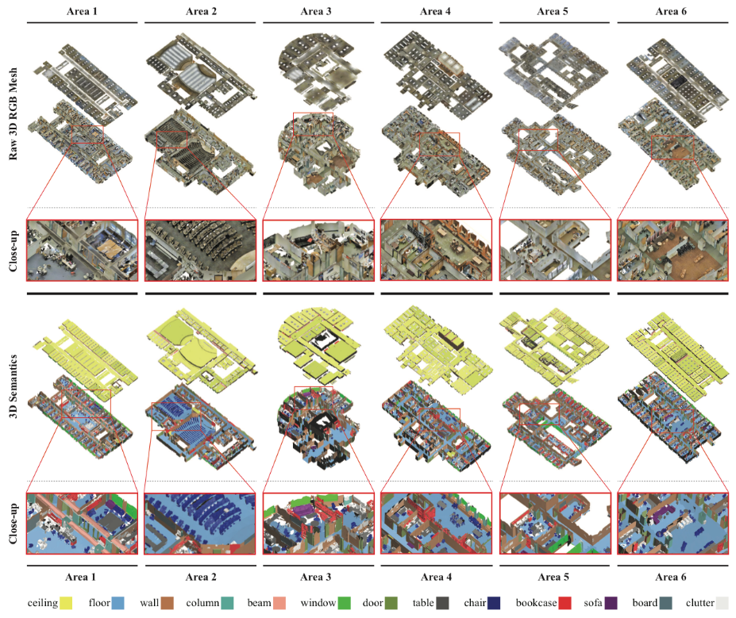
Publicly Available Dataset ^{(2/3)}
S3DIS (Stanford Large-Scale 3D Indoor Space)
3D RGB point clouds of six floors from three different buildings
http://buildingparser.stanford.edu/dataset.html
Currently, 2D-3D-S dataset is newly released.
13 object classes (ceiling, floor, wall, beam, column, window, door, and movable elements: table, chair, sofa, bookcase, board and clutter for all other elements)

Slide 14
Publicly Available Dataset ^{(3/3)}
Etc
Oakland 3-D Point Cloud Dataset (2009)
http://www.cs.cmu.edu/~vmr/datasets/oakland_3d/cvpr09/doc/
NYU Depth Dataset V2 (2012)
https://cs.nyu.edu/~silberman/datasets/nyu_depth_v2.html
Sydney Urban Objects data set
http://www.acfr.usyd.edu.au/papers/SydneyUrbanObjectsDataset.shtml
IQmulus & TerraMobilita Contest
Mobile laser scans (MLS) in dense urban environments
http://data.ign.fr/benchmarks/UrbanAnalysis/
Vaihingen3D airborne benchmark
http://www2.isprs.org/commissions/comm3/wg4/3d-semantic-labeling.html

Slide 15
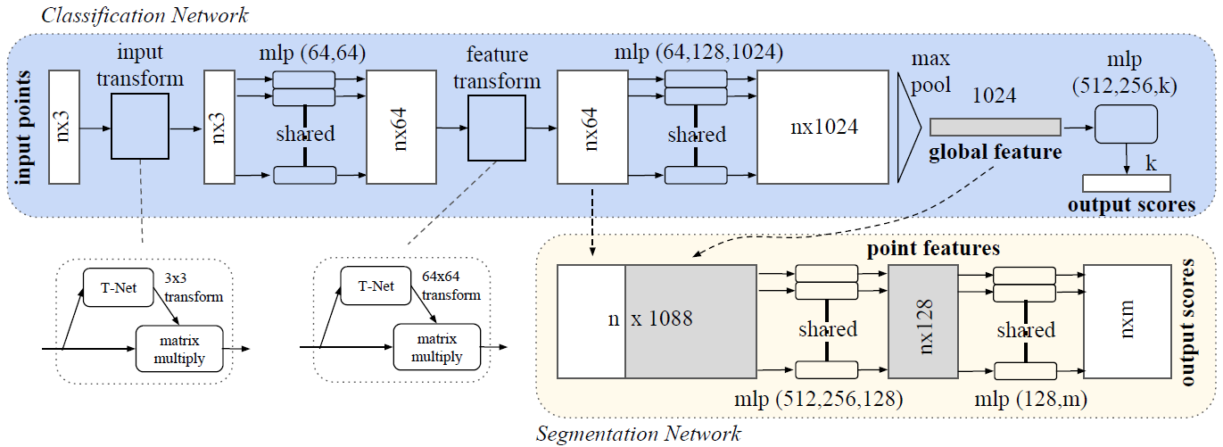
PointNet
Architecture
http://stanford.edu/~rqi/pointnet/
CVPR 2017

Slide 16
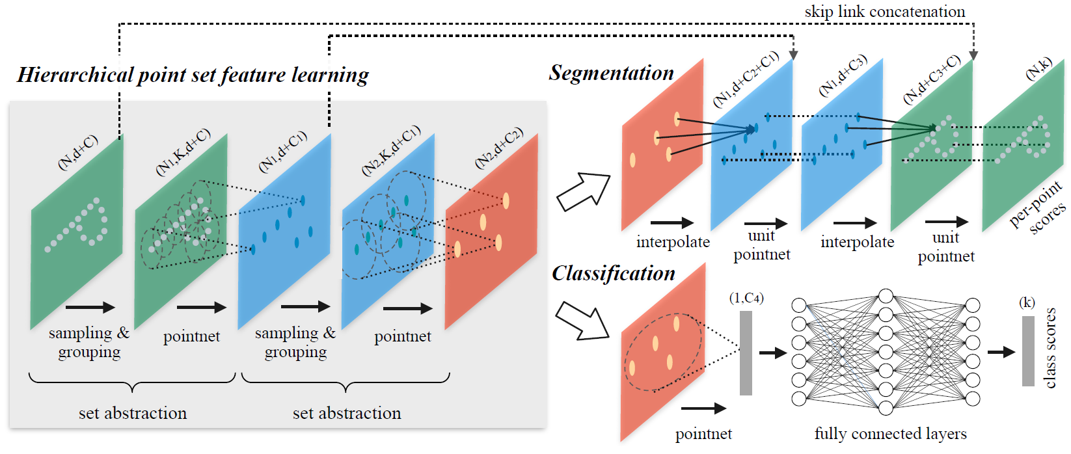
PointNet++
Hierarchical Feature Learning Architecture
http://stanford.edu/~rqi/pointnet2/
NIPS 2017

Slide 17
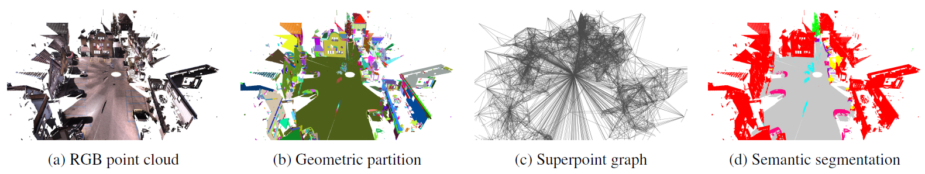
Superpoint Graph ^{(1/2)}
Individual steps in pipeline
CVPR 2018

Slide 18
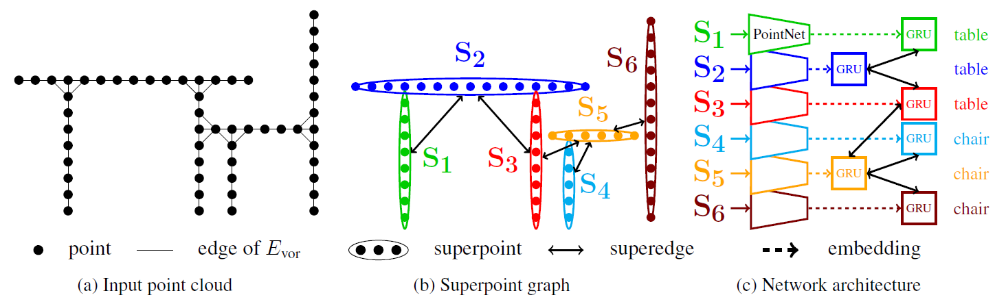
Superpoint Graph ^{(2/2)}
CVPR 2018

Slide 19
Plan
Month | Task | Deliverable
Oct 2018 | • Problem definition • Dataset preparation • Literature survey | • Document describing problem definition, dataset, and literature survey • Visualization of dataset
Nov | • Practicing deep library • Design & implementation | • Document describing design
Dec | • Implementation | • Source code (Dec 31)
Jan 2019 | • Documentation | • Document describing implementation (Jan 15)

