Slide 1
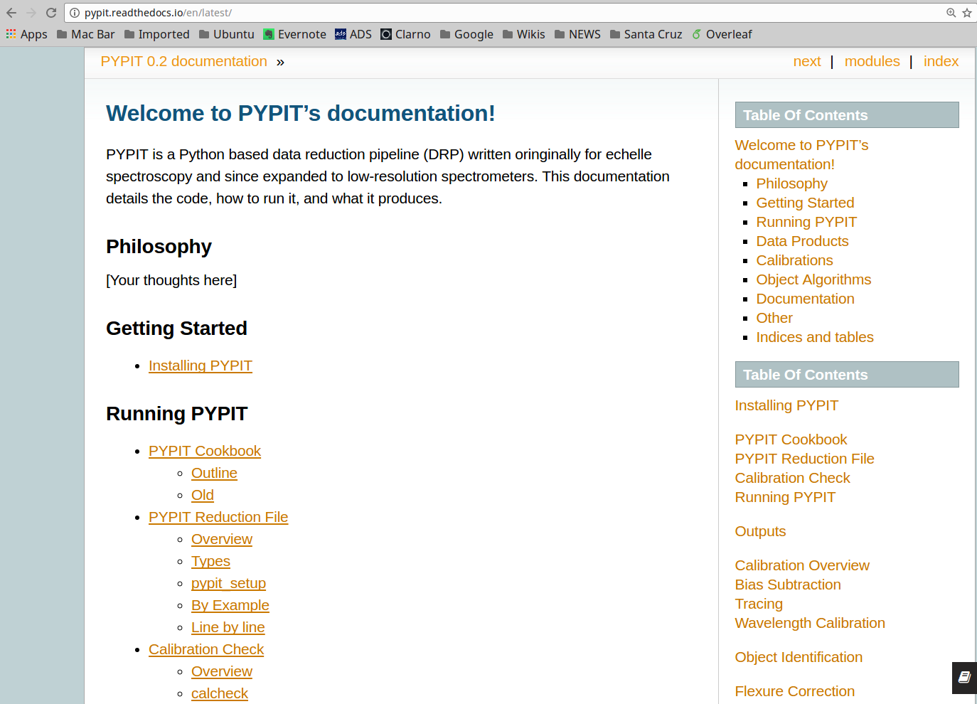
PYPIT for WMKO (v3)
J. Xavier Prochaska (UC Santa Cruz; UCO)
R. Cooke (Durham)

Slide 2
PYPIT at WMKO
Construct a flexible, modern platform for automated reduction of all WMKO spectrographs
  With the potential to include imaging cameras
Automate throughput monitoring
  With updates to Exposure Time Calculators
Codify and adopt best practices for calibration acquisition
  Enhance the archive
Enable Science

Slide 3
PYPIT: Philosophy
IDL → PYPIT (command-line interpreter essential)
  IDL could vanish any day (whim of Harris geospatial)
  Python continues to develop (now at 3.6)
Fully public development and usage
  Github: https://github.com/PYPIT/PYPIT
  Including unit tests and development suite (~80% coverage)
  Minimal but valuable dependencies (numpy, astropy)
  Adopt and follow astropy-affiliate guidelines
Fully automated and generalized
  Builds on 17+ years of algorithm development in IDL
Science driven

Slide 4
PYPIT v0.2 (released)
Algorithm
  Parse data files from archive
  Generate PYPIT scripts
  Slit identification
  Wavelength solutions
  Object identification
  Sky subtract
  Extraction
  Fluxing
  Coadding
LRIS
  Blue and red cameras
  Most grisms/gratings
  Limited multi-slit testing
Lick/Kast
WHT/ISIS

Slide 5
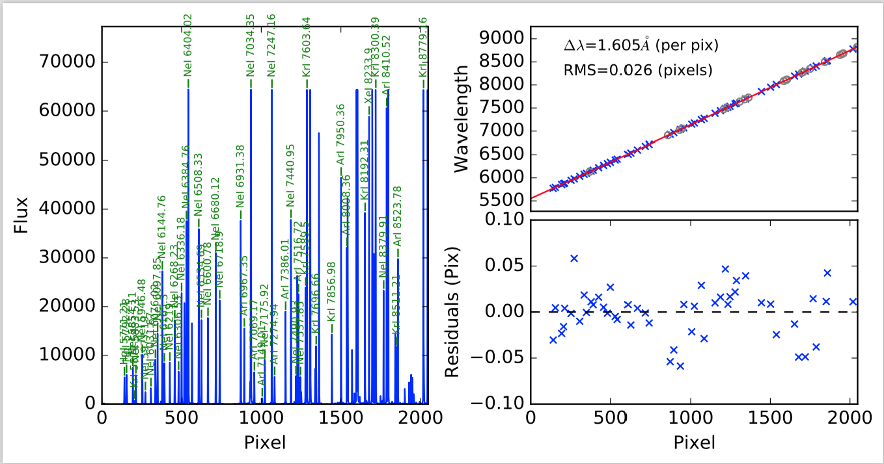
PYPIT QA
PYPIT performs automated wavelength calibration

Slide 6
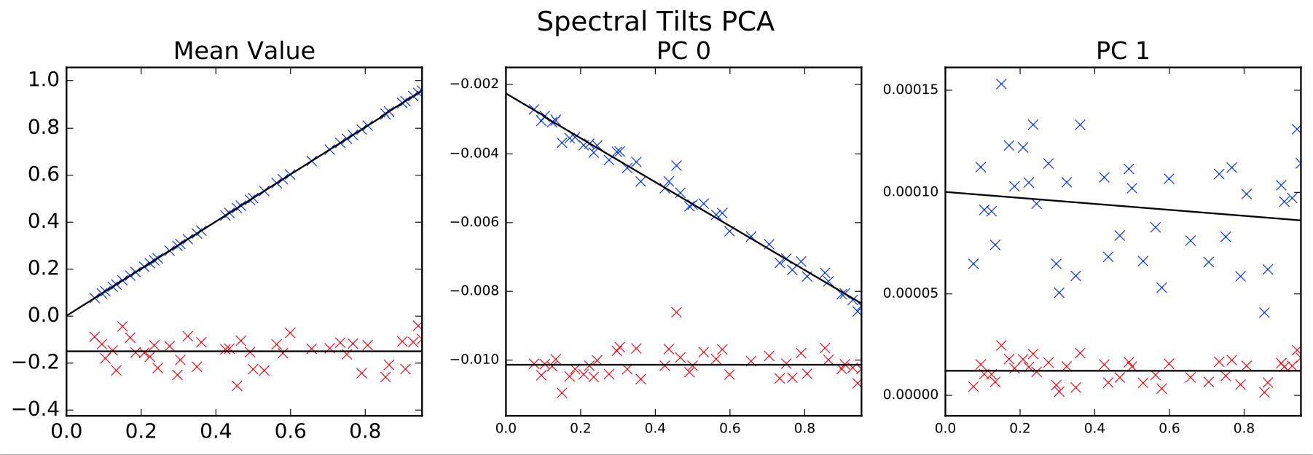
PYPIT QA
PYPIT traces tilted arc-lines with Principal Component Analysis

Slide 7
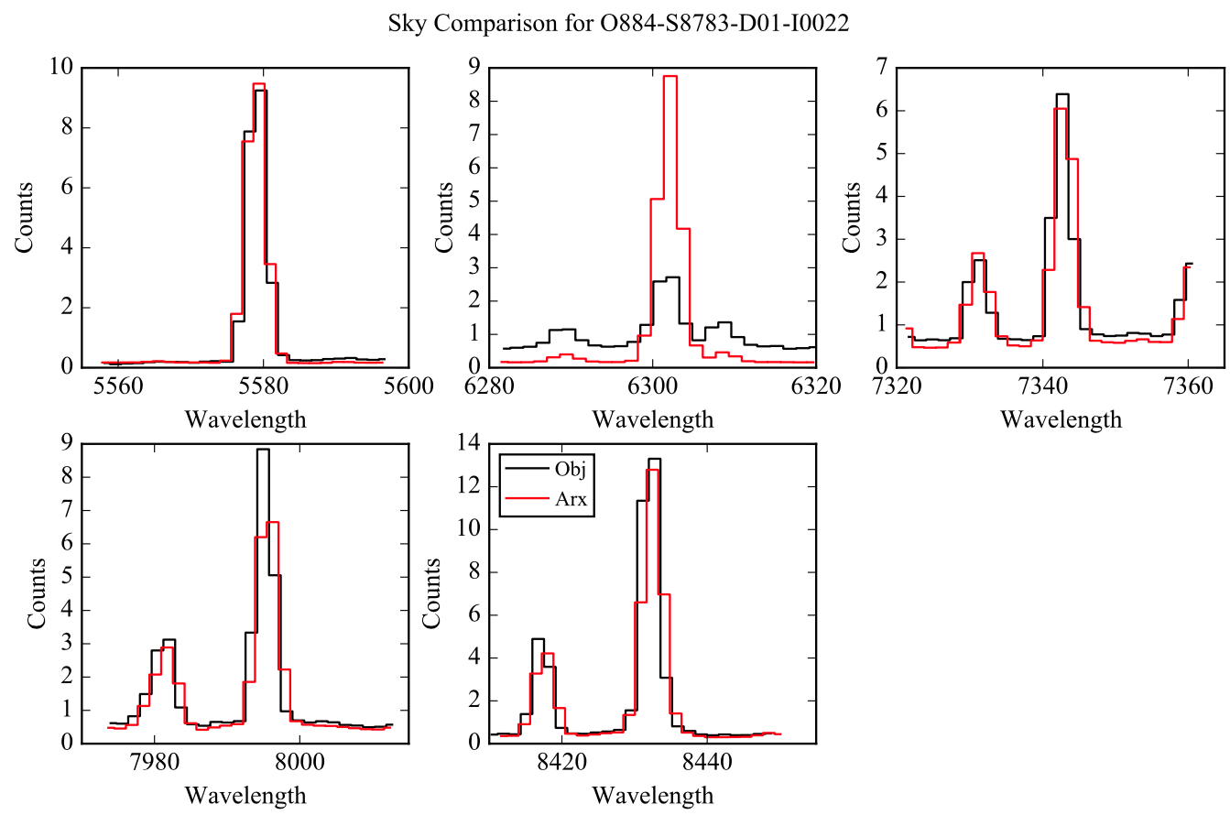
PYPIT QA
PYPIT corrects for instrument flexure using sky lines

Slide 8
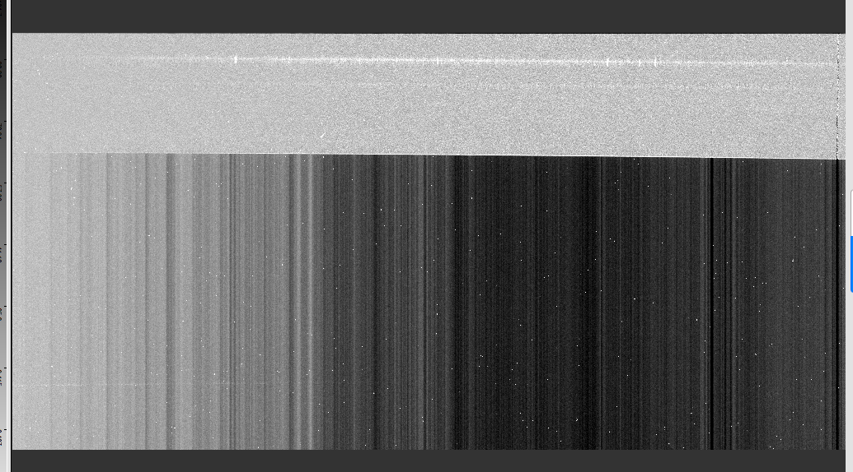
PYPIT QA
Processed
Raw

Slide 9
PYPIT: Next Generation Algorithms
Wavelength solution
  New holy grail algorithm: https://github.com/PYPIT/arclines
  Machine learning approach is underway
Image identification
  Neural network algorithm
  Ideal for archival slurping (e.g. without log sheets or headers!)
  More training sets needed..
Multi-core processing
Pixel level reductions for high-precision analysis (echelle)

Slide 10
PYPIT: Future Releases
v1.0 (April 2017)
  APF/Levy
  Keck/HIRES
  Keck/DEIMOS
v2.0 (Summer 2017)
  NIRSPEC, ESI, MOSFIRE
v3.0 (Winter 2018)
  KCWI, NIRES

Slide 11
PYPIT: Working with WMKO
Interface to KOA
  Seamless integration
  Produce Level 1 data products
Monitor instrument throughput
  ETC integration
Enable calibration archiving
  And more formalized calibration taking
Perform quick reductions at WMKO
Generalize parts of PYPIT for imaging cameras??

Slide 12
PYPIT: UCO
JXP
  Commit UCO service to PYPIT support + development
  Negotiated with UCO Director
UCO
  Director strongly supports DRP development
  Will commit at least 0.5 FTE
External
  Soliciting funds from NSF opportunities
  Funding astronomers at UC to co-develop

Slide 13
PYPIT at WMKO
Construct a flexible, modern platform for automated reduction of all WMKO spectrographs
  With the potential to include imaging cameras
Automate throughput monitoring
  With updates to Exposure Time Calculators
Codify and adopt best practices for calibration acquisition
  Enhance the archive
Enable Science

