Slide 1
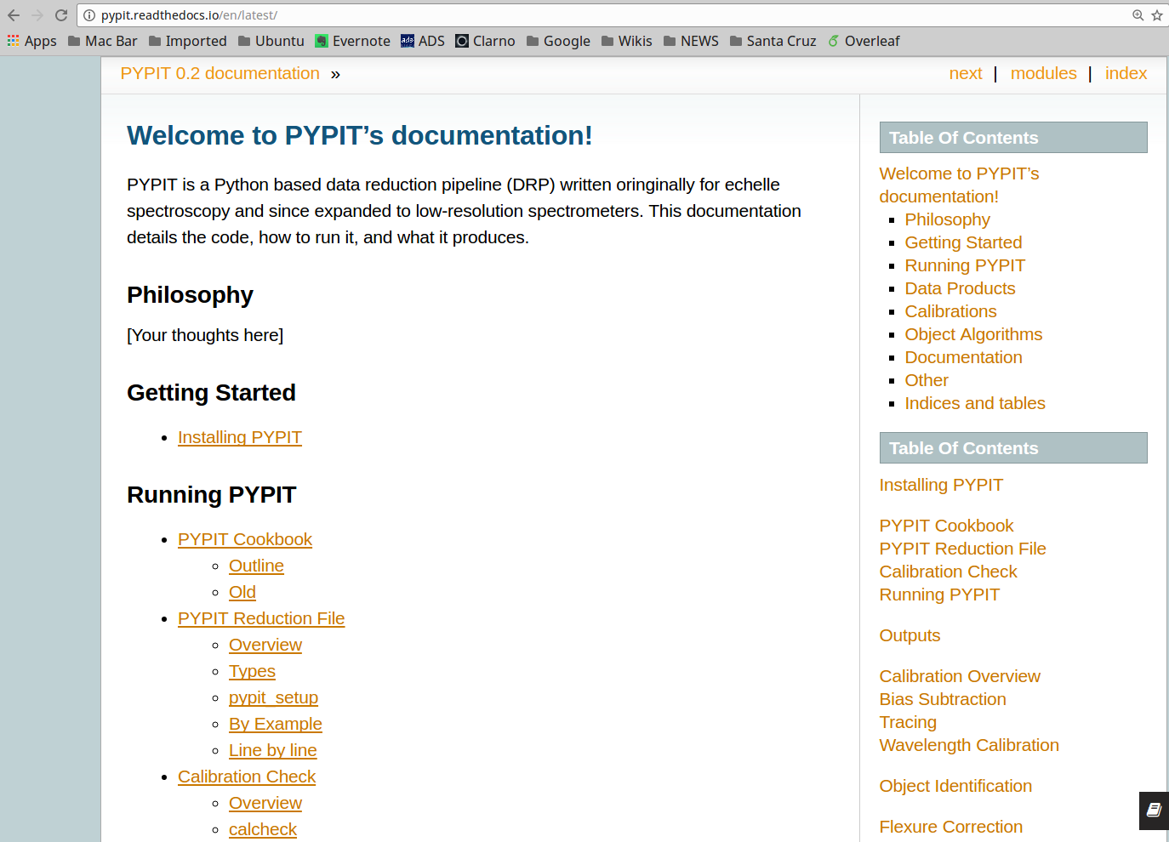
PYPIT at UCSC
J. Xavier Prochaska (UC Santa Cruz; UCO)
R. Cooke (Durham)

Slide 2
PYPIT: What?
A flexible, modern platform for automated reduction of any ground-based spectrograph
  Kast, LRIS, DEIMOS, MOSFIRE, etc.
Python
  Modern algorithms for data reduction
  With Cython speed-ups
QA, standard data products, documentation
  Plenty more to come

Slide 3
PYPIT v0.2 (released)
Algorithm
  Parse data files from archive
  Generate PYPIT scripts
  Slit identification
  Wavelength solutions
  Object identification
  Sky subtract
  Extraction
  Fluxing
  Coadding
LRIS
  Blue and red cameras
  Most grisms/gratings
  Limited multi-slit testing
Lick/Kast
  Both cameras; most gratings
WHT/ISIS

Slide 4
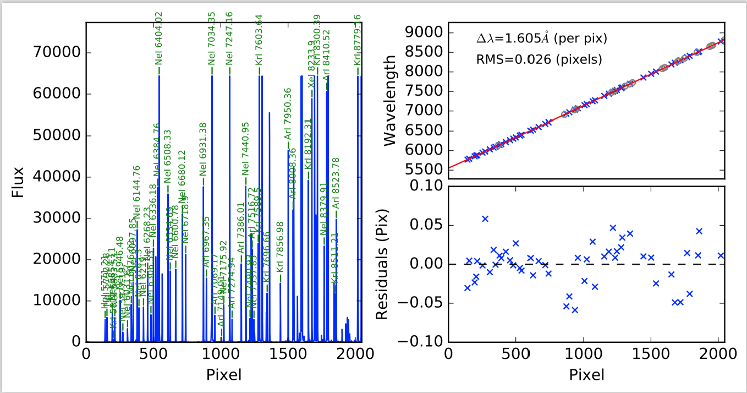
PYPIT QA
PYPIT performs automated wavelength calibration

Slide 5
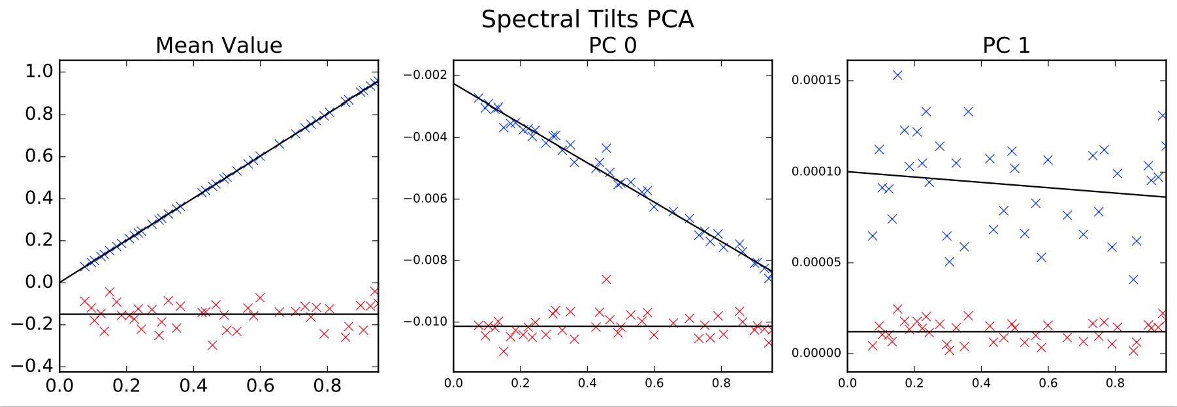
PYPIT QA
PYPIT traces tilted arc-lines with Principal Component Analysis

Slide 6
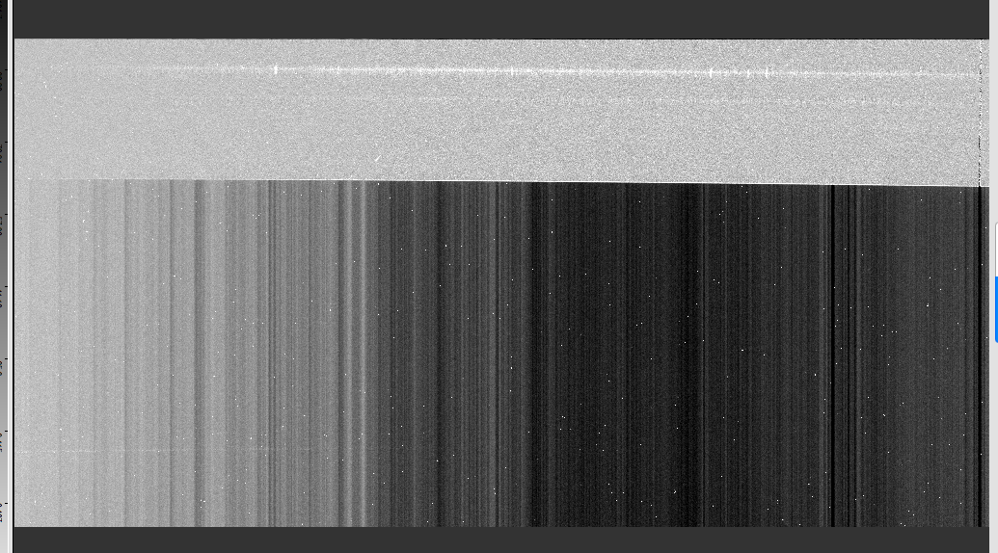
PYPIT Output
Processed
Raw

Slide 7
PYPIT: Next Generation Algorithms
Wavelength solution
  New holy grail algorithm: https://github.com/PYPIT/arclines
  Machine learning approach is underway
Image identification
  Neural network algorithm
  Ideal for archival slurping (e.g. without log sheets or headers!)
  More training sets needed..
Multi-core processing
Pixel level reductions for high-precision analysis (echelle)

Slide 8
PYPIT: Why?
IDL → PYPIT (command-line interpreter essential)
  IDL could vanish any day (whim of Harris geospatial)
  Python continues to develop (now at 3.6)
No other existing Python DRP for the majority of grounds-based instruments
  MOSFIRE one is flawed
Fully automated and generalized
  Builds on 17+ years of algorithm development in IDL
Science driven

Slide 9
PYPIT: How?
Github development (public)
  https://github.com/PYPIT/PYPIT
  Including unit tests and development suite (~80% coverage)
  Minimal but valuable dependencies (numpy, astropy)
  Adopt and follow astropy-affiliate guidelines
Currently relying on the community
  Professional FTEs may be on the way!
  But astronomers will always be essential to development

Slide 10
PYPIT: Where?
Github
  https://github.com/PYPIT/PYPIT
UCSC is the focal point
  WMKO may get engaged
  UCO too
  And we have a strong outpost at Durham University (Ryan Cooke)

Slide 11
PYPIT: When?
Now
  Code development has accelerated over the past year
  JXP is driven to get Keck/LRIS data out
  Ryan is driven to get APF and HIRES solutions in place
Then
  Development will continue

Slide 12
PYPIT: Future Releases
v1.0 (April 2017)
  APF/Levy
  Keck/HIRES
  Keck/DEIMOS
v2.0 (Summer 2017)
  NIRSPEC, ESI, MOSFIRE
v3.0 (Winter 2018)
  KCWI, NIRES

Slide 13
PYPIT: Who?
Us
  JXP
  Tiffany
  Asher
  Alexa
Them
  Ryan
  Joe Hennawi (soon)
You?

Slide 14
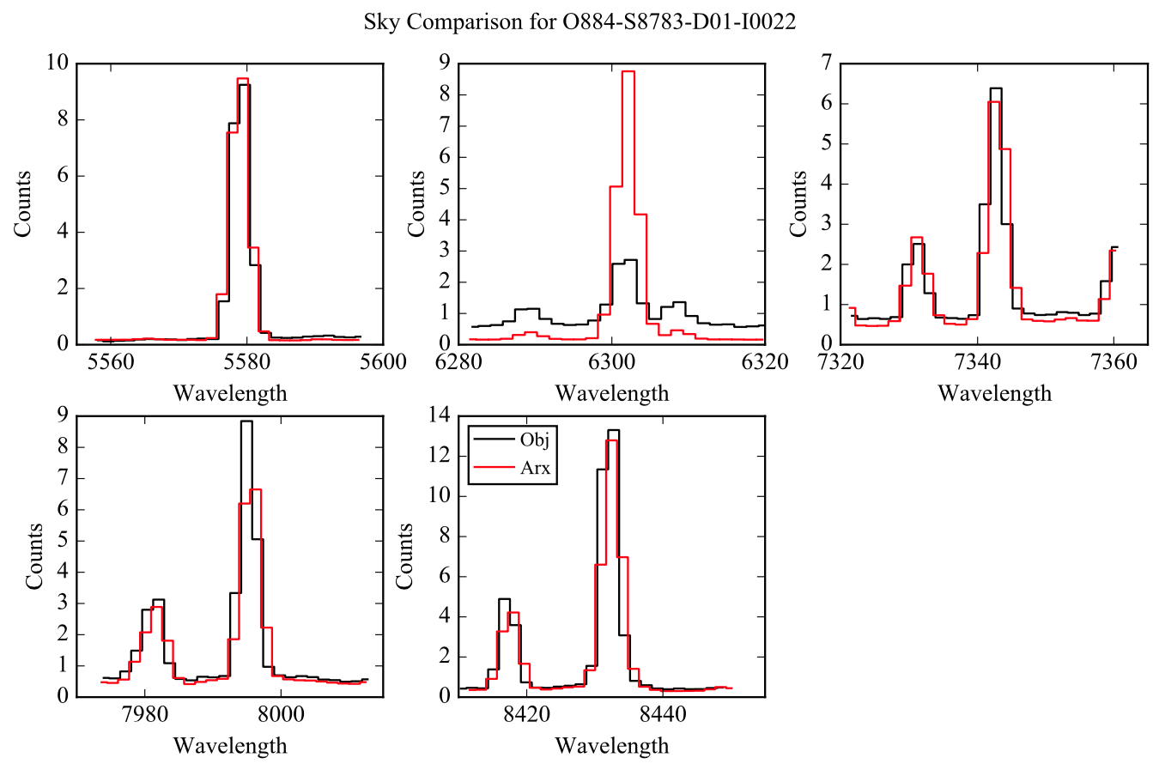
PYPIT QA
PYPIT corrects for instrument flexure using sky lines

