Slide 1
Re-detecting HD 187123 b from the 1998 Keck/HIRES frames
A modern, open reduction of the first planet Keck found: PypeIt + an iodine forward model
J. Xavier Prochaska and Claude · phases 1–3 · 30 September 2026

Slide 2
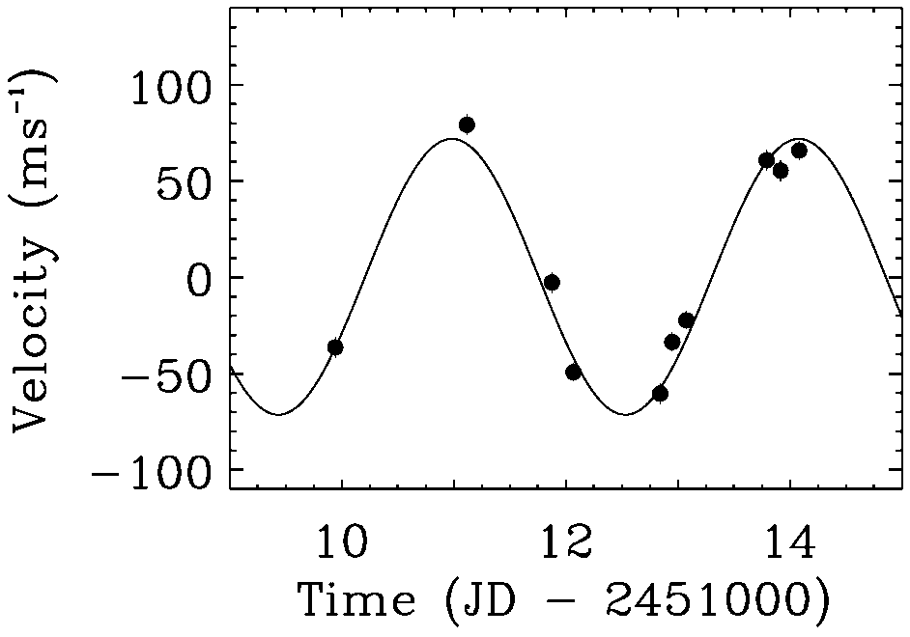
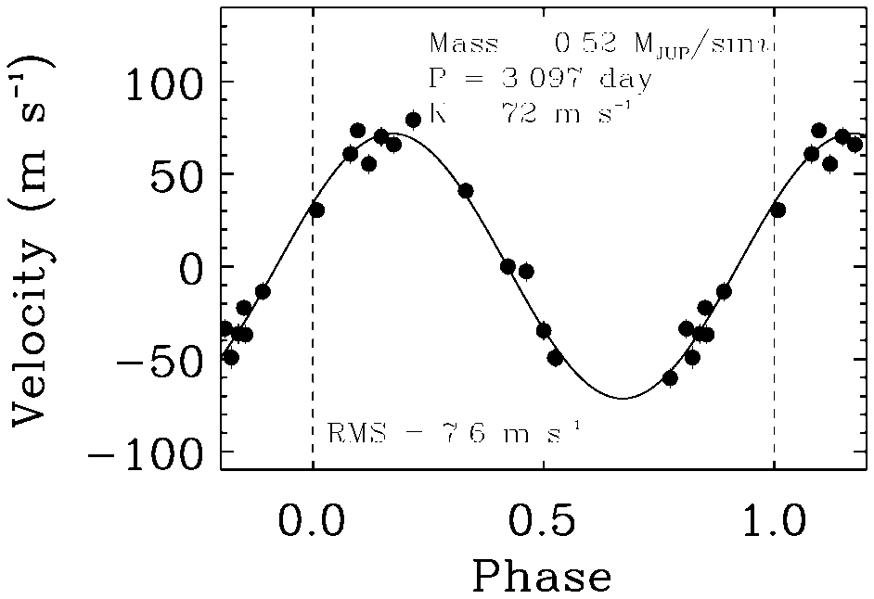
The 1998 discovery: Butler et al., PASP 110, 1389
2
Fig. 1: the 1998 July 15–19 run
Fig. 2: all 20 velocities, phased
P = 3.097 ± 0.003 d · K = 72.0 ± 2.0 m/s · e = 0.03 ± 0.03 · M sin i = 0.52 Jupiter masses
Table 1. 20 velocities, 1997 Dec – 1998 Aug; errors ~6 m/s; rms 7.5 m/s about the orbit
Our target. This work: K = 72.4 ± 7.1 m/s at 25.8 m/s rms, from 31 cell-in epochs.

Slide 3
The bottom line
3
• Planet recovered: K = 72.4 ± 7.1 m/s (10.2σ); published 72, modern catalogue 69.2
• Period found blind: 3.0954 d (true 3.0966 d), false-alarm probability 2 × 10⁻¹¹
• 25.8 m/s per epoch about the orbit; 31 cell-in epochs, 19 nights
• 28× better than lamp-calibrated velocities; ~9× short of Butler’s 3 m/s; ~12× short of the modern pipeline (2.2 m/s)
• All open: PypeIt + a tested pyodine fork; nothing from the discovery pipeline
Success criterion (50 m/s per epoch, an independent detection): met.

Slide 4
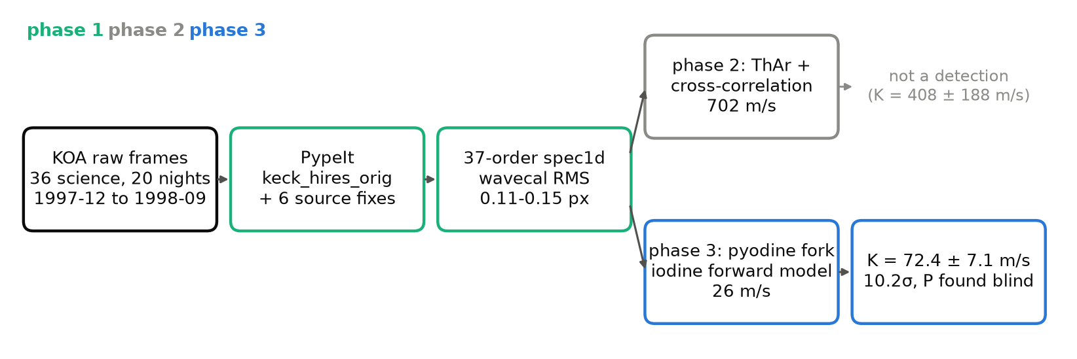
Three phases, one chain
4
Phase 2 measured why lamps fail; phase 3 replaced the lamp with the iodine cell.

Slide 5
Phase 1
PypeIt on the pre-2004 HIRES CCD
Can a modern open pipeline reduce the original Tektronix-detector frames at all?

Slide 6
Phase 1: what PypeIt needed
6
item | fix | symptom
get_rawimage | prepix × namp | image 21 columns off
bad-pixel mask | column C − PREPIX | mask 20 px off
binning | '1,2' not '2,1' | platescale halved
check_spectrograph | raise the error | silently accepted
exprng | [1, None] for Orig | science excluded
find_trim_edge, sky | 1,1; no sky fit | star fills the slit
flats | borrow clean B1 flats | none on most nights
Fixes on branch orig-hires-fixes (017bece06); verify_orig_fixes.py reproduces them.

Slide 7
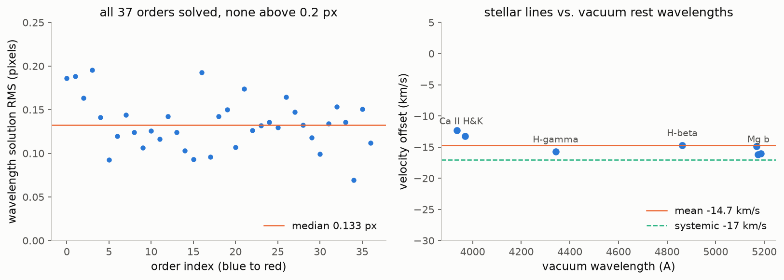
37 orders, every one solved below 0.2 px
7
July 1998: 10 of 10 frames, 37 orders each; wavecal RMS medians 0.115–0.127 px.

Slide 8
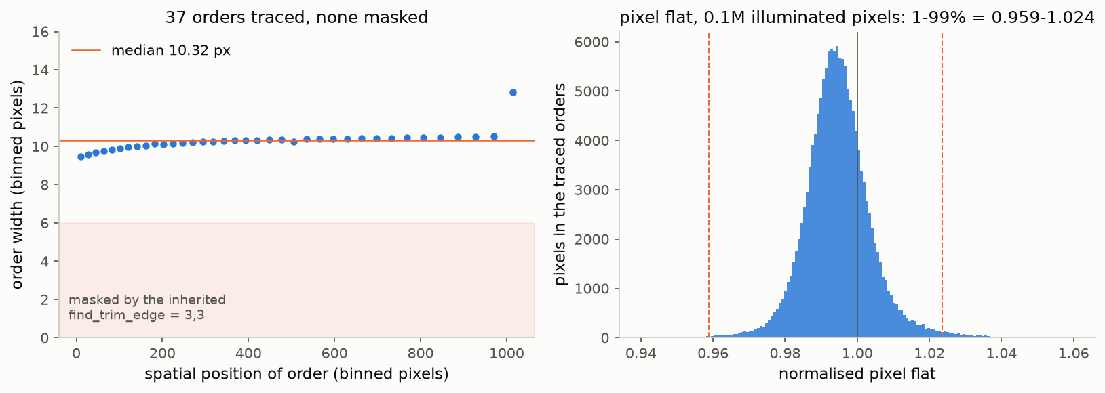
The traced orders and the flat
8
The inherited find_trim_edge = 3,3 would mask 6 of ~10 pixels per order.

Slide 9
Phase 2
Twenty nights, and velocities from a lamp
The whole discovery era reduced; velocities by cross-correlation; the inputs phase 3 needs.

Slide 10
What phase 2 built
10
• 20 nights, 36 frames, 37 orders; wavecal RMS 0.11–0.15 px
• Quality filter: 1329 order-spectra, 11.3% rejected
• Template: three cell-out exposures, S/N ~790 per pixel
• Atlas: Fischer 2022 FTS; positions match (r = 0.928), depths need α = 2.59
• Adapter: observed frame, JD(UTC) mid-exposure, BVC in m/s
Plus refframe_audit.py: two PypeIt core/wave.py bugs (next slide).

Slide 11
PypeIt’s velocity correction (refframe_audit.py)
11
• Solar-term sign error in geomotion_velocity (wave.py:128)
  – +9 to +14 m/s off astropy; drifts 5.2 m/s over nine months
  – heliocentric is the default: every user is affected
• Relativistic terms omitted in geomotion_correct
  – −4.6 m/s, nearly constant
Both still in develop; reported upstream.

Slide 12
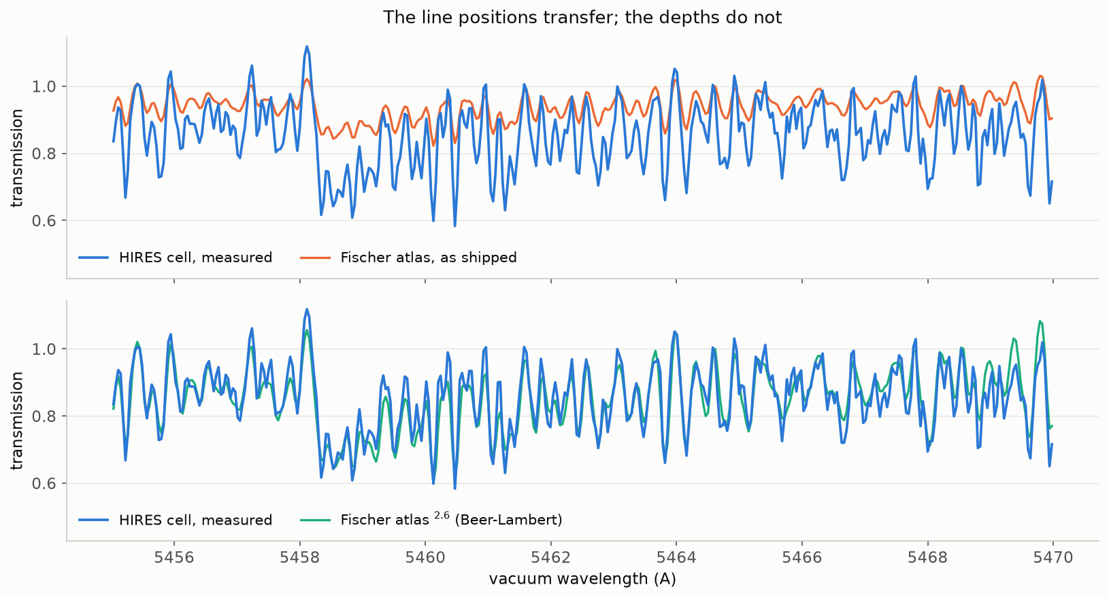
The atlas: positions transfer, depths need α ≈ 2.6
12
Beer–Lambert, not pyodine’s linear scaling (negative at α = 2.6).

Slide 13
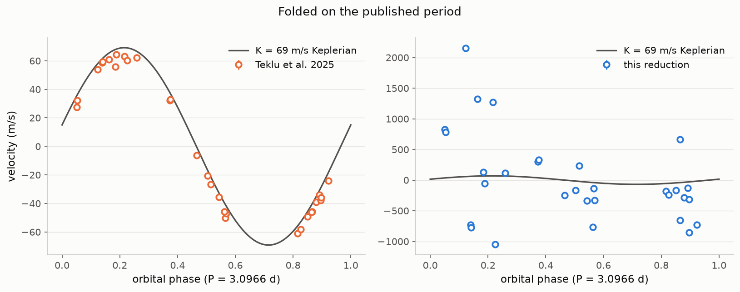
Cross-correlation: the planet is not there
13
36 epochs, rms 702 m/s; K = 408 ± 188 m/s — not a detection.

Slide 14
Why the lamp fails
14
• Orders within one exposure agree to 47 m/s
• Exposures disagree by ~700 m/s
• So the limit is the wavelength zero point
• Borrowed-arc night: +1.5 to +2.4 km/s off
• 08-25: drifts 1.6 km/s in 6.7 hours
The iodine cell fixes exactly this: its ruler rides on the same photons.

Slide 15
Phase 3
The iodine forward model
Fork pyodine, adapt it to HIRES, fit every cell-in epoch, and assess exactly as phase 2 did.

Slide 16
The pyodine fork: six tested changes
16
# | change | why
0 | NumPy 2 | does not run as shipped
1 | Beer–Lambert depth | linear goes negative
2 | atlas wavelength frame | air vs vacuum: 83 km/s
3 | bary units | JD(UTC) and m/s
4 | weight by 'ivar' | use PypeIt’s noise
5 | chunk template index | order subsets misfit
pyodine 4488b09 + changes 0–5; each has a test that fails without it.

Slide 17
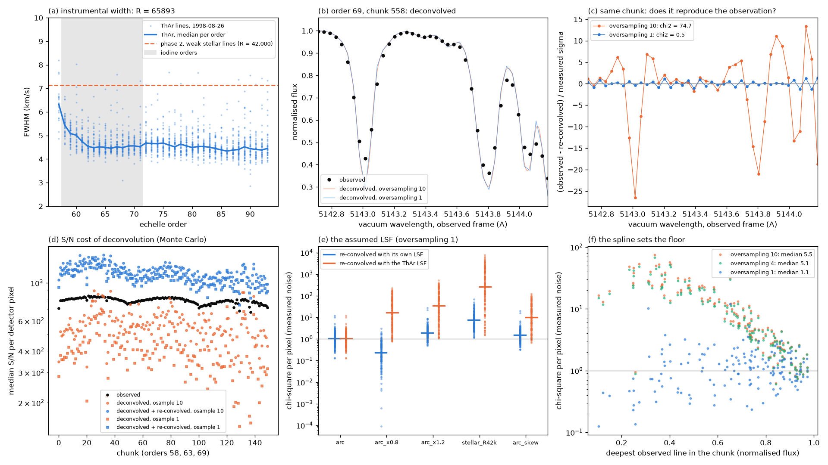
Deconvolution: pyodine’s spline fails at HIRES sampling
17
misc.rebin overshoots 2.2-px lines; oversampling 1 re-convolves at χ² 1.1.

Slide 18
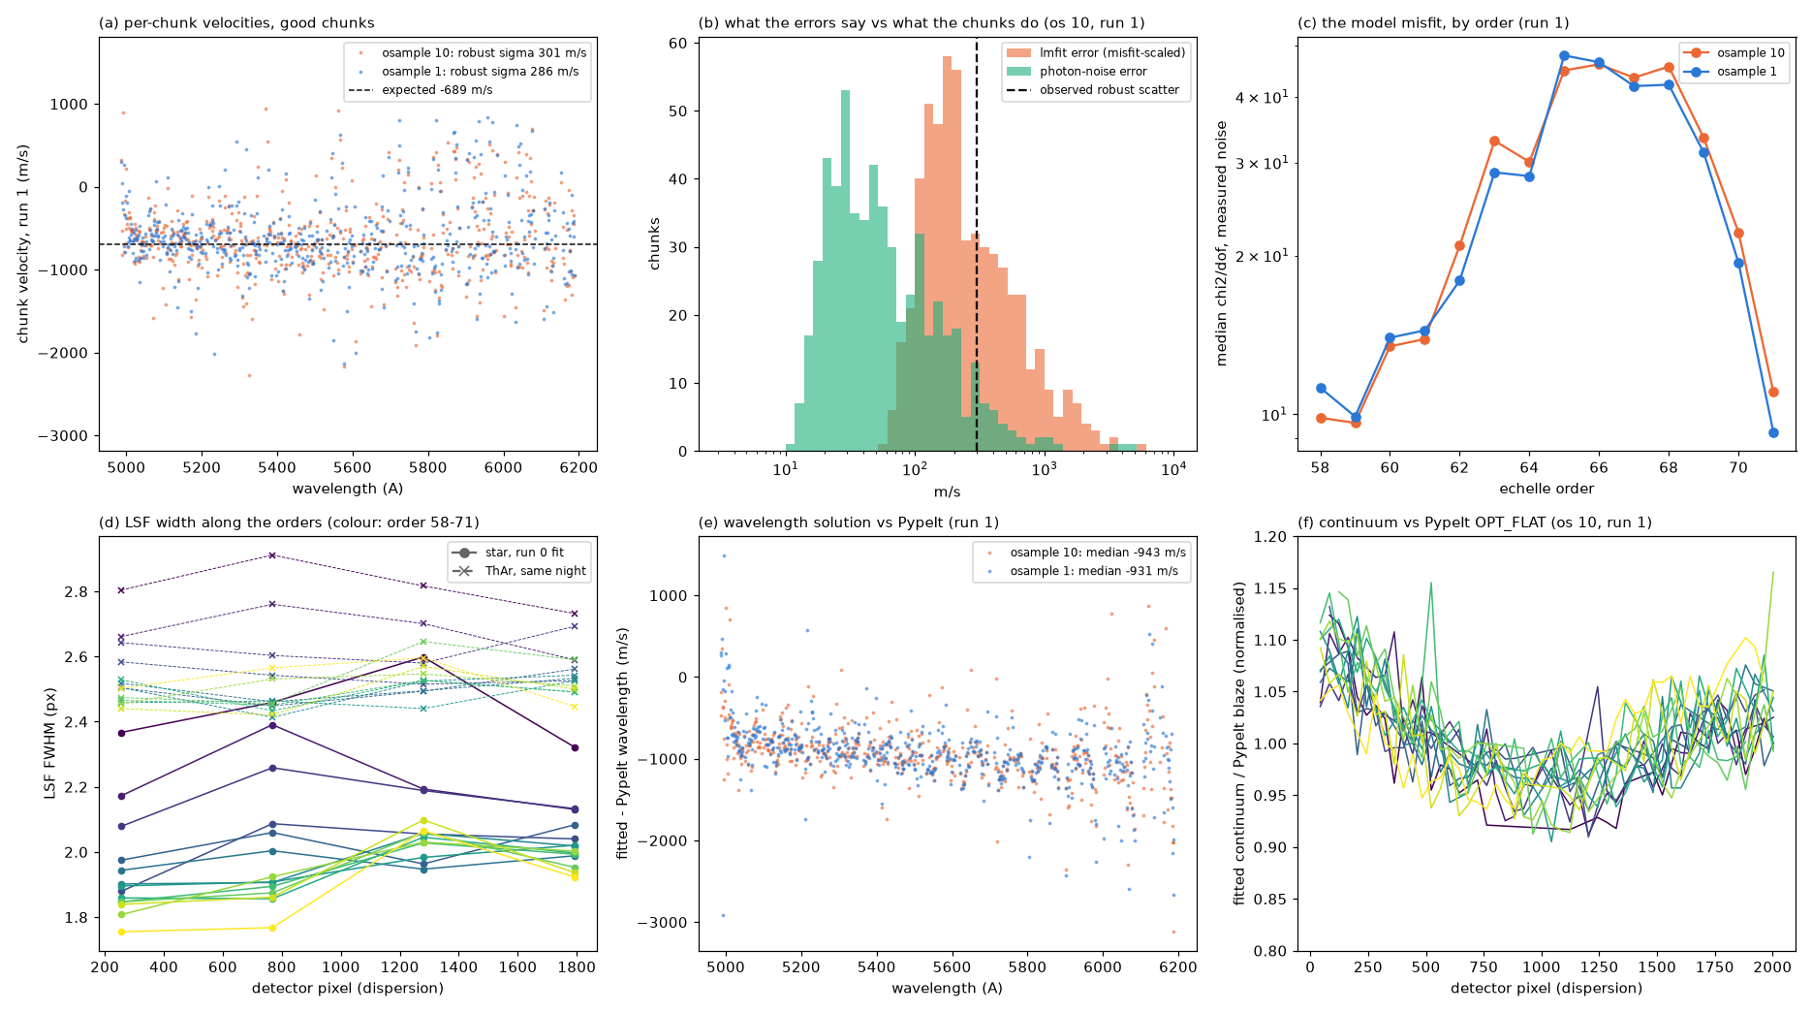
One epoch: right velocity, wrong iodine
18
Within 12–18 m/s of prediction; the misfit tracks iodine contrast (ρ ≈ +0.7).

Slide 19
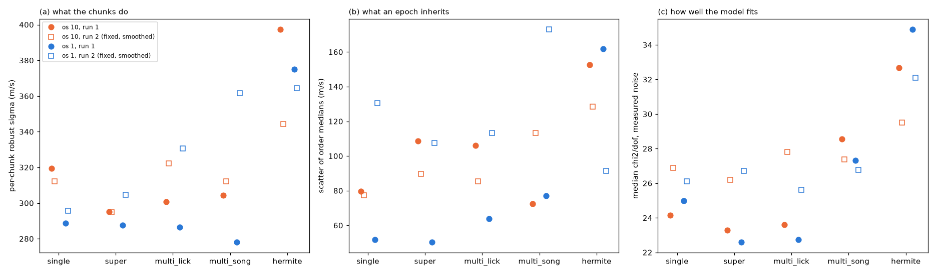
The instrumental profile is not the lever
19
Four LSF models tie to ±5%; super-Gaussian chosen.

Slide 20
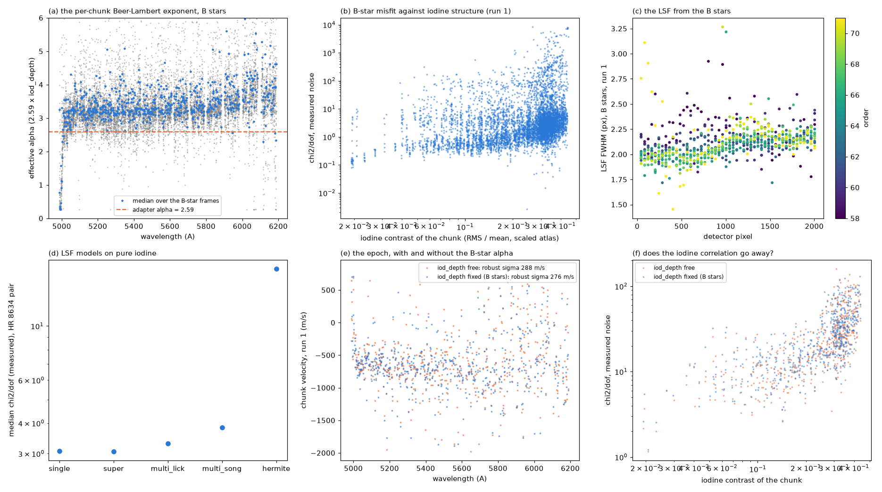
B stars: the atlas’s line pattern is the limit
20
HIRES cell α ≈ 3.33; fixing α per chunk buys nothing.

Slide 21
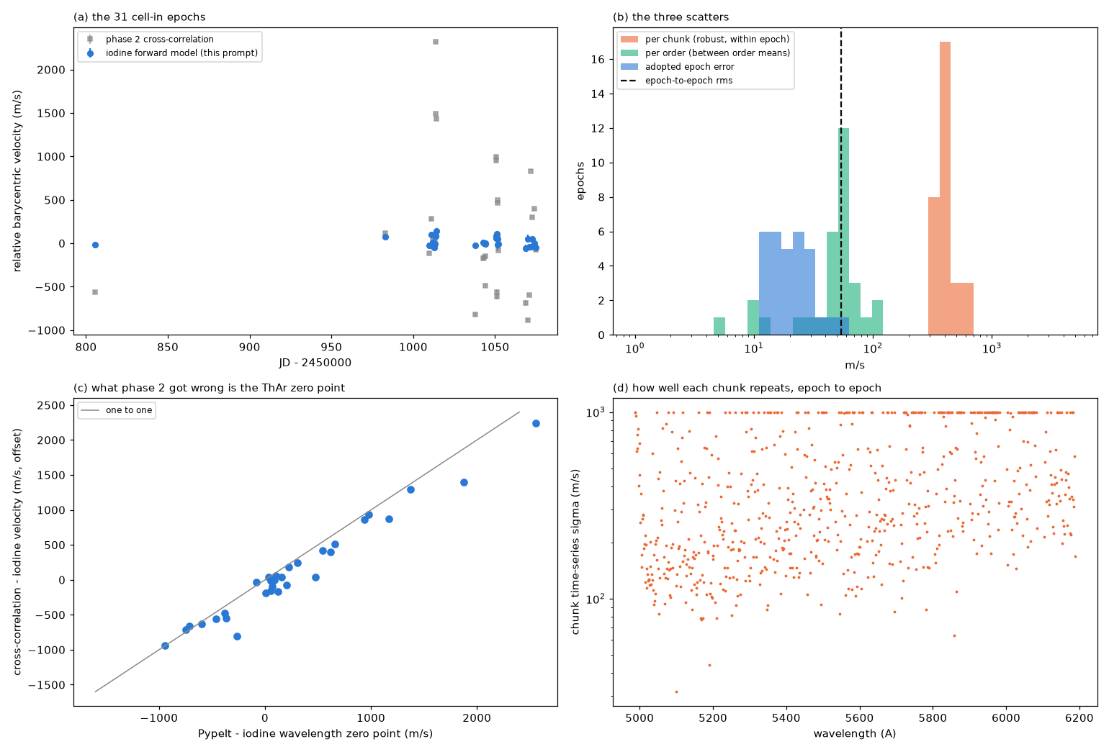
All 31 epochs: the misfit is common, and cancels
21
pyodine’s chunk offsets remove it: 290 → 230 m/s per chunk; ~19 m/s per epoch.

Slide 22
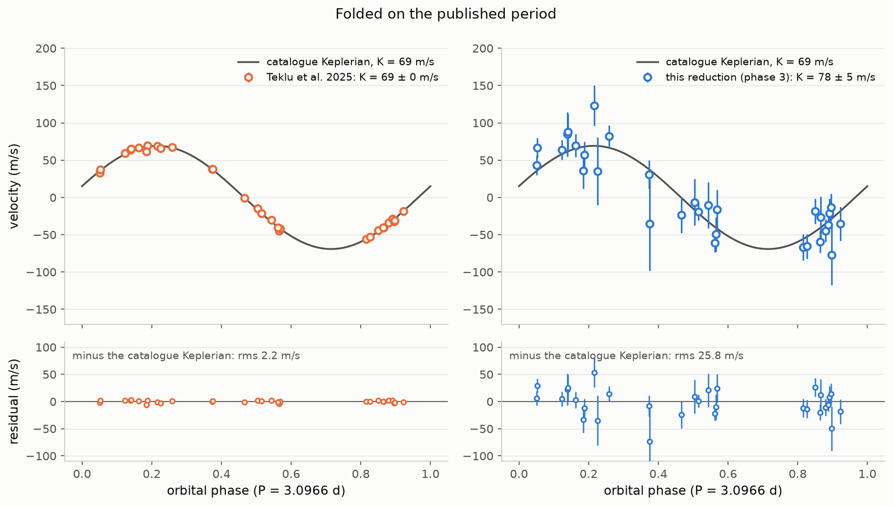
The detection
22
K = 72.4 ± 7.1 m/s (10.2σ); residual 25.8 m/s, χ²/dof 1.05.

Slide 23
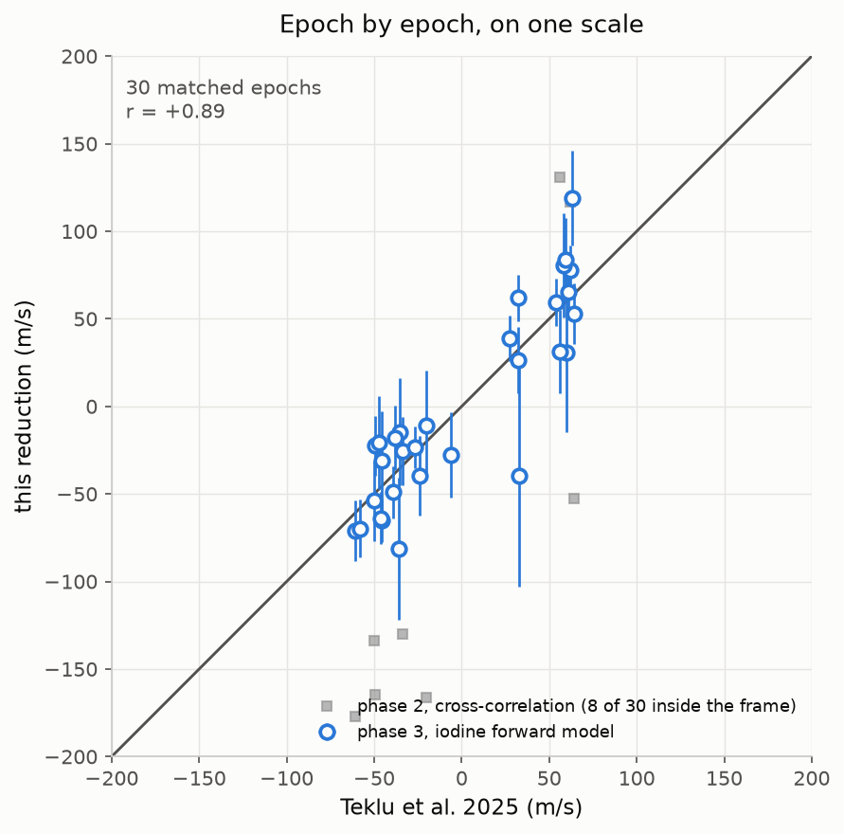
Epoch by epoch against the modern catalogue
23
r = +0.89 (phase 2: +0.38); the errors are honest (χ²/dof 1.03).

Slide 24
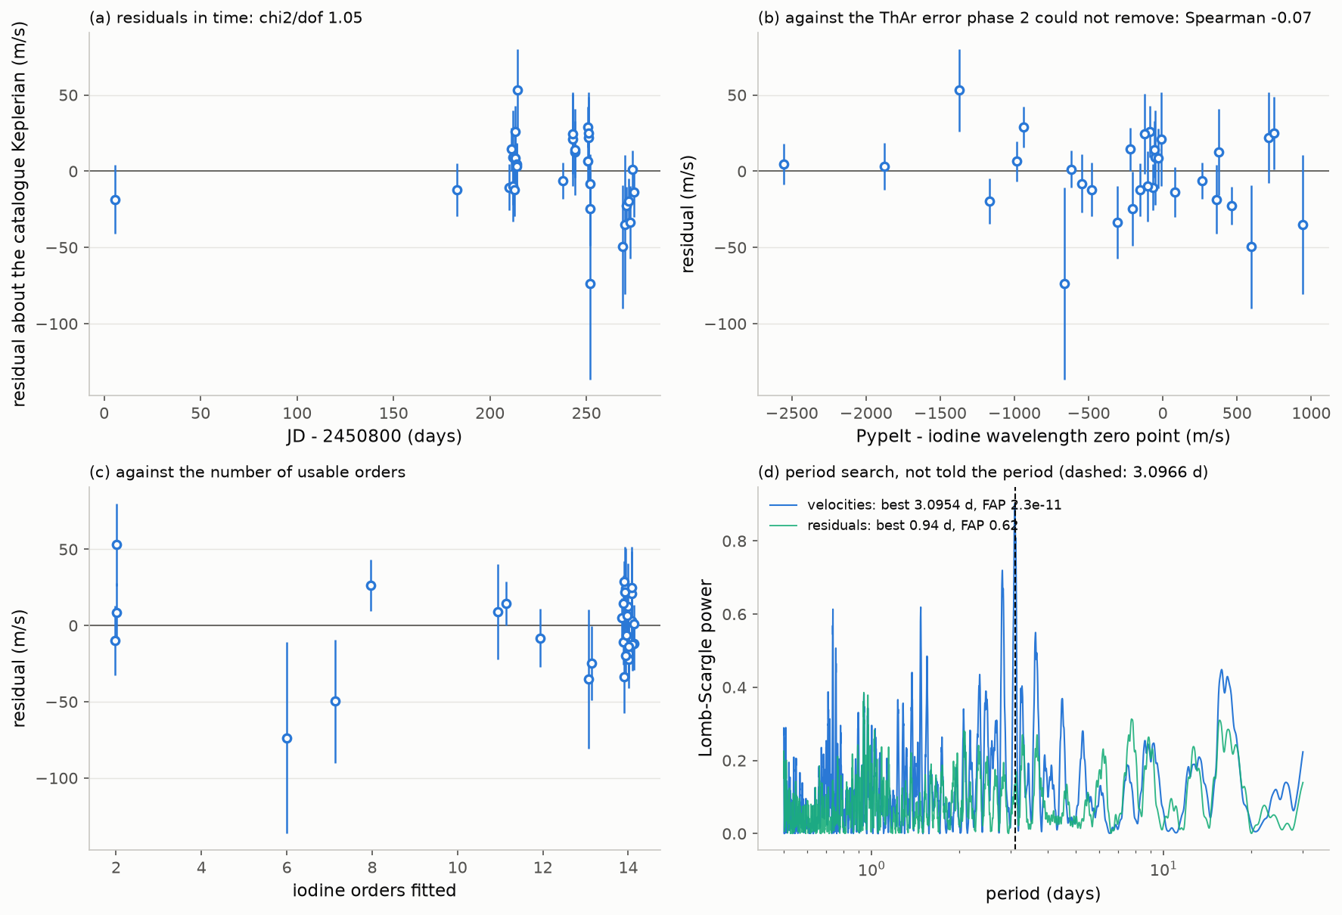
Residuals and the blind period search
24
No ThAr, misfit or order-count dependence; residual periodogram flat.

Slide 25
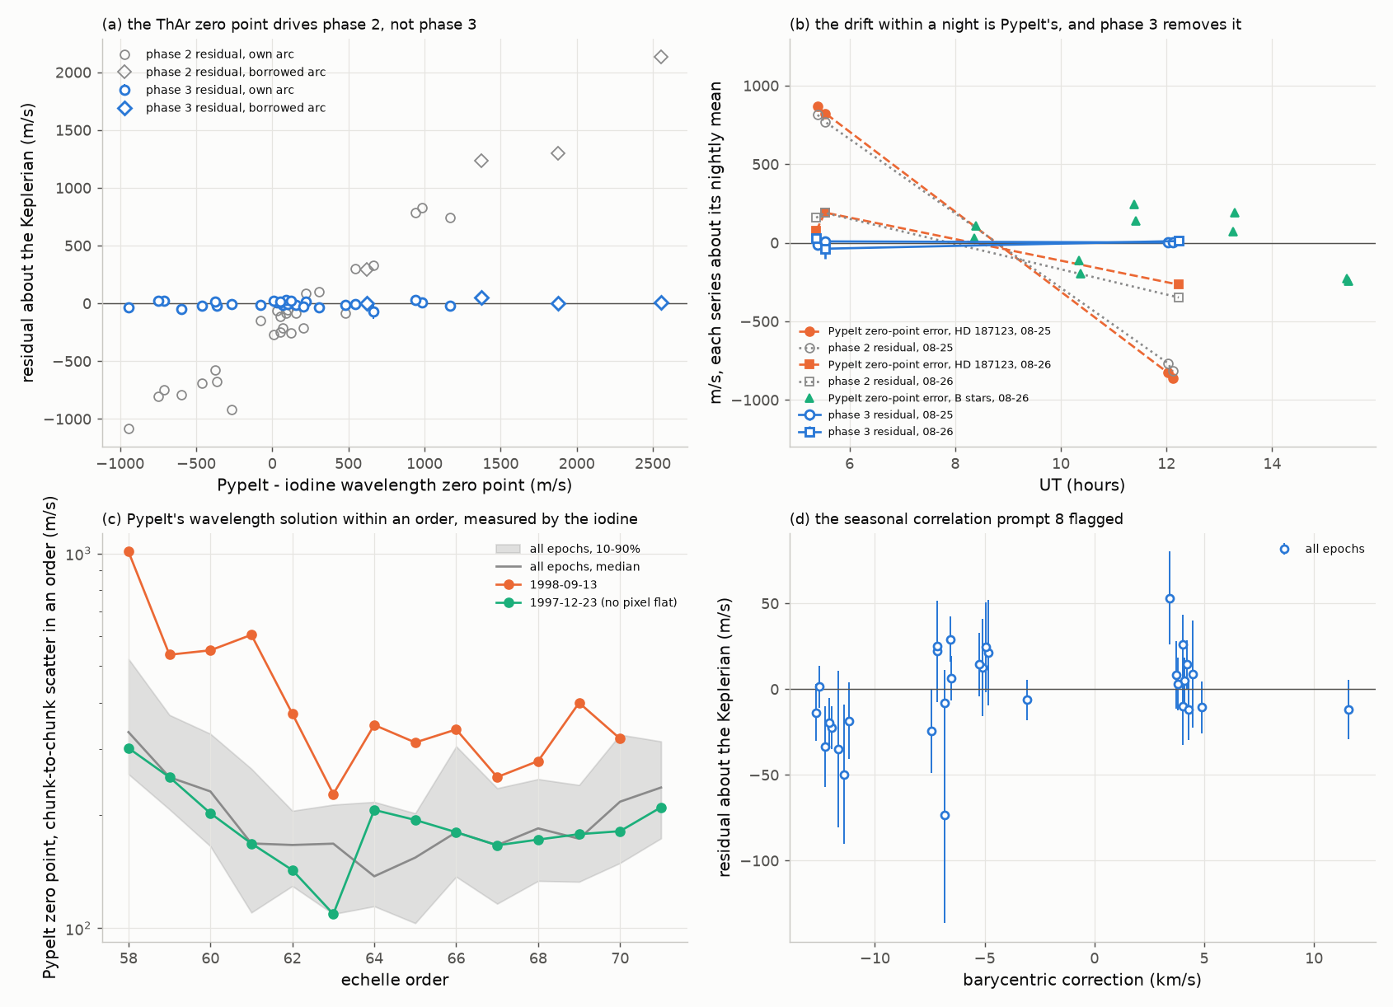
Every named calibration defect is fixed
25
Borrowed arcs, intra-night drift, the no-flat night, 09-13’s bad arc.

Slide 26
What is left: re-combining without the weakest data
26
variant | epochs | rms | K (m/s)
everything (the result) | 31 | 25.8 | 72.4 ± 7.1
tellurics masked | 31 | 24.2 | 73.0 ± 6.7
no epochs with ≤ 8 orders | 25 | 18.2 | 70.8 ± 5.6
no red orders 58–61 | 31 | 17.2 | 72.4 ± 4.7
both | 25 | 11.5 | 71.8 ± 3.5
K is stable (69.5–73.8). The 11.5 m/s variant was chosen after seeing residuals: reported, not claimed.

Slide 27
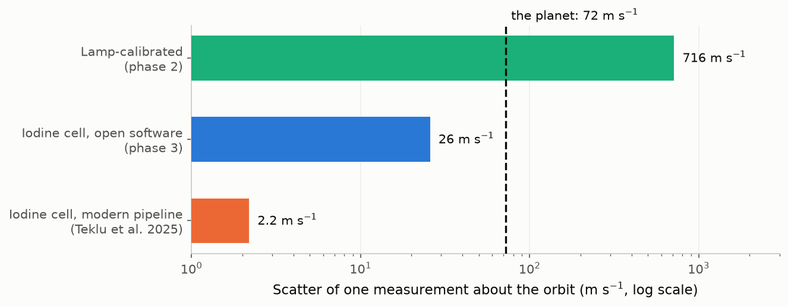
Where we stand
27
Photon budget 1.4 m/s; achieved 26 m/s. The gap is modelling, not photons.

Slide 28
Why 26 m/s and not 3
28
• The atlas is a different cell: part of its misfit does not cancel
• Weak iodine in the red orders: errors shared by whole orders
• Six epochs with only 2–8 usable orders
• A simple instrumental profile (4-parameter super-Gaussian)
• Tellurics unmodelled; a marginal seasonal term
Largest single gain: the HIRES cell’s own FTS spectrum, if it exists.

Slide 29
Upstream reports
29
• PypeIt: 15 items (email to Ryan Cooke, issues, PR)
  – keck_hires_orig bugs; silent failures of run_pypeit
  – wave.py sign error; ivar mis-scaled; zero wavelengths
• pyodine: 21 items (GitHub issues)
  – 6 fork changes; index and order traps; swallowed errors

Slide 30
Next steps
30
• A HIRES-cell iodine spectrum: FTS scan, or empirical from B stars
• Weight whole orders, not just chunks, in the combination
• Fix PypeIt’s noise model (optimal vs boxcar)
• Diagnose 1998-09-13’s arc

Slide 31
Reproducibility
31
• Every number from a script; every table in first_hires_exoplanet/data/
• PypeIt 2.0.2.dev1217+g017bece06; pyodine 4488b09 + fork
• Velocities: fit_all_epochs.py; assessment: figs_phase3.py
• Reports: claude_prompts/data_phase{1,2,3}_prompt.md
• This deck: make_slides.py

