Slide 1
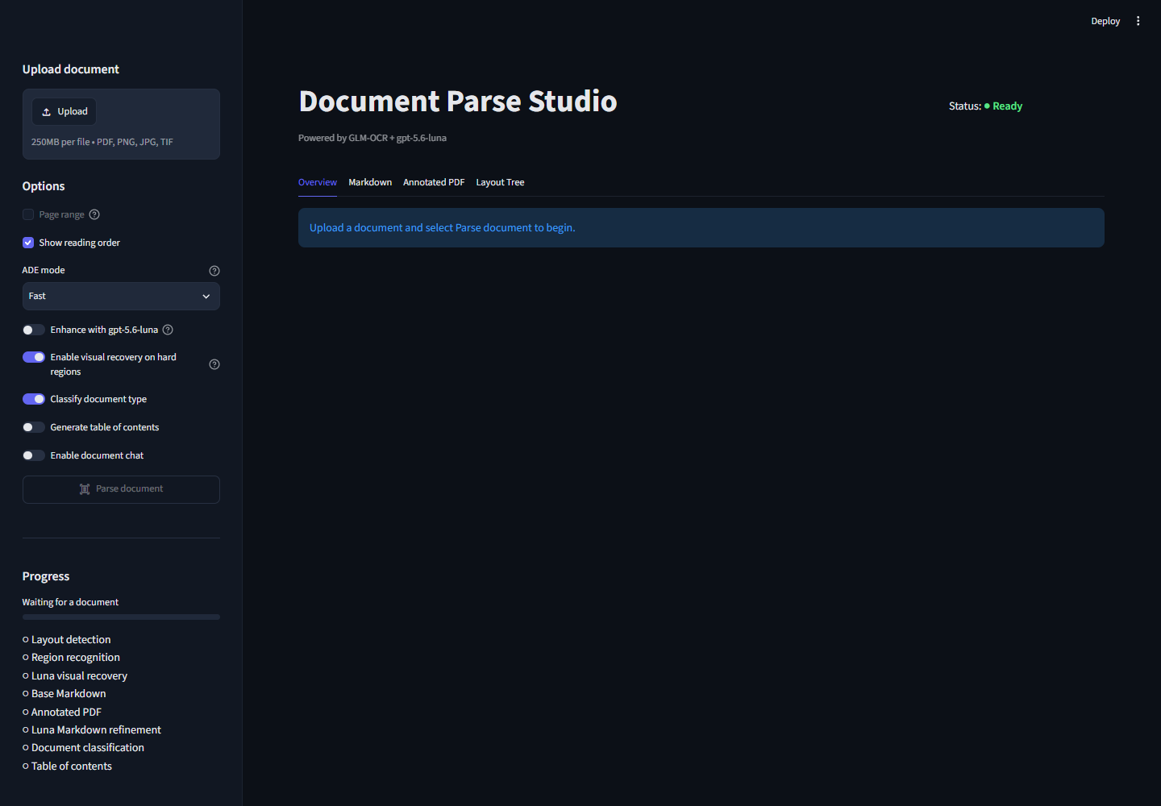
ACCELERATE WITH AI / INDUSTRY PROBLEM SOLVER / AHMAD MUJTABA
Grounded DocParse: Making Mixed Medical Faxes Reviewable
AI-assisted routing and evidence-linked extraction for mixed fax packets
ISSUE
IMPACT
Extract approved pages only.
EFFICIENCY EVIDENCE
24 min
14 min
industry average for phone / fax / email prior authorization
average industry time-savings opportunity when moving manual prior authorization to electronic
A single medical fax can mix:
2024 CAQH Index benchmark — not achieved prototype savings
New authorization
95.24% → 100%
Authorization updates
Medical records
median source-checked anchor coverage
Unrelated pages
Targeted prototype experiment — not extraction accuracy
Staff find the right form, re-key fields, then verify every value.
1
Parse once
2
Segment pages
3
Extract New Auth
4
Review evidence
Each returned value stays linked to its page and bounding-box evidence.
PROJECT-INSPIRED PROTOTYPE; NOT PRODUCTION DEPLOYED.
Industry savings are external benchmarks, not realized project results.
Sources: 2024 CAQH Index; CMS electronic prior authorization overview; repository workflow and quality research. Full links in speaker notes.
Notes:
Contest talk track The issue is not merely OCR. Mixed medical fax packets can contain a new authorization request, updates, medical records, and unrelated pages in one PDF. Staff must find the relevant form, re-key fields, and verify the source. The 2024 CAQH Index reports an average of 24 minutes for provider and staff prior-authorization work using phone, fax, or email. Grounded DocParse is a project-inspired prototype that parses a packet once, classifies contiguous page ranges, sends only approved New Authorization segments to extraction, and returns structured values linked to page and bounding-box evidence for human review. The 14-minute figure is the CAQH average industry time-savings opportunity for moving manual prior authorization to a fully electronic workflow. It is not a realized result from this prototype. In a targeted prototype experiment, median source-checked anchor coverage increased from 95.24% to 100%. That metric is not extraction accuracy or a document-wide production result. [Sources] - https://www.caqh.org/hubfs/Index/2024%20Index%20Report/CAQH_IndexReport_2024_FINAL.pdf - https://www.cms.gov/priorities/electronic-prior-authorization/overview - README.md - docs/business-user-extraction-workflow.md - docs/extraction-quality-research.md - docs/images/document-parse-studio-full.png

