Slide 1
BUSINESS OVERVIEW
BUSINESS WORKFLOW
Grounded DocParse
From Documents to
Decisions
PDF
LAYOUT
Parse once, route what matters, and extract reviewable data with source evidence.
JSON
For operations, product, risk, and technical stakeholders
Grounded DocParse | Business
01
Notes:
Frame the product in business terms: it turns document packets into readable and structured outputs while keeping a path back to the source. [Sources] - README.md - docs/complete-user-guide.md

Slide 2
WHY IT MATTERS
Text alone is not enough
The missing context is often the difference between usable and risky
A value is easier to trust when a reviewer can see where it came from.
READABLE
Markdown for people and downstream language tasks.
Grounded DocParse preserves page location, element identity, and source context alongside readable text and structured outputs.
STRUCTURED
JSON contracts for systems and automation.
REVIEWABLE
Evidence links and annotated previews for verification.
Grounded DocParse | Business
02
Notes:
The business problem is not simply OCR accuracy. Teams need outputs that can be checked and integrated without losing where information appeared. [Sources] - README.md - docs/complete-user-guide.md

Slide 3
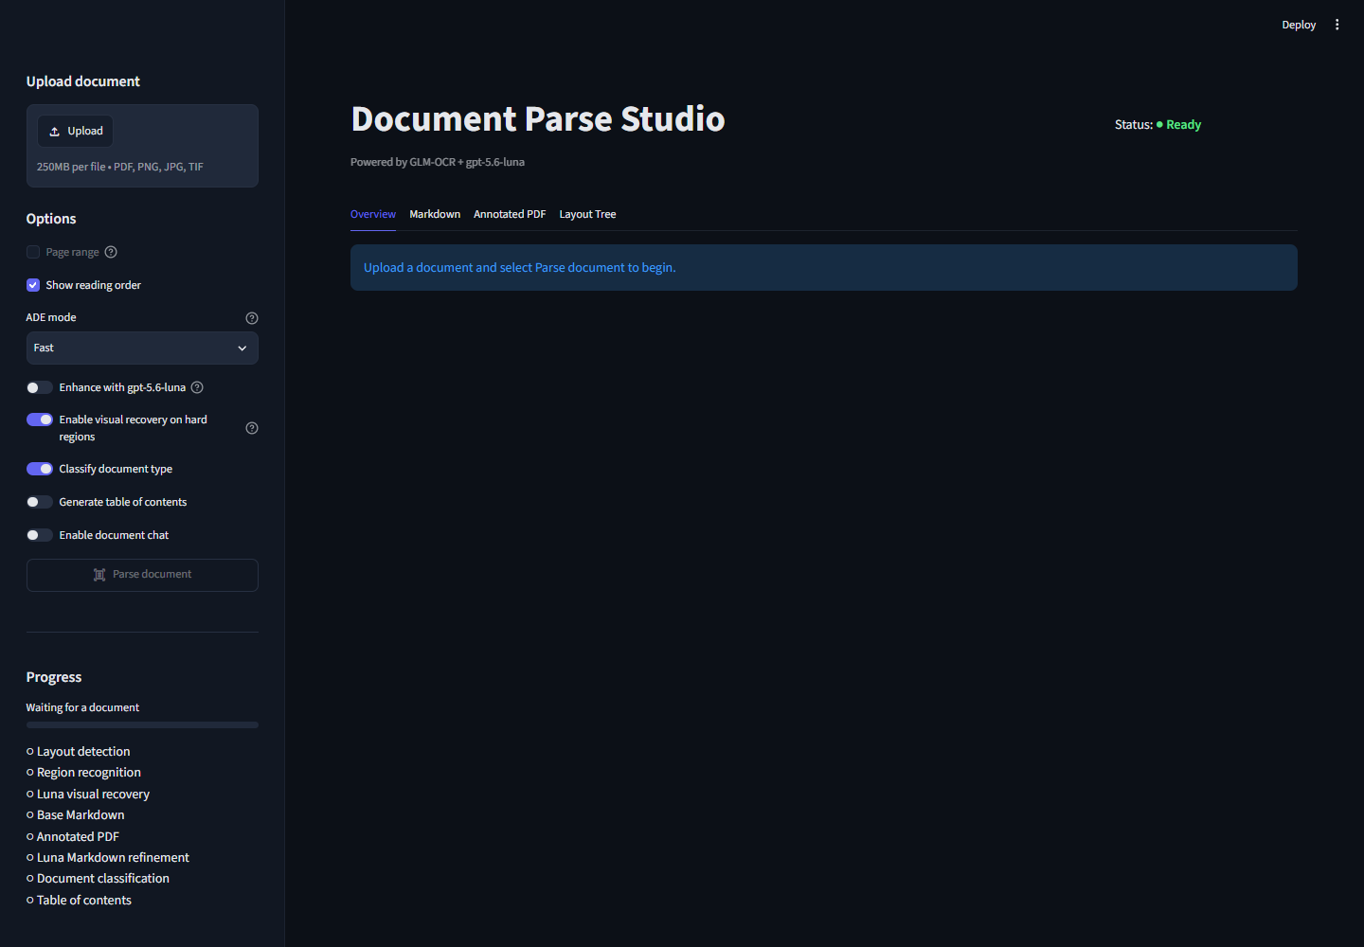
CONTROLLED WORKFLOW
One controlled path from intake to handoff
Optional steps are enabled only when the use case needs them
Upload one or more PDFs
Parse into text, layout, IDs, and boxes
Route relevant documents or segments
Extract using business-defined fields
Review evidence and download structured results
Grounded DocParse | Business
03
Notes:
Walk through the operator journey in the interface. Parsing is the required foundation; routing and extraction are optional controls layered on top. [Sources] - docs/images/document-parse-studio-full.png - docs/complete-user-guide.md - docs/business-user-extraction-workflow.md

Slide 4
OPERATOR CONTROL
The operator decides how much automation to use
Optional features are configured in plain business language
1
PARSE ONLY
2
CLASSIFY
Create Markdown, structured JSON, and an annotated preview without using optional reasoning.
Define categories and choose which categories are eligible for the next step.
3
SEGMENT
4
EXTRACT
Split a mixed packet into contiguous category ranges while preserving page order.
Define fields in input boxes, upload JSON, or import a Markdown field list.
Grounded DocParse | Business
04
Notes:
Stress configurability without code. A business user can define categories and fields in the UI, with JSON and Markdown import for repeatable workflows. [Sources] - README.md - docs/complete-user-guide.md - docs/business-user-extraction-workflow.md

Slide 5
ILLUSTRATIVE SCENARIO
Example: route only the relevant form from a mixed fax
Illustrative workflow - no patient or document details shown
ABSTRACT FAX PACKET
Pages 1-2 | Cover
SELECTED
CUSTOM ROUTING
Pages 3-5 | New request
New request
Categories describe the business meaning of each form type
Pages 6-7 | Records
eligible for extraction
Pages 8-9 | Update
Only the selected segment moves forward; all categories remain visible for review.
Grounded DocParse | Business
05
Notes:
Use this as an abstract medical-fax example. The packet may contain several form types, but the workflow selects only the new-request segment for extraction. [Sources] - docs/business-user-extraction-workflow.md - docs/complete-user-guide.md

Slide 6
TRUST MODEL
Evidence travels with the accepted value
A reviewer can move from output back to the source
REQUESTED FIELD
PROPOSED VALUE
SOURCE CONTEXT
A business-defined name and description explain what should be captured.
The optional extraction stage returns a structured value and evidence references.
Page, element, and bounding box support rapid review and correction.
Automation proposes; evidence and review govern acceptance.
Grounded DocParse | Business
06
Notes:
Describe evidence as a control, not decoration. The application resolves referenced elements so a reviewer can validate the proposed value. [Sources] - docs/spec.md - docs/complete-user-guide.md

Slide 7
HUMAN OVERSIGHT
Uncertainty stays visible to the operator
Three controls keep exceptions from disappearing
01
DEFINE
02
REVIEW
03
VERIFY
Users supply category and field descriptions that reflect the actual workflow.
Other or uncertain routing paths remain available for operator inspection.
Evidence-linked values can be checked before they reach another system.
business intent
exception path
human acceptance
Grounded DocParse | Business
07
Notes:
The workflow is designed around human oversight. Definitions, exception handling, and evidence review are explicit operating controls. [Sources] - docs/business-user-extraction-workflow.md - docs/complete-user-guide.md

Slide 8
USE CASES
The same pattern applies beyond healthcare
Grounded parsing supports different document families without changing the core
DOCUMENT FAMILY
PARSE
ROUTE
EXTRACT
Invoices
Text + tables
Invoice / credit / other
Number, date, total
Operational forms
Fields + layout
Request type
Business-required fields
Reports
Sections + figures
Report category
Named facts and summaries
Records
Pages + evidence
Record subtype
Index fields
Category and field definitions remain use-case specific; the grounded pipeline stays the same.
Grounded DocParse | Business
08
Notes:
Generalize the scenario. The value is a reusable pattern: parse, optionally route, then extract according to user-defined definitions. [Sources] - README.md - docs/complete-user-guide.md

Slide 9
OPERATING MODEL
Start as an operator-led workstation workflow
Know the current boundaries before scaling
GOOD FIT TODAY
LIMITS TODAY
Interactive processing
Not yet a bulk service
Users upload and review documents
Browser session is not a durable job queue
Outputs are downloaded per session
Large batches need capacity planning
Local OCR service is available and monitored
Retention, access, and review policy remain deployment responsibilities
Grounded DocParse | Business
09
Notes:
Set realistic expectations. The current UI is suited to interactive processing; sustained bulk fax operations need durable infrastructure and operating controls. [Sources] - README.md - docs/azure-bulk-fax-deployment.md - SETUP.md

Slide 10
SCALE PATH
High-level Azure path for bulk faxes
Separate intake, durable work, processing, review, and export
1
2
3
4
5
6
Intake
Queue
Workers
Results
Review
Export
Blob / managed upload
Durable job message
Parse + optional AI
Versioned artifacts
Exception workflow
Downstream handoff
REQUIRED CONTROLS
Identity, private networking, observability, retention, and bounded concurrency.
Grounded DocParse | Business
10
Notes:
This is a deployment blueprint, not a claim about the current app. A durable queue and worker model are the key changes for bulk processing. [Sources] - docs/azure-bulk-fax-deployment.md

Slide 11
PILOT DECISION
Run a bounded pilot before broad adoption
Evaluate workflow fit and evidence quality - not a headline accuracy claim
1
Choose one packet family
4
Create a review set
Limit variation for the first evaluation.
Include representative quality and edge cases.
2
Define categories
5
Measure operations
Include an explicit other or uncertain path.
Track routing, extraction, review effort, and failures.
3
Define the schema
6
Set acceptance rules
Use descriptions that reviewers agree on.
Decide what may proceed and what requires review.
Grounded DocParse | Business
11
Notes:
Close with a controlled pilot recommendation. The pilot should measure routing quality, field acceptance, exception volume, and review effort on representative documents. [Sources] - docs/business-user-extraction-workflow.md - docs/azure-bulk-fax-deployment.md

