Slide 1
REPOSITORY OVERVIEW
OPEN REPOSITORY GUIDE
Grounded DocParse
GitHub Overview
PDF
LAYOUT
What the project does, how to run it, and where contributors can extend it safely.
JSON
Users | operators | contributors
Grounded DocParse | GitHub
01
Notes:
Introduce the repository as both an application and a reference implementation for grounded document parsing with optional routing and extraction. [Sources] - README.md - CONTRIBUTING.md

Slide 2
PROJECT PURPOSE
Built for outputs that remain connected to the page
A document parser for users and developers who need more than plain OCR text
Readable Markdown, structured JSON, and page-aware evidence come from one parse.
USERS
Upload PDFs, configure optional steps, review, and download.
The repository combines an interactive Streamlit UI, a GLM-OCR parsing core, optional reasoning stages, documented schemas, and tests.
INTEGRATORS
Consume versioned JSON contracts and source references.
CONTRIBUTORS
Extend adapters, schemas, UI flows, and tests.
Grounded DocParse | GitHub
02
Notes:
Explain the three audiences. The common foundation is a single grounded parse that supports both human and machine consumers. [Sources] - README.md - docs/architecture.md - CONTRIBUTING.md

Slide 3
ARCHITECTURE
Repository architecture at a glance
UI orchestration around a grounded parsing core
1
2
3
4
5
6
Streamlit
Renderer
GLM-OCR
Models
Agentic
Exports
operator workflow
PDF to images
layout + text
schema contracts
route + extract
JSON + Markdown
OWNERSHIP
GLM-OCR supplies geometry; optional reasoning consumes grounded context.
Grounded DocParse | GitHub
03
Notes:
Use this map to orient contributors. The UI coordinates rendering, parsing, schemas, optional reasoning, and exports without changing evidence ownership. [Sources] - docs/architecture.md - src/grounded_docparse/render.py - src/grounded_docparse/models.py - src/grounded_docparse/agentic.py

Slide 4
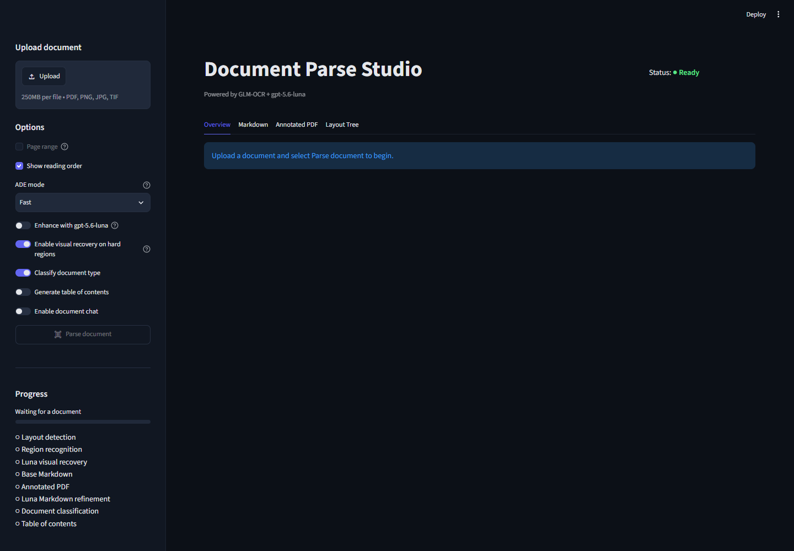
UI TOUR
One workspace for parse, route, extract, review, and export
Sanitized repository screenshot
Upload one or more PDFs
Choose parsing and recovery settings
Optionally define classification categories
Optionally define extraction fields
Inspect previews and download outputs
Grounded DocParse | GitHub
04
Notes:
Orient the audience to the application surface. The screenshot is sanitized and contains no credentials, patient data, or private endpoints. [Sources] - docs/images/document-parse-studio-full.png - docs/complete-user-guide.md

Slide 5
FIRST RUN
Windows + WSL first-run path
Follow the repository setup guide for the supported local workflow
CLONE
MODEL
LAUNCH
Get the repository.
Prepare GLM-OCR service.
Start service and Streamlit.
1
2
3
4
5
6
SYNC
CONFIG
VERIFY
Install locked Python dependencies.
Set required environment values.
Parse a safe sample.
Keep secrets in environment variables; do not place them in source or screenshots.
Grounded DocParse | GitHub
05
Notes:
Do not improvise setup flags from this slide. Use SETUP.md for the current commands, prerequisites, and troubleshooting steps. [Sources] - SETUP.md - docs/run.md - README.md

Slide 6
CORE WORKFLOW
The core parsing workflow is useful by itself
Optional reasoning is not required to produce grounded outputs
1
2
3
4
5
6
Upload
Rasterize
Detect
Recognize
Assemble
Download
PDF input
page images
layout regions
text + types
stable IDs + order
Markdown + JSON
RECOVERY
Selective recovery can revisit weak or empty OCR regions before assembly.
Grounded DocParse | GitHub
06
Notes:
Explain the baseline path. Users can stop after parsing and still receive Markdown, structured JSON, and page-aware annotations. [Sources] - README.md - docs/architecture.md - docs/complete-user-guide.md

Slide 7
OPTIONAL FEATURES
Add classification and extraction only when needed
Both consume the grounded parse
Document class
Segmentation
Assign one category to a whole document.
Label contiguous ranges in a mixed packet.
PARSE ONCE
A compact evidence context is shared downstream
Category filter
Field extraction
Select which categories may continue.
Apply user-defined field definitions.
Grounded DocParse | GitHub
07
Notes:
Clarify that routing can operate at document or segment level. Extraction then receives only eligible content when category filtering is enabled. [Sources] - README.md - docs/complete-user-guide.md - docs/business-user-extraction-workflow.md

Slide 8
DEFINITIONS
Definitions can be entered or imported
Markdown and JSON support repeatable non-code configuration
CLASSIFICATION
EXTRACTION
Category definitions
Field definitions
Category name and description
Field name and plain-language description
Selection of categories to extract
Input boxes, JSON upload, or Markdown import
Optional Markdown import for reusable setups
Validation before model invocation
Grounded DocParse | GitHub
08
Notes:
Show how non-developers can configure repeatable workflows. Definitions can be typed in the UI or imported from version-controlled Markdown or JSON. [Sources] - docs/complete-user-guide.md - docs/business-user-extraction-workflow.md

Slide 9
OUTPUTS
Outputs are designed for review and integration
Choose the artifact that matches the next consumer
PREVIEW
Annotated pages and evidence-oriented review
MARKDOWN
Readable document content for people and language tasks
JSON
Versioned parse, extraction, full, or routed contracts
DOWNLOAD
Session artifacts packaged for handoff
Retain the schema version and evidence references when integrating downstream.
Grounded DocParse | GitHub
09
Notes:
Explain the output families. Previews support review, Markdown supports reading, and JSON supports automation through explicit schema versions. [Sources] - docs/spec.md - docs/api.md - docs/complete-user-guide.md

Slide 10
CONTRIBUTOR MAP
Where to look before changing the code
Start from the public contract, then follow the implementation and tests
AREA
START HERE
IMPLEMENTATION
VERIFICATION
UI workflow
README / user guide
streamlit_app.py + app_pages
tests for public behavior
Parsing
architecture / spec
render + parser modules
parser and schema tests
Optional AI
API / workflow guide
agentic.py + models.py
contract and failure tests
Contribution
CONTRIBUTING.md
match existing patterns
narrow checks first
Read the project guidance and existing patterns before introducing a new abstraction or dependency.
Grounded DocParse | GitHub
10
Notes:
Give contributors a practical map. Documentation defines intent, implementation files show current patterns, and tests define public behavior. [Sources] - CONTRIBUTING.md - docs/architecture.md - docs/spec.md - docs/api.md

Slide 11
GET STARTED
Use the docs, respect the boundaries, verify the change
A short path for users and contributors
1
Run the guided setup
4
Know current limits
Use SETUP.md and docs/run.md.
The UI is interactive, not a durable bulk queue.
2
Read the user guide
5
Change one concern
Learn parsing, routing, extraction, and downloads.
Match current architecture and style.
3
Inspect the contracts
6
Verify before handoff
Use docs/spec.md and docs/api.md.
Run targeted tests and inspect outputs.
Grounded DocParse | GitHub
11
Notes:
Close with the documentation path and current limitation. New users can run the app; contributors should ground changes in contracts and tests. [Sources] - README.md - SETUP.md - docs/run.md - docs/complete-user-guide.md - CONTRIBUTING.md

