Slide 1
TECHNICAL OVERVIEW
CURRENT SYSTEM
Grounded DocParse
Technical Architecture
PDF
LAYOUT
A source-grounded document pipeline for parsing, routing, and optional extraction.
JSON
Current implementation | contracts | production boundaries
Grounded DocParse | Technical
01
Notes:
Introduce the system as a grounded parsing pipeline. The key idea is that OCR structure remains the evidence layer, while optional reasoning consumes that evidence. [Sources] - README.md - docs/architecture.md

Slide 2
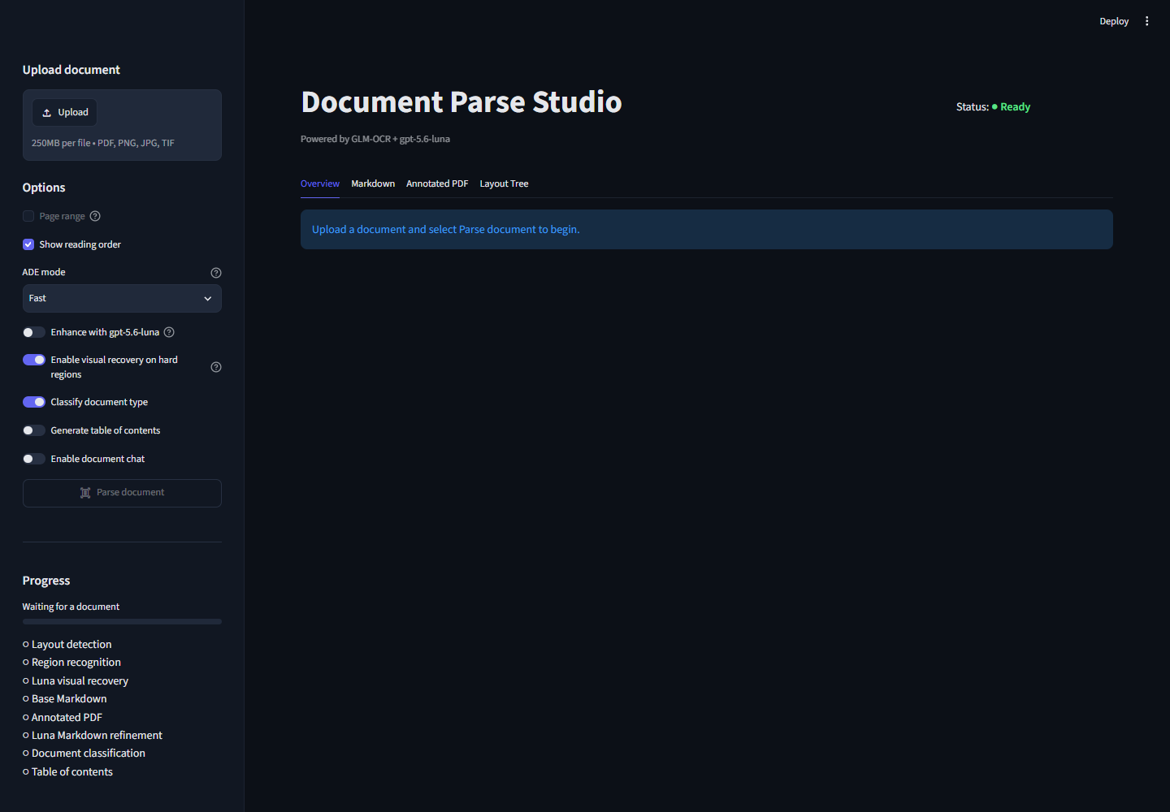
SYSTEM BOUNDARY
What runs where today
A local parsing core with optional remote reasoning
Streamlit provides uploads and operator controls
GLM-OCR handles local layout-aware parsing
Grounded JSON, Markdown, previews, and downloads stay in the app workflow
Luna powers optional classification and extraction
Azure is a documented scale path, not the current runtime
Grounded DocParse | Technical
02
Notes:
Clarify the boundary using the interface: parsing is local and deterministic around GLM-OCR; classification and extraction are optional model-assisted stages. Azure is documented as a deployment path, not the current runtime. [Sources] - docs/images/document-parse-studio-full.png - README.md - docs/architecture.md - docs/azure-bulk-fax-deployment.md

Slide 3
PARSING PIPELINE
From page pixels to grounded document
Each stage preserves or improves traceability
1
2
3
4
5
6
Rasterize
Layout
OCR
Recover
Assemble
Reason
PDF to page images
regions + order
text per region
empty/weak regions
document schema
optional AI
DESIGN RULE
Later stages may enrich content, but they do not become the source of geometry.
Grounded DocParse | Technical
03
Notes:
Walk left to right. Recovery is selective, assembly creates the stable contract, and optional reasoning happens only after grounded parsing. [Sources] - docs/architecture.md - docs/spec.md - src/grounded_docparse/render.py

Slide 4
GROUNDING CONTRACT
One owner for every kind of truth
The ownership split prevents plausible but ungrounded output
GLM-OCR OWNS
LUNA MAY ADD
Document evidence
Reasoned interpretation
Element IDs and page ownership
Category labels and explanations
Bounding boxes and reading order
Values matching a user schema
Element type, confidence, and source text
References back to supplied element IDs
Grounded DocParse | Technical
04
Notes:
Emphasize the contract: the model can interpret supplied evidence, but IDs and coordinates originate from the parser. This makes downstream review possible. [Sources] - docs/spec.md - docs/api.md - src/grounded_docparse/models.py

Slide 5
OPTIONAL INTELLIGENCE
Optional features share one grounded context
Parse once; reuse compact evidence
Classify
Extract
Label documents or contiguous page ranges.
Return schema-shaped values.
GROUNDED CONTEXT
Markdown + layout tree + stable element IDs
Review
Export
Expose evidence and uncertainty.
Package results and annotations.
Grounded DocParse | Technical
05
Notes:
The important implementation choice is reuse. Optional features do not each reparse the PDF; they consume a compact representation of the already-parsed document. [Sources] - docs/architecture.md - docs/complete-user-guide.md - src/grounded_docparse/agentic.py

Slide 6
CUSTOM ROUTING
Route contiguous page ranges before extraction
Designed for packets that may contain more than one form type
PARSED PAGE SEQUENCE
Pages 1-2 | New request
ELIGIBLE
CUSTOM CLASSIFIER
Pages 3-4 | Records
Selected ranges only
User-defined categories + category descriptions + review controls
Pages 5-6 | Update
continue to extraction
Page 7 | Other
An "other" path and operator review keep routing uncertainty visible.
Grounded DocParse | Technical
06
Notes:
Show the document-level and segmented routing model. Categories come from the user, contiguous ranges preserve packet order, and only selected categories proceed. [Sources] - README.md - docs/complete-user-guide.md - docs/business-user-extraction-workflow.md

Slide 7
EXTRACTION
Validate extracted values against source evidence
A schema request becomes a reviewable result
USER SCHEMA
MODEL RESULT
EVIDENCE LOOKUP
Field name
Description
Optional type or constraint
Entered in the UI, uploaded as JSON, or imported from Markdown.
Structured value
Confidence / status
Referenced element IDs
The response must conform to the extraction contract.
Resolve element IDs
Recover page + bbox
Attach source snippets
Accepted values stay traceable to the parsed document.
No evidence reference means no grounded acceptance.
Grounded DocParse | Technical
07
Notes:
The extraction model receives the schema plus compact context. The application validates the response shape and resolves cited IDs back to pages and boxes. [Sources] - docs/spec.md - docs/api.md - docs/complete-user-guide.md - src/grounded_docparse/agentic.py

Slide 8
OUTPUT CONTRACTS
Versioned outputs keep consumers explicit
Each optional capability has a distinct schema surface
2.0
Routed result | classification, segments, eligibility, extraction
1.1
Extraction result | fields, evidence references, status
4.5
Full result | parse plus optional feature outputs
4.4
Parse result | pages, elements, geometry, reading order
Consumers should bind to the contract they need and retain the declared schema version.
Grounded DocParse | Technical
08
Notes:
Explain the layered contracts. The parse schema is the foundation, the full schema includes optional outputs, and dedicated extraction and routed schemas support focused consumers. [Sources] - docs/spec.md - docs/api.md - src/grounded_docparse/models.py

Slide 9
RUNTIME BEHAVIOR
Failure isolation protects completed work
Retries and concurrency are bounded at stage boundaries
01
RETRY
02
REUSE
03
ISOLATE
Transient model or service failures are retried without repeating every successful stage.
Parse output is retained and reused by classification, extraction, preview, and downloads.
Optional-stage failure remains visible without invalidating the grounded parse result.
bounded retries
parse once
degrade safely
Grounded DocParse | Technical
09
Notes:
Focus on operational behavior: preserve expensive parse work, isolate optional failures, and keep concurrency bounded so a batch cannot overwhelm the service. [Sources] - docs/architecture.md - docs/api.md - docs/azure-bulk-fax-deployment.md

Slide 10
PRODUCTION BOUNDARY
Current workstation app vs. production service
The deployment guide is a target operating model - not hidden implementation
CURRENT
PRODUCTION PATH
Interactive workstation
Azure bulk workflow
Streamlit UI and local session state
Durable object storage and queued jobs
Local GLM-OCR/vLLM service
Stateless workers with controlled concurrency
Operator-driven files and downloads
Identity, monitoring, retention, and human-review controls
Grounded DocParse | Technical
10
Notes:
Be precise about current scope. The repository documents an Azure path for bulk processing, but production durability, identity, and operations require deployment work. [Sources] - README.md - docs/azure-bulk-fax-deployment.md - SETUP.md

Slide 11
EXTENSION CHECKLIST
Extend the pipeline without breaking grounding
Six checks for any new model, adapter, or workflow
1
Keep geometry owned
4
Validate at boundaries
Do not let downstream models invent IDs or boxes.
Treat model output as untrusted structured input.
2
Reuse parse output
5
Test public behavior
Avoid duplicate OCR and divergent evidence.
Cover happy path, weak OCR, and optional-stage failure.
3
Version contracts
6
Protect operator review
Make schema changes explicit to consumers.
Expose uncertainty and retain evidence links.
Grounded DocParse | Technical
11
Notes:
Close with a practical checklist. Any extension should preserve the ownership model, validate outputs, and maintain an operator-review path. [Sources] - docs/spec.md - docs/api.md - CONTRIBUTING.md

