Slide 1
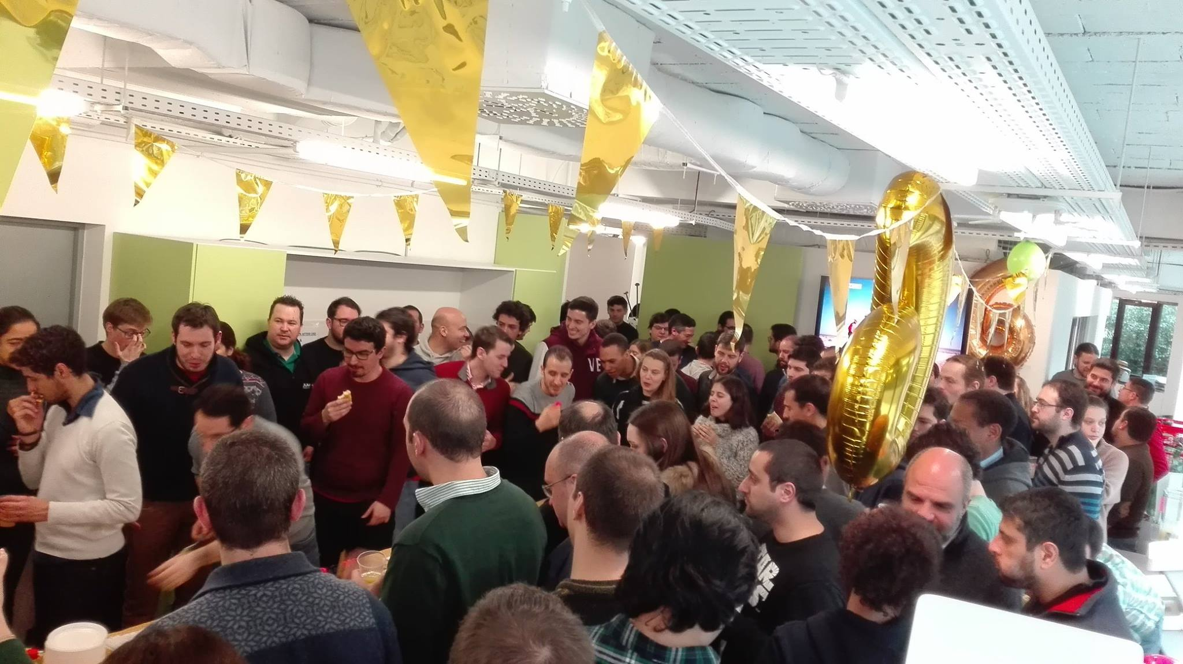
A little about me
I Work at Jumia as a Data Analyst
Finance Intelligence
Data Science as a hobby

Slide 2
What is Machine Learning?
“Semi-automated extraction of Knowledge from data”.
By Kevin Markham (Data Science Educator)
Extracts Knowledge/ insights from data
Involves automation (applying algorithms)
We also need humans ☺

Slide 3
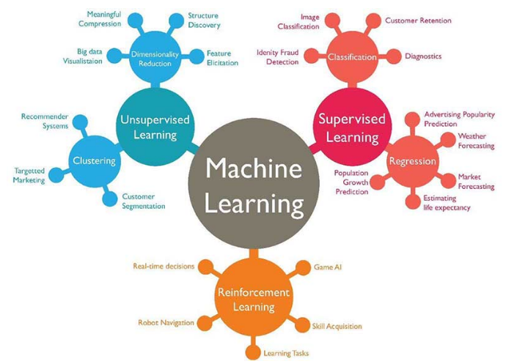

Slide 4
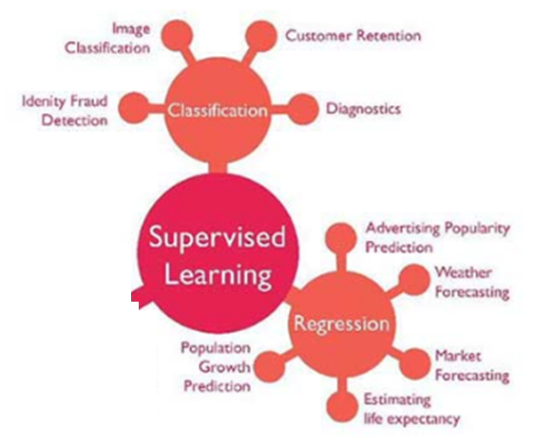
Difference between supervised and unsupervised Learning?
Differences between Classification and Regression problems
What is scikit-learn?

Slide 5
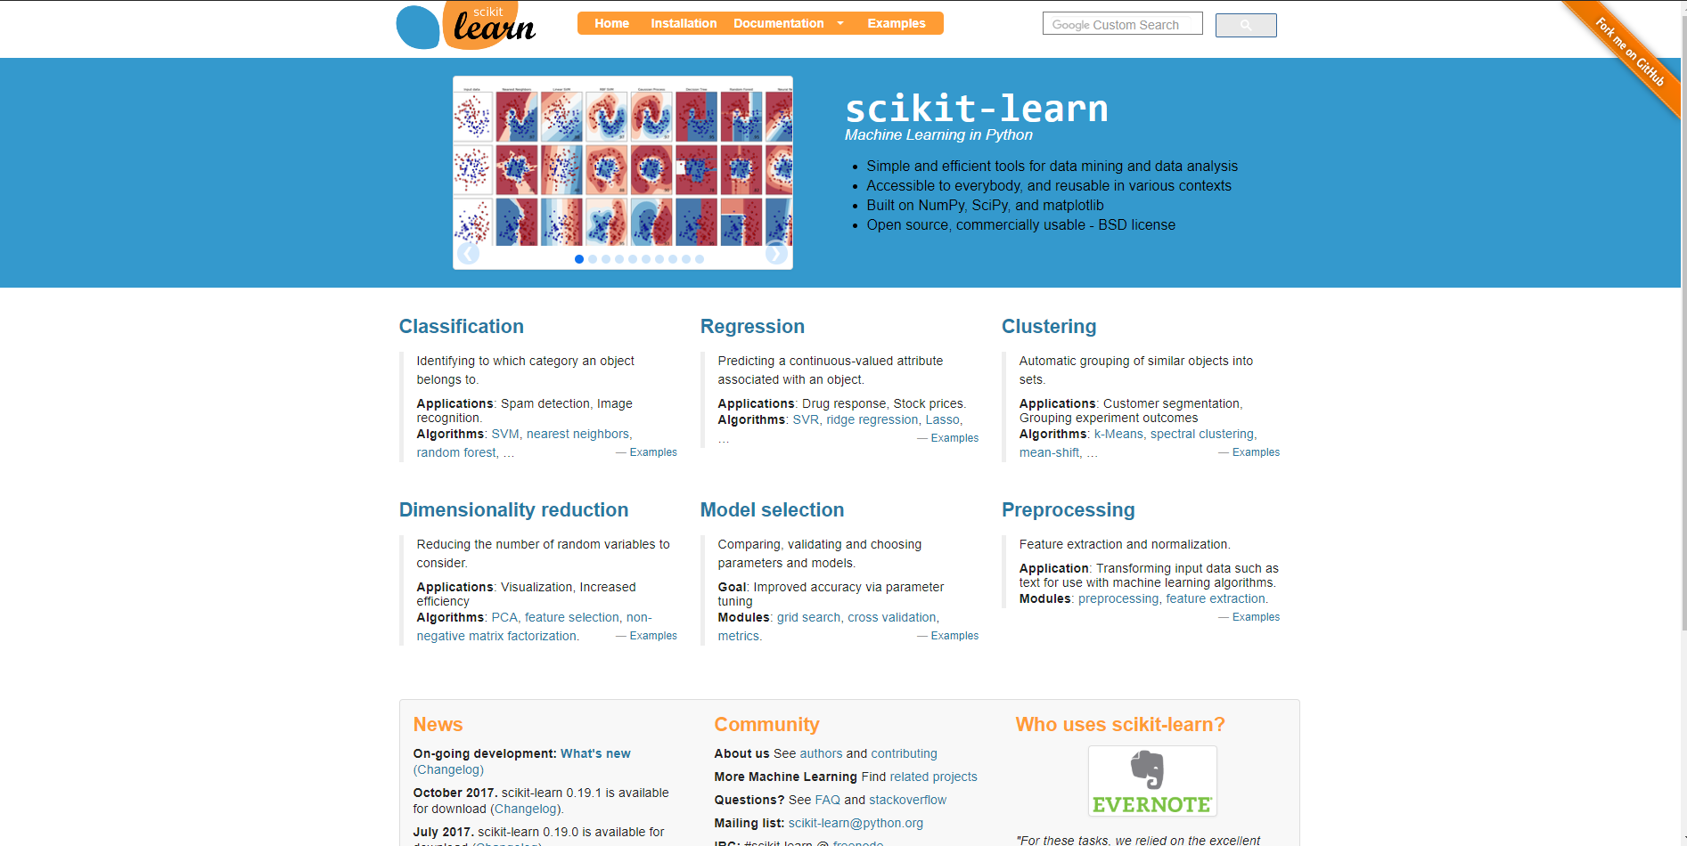

Slide 6
Customer Churn Business - Dataset
“Customer churn” in telecom business refers to the customer movement from one provider to another.
2 approaches to customer churn: reactive and proactive.
Reactive: wait until customer says he is going to cease contract, and then the company offers a better deal ☺
Proactive: where a company tries to identify which customers are more likely to churn before they do so (our project today)

Slide 7
Machine Learning Project Steps
1. Define problem
2. Summarize data
3. Prepare data
4. Evaluate Algorithms
5. Present Results

Slide 8
1. Define problem
How to know when a customer will churn (cease the contract with the telecommunications company)
This is a classification problem: we will predict if a customer will churn or not

Slide 9
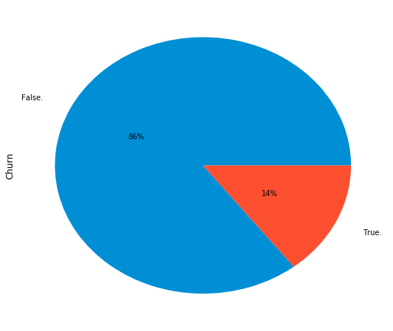
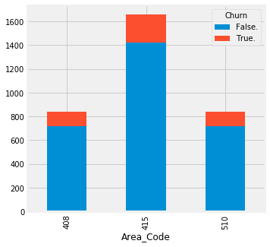
2. Summarize data
This step is about understanding the data
And also about creating visualizations

Slide 10
3. Prepare data
This step is about preparing data that best exposes your problem
Cleaning data by removing duplicates and missing values
Feature selection where some features might be removed or new ones might be added

Slide 11
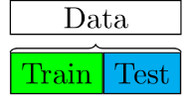
4. Evaluate Algorithms
It first begins by splitting the dataset into train and test datasets

Slide 12
4. Evaluate Algorithms – Cont.
What evaluation metric should I use? In this case, accuracy.
Applying different classification algorithms
Comparing the estimated accuracy (%) of all those algorithms

Slide 13
5. Present Results
Final step in which you will have a dataset with all of your customers and the results for each.
This is the predictions output

Slide 14
Libraries that will be used today
Manipulate data:
Pandas: import pandas as pd
Numpy: import numpy as np
Visualize data:
Seaborn: import seaborn as sns
Matplotlib: import matplotlib.pyplot as plt

Slide 15
Classification Algorithms in scikit-learn
Logistic Regression (LogisticRegression)
Linear Discriminant Analysis (LinearDiscriminantAnalysis)
K-Nearest Neighbors (KNeighborsClassifier)
Naïve Bayes (GaussianNB)
Classification and Regression Trees (DecisionTreeClassifier)
Support Vector Machines (SVC)

Slide 16
Regression Algorithms in scikit-learn
Linear Regression (LinearRegression)
Ridge Regression (Ridge)
Lasso Regression (Lasso)
ElasticNet Regression (ElasticNet)
K-nearest Neighbors (KNeighborsRegressor)
Classification and Regression Trees (DecisionTreeRegressor)

Slide 17
Great links:
Coursera on Machine Learning:
https://www.coursera.org/learn/machine-learning
Data School Channel:
https://www.youtube.com/user/dataschool/featured
Scikit Learn:
http://scikit-learn.org/
Data Science Competitions:
www.kaggle.com

